Slide 1
ExerCise #2
Overview Review
Write your name and answer the following on the provided form
The companion to static analysis (analysis without running the target program) is dynamic analysis (analysis that includes running the target program). Give an example of a dynamic analysis.
Program observation – run the program

Slide 2
Abstracting CODE
EECS 677: Software Security Evaluation
Drew Davidson

Slide 3
Administrivia and
Announcements
Miss a class? It’s not too late to get points for the check-in assignment!
The Entry Survey: results and thoughts

Slide 4
Entry Survey
Office Hours:
M, W: 10:00 AM – 12:00 PM
Also, by appointment
Also, whenever I’m free
https://drew.davidson.cool/where

Slide 5
Entry Survey
Lots of interest in learning about vulnerabilities

Slide 6
Entry Survey
Some concern about workload

Slide 7
Entry Survey
How long are the quizzes?

Slide 8
Class Website
https://analysis.cool

Slide 9
Last Time: Overview
Review: Overview
Discussed the insufficiency of manual source code analysis for security evaluation.
Described the need to deal with abstractions of software. These abstractions can do two things:
  Emphasize some under-appreciated aspect of the target program
  Simplify or ease a form of reasoning about the target program

Slide 10
Lecture Outline
Instruction Flowcharts
Control Flow Graphs
Intermediate Representations

Slide 11

Visualizing Programs
Instruction Flowcharts
Reading code is hard!
It’s really important to determine how code flows from one instruction to the next

Slide 12
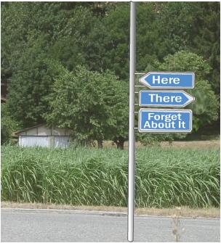
Code Graphs
Instruction Flowcharts
Program analysis relies heavily on two questions
(How) can we get to a particular program point?
What is the program configuration at a given point?
Helpful to structure program instructions as a graph
Visualize transfer of control
Avail ourselves of graph analyses (e.g. reachabilty)

Slide 13
FlowCharts
Abstracting Code: Instruction Flowcharts
Instruction Flowchart
Notation
Nodes are instructions
Edges go to successor node
Operation
Execute current instruction
Proceed to successor Node
Step 1
Step 2
Step 3
Step 4
Step 5

Slide 14
FlowChart Example – How to Floss
Abstracting Code: Instruction Flowcharts
Stand with your feet shoulder-width apart, hands at your sides
Notation
Nodes are instructions
Edges go to successor node
Operation
Execute current instruction
Proceed to successor Node
Sweep your arms to the left
Push your hips to the right while swinging your arms up to the left
Pull both arms back to the right and swing your hips through
Sweep both arms down in front of your body to the left
Swing your arms to the right while pushing your hips to the left
Repetition!

Slide 15
FlowChartS – COnditionals
Abstracting Code: Instruction Flowcharts
Stand with your feet shoulder-width apart, hands at your sides
Notation
Nodes are instructions
Edges go to successor node
Operation
Execute current instruction
Proceed to successor Node
Sweep your arms to the left
s
(disambiguated with conditions)
Push your hips to the right while swinging your arms up to the left
Pull both arms back to the right and swing your hips through
Sweep both arms down in front of your body to the left
(According to condition)
Swing your arms to the right while pushing your hips to the left

Slide 16
FlowChartS – COnditionals
Abstracting Code: Instruction Flowcharts
Stand with your feet shoulder-width apart, hands at your sides
Notation
Nodes are instructions
Edges go to successor node
Operation
Execute current instruction
Proceed to successor Node
New!
Are you a 12 year old Fortnite player?
false
true
s
stop
Sweep your arms to the left
(disambiguated with conditions)
Push your hips to the right while swinging your arms up to the left
Pull both arms back to the right and swing your hips through
(According to condition)
Sweep both arms down in front of your body to the left
Swing your arms to the right while pushing your hips to the left

Slide 17
Flowcharts – For Code?!?!?!!
Abstracting Code: Instruction Flowcharts
Source Code
Instruction Flowchart
Notation
Nodes are instructions
Edges go to successor node
Operation
Execute current instruction
Proceed to successor Node
a = 7;
a += 2;
int b;
b = 9 + c * 2;
a = 7;
s
a += 2;
(disambiguated with conditions)
int b;
b = 9 + c * 2;
Should this be
just 1 instruction?
(According to condition)

Slide 18
CODE FlowCharts
Instruction Flowcharts
Notation
Nodes are instructions
Edges go to successor nodes under appropriate condition
Operation
Execute current instruction
Proceed to the right successor
source code
Instruction Flowgraph
a = 7;
if (a < 4){
a = 7;
}
a += 2;
a = 7
if (a < 4)
true
false
a = 7
a += 2

Slide 19

FlowCharts: Visualizing Control
Abstracting Code: Instruction Flowcharts
void funk(int a, int b){
if (a < b){
if (a < 10){
a = a + b;
}
}
if (b < 3){
a = 1;
}
return;
}
if a < b
if a < 10
a = a + b
if b < 3
a = 1
return

Slide 20

FlowCharts: Visualizing Control
Abstracting Code: Instruction Flowcharts
void funk(int a, int b){
if (a < b){
if (a < 10){
a = a + b;
}
}
if (b < 3){
a = 1;
}
return;
}
if a < b
if a < b
true
if a < 10
if a < 10
false
true
false
a = a + b
a = a + b
if b < 3
if b < 3
true
a = 1
false
a = 1
return
return

Slide 21

FlowCharts: A Useful TOOL
Abstracting Code: Instruction Flowcharts
Maybe this is how you learned to think about code!
It’s a nice way to visualize the control flow of the program
We can extend this intuition for program analysis
Analysis

Slide 22
Lecture Outline
Instruction Flowcharts
Control Flow Graphs
Intermediate Representations

Slide 23
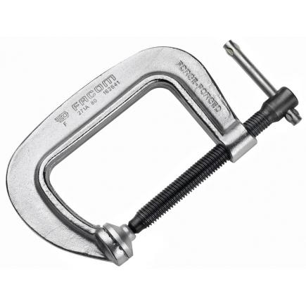
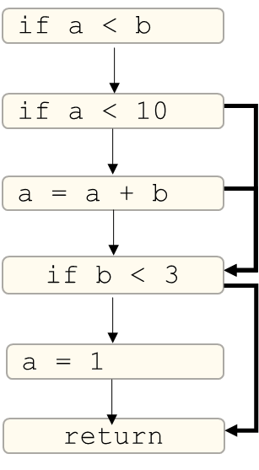
Compacting The Flow Chart
Abstracting Code: Control-Flow Graphs
From Flowcharts to Control Flow Graphs
This graph is needlessly verbose
Too many nodes that communicate nothing
what if we Eliminate the 1 instruction per Node Constraint?
Attempt to use as few edges as possible

Slide 24

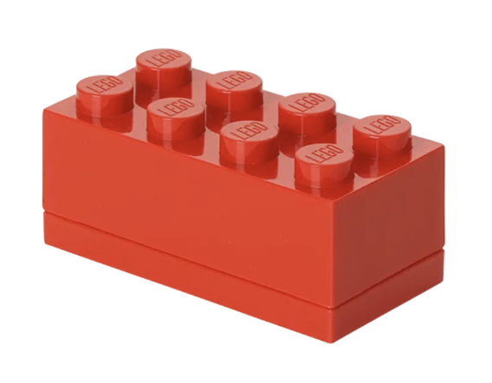
Basic Blocks
Abstracting Code: Control-Flow Graphs
Definition: Sequence of instructions guaranteed to execute without interruption

Slide 25


Basic Blocks Boundaries
Abstracting Code: Control-Flow Graphs
Two Distinguished Instructions in a Block (may be the same Instruction)
Leader: An instruction that begins the block
Terminator: An instruction that ends the block

Slide 26
Basic Blocks Boundaries
Abstracting Code: control-Flow graphs
Two Distinguished Instructions in a Block (may be the same Instruction)
Leader: An instruction that begins the block
The first instruction in the procedure
The target of a jump
The instruction after an terminator
Terminator: An instruction that ends the block
The last instruction of the procedure
A jump (goto, if statement, loop construct)
A call (We’ll use a special LINK edge)

Slide 27
BENEFITS of Basic Blocks
Abstracting Code: Control-Flow Graphs
Characteristic structure of common control constructs
Loops
If-stmt
If-else
(head)
(head)
(head)
jmp
(True branch)
jmp
(True branch)
jmp
(body)
jmp
(False branch)
(after)
(after)
jmp
(after)

Slide 28
Note CFGs are PER-Function Objects
Abstracting Code: Control-Flow Graphs
int foo(int c){
a = 1;
b = 2;
if (c > 5){
c = 1;
}
return 0;
}
int main(){
int local = 1;
int ret = foo(local);
if (ret > 1){
return 1;
}
return 2;
}
1 CFG for foo
1 CFG for main
Special “link edge” to connect call to its return site

Slide 29
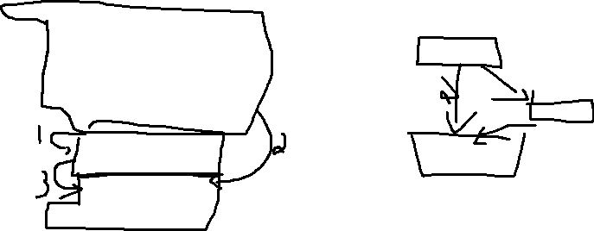
Exercise: Build the CFG
Abstracting Code: Control-Flow Graphs
int foo(int c){
a = 1;
b = 2;
if (c > 5){
c = 1;
}
return 0;
}
int main(){
int local = 1;
int ret = foo(local);
if (ret > 1){
return 1;
}
return 2;
}

Slide 30
Lecture Outline
Instruction Flowcharts
Control Flow Graphs
Intermediate Representations

Slide 31

SSA Form: A Simplifying Assumption
Abstracting Code
Static Single Assignment
if (b){
a = 1;
} else {
a = 2;
}
while(true){
a = 7;
}
int a = 1;
int b = 2;
int a = 1;
a += 2;

Slide 32
SSA Form: (Non)Examples
Abstracting Code

Slide 33
Lecture END!
Instruction Flowcharts
Control Flow Graphs
Intermediate Representation

Slide 34
Summary
Described the need to Visualize Programs in ways other than a Flat listing of source code
Showed one such visualization, the Control-Flow graph

Slide 35
Next TiME
Introduce our operational IR

