Slide 1
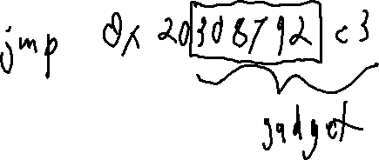
Exercise 7
Memory Attack Review
Is return-oriented programming impacted by the W$⊗$X protection? Why or why not?

Slide 2
Exercise 7 Solution
Memory Attack Review

Slide 3
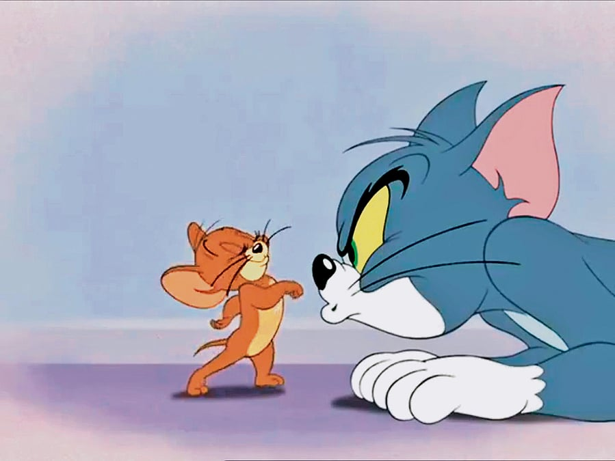
Last Time
Memory Review
The game of cat-and-mouse for remote code execution

Slide 4

Last Time
Memory Review
The game of cat-and-mouse for remote code execution
Jump to attack
code
Addressed by
Principle of
Least Privilege
Defeated by
Script injection
Addressed by
W$⊗$X
Defeated by
Return-oriented
programming
Addressed by
Code Analysis
What can we expect out of code analysis?

Slide 5
Computability
EECS 677: Software Security Evaluation
Drew Davidson

Slide 6
Administrivia and
Announcements
P1 graded
Good job!
Main issues: Incorrect output values

Slide 7
Today’s Roadmap
Decidability
The Halting Problem
Type I/Type II Errors
Soundness / Completeness

Slide 8

The Limits of Computation
Decidability
Computers! What can’t they do?!
As we begin our exploration of security evaluation, we care about this question for two reasons:
  We need to know the capabilities of our analysis target
  We need to know the capabilities of our analysis engine

Slide 9

Bounding our Workflow
Decidability
Evaluation
Analysis Target
Analysis Engine
software
program
software
program
Text output,
Blaring siren,
Plume of white smoke,
Etc.

Slide 10

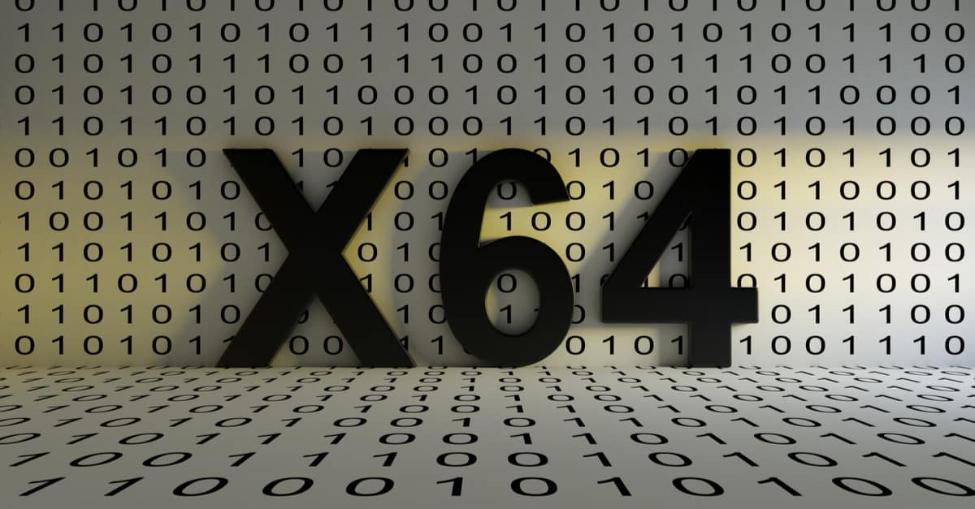

COMPUTATIONAL POWER
Decidability
What is a program?
A set of executable instructions
Instructions modify memory
There are many formats for programs
i.e. programming languages
Does the language of the analysis target limit it’s computational power?
Does the language of the analysis engine limit its computational power?
Good(?) news:
It does not!

Slide 11

Church-Turing Thesis
Decidability
Roughly: a function on the natural numbers can be calculated if and only if it is computable by a Turing machine
Practical Upshot: Language choice doesn’t matter beyond Turing completeness
(It is sufficient to model the analysis engine and analysis target as Turing machines)
Turing
Machine

Slide 12

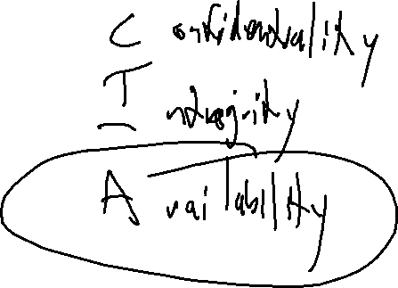
Averting Disaster
Decidability
Software Security is all about avoidance
Avert a flaw before it is exploited
Squash a bug before it bites
Notes:
The CIA Triad

Slide 13

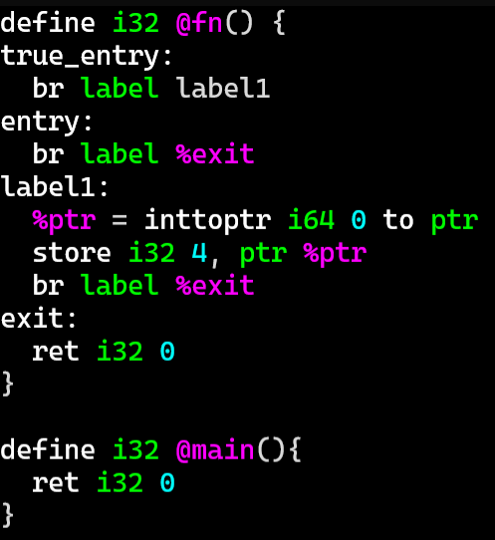
Averting Disaster
Decidability
How do we know a disaster is imminent?
Is this code “disastrous”?

Slide 14
Averting Disaster
Decidability
How do we know a disaster is imminent?
Is this code “disastrous”?

Slide 15
Averting Disaster
Decidability
How do we know a disaster is imminent?
Is this code “disastrous”?

Slide 16
Averting Disaster
Decidability
How do we know a disaster is imminent?
Is this code “disastrous”?

Slide 17
Decision PROCEDURES
Decidability
A little vocabulary:
A decision problem is a computational question that can be solved with either a yes or a no. Frequently, we consider decision problems as detection of a property in a program
A decision procedure is a method for solving a decision problem that always yields the correct answer
If there is no decision procedure for a given decision problem, that decision problem is called undecidable

Slide 18
Program Analysis as Decision PROCEDURE
Decidability
Since a program is just a list of instructions, it is valid input to a decision procedure
Analysis Target
(arbitrary program)
Analysis Engine
(property detector program)
Yes
(property present)
No
(property is not present)

Slide 19


Strong Guarantees
Decidability
A decision procedure is a high bar
Guarantee that:
The analysis engine accepts every program
The analysis engine always returns an answer
The answer returned is always correct
Analysis Target
(arbitrary program)
Analysis Engine
(property detector program)
Rice’s Theorem
Yes
(property present)
No
(property is not present)

Slide 20
Today’s Roadmap
Decidability
The Halting Problem
Type I/Type II Errors
Soundness / Completeness

Slide 21
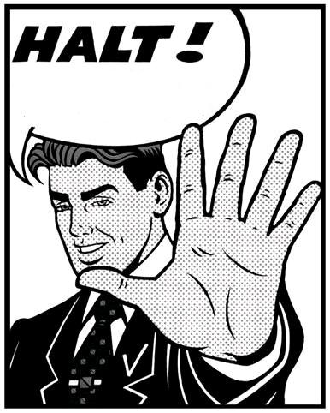
Stating The Problem
The Halting Problem
Given a description of a Turing machine and its initial input, determine whether the program, when executed on this input, ever halts (completes). The alternative is that it runs forever without halting

Slide 22
A Halting Detector
The Halting Problem
Analysis Target
+ Input
(arbitrary program)
Given a description of a Turing machine and its initial input, determine whether the program, when executed on this input, ever halts (completes). The alternative is that it runs forever without halting
Halting Detector
Is there a decision procedure for the halting problem?
We’ll sketch the proof outline that there is NOT
Relies on a proof by contradiction
Yes
(target halts)
No
(target spins)

Slide 23
Proof By Contradiction
The Halting Problem
Reductio ad absurdum – Assuming the premise has obviously incorrect consequences
Here: assume there is a halting detector
Assumption
Black_magic
Halting Detector
Black_magic
black_magic(){
if (halts(black_magic){
while(true){} //Spin
}
//Halt
}
Halting Detector
Yes
(target halts)
No
(target spins)
black_magic halts
Black_magic spins
halts(ANY ARBITRARY PROGRAM)
spin
halt

Slide 24
Who Cares?
The Halting Problem
No halting decision procedure means no reachability decision procedure
1. int main(){
2. if (my_function()){
3. int * a = nullptr;
4. *a = 1;
5. }
6. }
This program crashes if and only if it reaches line 4,
which depends on the result of a function call being
true
black_magic()

Slide 25
Rice’s Theorem
The Halting Problem
No halting decision procedure means no reachability decision procedure
1. int main(){
2. if (my_function()){
3. int * a = nullptr;
4. *a = 1;
5. }
6. }
Exhibits the behavior you care about
This program crashes if and only if it reaches line 4,
which depends on the result of a function call being
true
black_magic()
behavior you care about

Slide 26


Rice’s Theorem
The Halting Problem
“All non-trivial semantic properties of programs are undecidable”

Slide 27
Limitations of Rice's Theorem
The Halting Problem
Rice’s Theorem is less catastrophic than you might expect for security:
A decision procedure is a pretty high bar
A Turing machine is actually not a perfect approximation of the computers we use!
Despite these limitations, it is widely accepted that program analysis is always approximate
We can’t be right all of the time
We can choose what types of errors we make

Slide 28
Today’s Roadmap
Decidability
The Halting Problem
Categorizing Program Analyses
Soundness / Completeness

Slide 29
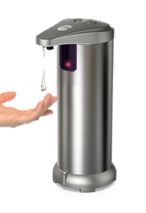
Classifying Detectors
Categorizing Program Analyses
Abstractly: an analysis is a system to detect a phenomenon
A hand detector: when hand detected, emit soap

Slide 30
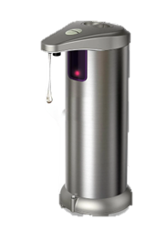
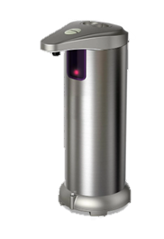
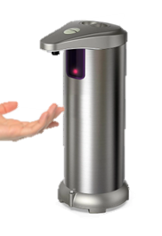
Classifying Detectors
Categorizing Program Analyses
TRUE
False
correct
wrong
POSITIVE
“present”
NEGATIVE
“absent”

Slide 31
Types of Analysis
Categorizing Program Analyses
In order to determine the properties of a given program analysis, let’s frame it as a detector
Analysis Target
(arbitrary program)
Note: we can detect bad
behavior or good behavior
Analysis Engine
(property detector program)
Yes
(property present)
No
(property is not present)

Slide 32
Classifying Errors
Categorizing Program Analyses
True
False
Analysis is correct
Analysis is wrong
Analysis Target
(arbitrary program)
Has report
Has report
Has bug
No bug
Positive
report
bug
Correct
Type I
Error
Analysis Engine
(bug detector)
No report
No report
Negative
No bug
Has bug
No bug
report
Correct
Type II
Error
Yes
(buggy)
No
(property is not present)

Slide 33
Today’s Roadmap
Decidability
The Halting Problem
Categorizing Program Analyses
Soundness / Completeness

Slide 34
Guarantees of Imperfect Analyses
Soundness / Completeness
Consistency / Reliability super important for users
We’d like to limit the kinds of errors we report
We can choose which type of bug report error to avoid
Soundness: No false positives
Completeness: No false negatives

Slide 35
Visual Analogy
Soundness / Completeness
Reported
bugs
Imagine the universe of all programs is contained in a circle
You can draw a circle around the programs you report as buggy
The actual buggy programs occupy a jagged region
All Programs
Buggy programs

Slide 36
Visual Analogy
Soundness / Completeness
Reported
bugs
Reported
bugs
All Programs
All Programs
Buggy programs
False
Positive
Buggy programs
False
Negative
Sound bug detection
Complete bug detection
All correct programs pass through
(No false positive problem)
All buggy programs get flagged
(No false negative problem)
Some buggy programs pass through
(has false negative problem)
Some correct programs get flagged
(has false positive problem)

Slide 37
Trivial Soundness
Soundness / Completeness
Reported
bugs
All Programs
Analysis Target
(arbitrary program)
Buggy programs
Analysis Engine
(bug detector)
False
Negative
No
(property is not present)
Sound bug detection
All correct programs pass through
(No false positive problem)
Some buggy programs pass through
(has false negative problem)

Slide 38
Trivial Completeness
Soundness / Completeness
Reported
bugs
Analysis Target
(arbitrary program)
All Programs
False
Positive
Buggy programs
Analysis Engine
(bug detector)
Yes
(buggy)
Complete bug detection
All buggy programs get flagged
(No false negative problem)
Some correct programs get flagged
(has false positive problem)

Slide 39


The Importance of Guarantees
Soundness / Completeness
Classic security posture: Ensure safety
A complete bugfinder:
Reports bugs in programs
Equivalently, a sound verifier
Reports bug-free programs

Slide 40

Analysis Method vs Errors
Soundness / Completeness
It’s natural to consider the types of compromises of each analysis method
Static analysis
  Often builds a model of the program, makes inferences on that model
  Tends to make completeness easier
  Scalability concerns for large programs
Dynamic analysis
  Often performs the analysis by straight up running the program, observing behavior
  Tends to make soundness easier
  Coverage problems

Slide 41
Beyond All-or-Nothing
Soundness / Completeness
As you can imagine, soundness and completeness are not the full story
Guarantees are nice, but we want legitimately useful analyses!
Many practical analyses are neither sound nor complete

Slide 42
Summary
Explored the limits of program analysis
Theoretical abstractions can be sound or complete, but not both
Guarantees are still possible, e.g.:
guarantee all bugs (of some sort) reported are real, but we might miss some bugs (sound, incomplete bugfinder)
guarantee total absence of bugs (of some sort), but may report fake bugs (complete, unsound bugfinder)

Slide 43
Summary
Explored the limits of program analysis
Theoretical abstractions can be sound or complete, but not both
Guarantees are still possible, e.g.:
guarantee all bugs (of some sort) reported are real, but we might miss some bugs (sound, incomplete bugfinder)
guarantee total absence of bugs (of some sort), but may report fake bugs (complete, unsound bugfinder)
NEXT TIME
Look at how we build a useful complete bugfinder (static analysis)

Slide 44
Lecture End!
TODO:
E7
Look out for P2

Slide 45

Turing Machines v Reality
Decidability
Are Turing machines good models of computation?
i.e. a memory-safe language is not subject to memory attacks
Perhaps computational power is a bad proxy for target capabilities
I actually agree with this perspective
BUT! Rice’s Theorem gives us a sense of what we’re up against
In practice, simultaneous soundness and completeness will hit scalability challenges first

Slide 46
Turing Machines v Reality
Decidability
Are Turing machines good models of computation?
i.e. a memory-safe language is not subject to memory attacks
Perhaps computational power is a bad proxy for target capabilities
I actually agree with this perspective
BUT! Rice’s Theorem gives us a sense of what we’re up against
In practice, simultaneous soundness and completeness will hit scalability challenges first

