Slide 1
Exercise #3
Review: Abstracting Code
Write your name and answer the following on a piece of paper
Draw the Control Flow Graph for the following code
void v(int a){
if (a < 2){
while (c < 3){
c++;
}
if (b > 3){
c = 12;
}
}
return;
}

Slide 2
Exercise #3
Review: Abstracting Code
Write your name and answer the following on a piece of paper
Draw the Control Flow Graph for the following code
void v(int a){
if (a < 2){
while (c < 3){
c++;
}
if (b > 3){
c = 12;
}
}
return;
}
if (a < 2)
true
while (c < 3)
true
c++;
false
false
if (b > 3)
false
true
c = 12;
return;

Slide 3
Administrivia and
Announcements

Slide 4
Class Progress
Exploring Program Abstraction
Some basic data structures (Control-Flow Graphs)
But what do the data structures hold?

Slide 5
Last Lecture: Abstracting Code
Why we Model/Abstract Programs
One way to abstract programs
- The Control-Flow Graph

Slide 6
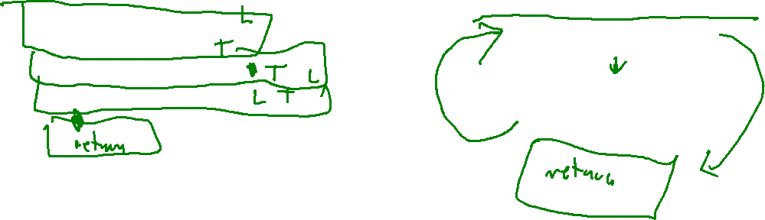
Review: Basic Blocks
Last Lecture: Abstracting code
Visualize the flow of control in the program
Use the Control-Flow Graph (CFG) to make flow explicit
Guaranteed sequential “fall-through” code is glommed into the same node (called a basic block)
void f(int i){
int a = 1;
while (a < i)
void f(int i){
int a = 1;
while (a < i){
a = a + 1;
}
}
a = a + 1

Slide 7

Review: Control-Flow Graphs
Last Lecture: Abstracting code
Visualize flow of control in a procedure
void f(int i)
if (a < 2)
Use the Control-Flow Graph (CFG) to make flow explicit
Connect basic blocks according to possible successors
true
while (c < i)
void f(int i){
if (a < 2){
while (c < i){
c++;
}
}
if (b > 3){
}
return;
}
true
c++;
false
false
if (b > 3)
false
true
c = 12;
return;

Slide 8
LLVM BITCODE
EECS 677: Software Security Evaluation
Drew Davidson

Slide 9

Quick Disclaimer
Vibe Check
Entangled Concepts
There are a lot of deep concepts that are interdependent
We’re skimming through a couple of ideas just enough to dig in
We’ll come back to
This class right now: A tangle (of concepts)

Slide 10
Lecture Outline
LLVM Bitcode Format
Very simple examples
SSA Format

Slide 11

Behold: LLVM
LLVM bitcode format
A set of Program Manipulation tools built around a “mid-level” abstract instruction set
- Called an intermediate representation (IR) because it sits between source code and executable
- High level enough to avoid architecture lock-in
- Low level enough to optimize / provide explicit operational details
Common
Middle-end
Front-end₁
Back-end₁
C
X64
Common
IR
Common
IR
Back-end₂
Front-end₂
Analysis
Haskell
…
MIPS
…
Optimization
Back-end_{m}
Front-end_{n}
WASM
Ruby

Slide 12

LLVM’s “Universal IR”
LLVM Bitcode
Bit-Code Language Design Goals
An in-memory compiler IR
Bit-code
An on-disk program representation
A human readable assembly language
A Compiler’s Representation
Relatively generic
Relatively easy to analyze

Slide 13

Bitcode Structure
LLVM Bitcode
Nested Structure
Modules
Individual translation unit (can be a whole program)
Functions
Invokable execution units
Global variables (globals)
Regions of statically-allocated memory
modules
Local variables
Regions of dynamically-allocated memory
functions
globals
Instructions
Data transformers
locals
instructions
registers
Registers
Value holders

Slide 14

An Abstract Computer
LLVM Bitcode
No real computer runs bitcode natively*
Abstract representation of memory
Highly-explicit instructions
*Without some additional translation software

Slide 15

LLVM’S Abstract Memory
LLVM Bitcode
Named Memory Objects
No explicit layout between objects
Sized field within the object
Highly-explicit instructions
Abstract registers
Infinite number of registers

Slide 16

example-Driven Learning
LLVM Bitcode
Before we get too lost in the details, let’s explore bit-code with an example
Example

Slide 17
Lecture Outline
LLVM Bitcode Format
Very simple examples
SSA Format

Slide 18
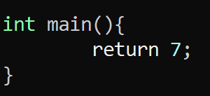
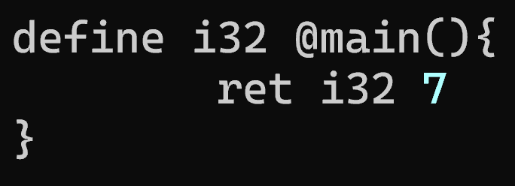
An Example Program
LLVM Bitcode
Source code
Basically-equivalent bit-code
@ precedes a function Name
Types explicitly denote their bit size (i32)
Operands are prefixed by a type annotation
ret i32 7

Slide 19
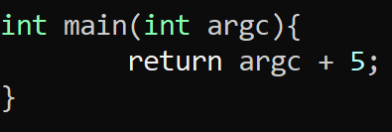
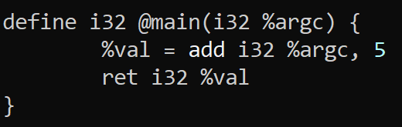
An Example Program - Math
LLVM Bitcode
Source code
Basically-equivalent bit-code
% precedes a register name
No complex operands (the operand of the return cannot be the add)

Slide 20
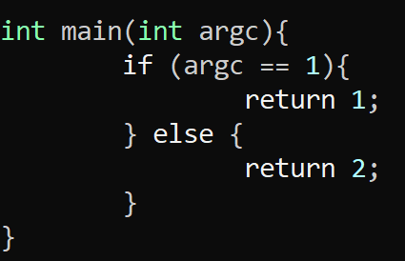
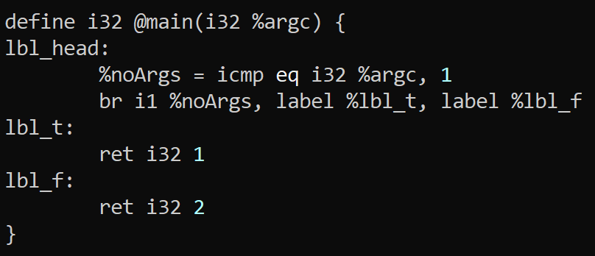
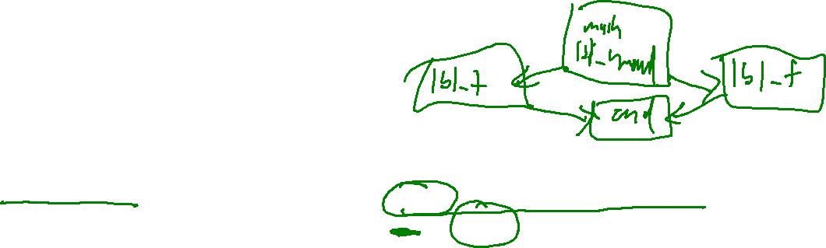
An Example Program - Jumps
LLVM Bitcode
Source code
Basically-equivalent bit-code
All blocks must end in a terminator instruction

Slide 21
simple Instruction Set
LLVM Bitcode – Very Simple Examples
Math
Comparison
The add instruction for addition
The mul instruction for multiplication
The sub instruction for subtraction
The div instruction for division
The icmp <kind> for integer comparison
Where kind is…
eq: equal
ne: not equal
ugt: unsigned greater than
uge: unsigned greater or equal
ult: unsigned less than
ule: unsigned less or equal
sgt: signed greater than
sge: signed greater or equal
slt: signed less than
sle: signed less or equal
Control Flow
The br instruction for branching
Predicate + multiple targets for conditional branch
No predicate + 1 target for unconditional branch

Slide 22

Running BITCODE Programs
LLVM Bitcode – Very Simple Examples
LLVM Programs
LLI – A runtime environment for bit-code programs!

Slide 23
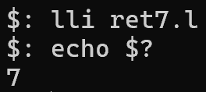
Running BITCODE Programs
LLVM Bitcode – Very Simple Examples
LLI – A runtime environment for bit-code programs!

Slide 24
Section Summary
LLVM Bitcode – Very Simple Examples
We can write Simple programs using the instructions given
We can write Run simple programs using LLI

Slide 25
Lecture Outline
LLVM Bitcode Format
Very simple examples
Format Constraints - SSA

Slide 26
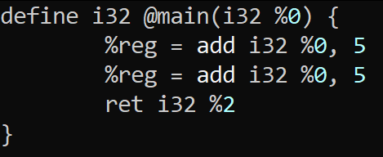
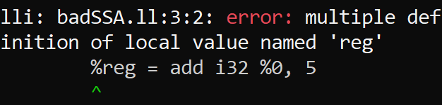
an Incorrect Program
LLVM Bitcode –Format Constraints: SSA
This program is invalid!
The register %reg is not
is not in SSA form

Slide 27

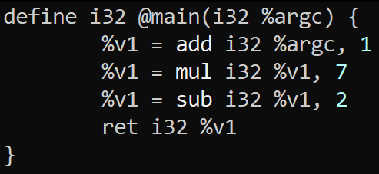
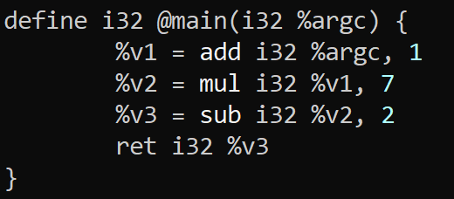
SSA FOrm
LLVM Bitcode –Format Constraints: SSA
In static single assignment form, a variable (here, register) may be assigned in at most one program point

Slide 28
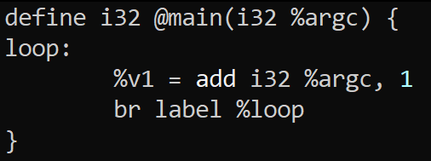
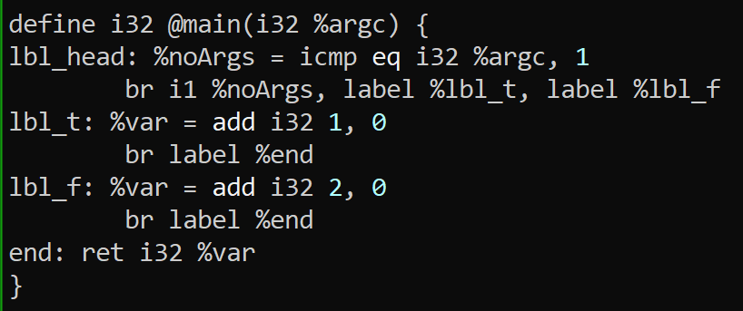
SSA FOrm
LLVM Bitcode –Format Constraints: SSA
In static single assignment form, a variable (here, register) may be assigned in at most one program point
Is this program in SSA form?
Yes!
Remember static means “before runtime”
only one static assignment
(many dynamic assignments)
Is this program in SSA form?
No!
var is assigned at two program points

Slide 29
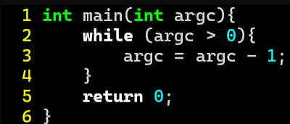
PHI Functions
LLVM Bitcode –Format Constraints: SSA
Dealing with “joined” values
Can the following program be made into SSA?

Slide 30
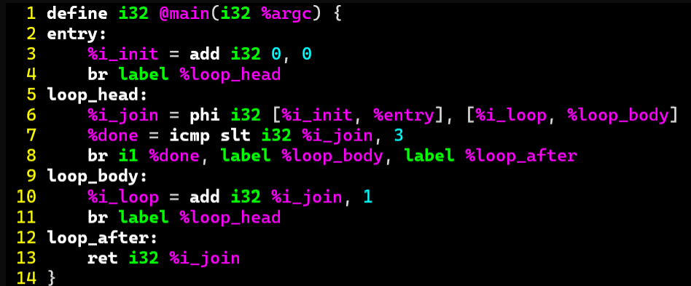
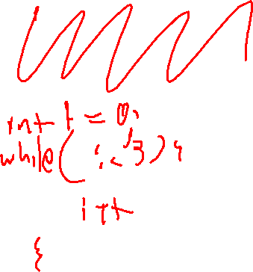
PHI Functions
LLVM Bitcode –Format Constraints: SSA
%res = phi <type> [val₁, bbl₁], [val₂, bbl₂], … [val_{n}, bbl_{n}]
Set %res to val_{i} if the block was entered from bbl_{i}

Slide 31
Section Summary
Static Analysis
LLVM Constrains how values can be set
One solution is to use PHI instructions to unify disparate values

Slide 32
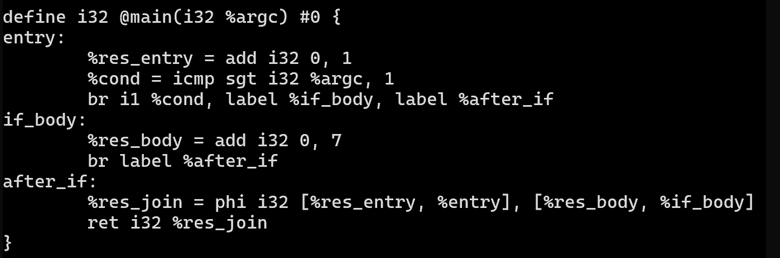
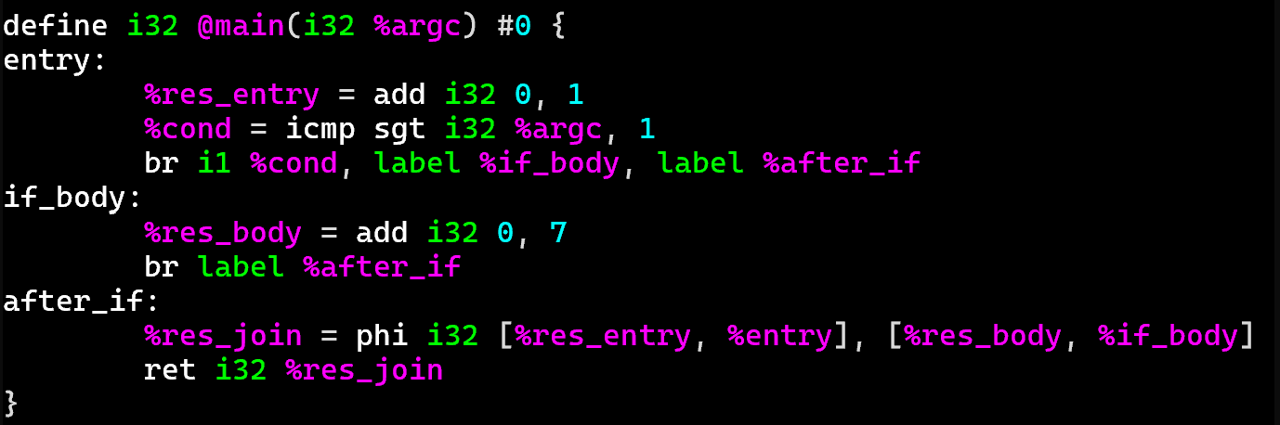
Aside: Fancy Syntax Highlighting
Drew’s Cool Tools
TIRED:
WIRED:

Slide 33
Aside: Fancy Syntax Highlighting
Drew’s Cool Tools
Turns out syntax highlighters are available for several editors
vim (my personal choice)
emacs
vscode
TIRED:
Files are in the git repo
https://github.com/llvm/llvm-project
Under the directory llvm/utils
WIRED:
If you don’t want to download all that code, check
https://analysis.cool/llvm-syntax.tgz

Slide 34
Wrap-up

Slide 35
Homework 1
Due Friday, 9/4
Write an LLVM program that iteratively computes the K^{th} Fibonacci Number where K is the arg Count to the program

Slide 36
Next Time
Look at some more complex LLVM examples
Start looking at manipulating memory:
- Pointers / Ref+DEREF
- Structures / Arrays

