Slide 1
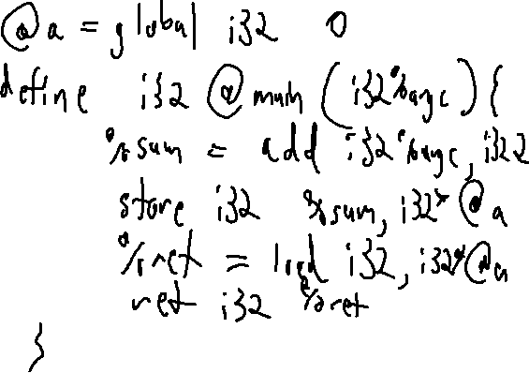
Exercise 5
LLVM MEMORY Review
Write your name and answer the following on a piece of paper
Write the LLVM bitcode for the following c code
int a;
int main(int argc){
a = argc + 2;
return a;
}

Slide 2
Exercise 5 Solution
LLVM MEMORY Review

Slide 3
Administrivia and
Announcements

Slide 4
LLVM calls
EECS 677: Software Security Evaluation
Drew Davidson

Slide 5
Class Progress
We’re Almost ready to do static Analysis

Slide 6
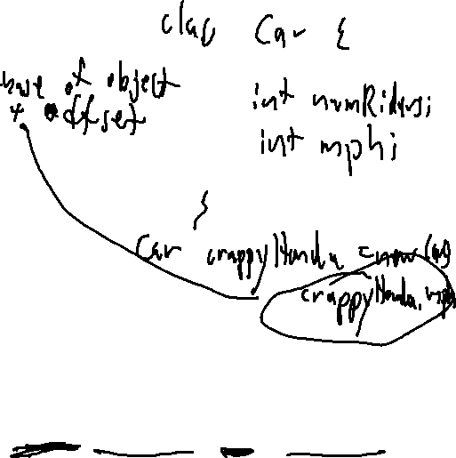
Last Time: LLVM MEMORY
Review: Last Lecture
Described LLVM’s Concept of Named Memory
No mathematical relationship between distinct named memory items
Guaranteed mathematical relation WITHIN named memory items (as exploited by GEP)
Declaring memory
Local memory:
%ptrL = alloca i32, align 4
Global memory:
@ptrG = global i32 2, align 4
(Global) constant: Guaranteed mathematical relation
@ptrC = constant i32 2, align 4
%ptrLarr = alloca [8 x i32], align 4
%ptrGstruct = global i32 {i32, i8}, align 4
@ptrCstructs = constant [2 x {i8, i32}]
[{i8, i32} {i8 1, i32 2}, {i8, i32}{ i8 3, i32 4} ] ,
align 4

Slide 7
Last Time: LLVM MEMORY
Review: Last Lecture
Declaring memory
Local memory:
%ptrL = alloca i32, align 4
Global memory:
@ptrG = global i32 2, align 4
(Global) constant: Guaranteed mathematical relation
@ptrC = constant i32 2, align 4
%ptrLarr = alloca [8 x i32], align 4
%ptrGstruct = global i32 {i32, i8}, align 4
@ptrCstructs = constant [2 x {i8, i32}]
[{i8, i32} {i8 1, i32 2}, {i8, i32}{ i8 3, i32 4} ] ,
align 4
Accessing memory
Store scalar:
store i32 1, i32* %ptrL
Global memory:
  %reg = load i32, i32* @ptrG
Load index of aggregate type
%eltPtr = getelementptr [2 x {i8, i32}],
[2 x {i8, i32}]* @ptrCstructs, i64 0, i64 0, i32 1
%res = load i32, i32* %ret

Slide 8
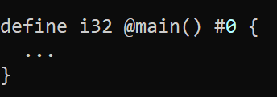

Follow-up What is the #0 here?
Review: Last Lecture
It’s an alias for an attribute list

Slide 9
Lecture Outline
The GEP Instruction and Intuition
Function calls

Slide 10
GetElementPtr
The Dreaded GEP
Let me Simplify this a bit with a slight reformat of GEP
base
array index
Field traversal
<result> = getelementptr <ty_{work}>, <ty_{src}> <src>, <idxtype> <siblingidx>, [<idxtype> <fieldidx>]+
Here is my explanation of this version of GEP:
Assume base is a pointer into some array of somethings (possibly a nested data structure)
- Arg 1: <ty_{work}>: Specify the type of the somethings
- Arg 2: <ty_{src}> <src>: base address to start your computation
- Arg 3: <idxtype> <siblingidx>: array index to jump forward from the base address
(end of optional arguments)
- Arg 4+: <idxtype> <fieldidx>: field traversal to index into the fields of the nested data structure

Slide 11
GetElementPtr
The Dreaded GEP
Let me (maybe?) Simplify this a bit with a slight reformat of GEP
base
array index
Field traversal
<result> = getelementptr <ty_{work}>, <ty_{src}> <src>, <idxtype> <siblingidx>, [<idxtype> <fieldidx>]+
7
7
7
Very generic format to capture the large variety of ways that you need to index into memory
Basic GEP invocations handle simple cases
getelementptr %T2, ptr @ptr_n1, i64 0, i64 0
Complex GEP invocations handle complex cases

Slide 12
GetElementPtr: Pictorially
The Dreaded GEP
Can be helpful to walk through memory as a tree
%T1 = type { i32, i32, i32 }
ptr_n1
%T2 = type [ 2 x %T1 ]
@ptr_n1 = global %T2 [ { i32 1, i32 2, i32 3 }, { i32 4, i32 5, i32 6} ]
n1
“base addr”
“sibling 0”
“field 0”
ptr_n2 =
getelementptr %T2, ptr @ptr_n1, i64 0, i64 0
n2
n3
ptr_n2
a₀
b₀
c₀
a₁
b₁
c₁

Slide 13
GetElementPtr: Pictorially
The Dreaded GEP
Can be helpful to walk through memory as a tree
%T1 = type { i32, i32, i32 }
ptr_n1
%T2 = type [ 2 x %T1 ]
@ptr_n1 = global %T2 [ { i32 1, i32 2, i32 3 }, { i32 4, i32 5, i32 6} ]
n1
ptr_n2 =
getelementptr %T2, ptr @ptr_n1, i64 0, i64 0
“base addr”
“sibling 1”
“field 1”
ptr_b1 =
getelementptr %T1, ptr @ptr_n2, i64 1, i64 1
n2
n3
ptr_n2
a₀
b₀
c₀
a₁
b₁
c₁
ptr_b1

Slide 14
GetElementPtr: Pictorially
The Dreaded GEP
Can be helpful to walk through memory as a tree
%T1 = type { i32, i32, i32 }
ptr_n1
%T2 = type [ 2 x %T1 ]
@ptr_n1 = global %T2 [ { i32 1, i32 2, i32 3 }, { i32 4, i32 5, i32 6} ]
n1
ptr_n2 =
getelementptr %T2, ptr @ptr_n1, i64 0, i64 0
“base addr”
“sibling 1”
“field 1”
ptr_b1 =
getelementptr %T1, ptr @ptr_n2, i64 1, i64 1
n2
n3
ptr_n2
a₀
b₀
c₀
a₁
b₁
c₁
ptr_b1

Slide 15
GetElementPtr: Ya Gotta Handle C
The Dreaded GEP
My Theory: GEP is designed to accommodate the needs of C source code
struct Inner {
int32_t a;
int8_t b;
char c;
};
struct Outer{
int32_t k;
struct Inner m;
}
struct Outer v[3];
int main(){
v[2].m.c = ‘X’;
}

Slide 16
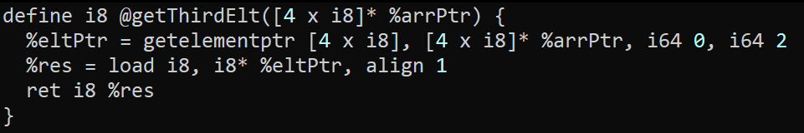
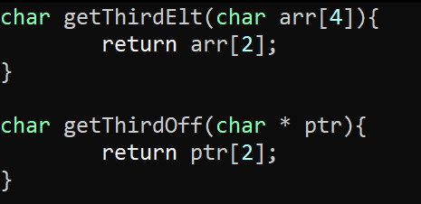
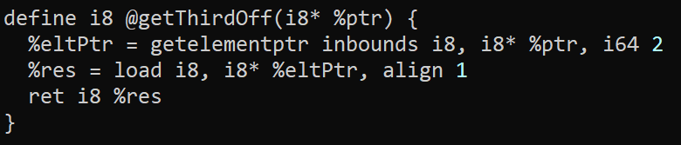
Some time with GEP
LLVM Bitcode

Slide 17

Writing “Interesting” Programs
LLVM Bitcode
We can now write Turing complete programs
But these programs are very Boring!
We need to interact with external functionality

Slide 18
LLVM Calls
LLVM Bitcode
General syntax
call <callee sig> <function name> ( <argList> )
%res = call i32(i32,i32) @max (i32 1, i32 2)
Somewhat surprisingly, does not (always) require the full function signature of the callee!
Constrained Syntax
call <return type> <function name> ( <argList> )
%res = call i32 @max (i32 1, i32 2)
The general syntax IS required if a function has varargs
%len = call i32 (i8*, ...) @printf(i8* %strPtr, i32 123)

Slide 19
LLVM External Calls
LLVM Bitcode
Example
%len = call i32 (i8*, ...) @printf(i8* %strPtr, i32 123)

Slide 20
LLVM AtoI
LLVM Bitcode
To the Terminal!

Slide 21
LLVM PRINTF
LLVM Bitcode
To the Terminal!

Slide 22
RUNNING THE LLVM TOOLS: CLANG
LLVM Bitcode
clang -S -emit-llvm foo.c -o foo.ll -disable-O0-optnone

Slide 23
Wrap-up

Slide 24
Next Time
WRITING AN ANALYSIS

