Slide 1
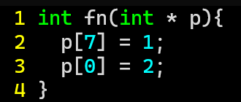
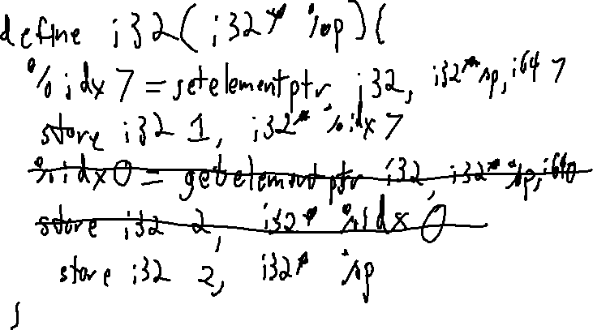
Exercise 6
LLVM Calls Review
Write the LLVM bitcode code corresponding to this function:

Slide 2
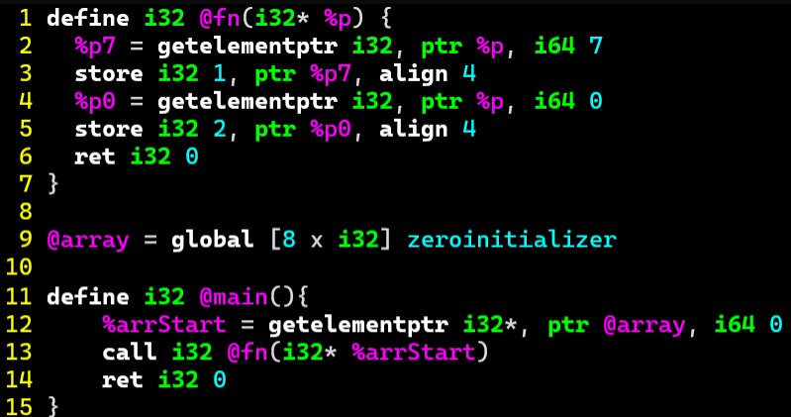
Exercise 6 Solution
LLVM Calls Review

Slide 3
Administrivia and
Announcements
P1 due tonight

Slide 4
Memory Attacks
EECS 677: Software Security Evaluation
Drew Davidson

Slide 5
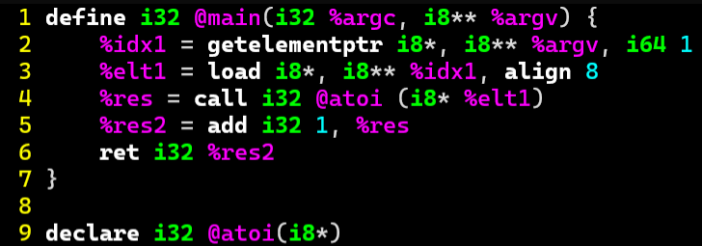
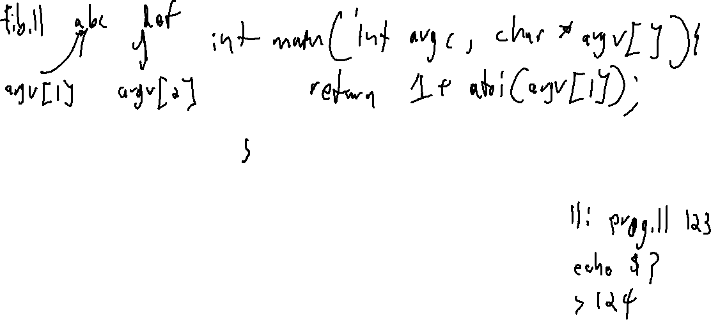
Last Time: LLVM Calls
Review: Last Lecture

Slide 6
Class Progress
We’ve got ourselves a way to represent programs
What are we trying to prevent?

Slide 7

Overview
Preventing bad stuff from happening in a program
Program

Slide 8
Lecture Outline
Terms/Concepts
Memory Layout
Memory Attacks

Slide 9

A Security Incident Workflow
Malware – Terms and Concepts
Exploit
Malicious
Behavior
Threat Actor
Attack Vector
Security Impact

Slide 10

Adversaries
Malware – Terms and Concepts
Anyone attempting to cause a security incident

Slide 11

Threat models
Malware – Terms and Concepts
Set of adversary goals
Set of adversary capabilities

Slide 12
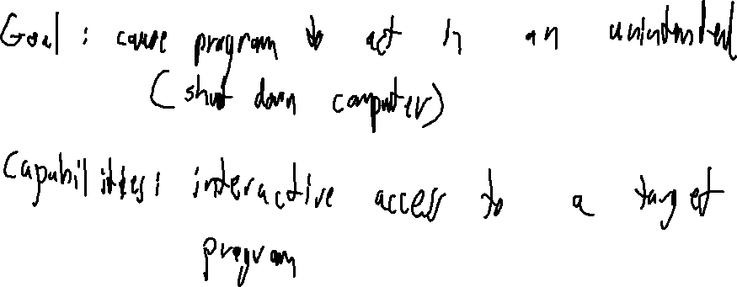
System Security
Malware – Terms and Concepts
A common threat model

Slide 13
Lecture Outline
Terms/Concepts
Memory Layout
Memory Attacks

Slide 14
How do “BAD” programs run?
Malware – terms and concepts
Reactive Concerns
Evaluating others’ programs
Social engineering
“Flaws” in system installation policies
We’re concerned about all these threats
Proactive Concerns
Behavioral opacity
Evaluating our own programs
Remote Code Execution
The program accidentally does damage
The program contains a vulnerability
Drive by Downloads

Slide 15
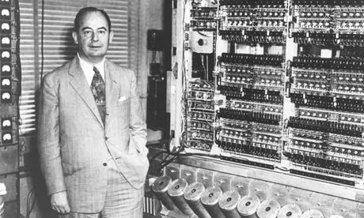
Data and Code
A history of Computing
The Von Neumann architecture
Another big idea: Code and data share memory
Good news!
Programs can write code just like any other form of data
Bad news!
Code is data

Slide 16
Program Memory: A 1-D Array
A history of Subversion
Code
Data
Load 2 bytes memory[G] into register a
Store register a into 4 bytes memory[K]
More ops …
Global variable G
Foo’s local variable K
Program instructions (binary sequences)
Program data & metadata (binary sequences)
Addr
0x01
Addr
0x02
Addr
0x01
Addr
0x03
Addr
0x04
Addr
0x05
Addr
0x06
Addr
0x07
Addr
0x08
Addr
0x09
Addr
0x0A
Addr
0x0B
Addr
0x0C
Addr
0x0D
Addr
0x0E
Addr
0x0F
Addr
0x10
Addr
0x11
Addr
0x12
Addr
0x13
Addr
0x14
Addr
0x15
Addr
0x16
Addr
0x17
f0
ef
0c
0a
e1
39
0a
12
ef
5b
76
1b
4f
bf
01
35
13
08
dd
cb
11
93
27
19
Load 4 bytes
from memory[G]
to register a
Store 4 bytes
from register a
Into memory[k]
More
ops …
global
variable
G
Program
metadata
and
bookkeeping
local
variable
K
More
metadata
and
bookkeeping

Slide 17
Simulating Source Constructs
A history of Subversion
Assume main calls foo
foo (recursively) calls foo
Code
Data
All the code in function main()
All the code in function foo()
Global variable G
foo’s local variable K
Program instructions (binary sequences)
Program data & metadata (binary sequences)
Addr
0x01
Addr
0x02
Addr
0x01
Addr
0x03
Addr
0x04
Addr
0x05
Addr
0x06
Addr
0x07
Addr
0x08
Addr
0x09
Addr
0x0A
Addr
0x0B
Addr
0x0C
Addr
0x0D
Addr
0x0E
Addr
0x0F
Addr
0x10
Addr
0x11
Addr
0x12
Addr
0x13
Addr
0x14
Addr
0x15
Addr
0x16
Addr
0x17
f0
ef
70
81
e1
39
ac
00
ef
5b
76
1b
4f
bf
01
35
13
08
dd
cb
11
93
27
19
local
k
Return address
Return address
main instructions
foo instructions
foo call 1
data
main data

Slide 18
Simulating Source Constructs
A history of Subversion
Assume main calls foo
foo (recursively) calls foo
Code
Data
All the code in function main()
All the code in function foo()
Global variable G
foo’s local variable K
Program instructions (binary sequences)
Program data & metadata (binary sequences)
Addr
0x01
Addr
0x02
Addr
0x01
Addr
0x03
Addr
0x04
Addr
0x05
Addr
0x06
Addr
0x07
Addr
0x08
Addr
0x09
Addr
0x0A
Addr
0x0B
Addr
0x0C
Addr
0x0D
Addr
0x0E
Addr
0x0F
Addr
0x10
Addr
0x11
Addr
0x12
Addr
0x13
Addr
0x14
Addr
0x15
Addr
0x16
Addr
0x17
f0
ef
70
81
e1
39
ac
00
ef
5b
76
1b
4f
bf
01
35
13
08
dd
cb
11
93
27
19
local
k
Return address
local
k
Return address
Return address
main instructions
foo instructions
foo call 2
data
foo call 1
data
main data

Slide 19
Simulating Source Constructs
A history of Subversion
Assume main calls foo
foo (recursively) calls foo
Code
Data
All the code in function main()
All the code in function foo()
Global variable G
foo’s local variable K
Program instructions (binary sequences)
Program data & metadata (binary sequences)
Addr
0x01
Addr
0x02
Addr
0x01
Addr
0x03
Addr
0x04
Addr
0x05
Addr
0x06
Addr
0x07
Addr
0x08
Addr
0x09
Addr
0x0A
Addr
0x0B
Addr
0x0C
Addr
0x0D
Addr
0x0E
Addr
0x0F
Addr
0x10
Addr
0x11
Addr
0x12
Addr
0x13
Addr
0x14
Addr
0x15
Addr
0x16
Addr
0x17
f0
ef
70
81
e1
39
ac
00
ef
5b
76
1b
4f
bf
01
35
13
08
dd
cb
11
93
27
19
local
k
Return address
local
k
Return address
Return address
main instructions
foo instructions
foo call 2
data
foo call 1
data
main data

Slide 20
Simulating Source Constructs
A history of Subversion
Assume main calls foo
foo (recursively) calls foo
Code
Data
All the code in function main()
All the code in function foo()
Global variable G
foo’s local variable K
Program instructions (binary sequences)
Program data & metadata (binary sequences)
Addr
0x01
Addr
0x02
Addr
0x01
Addr
0x03
Addr
0x04
Addr
0x05
Addr
0x06
Addr
0x07
Addr
0x08
Addr
0x09
Addr
0x0A
Addr
0x0B
Addr
0x0C
Addr
0x0D
Addr
0x0E
Addr
0x0F
Addr
0x10
Addr
0x11
Addr
0x12
Addr
0x13
Addr
0x14
Addr
0x15
Addr
0x16
Addr
0x17
f0
ef
70
81
e1
39
ac
00
ef
5b
76
1b
4f
bf
01
35
13
08
dd
cb
11
93
27
19
local
k
Return address
Return address
main instructions
foo instructions
foo call 1
data
main data

Slide 21
Simulating Source Constructs
A history of Subversion
Assume main calls foo
foo (recursively) calls foo
Code
Data
All the code in function main()
All the code in function foo()
Global variable G
foo’s local variable K
Program instructions (binary sequences)
Program data & metadata (binary sequences)
Addr
0x01
Addr
0x02
Addr
0x01
Addr
0x03
Addr
0x04
Addr
0x05
Addr
0x06
Addr
0x07
Addr
0x08
Addr
0x09
Addr
0x0A
Addr
0x0B
Addr
0x0C
Addr
0x0D
Addr
0x0E
Addr
0x0F
Addr
0x10
Addr
0x11
Addr
0x12
Addr
0x13
Addr
0x14
Addr
0x15
Addr
0x16
Addr
0x17
f0
ef
70
81
e1
39
ac
00
ef
5b
76
1b
4f
bf
01
35
13
08
dd
cb
11
93
27
19
Return address
main instructions
foo instructions
main data

Slide 22
Lecture Outline
Terms/Concepts
Memory Layout
Memory Attacks

Slide 23
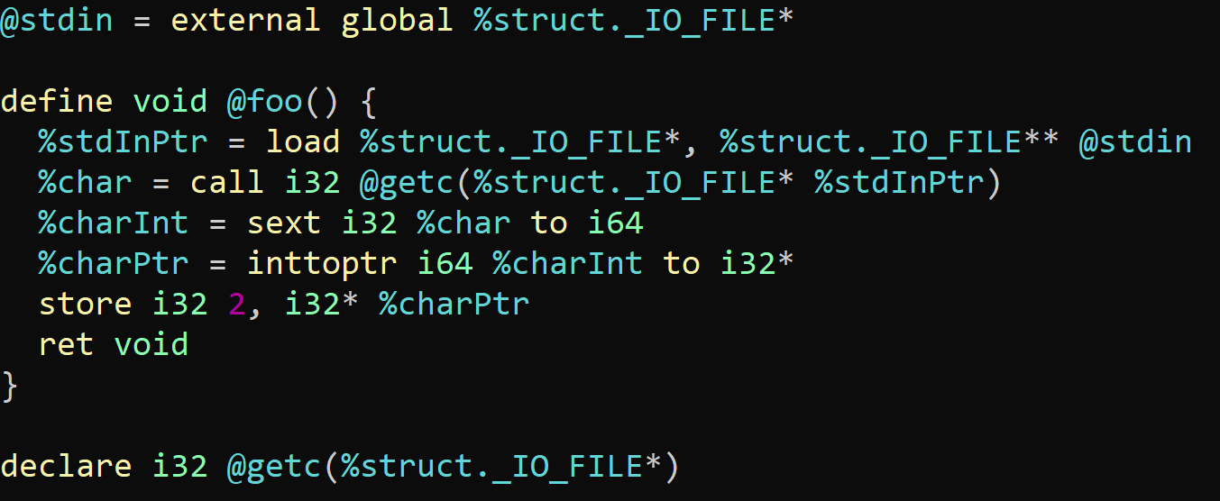

Breaking Bounds
A history of Subversion
(ascii hex value 0x44)
D
foo(){
int c = getc(stdout);
*((int *)c) = 2;
}
Program instructions
Program (meta)data
Addr
0x40
Addr
0x41
Addr
0x42
Addr
0x43
Addr
0x44
Addr
0x45
Addr
0x46
Addr
0x47
Addr
0x48
Addr
0x49
Addr
0x4A
Addr
0x4B
Addr
647E
Addr
647F
Addr
6480
Addr
6481
Addr
6482
Addr
6483
Addr
6484
Addr
6485
Addr
6486
Addr
6487
…
f0
ef
70
81
e1
39
ac
00
ef
5b
76
…
00
00
00
00
00
00
00
40
27
19
…
44
00
00
00
int c
Return addr.
foo instructions
foo
caller’s
data
foo’s
data

Slide 24
Breaking Bounds
A history of Subversion
(ascii hex value 0x44)
D
foo(){
int c = getc(stdout);
*((int *)c) = 2;
}
Pointer to
address 0x44
4-byte value
0x00000002
Program instructions
Program (meta)data
Addr
0x40
Addr
0x41
Addr
0x42
Addr
0x43
Addr
0x44
Addr
0x45
Addr
0x46
Addr
0x47
Addr
0x48
Addr
0x49
Addr
0x4A
Addr
0x4B
Addr
647E
Addr
647F
Addr
6480
Addr
6481
Addr
6482
Addr
6483
Addr
6484
Addr
6485
Addr
6486
Addr
6487
f0
ef
70
81
e1
39
ac
00
…
02
00
00
00
ef
5b
76
…
00
00
00
00
00
00
00
40
27
19
…
int c
Return addr.
foo instructions
foo
caller’s
data
foo’s
data

Slide 25

Breaking Bounds
A history of Subversion
(ascii hex value 0x44)
D
foo(){
int c = getc(stdout);
*((int *)c) = 2;
}
Pointer to
address 0x44
4-byte value
0x00000002
Program instructions
Program (meta)data
Addr
0x40
Addr
0x41
Addr
0x42
Addr
0x43
Addr
0x44
Addr
0x45
Addr
0x46
Addr
0x47
Addr
0x48
Addr
0x49
Addr
0x4A
Addr
0x4B
Addr
647E
Addr
647F
Addr
6480
Addr
6481
Addr
6482
Addr
6483
Addr
6484
Addr
6485
Addr
6486
Addr
6487
f0
ef
70
81
e1
39
ac
00
…
02
00
00
00
67
ef
5b
…
00
00
00
00
00
00
00
40
27
19
…
int c
Return addr.
foo instructions
foo
caller’s
data
foo’s
data

Slide 26
Buffer Overflows
A history of Subversion
int nm(){
char name[5];
printf("Enter your name: ");
gets(name);
printf(“hi %s\n", name);
return 0;
}
D r e w
(end)
0x44
0x72
0x65
0x77
0x00
Program instructions
Program (meta)data
Addr
1010
647E
Addr
1010
647F
Addr
1010
6480
Addr
1010
6481
Addr
1010
6482
Addr
1010
6483
Addr
1010
6484
Addr
1010
6485
Addr
1010
6486
Addr
1010
6487
Addr
1010
6488
Addr
0x40
Addr
0x41
Addr
0x42
Addr
0x43
Addr
0x44
Addr
0x45
Addr
0x46
Addr
0x47
Addr
0x48
Addr
0x49
Addr
0x4A
Addr
0x4B
…
f0
ef
70
81
e1
39
ac
00
67
ef
5b
…
00
00
00
00
00
46
00
00
00
19
8c
…
44
72
65
77
00
char name[5]
Return addr.
nm instructions
nm
caller’s
data
nm’s
data

Slide 27
Buffer Overflows
A history of Subversion
int nm(){
char name[5];
printf("Enter your name: ");
gets(name);
printf(“hi %s\n", name);
return 0;
}
D r e w
(end)
0x44
0x72
0x65
0x77
0x00
Program instructions
Program (meta)data
Addr
1010
647E
Addr
1010
647F
Addr
1010
6480
Addr
1010
6481
Addr
1010
6482
Addr
1010
6483
Addr
1010
6484
Addr
1010
6485
Addr
1010
6486
Addr
1010
6487
Addr
1010
6488
Addr
0x40
Addr
0x41
Addr
0x42
Addr
0x43
Addr
0x44
Addr
0x45
Addr
0x46
Addr
0x47
Addr
0x48
Addr
0x49
Addr
0x4A
Addr
0x4B
…
f0
ef
70
81
e1
39
ac
00
67
ef
5b
…
00
00
00
00
00
46
00
00
00
19
8c
…
44
72
65
77
00
char name[5]
Return addr.
nm instructions
nm
caller’s
data
nm’s
data

Slide 28
Buffer Overflows
A history of Subversion
int nm(){
char name[5];
printf("Enter your name: ");
gets(name);
printf(“hi %s\n", name);
return 0;
}
D r e w
(end)
0x44
0x72
0x65
0x77
0x00
Here’s the thing… Drew is just my nickname
Program instructions
Program (meta)data
Addr
1010
647E
Addr
1010
647F
Addr
1010
6480
Addr
1010
6481
Addr
1010
6482
Addr
1010
6483
Addr
1010
6484
Addr
1010
6485
Addr
1010
6486
Addr
1010
6487
Addr
1010
6488
Addr
0x40
Addr
0x41
Addr
0x42
Addr
0x43
Addr
0x44
Addr
0x45
Addr
0x46
Addr
0x47
Addr
0x48
Addr
0x49
Addr
0x4A
Addr
0x4B
…
f0
ef
70
81
e1
39
ac
00
67
ef
5b
…
00
00
00
00
00
46
00
00
00
19
8c
…
44
72
65
77
00
char name[5]
Return addr.
nm instructions
nm
caller’s
data
nm’s
data

Slide 29
Buffer Overflows
A history of Subversion
int nm(){
char name[5];
printf("Enter your name: ");
gets(name);
printf(“hi %s\n", name);
return 0;
}
A n d r e w
(end)
0x41
0x6e
0x64
0x72
0x65
0x77
0x00
Program instructions
Program (meta)data
Addr
1010
647E
Addr
1010
647F
Addr
1010
6480
Addr
1010
6481
Addr
1010
6482
Addr
1010
6483
Addr
1010
6484
Addr
1010
6485
Addr
1010
6486
Addr
1010
6487
Addr
1010
6488
Addr
0x40
Addr
0x41
Addr
0x42
Addr
0x43
Addr
0x44
Addr
0x45
Addr
0x46
Addr
0x47
Addr
0x48
Addr
0x49
Addr
0x4A
Addr
0x4B
…
f0
ef
70
81
e1
39
ac
00
67
ef
5b
…
00
00
00
00
00
46
00
00
00
19
8c
…
41
6e
64
72
65
77
00
char name[5]
Return addr.
nm instructions
nm
caller’s
data
nm’s
data

Slide 30
Buffer Overflows
A history of Subversion
int nm(){
char name[5];
printf("Enter your name: ");
gets(name);
printf(“hi %s\n", name);
return 0;
}
A n d r e w
(end)
0x41
0x6e
0x64
0x72
0x65
0x77
0x00
Program instructions
Program (meta)data
Addr
1010
647E
Addr
1010
647F
Addr
1010
6480
Addr
1010
6481
Addr
1010
6482
Addr
1010
6483
Addr
1010
6484
Addr
1010
6485
Addr
1010
6486
Addr
1010
6487
Addr
1010
6488
Addr
0x40
Addr
0x41
Addr
0x42
Addr
0x43
Addr
0x44
Addr
0x45
Addr
0x46
Addr
0x47
Addr
0x48
Addr
0x49
Addr
0x4A
Addr
0x4B
…
f0
ef
70
81
e1
39
ac
00
67
ef
5b
…
00
00
00
00
00
46
00
00
00
19
8c
…
41
6e
64
72
65
77
00
char name[5]
Return addr.
nm instructions
nm
caller’s
data
nm’s
data

Slide 31
Buffer Overflows
A history of Subversion
int nm(){
char name[5];
printf("Enter your name: ");
gets(name);
printf(“hi %s\n", name);
return 0;
}
A n d r e w
(end)
0x41
0x6e
0x64
0x72
0x65
0x77
0x00
Program instructions
Program (meta)data
Addr
1010
647E
Addr
1010
647F
Addr
1010
6480
Addr
1010
6481
Addr
1010
6482
Addr
1010
6483
Addr
1010
6484
Addr
1010
6485
Addr
1010
6486
Addr
1010
6487
Addr
1010
6488
Addr
0x40
Addr
0x41
Addr
0x42
Addr
0x43
Addr
0x44
Addr
0x45
Addr
0x46
Addr
0x47
Addr
0x48
Addr
0x49
Addr
0x4A
Addr
0x4B
…
f0
ef
70
81
e1
39
ac
00
67
ef
5b
…
00
00
00
00
00
46
00
00
00
19
8c
…
41
6e
64
72
65
77
00
char name[5]
Return addr.
nm instructions
nm
caller’s
data
nm’s
data

Slide 32
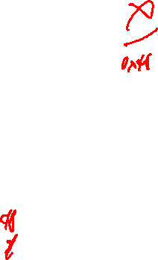
Buffer Overflows
A history of Subversion
int nm(){
char name[5];
printf("Enter your name: ");
gets(name);
printf(“hi %s\n", name);
return 0;
}
A n d r e w
(end)
0x41
0x6e
0x64
0x72
0x65
0x77
0x00
void explode(){
… //destroyTheComputer
}
Program instructions
Program (meta)data
Addr
1010
647E
Addr
1010
647F
Addr
1010
6480
Addr
1010
6481
Addr
1010
6482
Addr
1010
6483
Addr
1010
6484
Addr
1010
6485
Addr
1010
6486
Addr
1010
6487
Addr
1010
6488
Addr
0x40
Addr
0x41
Addr
0x42
Addr
0x43
Addr
0x44
Addr
0x45
Addr
0x46
Addr
0x47
Addr
0x48
Addr
0x49
Addr
0x4A
Addr
0x4B
…
f0
ef
70
81
e1
39
ac
00
67
ef
5b
…
00
00
00
00
00
46
00
00
00
19
8c
…
41
6e
64
72
65
77
00
char name[5]
Return addr.
nm instructions
explode
instructions
nm
caller’s
data
nm’s
data

Slide 33
Buffer Overflows
A history of Subversion
int nm(){
char name[5];
printf("Enter your name: ");
gets(name);
printf(“hi %s\n", name);
return 0;
}
H
A n d r e w
(end)
0x41
0x6e
0x64
0x72
0x65
0x77
0x00
0x48
void explode(){
… //destroyTheComputer
}
Program instructions
Program (meta)data
Addr
1010
647E
Addr
1010
647F
Addr
1010
6480
Addr
1010
6481
Addr
1010
6482
Addr
1010
6483
Addr
1010
6484
Addr
1010
6485
Addr
1010
6486
Addr
1010
6487
Addr
1010
6488
Addr
0x40
Addr
0x41
Addr
0x42
Addr
0x43
Addr
0x44
Addr
0x45
Addr
0x46
Addr
0x47
Addr
0x48
Addr
0x49
Addr
0x4A
Addr
0x4B
…
f0
ef
70
81
e1
39
ac
00
67
ef
5b
…
00
00
00
00
00
46
00
00
00
19
8c
…
41
6e
64
72
65
48
41
6e
64
72
65
48
00
00
char name[5]
Return addr.
nm instructions
explode
instructions
nm
caller’s
data
nm’s
data

Slide 34
Buffer Overflows
A history of Subversion
int nm(){
char name[5];
printf("Enter your name: ");
gets(name);
printf(“hi %s\n", name);
return 0;
}
H
A n d r e w
(end)
0x41
0x6e
0x64
0x72
0x65
0x77
0x00
0x48
void explode(){
… //destroyTheComputer
}
Program instructions
Program (meta)data
Addr
1010
647E
Addr
1010
647F
Addr
1010
6480
Addr
1010
6481
Addr
1010
6482
Addr
1010
6483
Addr
1010
6484
Addr
1010
6485
Addr
1010
6486
Addr
1010
6487
Addr
1010
6488
Addr
0x40
Addr
0x41
Addr
0x42
Addr
0x43
Addr
0x44
Addr
0x45
Addr
0x46
Addr
0x47
Addr
0x48
Addr
0x49
Addr
0x4A
Addr
0x4B
…
f0
ef
70
81
e1
39
ac
00
67
ef
5b
…
00
00
00
00
00
46
00
00
00
19
8c
…
41
6e
64
72
65
48
41
6e
64
72
65
48
00
00
char name[5]
Return addr.
nm instructions
explode
instructions
nm
caller’s
data
nm’s
data

Slide 35

Buffer Overflows
A history of Subversion
int nm(){
char name[5];
printf("Enter your name: ");
gets(name);
printf(“hi %s\n", name);
return 0;
}
H
A n d r e w
(end)
0x41
0x6e
0x64
0x72
0x65
0x77
0x00
0x48
void explode(){
… //destroyTheComputer
}
Program instructions
Program (meta)data
Addr
1010
647E
Addr
1010
647F
Addr
1010
6480
Addr
1010
6481
Addr
1010
6482
Addr
1010
6483
Addr
1010
6484
Addr
1010
6485
Addr
1010
6486
Addr
1010
6487
Addr
1010
6488
Addr
0x40
Addr
0x41
Addr
0x42
Addr
0x43
Addr
0x44
Addr
0x45
Addr
0x46
Addr
0x47
Addr
0x48
Addr
0x49
Addr
0x4A
Addr
0x4B
…
f0
ef
70
81
e1
39
ac
00
ef
5b
76
…
00
00
00
00
00
46
00
00
00
19
8c
…
41
6e
64
72
65
48
41
6e
64
72
65
48
00
00
char name[5]
Return addr.
nm instructions
explode
instructions
nm
caller’s
data
nm’s
data

Slide 36
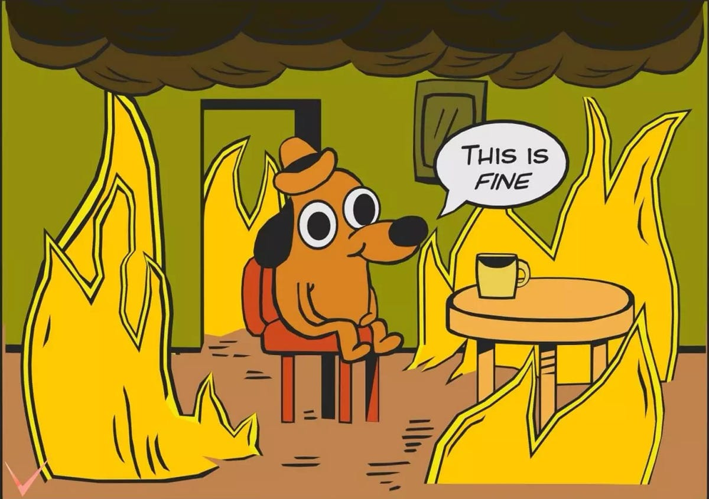
Buffer Overflows: impact
A history of Subversion
explodeTheComputer isn’t going to be in most programs
i.e. no good program ever includes 67 followed by ef 5b
Credit: KC Green

Slide 37
Script Injection
A history of Subversion
explodeTheComputer isn’t going to be in most programs
i.e. no good program ever includes 67 followed by ef 5b
Can we inject our own payload?
1) Put 67 then ef 5b into memory
2) Jump to that memory location

Slide 38
Script Injection
A history of Subversion
1) Put 67 then ef 5b into memory
2) Jump to that memory location
int nm(){
char name[5];
printf("Enter your name: ");
gets(name);
printf(“hi %s\n", name);
return 0;
}
g
ï
[
r
e
LF
LF
sp
B
(end)
0x67
0xef
0x5b
0x72
0x65
0x10
0x10
0x64
0x7e
0x00
Program instructions
Program (meta)data
Addr
1010
647E
Addr
1010
647F
Addr
1010
6480
Addr
1010
6481
Addr
1010
6482
Addr
1010
6483
Addr
1010
6484
Addr
1010
6485
Addr
1010
6486
Addr
1010
6487
Addr
1010
6488
Addr
0x40
Addr
0x41
Addr
0x42
Addr
0x43
Addr
0x44
Addr
0x45
Addr
0x46
Addr
0x47
Addr
0x48
Addr
0x49
Addr
0x4A
Addr
0x4B
…
f0
ef
70
81
e1
39
a2
3c
ef
5b
76
…
00
00
00
00
00
00
00
40
27
19
8c
…
67
ef
5b
72
65
10
10
64
7e
00
char name[5]
Return addr.
nm instructions
nm
caller’s
data
nm’s
data

Slide 39
Script Injection
A history of Subversion
1) Put 67 then ef 5b into memory
2) Jump to that memory location
int nm(){
char name[5];
printf("Enter your name: ");
gets(name);
printf(“hi %s\n", name);
return 0;
}
g
ï
[
r
e
LF
LF
sp
B
(end)
0x67
0xef
0x5b
0x72
0x65
0x10
0x10
0x64
0x7e
0x00
jump to the ”return” address
(which we overwrote with this
address) …
Program instructions
Program (meta)data
Addr
1010
647E
Addr
1010
647F
Addr
1010
6480
Addr
1010
6481
Addr
1010
6482
Addr
1010
6483
Addr
1010
6484
Addr
1010
6485
Addr
1010
6486
Addr
1010
6487
Addr
1010
6488
Addr
0x40
Addr
0x41
Addr
0x42
Addr
0x43
Addr
0x44
Addr
0x45
Addr
0x46
Addr
0x47
Addr
0x48
Addr
0x49
Addr
0x4A
Addr
0x4B
…
f0
ef
70
81
e1
39
a2
3c
ef
5b
76
…
00
00
00
00
00
00
00
40
27
19
8c
…
67
ef
5b
72
65
10
10
64
7e
00
char name[5]
Return addr.
nm instructions
nm
caller’s
data
nm’s
data

Slide 40
Script Injection
A history of Subversion
1) Put 67 then ef 5b into memory
2) Jump to that memory location
int nm(){
char name[5];
printf("Enter your name: ");
gets(name);
printf(“hi %s\n", name);
return 0;
}
g
ï
[
r
e
LF
LF
sp
B
(end)
0x67
0xef
0x5b
0x72
0x65
0x10
0x10
0x64
0x7e
0x00
… start executing the bytes
we put in memory!
jump to the ”return” address
(which we overwrote with this
address) …
Program instructions
Program (meta)data
Addr
1010
647E
Addr
1010
647F
Addr
1010
6480
Addr
1010
6481
Addr
1010
6482
Addr
1010
6483
Addr
1010
6484
Addr
1010
6485
Addr
1010
6486
Addr
1010
6487
Addr
1010
6488
Addr
0x40
Addr
0x41
Addr
0x42
Addr
0x43
Addr
0x44
Addr
0x45
Addr
0x46
Addr
0x47
Addr
0x48
Addr
0x49
Addr
0x4A
Addr
0x4B
…
f0
ef
70
81
e1
39
a2
3c
ef
5b
76
…
00
00
00
00
00
00
00
40
27
19
8c
…
67
ef
5b
72
65
10
10
64
7e
00
char name[5]
Return addr.
nm instructions
nm
caller’s
data
nm’s
data

Slide 41
Script Injection
A history of Subversion
int nm(){
char name[5];
printf("Enter your name: ");
gets(name);
printf(“hi %s\n", name);
return 0;
}
change this input…
A n d r e LF LF d ~
(end)
0x41
0x6e
0x64
0x72
0x65
0x10
0x10
0x64
0x7e
0x00
…execute whatever these
Instructions are
Program instructions
Program (meta)data
Addr
1010
647E
Addr
1010
647F
Addr
1010
6480
Addr
1010
6481
Addr
1010
6482
Addr
1010
6483
Addr
1010
6484
Addr
1010
6485
Addr
1010
6486
Addr
1010
6487
Addr
1010
6488
Addr
0x40
Addr
0x41
Addr
0x42
Addr
0x43
Addr
0x44
Addr
0x45
Addr
0x46
Addr
0x47
Addr
0x48
Addr
0x49
Addr
0x4A
Addr
0x4B
…
f0
ef
70
81
e1
39
ac
00
ef
5b
76
…
00
00
00
00
00
00
00
40
27
19
8c
…
41
6e
64
72
65
10
10
64
7e
00
char name[5]
Return addr.
nm instructions
nm
caller’s
data
nm’s
data

Slide 42
Script INjection: impact
A history of Subversion
explodeTheComputer isn’t going to be in most programs
i.e. no good program ever includes 67 followed by ef 5b
Can we inject our own payload?
1) Put 67 then ef 5b into memory
2) Jump to that memory location
Credit: KC Green

Slide 43
Script Injection: The FIX
A history of Subversion
explodeTheComputer isn’t going to be in most programs
i.e. no good program ever includes 67 followed by ef 5b
Can we inject our own payload?
1) Put 67 then ef 5b into memory
2) Jump to that memory location
Don’t allow execution of user-supplied data

Slide 44
Script Injection: The FIX
A history of Subversion
1) Put 67 then ef 5b into memory
int nm(){
char name[5];
printf("Enter your name: ");
gets(name);
printf(“hi %s\n", name);
return 0;
}
2) Jump to that memory location
g
ï
[
r
e
LF
LF
sp
B
(end)
0x67
0xef
0x5b
0x72
0x65
0x10
0x10
0x64
0x7e
0x00
… start executing the bytes
we put in memory!
jump to the ”return” address
(which we overwrote with this
address) …
W$⊗$X: hardware extension, assure every byte is EITHER executable OR writable (NEVER both)
Program instructions
Program (meta)data
Addr
1010
2040
Addr
1010
2041
Addr
1010
2042
Addr
1010
2043
Addr
1010
2044
Addr
1010
2045
Addr
1010
2046
Addr
1010
2047
Addr
1010
2048
Addr
1010
2049
Addr
1010
204A
Addr
1010
647E
Addr
1010
647F
Addr
1010
6480
Addr
1010
6481
Addr
1010
6482
Addr
1010
6483
Addr
1010
6484
Addr
1010
6485
Addr
1010
6486
Addr
1010
6487
Addr
1010
6488
…
f0
ef
70
81
e1
39
ac
00
ef
5b
76
…
00
00
00
00
00
00
00
40
27
19
8c
…
67
ef
5b
72
65
10
10
64
7e
00
x
x
x
x
x
x
x
x
x
x
x
w
w
w
w
w
w
w
w
w
w
w
char name[5]
Return addr.
nm instructions
nm instructions
nm
caller’s
data
nm’s
data

Slide 45
Script Injection: The FIX
A history of Subversion
1) Put 67 then ef 5b into memory
int nm(){
char name[5];
printf("Enter your name: ");
gets(name);
printf(“hi %s\n", name);
return 0;
}
2) Jump to that memory location
g
ï
[
r
e
LF
LF
sp
B
(end)
0x67
0xef
0x5b
0x72
0x65
0x10
0x10
0x64
0x7e
0x00
… start executing the bytes
we put in memory!
jump to the ”return” address
(which we overwrote with this
address) …
W$⊗$X: hardware extension, assure every byte is EITHER executable OR writable (NEVER both)
Crash
Program instructions
Program (meta)data
Addr
1010
2040
Addr
1010
2041
Addr
1010
2042
Addr
1010
2043
Addr
1010
2044
Addr
1010
2045
Addr
1010
2046
Addr
1010
2047
Addr
1010
2048
Addr
1010
2049
Addr
1010
204A
Addr
1010
647E
Addr
1010
647F
Addr
1010
6480
Addr
1010
6481
Addr
1010
6482
Addr
1010
6483
Addr
1010
6484
Addr
1010
6485
Addr
1010
6486
Addr
1010
6487
Addr
1010
6488
…
f0
ef
70
81
e1
39
ac
00
ef
5b
76
…
00
00
00
00
00
00
00
40
27
19
8c
…
67
ef
5b
72
65
10
10
64
7e
00
x
x
x
x
x
x
x
x
x
x
x
w
w
w
w
w
w
w
w
w
w
w
char name[5]
Return addr.
nm instructions
nm instructions
nm
caller’s
data
nm’s
data

Slide 46


W$⊗$X: impact
A history of Subversion
explodeTheComputer isn’t going to be in most programs
i.e. no good program ever includes 67 followed by ef 5b
Can we inject our own payload?
1) Put 67 ef 5b into memory
2) Jump to that memory location
Find existing bytes of payload instructions
… followed by a return instruction (c3)
Return-oriented programming

Slide 47
ROP
A history of Subversion
explodeTheComputer isn’t going to be in most programs
i.e. no good program ever includes 67 followed by ef 5b
Can we inject our own payload?
1) Put 67 ef 5b into memory
2) Jump to that memory location
Find existing bytes of payload instructions
… followed by a return instruction (c3)
Return-oriented programming

Slide 48
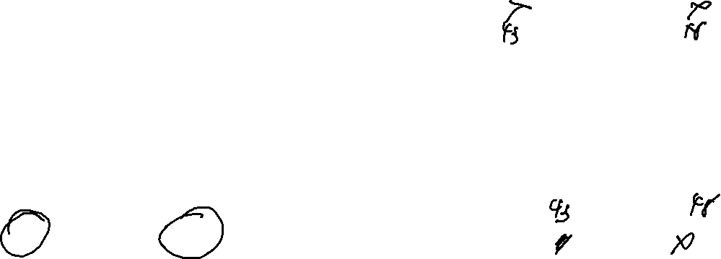
ROP
A history of Subversion
Find existing bytes of payload instructions
… followed by a return instruction (c3)
int nm(){
char name[5];
printf(“Your name: ");
gets(name);
printf(“hi %s\n", name);
return 0;
}
A
n
d
r
e
LF
LF
sp
B
LF
LF
sp
.
(end)
0x41
0x6e
0x64
0x72
0x65
0x10
0x10
0x20
0x42
0x10
0x10
0x20
0x46
0x00
Program instructions
Program (meta)data
Addr
1010
2040
Addr
1010
2041
Addr
1010
2042
Addr
1010
2043
Addr
1010
2044
Addr
1010
2045
Addr
1010
2046
Addr
1010
2047
Addr
1010
2048
Addr
1010
2049
Addr
1010
204A
Addr
1010
204B
Addr
1010
647E
Addr
1010
647F
Addr
1010
6480
Addr
1010
6481
Addr
1010
6482
Addr
1010
6483
Addr
1010
6484
Addr
1010
6485
Addr
1010
6486
Addr
1010
6487
Addr
1010
6488
Addr
1010
6489
Addr
1010
648A
…
f0
ef
70
67
c3
39
ac
9a
ef
5b
c3
…
00
00
00
00
00
00
00
40
27
19
8c
8c
8c
…
41
6e
64
72
65
10
10
20
42
10
10
20
46
char name[5]
Return addr.
Next Return addr.
nm instructions
nm
caller’s
data
nm’s
data

Slide 49
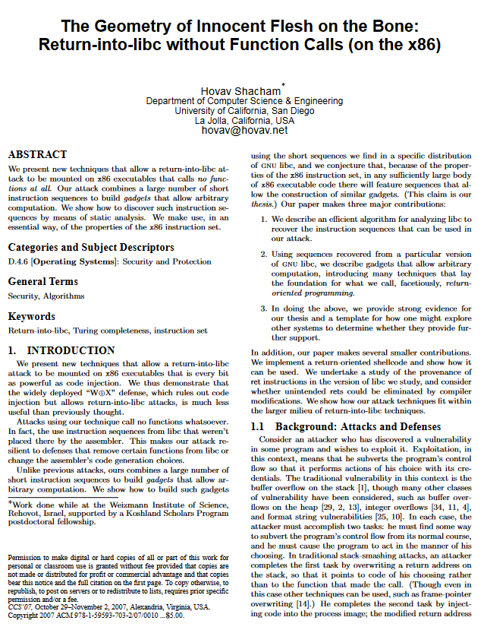
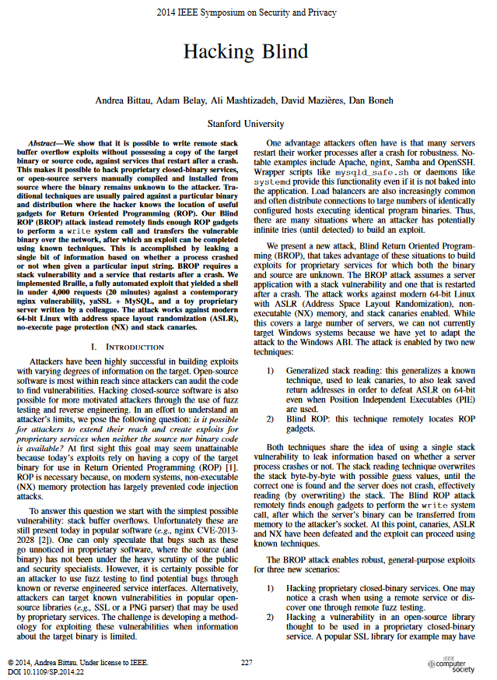
ROP: IMpact
A history of Subversion
The practicality of this attack may seem limited
Are (sub)sequences present in process code to do the attack?
Are the (sub)sequences placed in predictable positions?

Slide 50
Return-into-LIBC
A history of Subversion
int nm(){
char name[5];
printf(“Your name: ");
gets(name);
printf(“hi %s\n", name);
return 0;
}
Program instructions
Program (meta)data
Addr
1010
647E
Addr
1010
647F
Addr
1010
6480
Addr
1010
6481
Addr
1010
6482
Addr
1010
6483
Addr
1010
6484
Addr
1010
6485
Addr
1010
6486
Addr
1010
6487
Addr
1010
6488
Addr
0x40
Addr
0x41
Addr
0x42
Addr
0x43
Addr
0x44
Addr
0x45
Addr
0x46
Addr
0x47
Addr
0x48
Addr
0x49
Addr
0x4A
Addr
0x4B
…
f0
ef
70
81
c3
67
c3
92
ef
5b
c3
…
00
00
00
00
00
00
00
40
27
19
8c
…
char name[5]
Return addr.
nm instructions
libc instructions
nm
caller’s
data
nm’s
data

Slide 51
Return-into-LIBC
A history of Subversion
int nm(){
char name[5];
printf(“Your name: ");
gets(name);
printf(“hi %s\n", name);
return 0;
}
Program instructions
Program (meta)data
Addr
1010
647E
Addr
1010
647F
Addr
1010
6480
Addr
1010
6481
Addr
1010
6482
Addr
1010
6483
Addr
1010
6484
Addr
1010
6485
Addr
1010
6486
Addr
1010
6487
Addr
1010
6488
Addr
0x40
Addr
0x41
Addr
0x42
Addr
0x43
Addr
0x44
Addr
0x45
Addr
0x46
Addr
0x47
Addr
0x48
Addr
0x49
Addr
0x4A
Addr
0x4B
…
f0
ef
70
81
c3
67
c3
92
ef
5b
c3
…
00
00
00
00
00
00
00
40
27
19
8c
…
char name[5]
Return addr.
nm instructions
libc instructions
nm
caller’s
data
nm’s
data

Slide 52

(yes, time to panic)

Slide 53
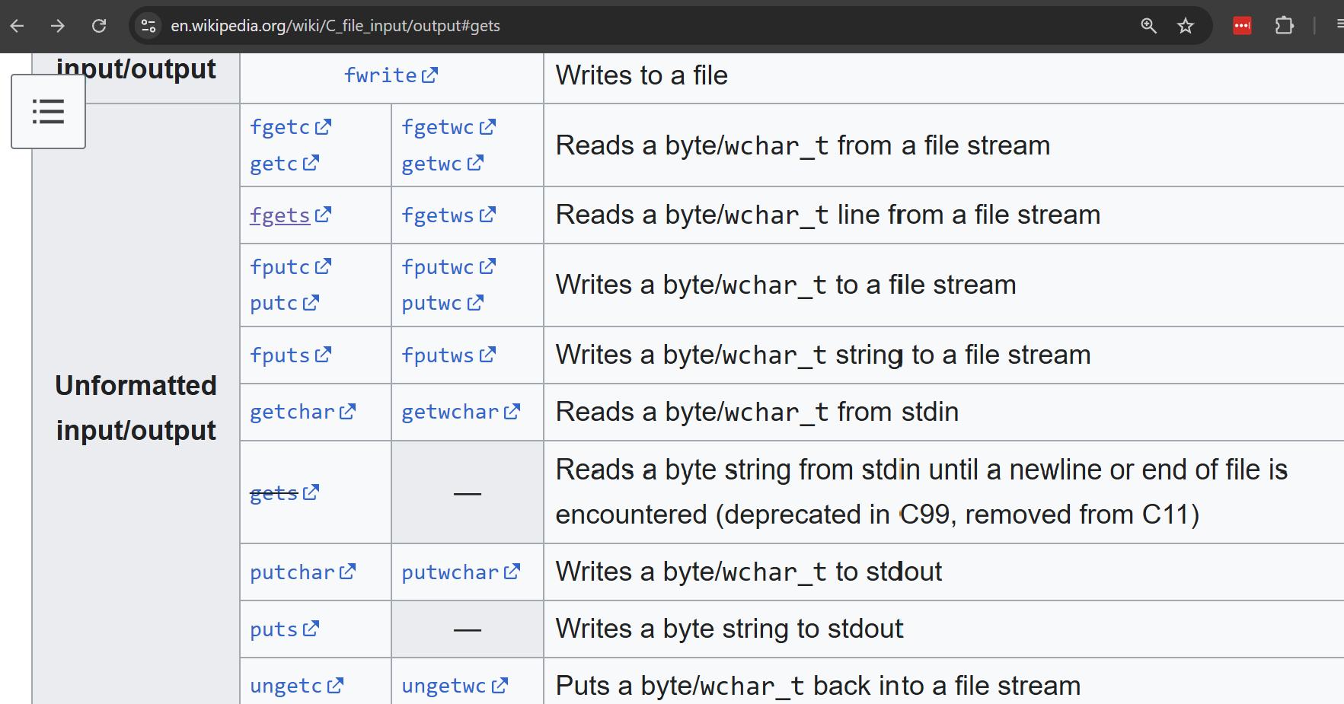
Thinking About Defenses
A history of Subversion
Can we detect programs with overflow potential?

Slide 54
End lecture

Slide 55
BEYOND ROP as RCE
A history of Subversion
Return oriented Programming constitutes a form of Remote code execution
It’s not the only form of remote code execution
Web programming

Slide 56

Stack Canaries
A history of subversion

Slide 57
Stack Canaries
A history of subversion
Program instructions (binary sequences)
Program data & metadata
User data
f0ef7081e1539ac00ef5b761b4fb01b351308dd003cb4b8930e27195a6ef34ba476e80e53f2af0

Slide 58

ASLR
A history of subversion

Slide 59
ASLR
A history of subversion
Program instructions (binary sequences)
Program data & metadata
User data
f0ef7081e1539ac00ef5b761b4fb01b351308dd003cb4b8930e27195a6ef34ba476e80e53f2af0

Slide 60
CFI
A history of subversion

