Slide 1
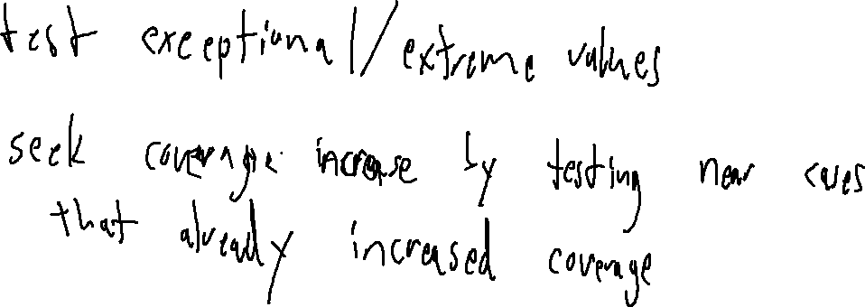
Exercise
Dynamic Analysis Review
Write your name and answer the following on a piece of paper
In fuzzing, it is easy to generate additional test cases for an analysis target. What are some of the strategies for prioritizing which test case to run next?

Slide 2
Administrivia and
Announcements

Slide 3
Symbolic Execution
EECS 677: Software Security Evaluation
Drew Davidson

Slide 4
Where We’re At
Dynamic Analysis
Generating test cases

Slide 5

Previously: Fuzzing
Outline / Overview
Generating Random test cases
Surprisingly effective in practice
Main challenge is exploring “new” behavior
The random “fuzz” of white noise

Slide 6
This Lecture: Symbolic Execution
Outline / Overview
A methodical approach to “abstract” execution

Slide 7
Recall: Test case generation
Symbolic Execution
Test Suite
Test Suite
Test1
Program
Test1
Test1
Test1
Test1
Test1
Test1
Test1
Input_{n}
Actual_{n}
Test1
Test1
Match?
Test1
Test1
Expected_{n}

Slide 8
The problem of coverage
Symbolic Execution
1: #include “stdlib.h”
2: int main(){
3: int c = getchar();
4: if (c == 12345){
5: blowUpTheOcean();
6: } else {
7: return 0;
8: }
9: }
A divergence, beyond which some behavior will be missed

Slide 9

Big Idea: Explore BOTH Outcomes
Symbolic Execution
1: #include “stdlib.h”
2: int main(){
3: int c = getchar();
4: if (c == 12345){
5: blowUpTheOcean();
6: } else {
7: return 0;
8: }
9: }

Slide 10






Big Idea: Explore BOTH Outcomes
Symbolic Execution
goodBoyfriend = NULL;
if (sheMakesTheSubway){
goodBoyfriend->surprise();
haircut = true;
goodBoyfriend = new Boyfriend()
}
else {
haircut = false;
minimumWageJob(gwyneth);
}

Slide 11
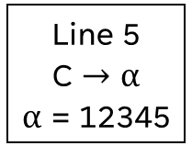
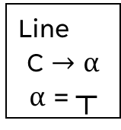

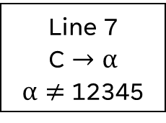
Big Idea #1: Symbolic Input
Symbolic Execution
1:
2:
3:
4:
5:
6:
7:
8:
9:
10:
#include “stdlib.h”
int main(){
int c = getchar();
Line
C $→$ α
α = ┬
if (c == 12345){
blowUpTheOcean();
} else {
return 0;
}
}
Line 5
C $→$ α
α = 12345
Line 7
C $→$ α
α $≠$ 12345

Slide 12
Respect Concrete Semantics
Symbolic Execution
1:
2:
3:
4:
5:
6:
7:
8:
9:
10:
#include “stdlib.h”
int main(){
int c = getchar();
Line
C $→$ α
α = ┬
if (c == 12345){
blowUpTheOcean();
} else {
return 0;
}
}
Line 5
C $→$ α
α = 12345
Line 7
C $→$ α
α $≠$ 12345

Slide 13
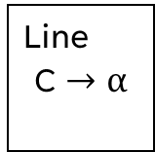

Respect Concrete Semantics
Symbolic Execution
1:
2:
3:
4:
5:
6:
7:
8:
9:
10:
#include “stdlib.h”
int main(){
int c = getchar();
Line
C $→$ α
α = 4
c = 4;
if (c == 12345){
blowUpTheOcean();
} else {
return 0;
}
}

Slide 14
Path Feasibility
Symbolic Execution
1: #include “stdlib.h”
2: int main(){
3: int c = getchar();
4: if (c == 12345){
5: if (c < 1){
6: blowUpTheOcean();
7: }
8 : } else {
10: return 0;
11: }
12: }
Even with symbolic variables,
it may be impossible to exercise both branches

Slide 15

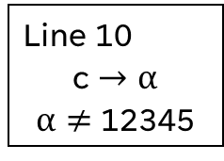
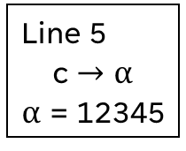

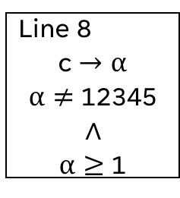
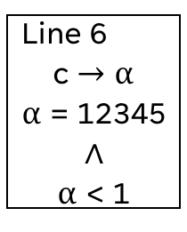
Path Feasibility
Symbolic Execution
1: #include “stdlib.h”
2: int main(){
3: int c = getchar();
4: if (c == 12345){
5: if (c < 1){
6: blowUpTheOcean();
7: }
8 : } else {
10: return 0;
11: }
12: }
2
Line
3
4
c $→$ α
α = ┬
Line 5
c $→$ α
α = 12345
Line 10
c $→$ α
α $≠$ 12345
Line 6
c $→$ α
α = 12345
$$∧$$
α < 1
Line 8
c $→$ α
α $≠$ 12345
$$∧$$
α $≥$ 1

Slide 16

Big Idea #2: PATH Constraints
Symbolic Execution
1: #include “stdlib.h”
2: int main(){
3: int c = getchar();
4: if (c == 12345){
5: if (c < 1){
6: blowUpTheOcean();
7: }
8 : } else {
10: return 0;
11: }
12: }
2
Line
3
4
c $→$ α
α = ┬
Line 5
c $→$ α
α = 12345
Line 10
c $→$ α
α $≠$ 12345
Line 6
c $→$ α
α = 12345
$$∧$$
α < 1
Line 8
c $→$ α
α $≠$ 12345
$$∧$$
α $≥$ 1

Slide 17
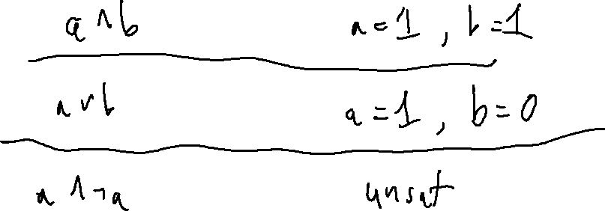
The magic of the solver
Symbolic Execution
Boolean
equation
SAT
Satisfying
assignment

Slide 18
The magic of the solver
Symbolic Execution
Somewhat arbitrary
equation
SMT
Satisfying
assignment
Translation!
Boolean
equation
SAT
Satisfying
assignment

Slide 19
The symbolic execution Tree
Symbolic Execution
1: #include “stdlib.h”
2: int main(){
3: int c = getchar();
4: if (c == 12345){
5: if (c < 1){
6: blowUpTheOcean();
7: }
8 : } else {
10: return 0;
11: }
12: }
At each line of the program:
Advance a symbolic program state
When you hit a branch split the symbolic state into 2 versions
  1) a state that satisfies the predicate
  2) a state that does not satisfy the predicate

Slide 20
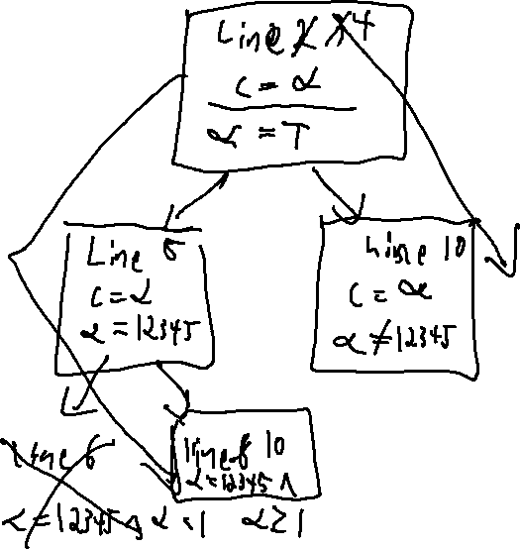
test suite Generation
Symbolic Execution
1: #include “stdlib.h”
2: int main(){
3: int c = getchar();
4: if (c == 12345){
5: if (c < 1){
6: blowUpTheOcean();
7: }
8 : } else {
10: return 0;
11: }
12: }

Slide 21

Soundness / Completeness
Symbolic Execution
1. int main(){
2. int c = getchar();
3. while ( c ){
4. if (c == 12345){
5. blowUpTheOcean();
6. }
7. }
8. return 4;
9. }
Soundness
Never generate a state that is unreachable
Completeness
Never miss a state
Termination
Maybe not!

Slide 22
Soundness / Completeness
Symbolic Execution
1. int main(){
2. int c = getchar();
3. while ( c ){
4. if (c == 12345){
5. blowUpTheOcean();
6. }
7. }
8. return 4;
9. }
Termination
Maybe not!

Slide 23
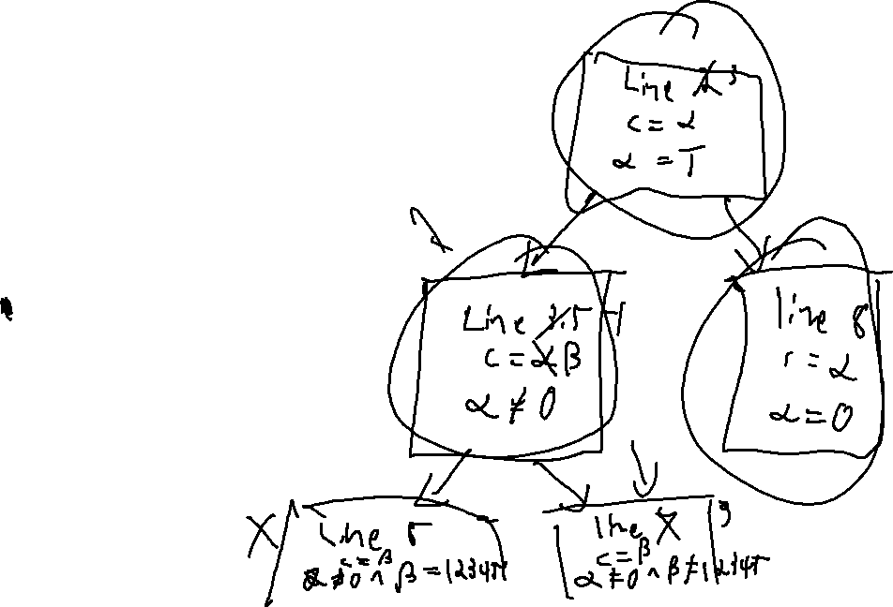
Limitation: Coverage
Symbolic Execution
1. int main(){
2. int c = getchar();
3. while ( c ){
3.5. c = getchar();
4. if (c == 12345){
5. blowUpTheOcean();
6. }
7. }
8. xreturn 4;
9. }

Slide 24
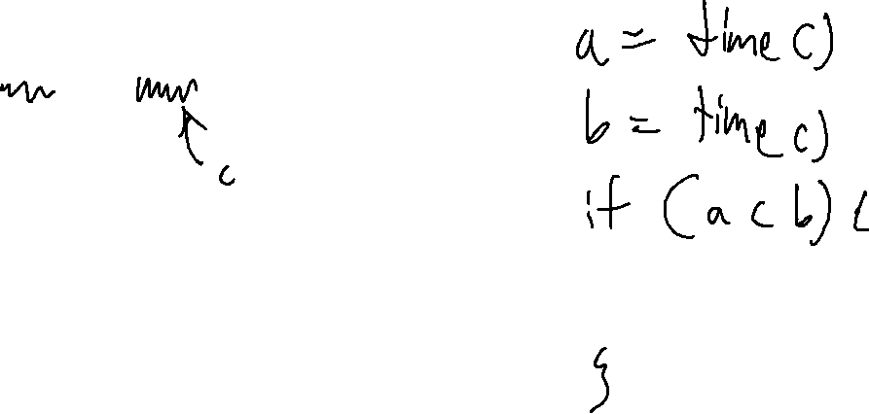
Limitation: Environment input
Symbolic Execution
1. int main(){
2. int c = getchar();
3. c = ioctl(0x92);
4. return 4;
5. }

Slide 25
Summary
Symbolic execution
A simple, elegant idea

Slide 26
Next Time
Concolic Execution
An extension to symbolic execution
Give up on completeness AND soundness to increase practical coverage

Slide 27
Previously: Fuzzing
Outline / Overview
Generating Random test cases
Surprisingly effective in practice
Main challenge is exploring “new” behavior
The random “fuzz” of white noise

Slide 28
This Lecture: Symbolic Execution
Outline / Overview
A methodical approach to “abstract” execution

Slide 29
Recall: Test case generation
Symbolic Execution

Slide 30
The problem of coverage
Symbolic Execution

Slide 31
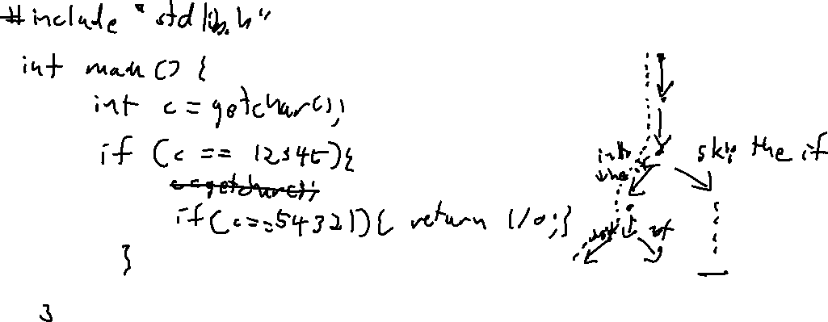
Predicates get in the way!
Symbolic Execution

Slide 32
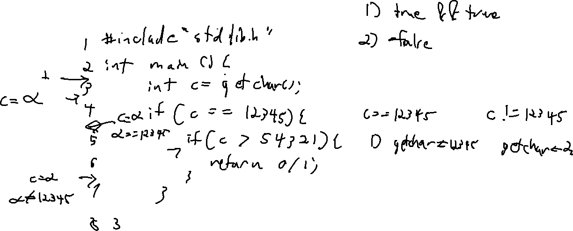
Eliminating Infeasible Paths
Symbolic Execution

Slide 33
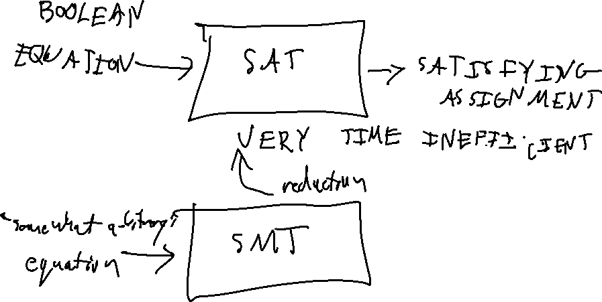
The magic of the solver
Symbolic Execution

Slide 34
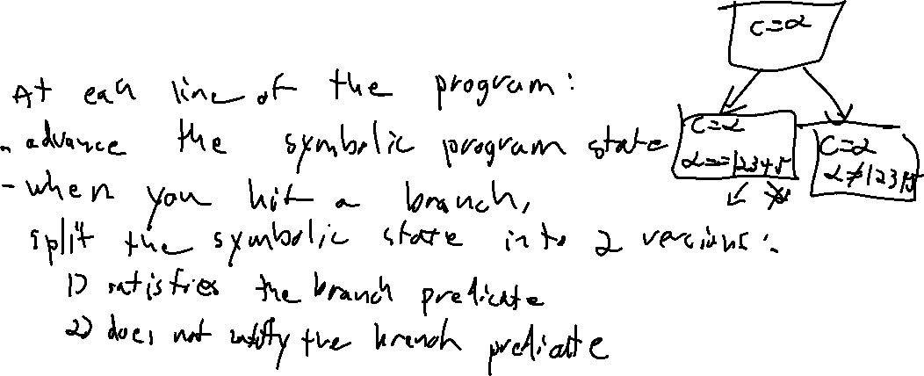
The symbolic execution Tree
Symbolic Execution

Slide 35
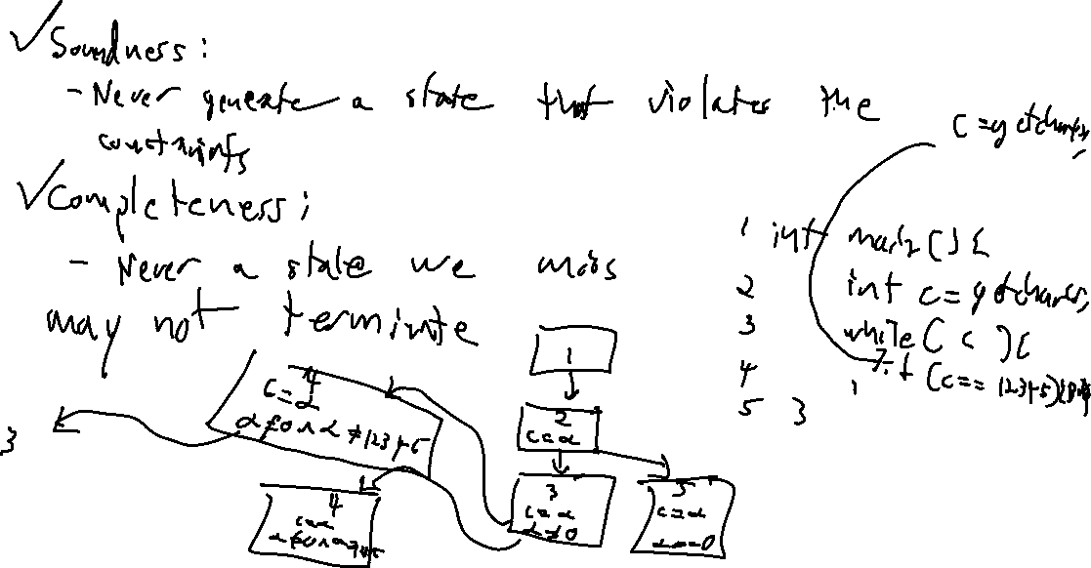
Soundness / Completeness
Symbolic Execution

Slide 36
Wrap-up
Symbolic execution
A simple, elegant idea

