Slide 1
ExerCise #12
Lattices Review
Write your name and answer the following on a piece of paper
Recall that the set of English words, ranked by substring inclusion, forms a poset but NOT a lattice. Explain why and give an example
Reflexive: every word includes the substring of itself
Anti-symmetric: if two words include substrings of each other, they must be the same word
Transitive: if a is a substring b, and b is a substring of c, then a is a substring of c
Not a lattice: consider the English words a and he. They have no greatest lower bound

Slide 2
Administrivia and Announcements

Slide 3
Abstract Interpretation
EECS 677: Software Security Evaluation
Drew Davidson

Slide 4
Last Time: Sharpening Analysis
Review: Lattices
We sharpened the precision of our Dataflow
Allow different facts along different CFG edges
Enrich our facts with a “no information” value
Dataflow
still relied on saturation for termination
The no-info
initializer
Moreover, required saturation to get a complete bug report
Raised the stakes on analysis termination
Cutting through imprecision

Slide 5
Last Time: Staring into the Abyss
Review: Lattices
How can we guarantee our analysis terminates?!?!?!
It’s a tricky thing to do in a Turing-complete model of computation, after all!
The halting
problem
Algorithmic “security blanket”
Intuition: add some constraints to the fact “datatype”
Ensure that there is a “biggest” fact value
Ensure that every step makes “appreciable progress” towards biggest value
Algorithmic
constraint
That’s a yikes!

Slide 6
Last Time: Staring into the Abyss
Review: Lattices
How can we guarantee our analysis terminates?!?!?!
It’s a tricky thing to do in a Turing-complete model of computation, after all!
The halting
problem
Algorithmic “security blanket”
Intuition: add some constraints to the fact “datatype”
Ensure that there is a “biggest” fact value
Ensure that every step makes “appreciable progress” towards biggest value
Algorithmic
constraint
That’s a yikes!

Slide 7
A formal Solution
Review: Lattices
How can we guarantee our analysis terminates?!?!?!
It’s a tricky thing to do in a Turing-complete model of computation, after all!
The halting
problem
Algorithmic “security blanket”
Intuition: add some constraints to the fact “datatype”
Ensure that there is a “biggest” fact value
Ensure that every step makes “appreciable progress” towards biggest value
Algorithmic
constraint
That’s a yikes!

Slide 8
A formal Solution
Review: Lattices
Algorithmic “security blanket”
Intuition: add some constraints to the fact “datatype”
Ensure that there is a “biggest” fact value
Ensure that every step makes “appreciable progress” towards biggest value
Algorithmic
constraint
Formal(ish) properties to meet this intuition
A fact datatype (ideally of unbounded size)
An ordering that indicates progress
A guarantee of a finite number of steps to hit the maximum value
Last time:
Maybe
lattices?
An algorithm that never loses progress
It’s a lattice!

Slide 9
Lecture Outline
Dataflow frameworks
Abstract Interpretation

Slide 10
The Promise of Dataflow
Dataflow Frameworks
Dataflow analysis showed some real potential!
Relatively straightforward computation: grind away at the dataflow fact stored at each basic block boundary
In our examples, output was always…
Complete behavioral over-approximation -> no behaviors missed
Relatively precise -> few “false positive” behaviors
Saturated -> terminated
We’d like some stronger guarantees
Algorithm needs
Guaranteed termination
Amenable to chaotic iteration
Some degree of precision

Slide 11
Dataflow Formalism job search
Dataflow Frameworks
Dataflow analysis showed some real potential!
Relatively straightforward computation: update the dataflow fact stored at each basic block boundary until saturation
In our examples, output was always…
Complete behavioral over-approximation -> no behaviors missed
Relatively precise -> few “false positive” behaviors
Saturated -> terminated
We’d like some stronger guarantees
Algorithm needs
Guaranteed termination
Amenable to chaotic iteration
Some degree of precision

Slide 12
Dataflow Formalism job search
Dataflow Frameworks
Algorithm needs
Guaranteed termination
Amenable to chaotic iteration
Some degree of precision
Formal(ish) requirements
A fact datatype (ideally of unbounded size)
Property
of the fact
datatype
An ordering that indicates progress
Unique solution
A guarantee of a finite number of steps to hit the maximum value
Property
of the update
function
An update step that never loses progress

Slide 13
Fact datatype NEEDs
Dataflow Frameworks
Formal(ish) requirements
poset
A fact datatype (ideally of unbounded size)
An ordering that indicates progress
Unique solution
A guarantee of a finite number of steps to hit the maximum value
An update step that never loses progress
Try-outs
poset
Lattice
Complete lattice

Slide 14
Fact datatype NEEDs
Dataflow Frameworks
Formal(ish) requirements
Lattice
A fact datatype (ideally of unbounded size)
Poset with a least upper bound and a greatest lower bound
An ordering that indicates progress
Unique solution
A guarantee of a finite number of steps to hit the maximum value
An update step that never loses progress
Try-outs
poset
Lattice
Complete lattice

Slide 15
Fact datatype NEEDs
Dataflow Frameworks
Formal(ish) requirements
Complete lattice
A fact datatype (ideally of unbounded size)
Lattice with a least upper bound and greatest lower bound for all subsets of the set
An ordering that indicates progress
Unique solution
A guarantee of a finite number of steps to hit the maximum value
An update step that never loses progress
Try-outs
poset
Lattice
Complete lattice

Slide 16
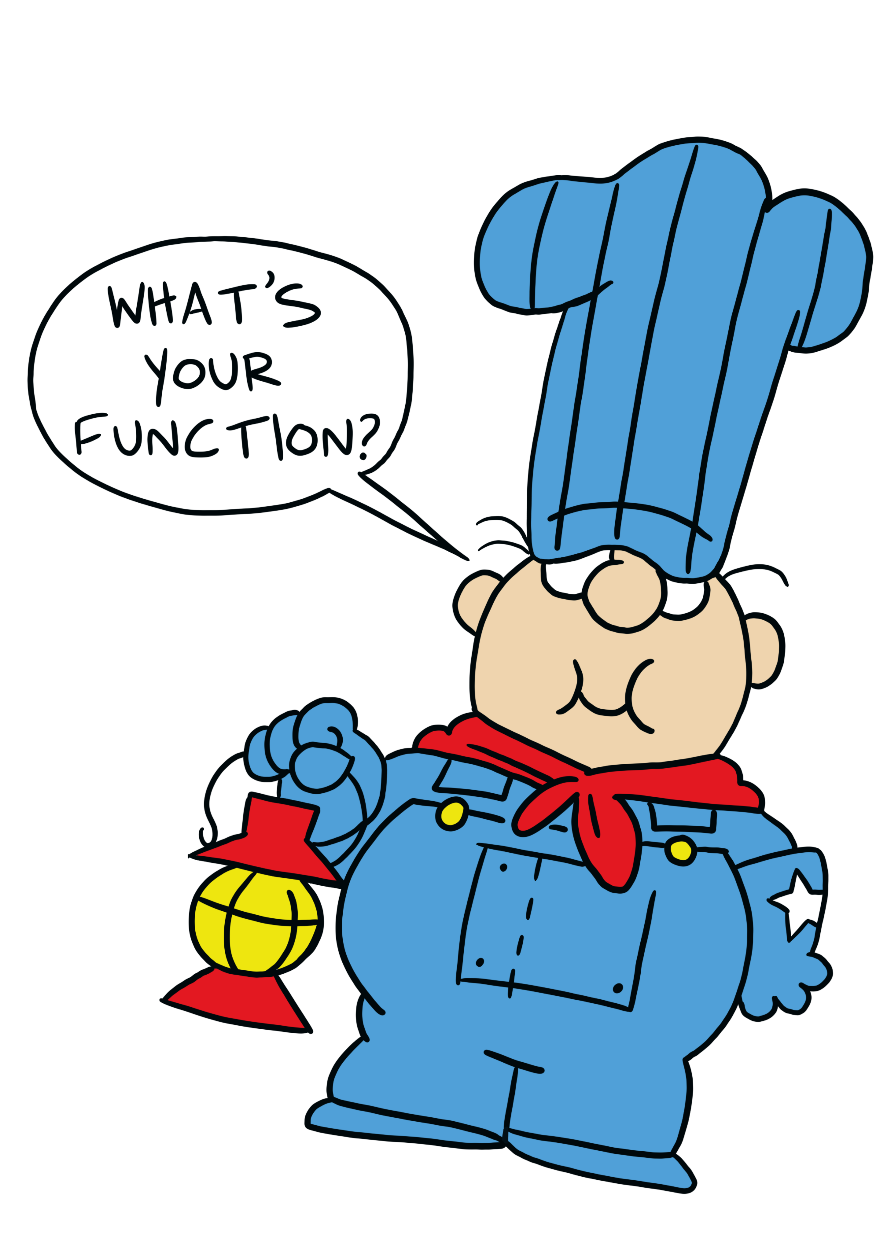
Function NEEDs
Dataflow Frameworks
Some Basic Definitions
A function f is a monotonic function if x $⊆$ y implies f(x) $⊆$ f(y)
An element z is a fixpoint of f iff z = f(z)

Slide 17
Function NEEDs
Dataflow Frameworks
Example
$$f\left(x\right)=x ∪\{ b \}$$
Some Basic Definitions
$\{b\}$ is a fixpoint of f
$$f\left(\{b\}\right)=\{ b \}$$
A function f is a monotonic function if x $⊆$ y implies f(x) $⊆$ f(y)
$$f\left(\{a\}\right)=\{ a, b \}$$
$\{a\}$ is not a fixpoint of f
$$f\left(\{a,b\}\right)=\{ a,b \}$$
$\{a,b\}$ is a fixpoint of f
An element z is a fixpoint of f iff z = f(z)
$f(f\left(\left\{a\right\}\right))$ is a fixpoint of f
$f(f\left(any set\right))$ is a fixpoint of f

Slide 18
Why Does this Matter?
Dataflow Frameworks
Every finite lattice
is a complete lattice
Practical Upshot
If L is a complete lattice and f is monotonic, then f has a greatest fixpoint and a least fixpoint
If L has no infinite ascending chains, the least fixpoint can be computed by iterative application of f
So the analysis will terminate

Slide 19
Why Does this Matter?
Dataflow Frameworks
Making the Theory Work for Us
A complete lattice with no infinite chains can be solved via iteration
Catches
Sometimes our domain DOESN’T have these properties
Sometimes the iteration is too lengthy

Slide 20
Lecture Outline
Dataflow frameworks
Abstract Interpretation

Slide 21
Analysis Precision
Abstract Interpretation
Precision / Efficiency Tradeoff
With a complete lattice we can, in theory, eventually terminate
The shallower the lattice, the faster the fixpoint
That’s not a very strong guarantee!
Choose to approximate the lattice

Slide 22
Analysis Precision
Abstract Interpretation
Precision / Efficiency Tradeoff
With a complete lattice we can, in theory, eventually terminate
The shallower the lattice, the faster the fixpoint
That’s not a very strong guarantee!
Choose to approximate the lattice

Slide 23
Let’s Consider A Very Approximate Lattice
Abstract Interpretation
Abstract Domain of Signs
{-2, -1, 0, 1}
num
{-2, 0, 1}
{-2, -1, 0}
{-1, 0, 1}
{-2, -1, 1}
pos
zero
neg
{-2, -1}
{-2, 0}
{-1, 0}
{-2, 1}
{-1, 1}
{0, 1}
$$∅$$
{-2}
{-1}
{0}
{1}

Slide 24
Let’s Consider A Very Approximate Lattice
Abstract Interpretation
Abstract Domain of Signs
{-2, -1, 0, 1}
num
{-2, 0, 1}
{-2, -1, 0}
{-1, 0, 1}
{-2, -1, 1}
≥ zero
≤ zero
pos
zero
neg
{-2, -1}
{-2, 0}
{-1, 0}
{-2, 1}
{-1, 1}
{0, 1}
$$∅$$
{-2}
{-1}
{0}
{1}

Slide 25
Analysis Precision
Abstract Interpretation
1. int x = 0;
2. int y = 0;
3. while (INPUT){
true
1. int x = 0;
2. int y = 0;
3. while (INPUT){
4. if (x > 0)
5. if (x < 0)
6. y = y / 0;
7. x++;
}
return;
4. if (x > 0){
true
5. if (x < 0){
false
false
true
false
6. y = y / 0;
7. x++
8. }
9. return;

Slide 26
Analysis Precision
Abstract Interpretation
1. int x = 0;
2. int y = 0;
3. while (INPUT){
true
1. int x = 0;
2. int y = 0;
3. while (INPUT){
4. if (x > 0)
5. if (x < 0)
6. y = y / 0;
7. x++;
}
return;
4. if (x > 0){
true
5. if (x < 0){
false
false
true
false
6. y = y / 0;
7. x++
8. }
9. return;

Slide 27
The Abstraction Function
Abstract Interpretation
From the Concrete Domain to the Abstract
α({0}) = | zero
α(S) = | if all values in S are greater than 0 then pos
 | else if all values in S are less than 0 then neg
 | else num

Slide 28
The Abstraction Function
Abstract Interpretation
{-2, -1, 0, 1}
num
{-2, 0, 1}
{-2, -1, 0}
{-1, 0, 1}
{-2, -1, 1}
pos
zero
neg
{-2, -1}
{-2, 0}
{-1, 0}
{-2, 1}
{-1, 1}
{0, 1}
$$∅$$
{-2}
{-1}
{0}
{1}

Slide 29
The ConCretization Function
Abstract Interpretation
From the Abstract Domain to the Concrete
γ(zero) = {0}
γ(pos) = {all positive ints}
γ(neg) = {all negative ints}
γ(num) = Int (i.e., all ints)

Slide 30
The ConCretization Function
Abstract Interpretation
{-2, -1, 0, 1}
num
{-2, 0, 1}
{-2, -1, 0}
{-1, 0, 1}
{-2, -1, 1}
pos
zero
neg
{-2, -1}
{-2, 0}
{-1, 0}
{-2, 1}
{-1, 1}
{0, 1}
$$∅$$
{-2}
{-1}
{0}
{1}

Slide 31
A Detour into formalization
Abstract Interpretation

Slide 32
Galois Connection
Abstract Interpretation
A Galois connection is a pair of functions, α and γ between two partially ordered sets (C, ⊆) and (A, ≤), such that both of the following hold.
∀ a ∈ A, c ∈ C: α(c) ≤ a iff c ⊆ γ(a)
∀ a ∈ A: α(γ(a)) ≤ a

Slide 33
End Formalization Detour
Abstract Interpretation

Slide 34
Abstract Domains in Practice
Static Analysis
Intervals
Property Existence
“Singleton Integer Sets”
You know the number, or you don’t
You know a concrete range
A property does or does not hold

Slide 35
Section Summary
Static Analysis
Static Analysis gives us an important guarantee
Anything that isn’t crystal clear to a static analysis tool probably isn’t clear to your fellow programmers, either. The classic hacker disdain for “bondage and discipline languages” is short-sighted – the needs of large, long-lived, multi-programmer projects are just different than the quick work you do for yourself.
- John Carmack's Static Code Analysis post
Completeness of bug finding / Soundness of verification
Thus far we’ve been using source code

Slide 36
Section Summary
Static Analysis
Static Analysis gives us an important guarantee
Anything that isn’t crystal clear to a static analysis tool probably isn’t clear to your fellow programmers, either. The classic hacker disdain for “bondage and discipline languages” is short-sighted – the needs of large, long-lived, multi-programmer projects are just different than the quick work you do for yourself.
- John Carmack's Static Code Analysis post
Completeness of bug finding / Soundness of verification
Thus far we’ve been using source code

