Slide 1
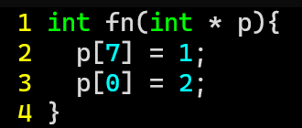
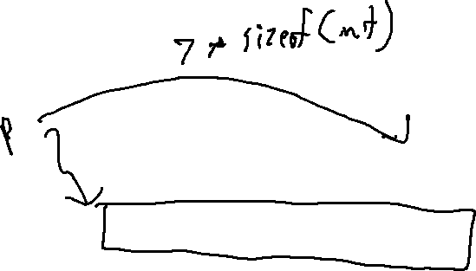
ExerCise #6
LLVM Calls Review
Write the code corresponding to this function:

Slide 2
ExerCise #6: Solution
LLVM Calls Review

Slide 3
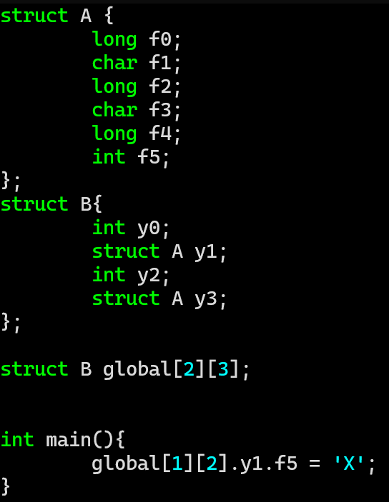
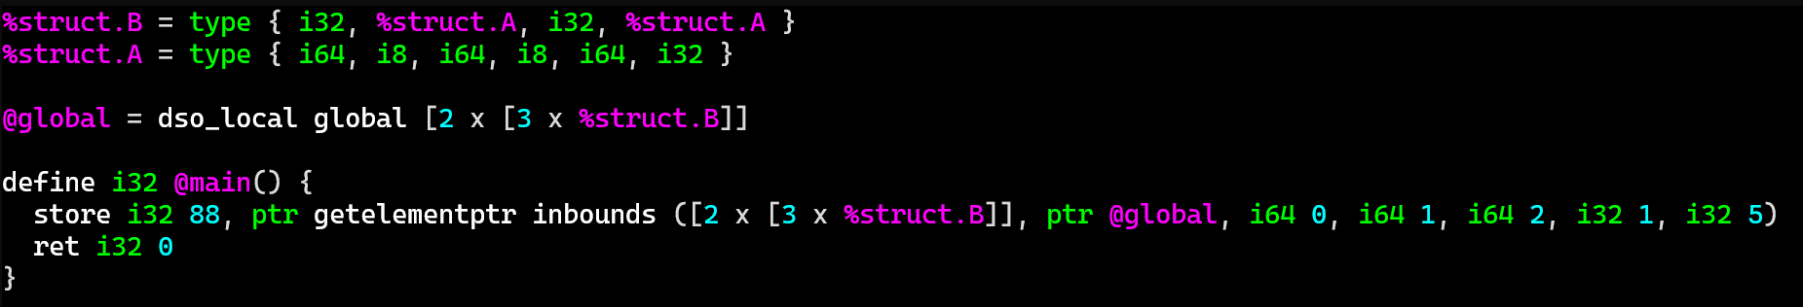
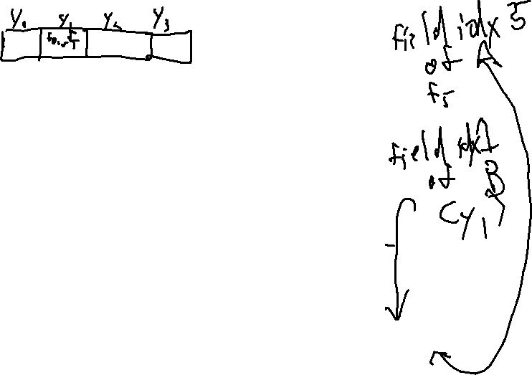
Bonus GEP Exercise
LLVM Calls Review
Write the code corresponding to the assignment statement

Slide 4
Computability
EECS 677: Software Security Evaluation
Drew Davidson

Slide 5
Administrivia and
Announcements

Slide 6
Today’s Roadmap
Decidability
The Halting Problem
Type I/Type II Errors
Soundness / Completeness

Slide 7


Averting Disaster
Decidability
Software Security is all about avoidance
Avert a flaw before it is exploited
Squash a bug before it bites

Slide 8

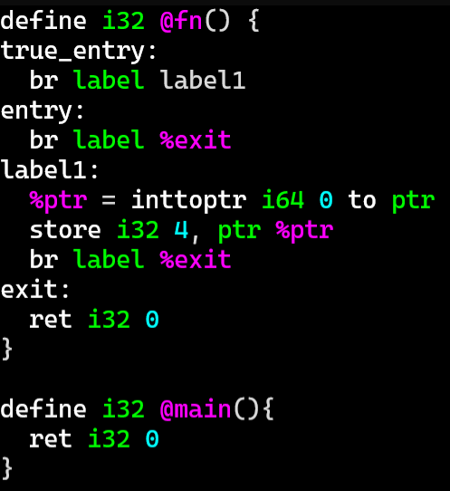
Averting Disaster
Decidability
How do we know a disaster is imminent?
Is this code “disastrous”?

Slide 9
Averting Disaster
Decidability
How do we know a disaster is imminent?
Is this code “disastrous”?

Slide 10
Averting Disaster
Decidability
How do we know a disaster is imminent?
Is this code “disastrous”?

Slide 11
Averting Disaster
Decidability
How do we know a disaster is imminent?
Is this code “disastrous”?

Slide 12

Theoretical Limits OF Computation
Decidability
Computability theory
The study of what is computable
Focused on abstractions for the sake of generalizability
  Considers theoretical hardware, for example

Slide 13

Vibe Check
Decidability
Does everyone remember why we are doing this?
We want to determine the power of our analysis target
We want to determine the power of our analysis engine
Good news! Both are bounded by Turing computability
Next up: abstracting analysis itself

Slide 14

Church-Turing Thesis
Decidability
Roughly: a function on the natural numbers can be calculated if and only if it is computable by a Turing machine
Practical Upshot: Turing machines are powerful!
Turing
Machine

Slide 15
Decision PROCEDURES
Decidability
A little vocabulary:
A decision problem is a computational question that can be solved with either a yes or a no. Frequently, we consider decision problems as detection of a property in a program
A decision procedure is a method for solving a decision problem that always yields the correct answer
If there is no decision procedure for a given decision problem, that decision problem is called undecidable

Slide 16
Program Analysis as Decision PROCEDURE
Decidability
Since a program is just a list of instructions, it is valid input to a decision procedure
Analysis Target
(arbitrary program)
Analysis Engine
(property detector program)
Yes
(property present)
No
(property is not present)

Slide 17


Strong Guarantees
Decidability
A decision procedure is a high bar
Guarantee that:
The analysis engine accepts every program
The analysis engine always returns an answer
The answer returned is always correct
Analysis Target
(arbitrary program)
Analysis Engine
(property detector program)
Rice’s Theorem
Yes
(property present)
No
(property is not present)

Slide 18
Today’s Roadmap
Decidability
The Halting Problem
Type I/Type II Errors
Soundness / Completeness

Slide 19

Stating The Problem
The Halting Problem
Given a description of a Turing machine and its initial input, determine whether the program, when executed on this input, ever halts (completes). The alternative is that it runs forever without halting

Slide 20
A Halting Detector
The Halting Problem
Analysis Target
+ Input
(arbitrary program)
Given a description of a Turing machine and its initial input, determine whether the program, when executed on this input, ever halts (completes). The alternative is that it runs forever without halting
Halting Detector
Is there a decision procedure for the halting problem?
We’ll sketch the proof outline that there is NOT
Relies on a proof by contradiction
Yes
(target halts)
No
(target spins)

Slide 21
Proof By Contradiction
The Halting Problem
Reductio ad absurdum – Assuming the premise has obviously incorrect consequences
Here: assume there is a halting detector
Assumption
Black_magic
Halting Detector
Black_magic
black_magic(){
if (halts(black_magic){
while(true){} //Spin
}
//Halt
}
Halting Detector
Yes
(target halts)
No
(target spins)
black_magic halts
Black_magic spins
halts(ANY ARBITRARY PROGRAM)
spin
halt

Slide 22
Who Cares?
The Halting Problem
No halting decision procedure means no reachability decision procedure
1. int main(){
2. if (my_function()){
3. int * a = nullptr;
4. *a = 1;
5. }
6. }
This program crashes if and only if it reaches line 4,
which depends on the result of a function call being
true
black_magic()

Slide 23
Rice’s Theorem
The Halting Problem
No halting decision procedure means no reachability decision procedure
1. int main(){
2. if (my_function()){
3. int * a = nullptr;
4. *a = 1;
5. }
6. }
Exhibits the behavior you care about
This program crashes if and only if it reaches line 4,
which depends on the result of a function call being
true
black_magic()
behavior you care about

Slide 24


Rice’s Theorem
The Halting Problem
“All non-trivial semantic properties of programs are undecidable”

Slide 25
Limitations of Rice’S Theorem
The Halting Problem
Rice’s Theorem is less catastrophic than you might expect for security:
A decision procedure is a pretty high bar
A Turing machine is actually not a perfect approximation of the computers we use!
Despite these limitations, it is widely accepted that program analysis is always approximate
We can’t be right all of the time
We can choose what types of errors we make

Slide 26
Today’s Roadmap
Decidability
The Halting Problem
Categorizing Program Analyses
Soundness / Completeness

Slide 27

Classifying Detectors
Categorizing Program Analyses
Abstractly: an analysis is a system to detect a phenomenon
A hand detector: when hand detected, emit soap

Slide 28


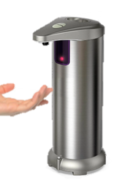
Classifying Detectors
Categorizing Program Analyses
TRUE
False
correct
wrong
POSITIVE
“alert”
NEGATIVE
“Not here”

Slide 29
Types of Analysis
Categorizing Program Analyses
In order to determine the properties of a given program analysis, let’s frame it as a detector
Analysis Target
(arbitrary program)
Note: we can detect bad
behavior or good behavior
Analysis Engine
(property detector program)
Yes
(property present)
No
(property is not present)

Slide 30
Classifying Errors
Categorizing Program Analyses
True
False
Analysis is correct
Analysis is wrong
Analysis Target
(arbitrary program)
Has report
Has report
Has bug
No bug
Positive
report
bug
Correct
Type I
Error
Analysis Engine
(bug detector)
No report
No report
Negative
No bug
Has bug
No bug
report
Correct
Type II
Error
Yes
(buggy)
No
(property is not present)

Slide 31
Today’s Roadmap
Decidability
The Halting Problem
Categorizing Program Analyses
Soundness / Completeness

Slide 32
Guarantees of Imperfect Analyses
Soundness / Completeness
Consistency / Reliability super important for users
We’d like to limit the kinds of errors we report
We can choose which type of bug report error to avoid
Soundness: No false positives
Completeness: No false negatives

Slide 33
Visual Analogy
Soundness / Completeness
Reported
bugs
Imagine the universe of all programs is contained in a circle
You can draw a circle around the programs you report as buggy
The actual buggy programs occupy a jagged region
All Programs
Buggy programs

Slide 34
Visual Analogy
Soundness / Completeness
Reported
bugs
Reported
bugs
All Programs
All Programs
Buggy programs
False
Positive
Buggy programs
False
Negative
Sound bug detection
Complete bug detection
All correct programs pass through
(No false positive problem)
All buggy programs get flagged
(No false negative problem)
Some buggy programs pass through
(has false negative problem)
Some correct programs get flagged
(has false positive problem)

Slide 35
Trivial Soundness
Categorizing Program Analyses
Reported
bugs
All Programs
Analysis Target
(arbitrary program)
Buggy programs
Analysis Engine
(bug detector)
False
Negative
No
(property is not present)
Sound bug detection
All correct programs pass through
(No false positive problem)
Some buggy programs pass through
(has false negative problem)

Slide 36
Trivial Completeness
Categorizing Program Analyses
Reported
bugs
Analysis Target
(arbitrary program)
All Programs
False
Positive
Buggy programs
Analysis Engine
(bug detector)
Yes
(buggy)
Complete bug detection
All buggy programs get flagged
(No false negative problem)
Some correct programs get flagged
(has false positive problem)

Slide 37
Beyond All-or-Nothing
Soundness / Completeness
As you can imagine, soundness and completeness are not the full story
Guarantees are nice, but we want legitimately useful analyses!
Many practical analyses are neither sound nor complete

Slide 38

Analysis Method vs Errors
SoundNess / Completeness
It’s natural to consider the types of compromises of each analysis method
Static analysis
  Often builds a model of the program, makes inferences on that model
  Tends to make completeness easier
  Scalability concerns for large programs
Dynamic analysis
  Often performs the analysis by straight up running the program, observing behavior
  Tends to make soundness easier
  Coverage problems

Slide 39
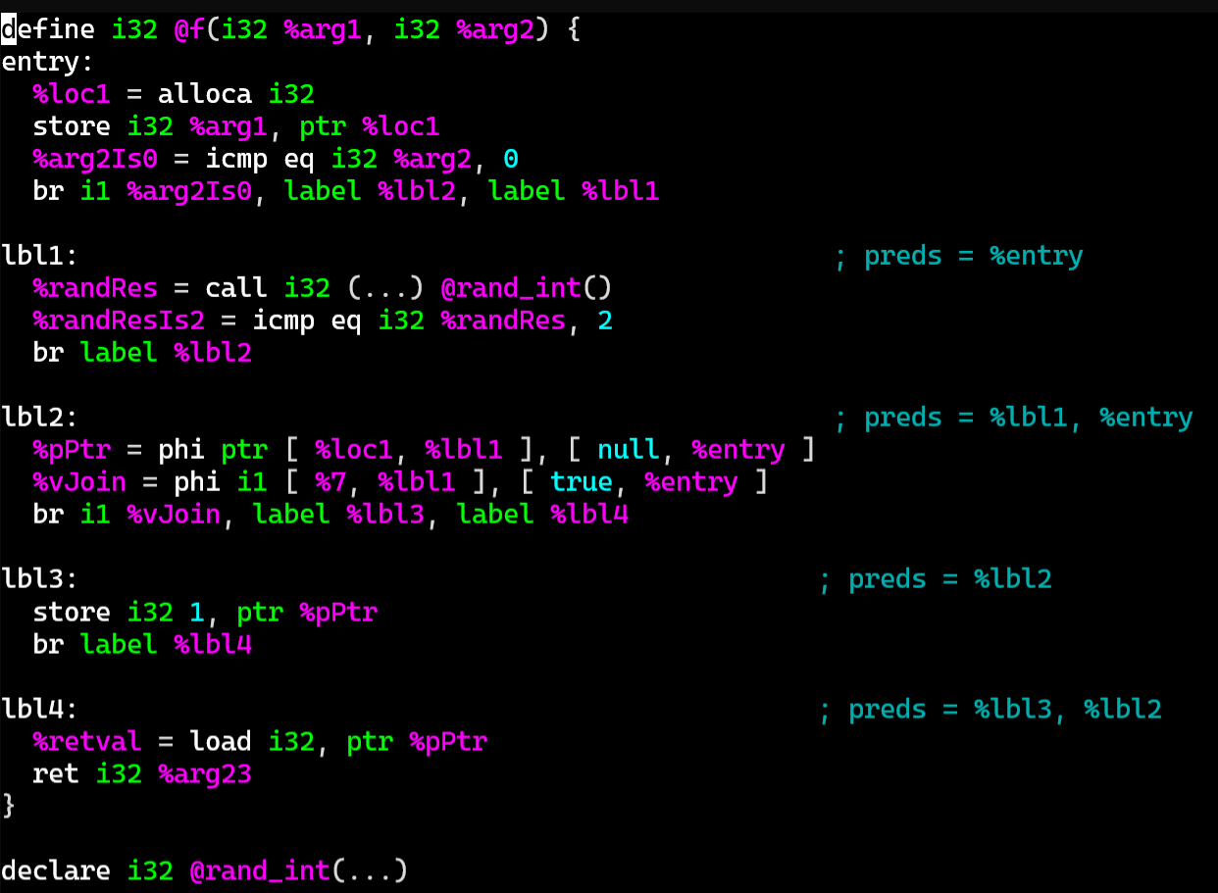
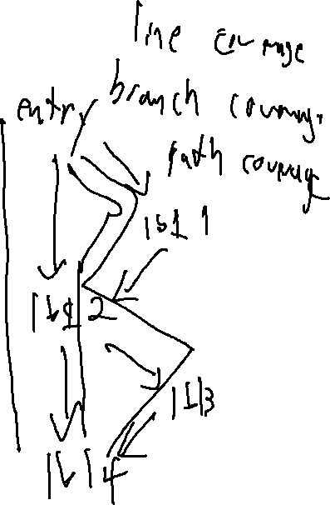
About Coverage
SoundNess / Completeness
int f(bool b) {
Obj * o = null;
int v = 2;
if (b) {
o = new Obj ();
v = rand_int();
}
if (v == 2){
o->setInvalid()
}
return o->property();
}
Line coverage
Branch coverage
Path coverage

Slide 40
Lecture END
Summary:
Decidability
Computational Theory
Categorizing analysis

Slide 44

The Limits of Computation
Decidability
Computers! What can’t they do?!
As we begin our exploration of security evaluation, we care about this question for two reasons:
  We need to know the capabilities of our analysis target
  We need to know the capabilities of our analysis engine

Slide 45

COMPUTATIONAL POWER
Decidability
What is a program?
A set of executable instructions

Slide 46




COMPUTATIONAL POWER
Decidability
What is a program?
A set of executable instructions
There are many formats for programs
i.e. programming languages
It would be nice to generalize what these programs can compute (without getting bogged down in syntax)

Slide 47
Abstracting Computation
Decidability
Computability theory considers classes of expressiveness
Combinational logic
Finite-state machines
Pushdown automata
Turing machines

