Slide 1
Exercise 25
Reference Monitors Review
Write your name and answer the following on a piece of paper
Give an example of a safety property that a reference monitor might enforce. How would an inline reference monitor work to enforce that safety property?

Slide 2
Exercise 25 Solution
Reference Monitors Review
Write your name and answer the following on a piece of paper
Give an example of a safety property that a reference monitor might enforce. How would an inline reference monitor work to enforce that safety property?

Slide 3
Control-Flow Integrity
EECS 677/777: Software Security Evaluation
Drew Davidson

Slide 4
Last Time: Reference Monitors
Review: Last Lecture
Enforce Safety Properties
Disallow a bad event from happening
Enforce Mechanisms
IRM
Wrapper RM
Kernel RM

Slide 5
Lecture Outline
Motivation
Implementation considerations
Practical manifestations

Slide 6
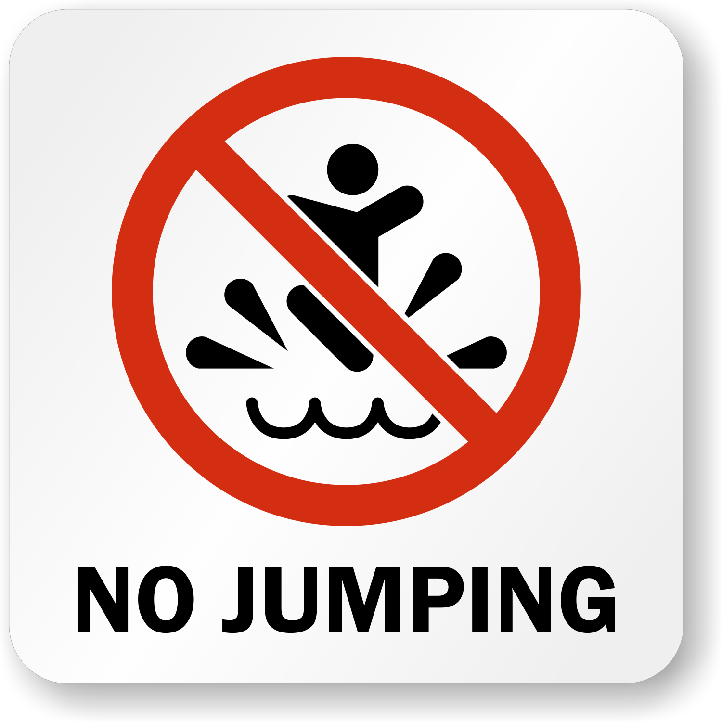
Re-engaging an Old Foe…
motivation
Jumping where you shouldn’t
This certainly includes ROP
Might also involve other attacks

Slide 7
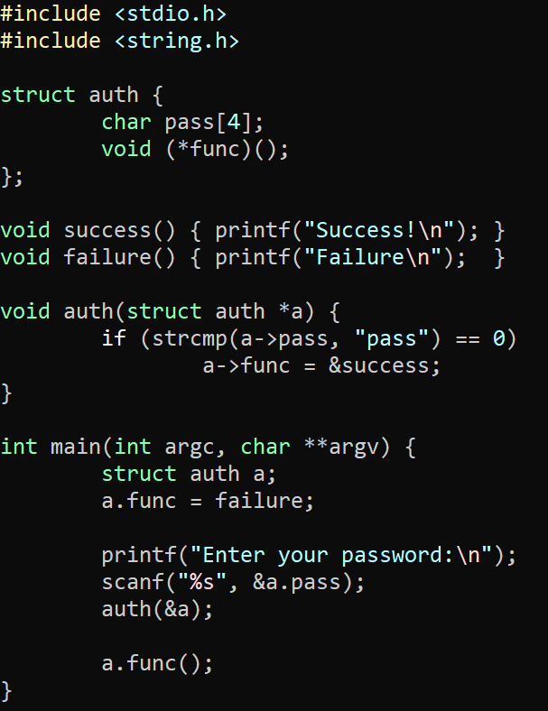
Re-engaging an Old Foe…
motivation
Jumping where you shouldn’t
This certainly includes ROP
Might also involve other attacks
Look, no ret overwrite!

Slide 8
Lecture Outline
Motivation
Implementation considerations
Practical manifestations

Slide 9
Key Idea
Keep the control flow “On Rails”

Slide 10
How to Implement?
Implementation Considerations
Naïve Approach:
Encode the entire CFG into the program text
Issues:
Dynamic: overhead
Static: precision

Slide 11
Lecture Outline
Motivation
Implementation considerations
Practical manifestations

Slide 12
Intel CET
Practical Manifestations
Control-Flow Enhancement Technology
Requires recompilation of software to support
Requires hardware support (!)
Scope
1) Prevent ret overwriting with a shadow stack

Slide 13
Intel CET
Practical Manifestations
Control-Flow Enhancement Technology
Requires recompilation of software to support
Requires hardware support (!)
Scope
1) Prevent ret overwriting with a shadow stack
2) Prevent indirect jumps into gadgets

Slide 14
Intel CET
Practical Manifestations
CET Hardware changes
Altered semantics of the CALL and JMP
Moves a processor state machine into the WAIT_FOR_ENDBRANCH state
In WAIT_FOR_ENDBRANCH, next instruction must be the ENDBRANCH instruction
Added a new instruction at control-transfer targets
The new ENDBRANCH instruction
Backwards compatible

Slide 15
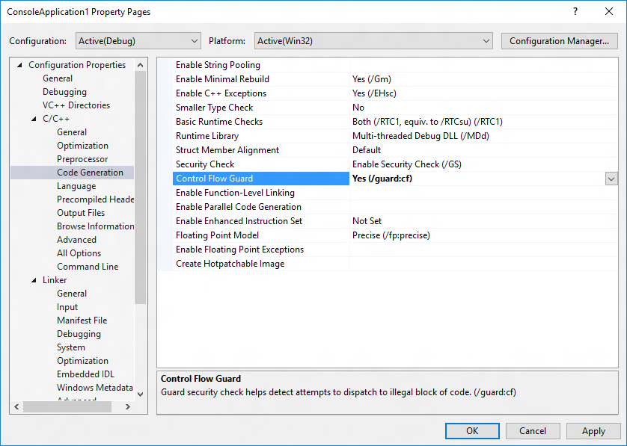
Microsoft Control Flow Guard
Practical Manifestations

Slide 16
Historical Detour
Practical Manifestations: MS Control-Flow Guard

Slide 17
Historical Detour
Practical Manifestations: MS Control-Flow Guard
Recall from last time…
ROP attacks considered harmful
How industry responded
MS CFG as a case study in a lot of interesting aspects of software security

Slide 18
Historical Detour
Practical Manifestations: MS Control-Flow Guard
Source: https://github.com/Microsoft/MSRC-Security-Research/blob/master/presentations/
2018_02_OffensiveCon/The%20Evolution%20of%20CFI%20Attacks%20and%20Defenses.pdf

Slide 20
Historical Detour
Practical Manifestations: MS Control-Flow Guard
This is an interesting talk!
I’d recommend you watch it: https://www.youtube.com/watch?v=oOqpl-2rMTw
It comes with the historical burden of Control Flow guard
Widely-publicized issue that allowed it to be avoided

Slide 22
Historical Detour
Practical Manifestations: MS Control-Flow Guard
Control Flow guard has a historical burden
Widely-publicized issue that allowed it to be avoided
We’ll get to the actual workaround, but let’s talk about its impact

Slide 23
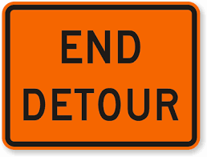
Historical Detour
Practical Manifestations: MS Control-Flow Guard

Slide 24
Control Flow Guard
Practical Manifestations
Details
Precision: call needs to be a valid function entry point
Enforcement: OS verifies indirect control transfer destinations via a table in protected memory
Protections
Protected destinations page in read-only memory
Read-only memory bit can be turned off by attacker ☹

Slide 25
Clang’s CFI
Practical Manifestations
Details
Precision: call needs to match type signature
Enforcement: compiler-inserted checks

Slide 26
Wrap-up

