Slide 1
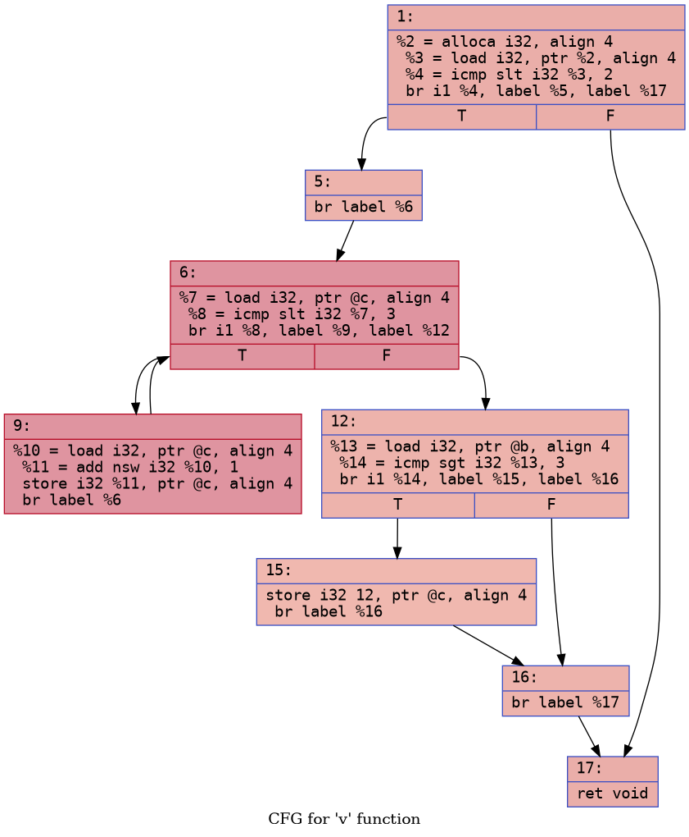
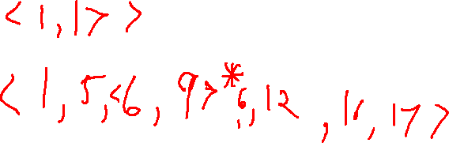
ExerCise #8
Static Analysis Review
Use path notation to indicate one path (or set of paths) through this CFG:

Slide 2
Administrivia and
Announcements

Slide 3
Dataflow Analysis
EECS 677: Software Security Evaluation
Drew Davidson

Slide 4
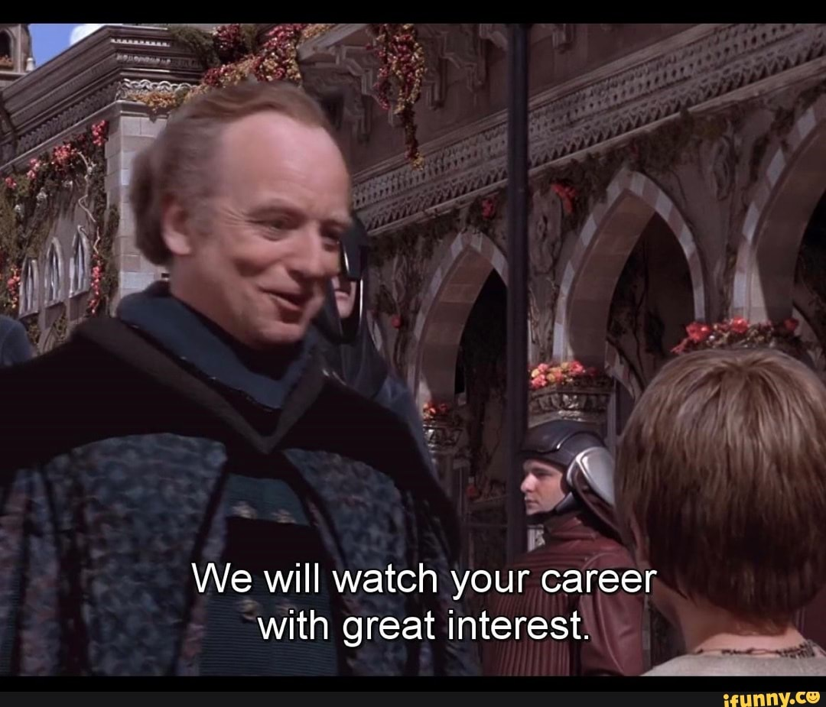
Continue to Explore Static Analysis
Class Progress
Look into concrete forms of Static Analysis
Particularly interested in dataflow analysis for now
Building up the underlying abstractions / techniques to perform such analysis

Slide 5


Last Time: Static Analysis
Review: Static Analysis
True Power of static analysis
Unnecessary to supply a given program input
Summarize the behavior of the program under ANY input
Capture all possible behaviors of a program
Mentioned some static analysis Techniques
Textual Analysis
CFG Analysis

Slide 6
Last Time: Static Analysis
Review: Static Analysis
Mentioned some static analysis Techniques
Textual Analysis
CFG Analysis
auth.c
int main(int argc, char * argv[] ){
return (strcmp(argv[1], “secretpw”);
}
cmdline
$: sudo apt install binutils
$: gcc auth.c –o auth
$: strings auth | less

Slide 7
Last Time: Static Analysis
Review: Static Analysis
Mentioned some static analysis Techniques
output
Textual Analysis
CFG Analysis
/lib64/ld-linux-x86-64.so.2 __libc_start_main __cxa_finalize libc.so.6 GLIBC_2.2.5 GLIBC_2.34 _ITM_deregisterTMCloneTable __gmon_start__ _ITM_registerTMCloneTable PTE1 u+UH secretpw 9*3$" GCC: (Ubuntu 13.2.0-23ubuntu4) 13.2.0 Scrt1.o
…
auth.c
int main(int argc, char * argv[] ){
return (strcmp(argv[1], “secretpw”);
}
cmdline
$: sudo apt install binutils
$: gcc auth.c –o auth
$: strings auth | less

Slide 8
Last Time: Static Analysis
Review: Static Analysis
Mentioned some static analysis Techniques
Textual Analysis
CFG Analysis
Simplistic Idea: identify isolated issues, refine FPs by CFG reachability
Build the CFG
Test if the isolated issue is reachable in the CF
Problems
A path might be infeasible even if there are edges in the CFG
Issues might not be isolated
Elaborate Idea: check every path in the program one-by-one
Build the CFG
Explore each path through the program

Slide 9
Last Time: Static Analysis
Review: Static Analysis
Mentioned some static analysis Techniques
Elaborate Idea: check every path in the program one-by-one
Build the CFG
Explore each path through the program
Textual Analysis
CFG Analysis

Slide 10

Last Time: Static Analysis
Review: Static Analysis
Mentioned some static analysis Techniques
Elaborate Idea: check every path in the program one-by-one
Build the CFG
Explore each path through the program
Problems
Too expensive: many paths, maybe an unbounded set!
Many program configurations even on a single path!
Textual Analysis
CFG Analysis

Slide 11
This Time: Addressing These problems
Review: Static Analysis
Mentioned some static analysis Techniques
Elaborate Idea: check every path in the program one-by-one
Build the CFG
Explore each path through the program
Problems
Too expensive: many paths, maybe an unbounded set!
Many program configurations even on a single path!
Textual Analysis
CFG Analysis

Slide 12
This Time: Addressing These problems
Review: Static Analysis
Elaborate Idea: check every path in the program one-by-one
Build the CFG
Explore each path through the program
Problems
Too expensive: many paths, maybe an unbounded set!
Many program configurations even on a single path!

Slide 13
Lecture Outline
Abstracting data
Abstracting control

Slide 14

The Art of Abstraction
Class Progress
Enumerating All program configurations is too expensive
The trick is getting an approximation of the program’s behavior that is both…
Complete
Close enough to avoid too many false positives
A complete approximation of program behavior
=
an over-approximation of program behavior

Slide 15
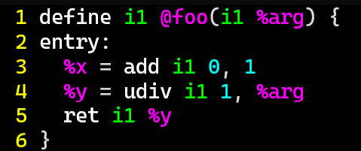
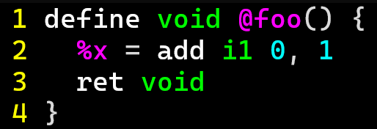
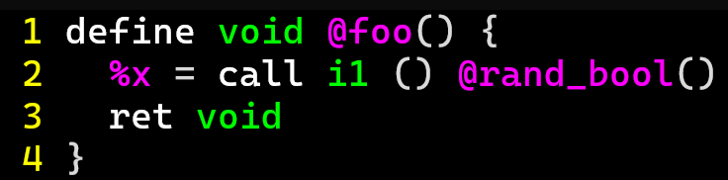
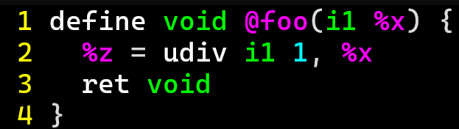
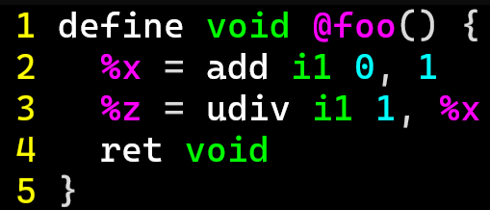
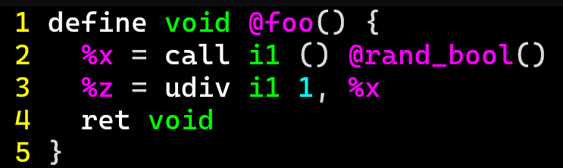
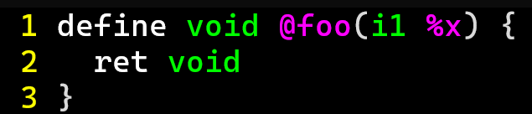
Modelling VALUES
Abstracting Data
Model the values a location MIGHT hold

Slide 16
Modelling Instructions
Abstracting Data

Slide 17
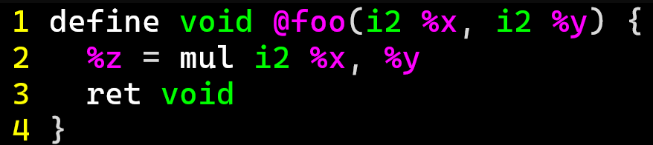


Modelling Instructions
Abstracting Data
mul instruction

Slide 18

dataflow analysis
Class Progress
View instructions as transformers of program state
Several dimensions to tune the state space, we started describing one:
Flow-insensitive analysis
Flow-sensitive analysis
Path-sensitive analysis
Too squishy
Just right
Too hard

Slide 19
Flow-Sensitive Analysis
dataflow Analysis
Consider the order of instructions along ANY Feasible control flow
Glom together results of multiple paths
For now, let’s start simple: analysis within a Basic Block
Known as local analysis

Slide 20
Lecture Outline
Intuition: Flow-sensitive analysis
Local Flow-sensitive analysis
Global Flow-sensitive analysis

Slide 21

Composing Transfer Functions
dataflow Analysis
Statements Compose Naturally with each other (within a Basic Block)
state M
y has the value 1
Stmt₁: x = y ;
For now, we’ll only think about
analysis within a BBL
Stmt₂: z = x ;
state M’
x has the value 1
y has the value 1
z has the value 1

Slide 22



An Early Win
dataflow Analysis
Even with this Very Simple Concept, might be able to detect some issues
state M
y has the value 1
Stmt₁: x = y ;
$$\left\langle y:1\right\rangle , \left\langle x:1\right\rangle$$
Stmt₂: z = 0 ;
$$\left\langle y:1\right\rangle , \left\langle x:1\right\rangle ,\left\langle z:0\right\rangle$$
Stmt₃: p = 1 / z ;
$$CRASH?!$$

Slide 23
Formalizing Transfer Functions
dataflow Analysis
If we want to Build an Automated (Local) Dataflow analysis, we need programmatic Precision
Need a semantics!
Some sort of specification of what a statement does
A statement is a memory state transformer
Representation mapping (large)
set of memory states to each other
Memory state M
Stmt₁: k += 1 ;
Depend somewhat on the analysis
Goals:
Memory state M’
Keep states manageable
Handle the uncertainty inherent in static analysis

Slide 24




Memory As Value SEts
dataflow Analysis
Let each memory Location correspond to a Set of Values it might Contain
We’re still kinda-dodging the
larger semantic questions here,
for now lets just say we’re using a
big ol’ if statement to define an operator
Define (informally) transfer functions as mapping elements of M to elements of M’
Memory state M
$$\left\langle k:\{1\}\right\rangle$$
$$\left\langle k:\{3,4\}\right\rangle$$
Stmt₁: k += 1 ;
Memory state M’
$$\left\langle k:\{2\}\right\rangle$$
$$\left\langle k:\{4,5\}\right\rangle$$

Slide 25




Composing Value SEts
dataflow Analysis
(example: assume a 1-bit data size)
Stmt₀: y = randomBit()
$$\left\langle y:\left\{0,1\right\}\right\rangle$$
Stmt₁: x = y ;
$$\left\langle y:\left\{0,1\right\}, x:\{0, 1\}\right\rangle$$
Stmt₂: z = x ;
$$\left\langle y:\left\{0,1\right\}, x:\left\{0, 1\right\}, z:\{0,1\}\right\rangle$$
Stmt₃: p = 1 / z ;
$$CRASH?!$$

Slide 26
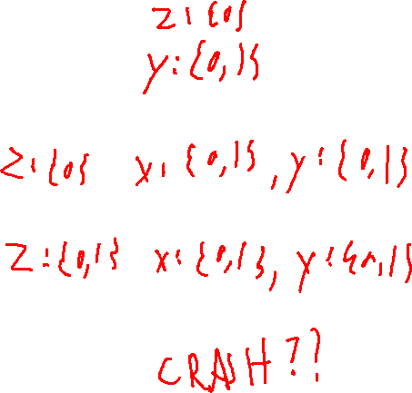
Modelling Uncertainty
dataflow Analysis
We can now handle opaque data somewhat cleanly
Stmt₁: x = y ;
Stmt₁: x = y ;
Stmt₂: z = USER_INPUT ;
Stmt₂: z = global ;
Stmt₃: p = 1 / z ;
Stmt₃: p = 1 / z ;

Slide 27
Lecture Outline
(Local) Dataflow analysis
Global dataflow analysis

Slide 28

Composing Blocks
GLOBAL Dataflow analysis
Value-Set Model of memory implies a method to extend beyond Local Analysis
void f(bool a){
bool b = a;
bool c = a;
if (a){
b = true;
c = true
} else {
b = true;
c = false;
}
return b;
}

Slide 29
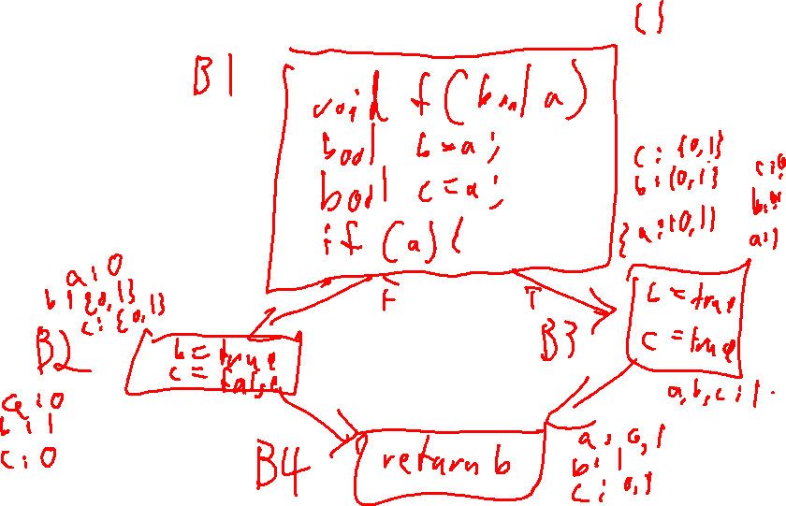
Composing Blocks
GLOBAL Dataflow analysis
Value-Set Model of memory implies a method to extend beyond Local Analysis
void f(bool a){
bool b = a;
bool c = a;
if (a){
b = true;
c = true
} else {
b = true;
c = false;
}
return b;
}

Slide 30
MAY-BE vs MUST-BE Analysis
Global Dataflow Analysis
How we join values is based on the goal of our analysis
void f(bool a){
bool b = a;
bool c = a;
if (a){
b = true;
c = true
} else {
b = true;
c = false;
}
return b;
}

Slide 31
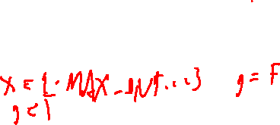
Chaotic Iteration
Global Dataflow Analysis
01. int x = 2;
02. if ( g ){
In what order do we process blocks?
03. x = x – 1;
04. if ( g2 ){
01. int x = 2;
02. if ( g ){
03. x = x - 1;
04. if ( g2 ){
05. x = x – 1;
06. }
07. }
08. return 1 / x;
05. x = x -1;
06. }
07. }
08. return 1 / x;

Slide 32

Trouble on the Horizon
Global Dataflow Analysis
Loops

Slide 33
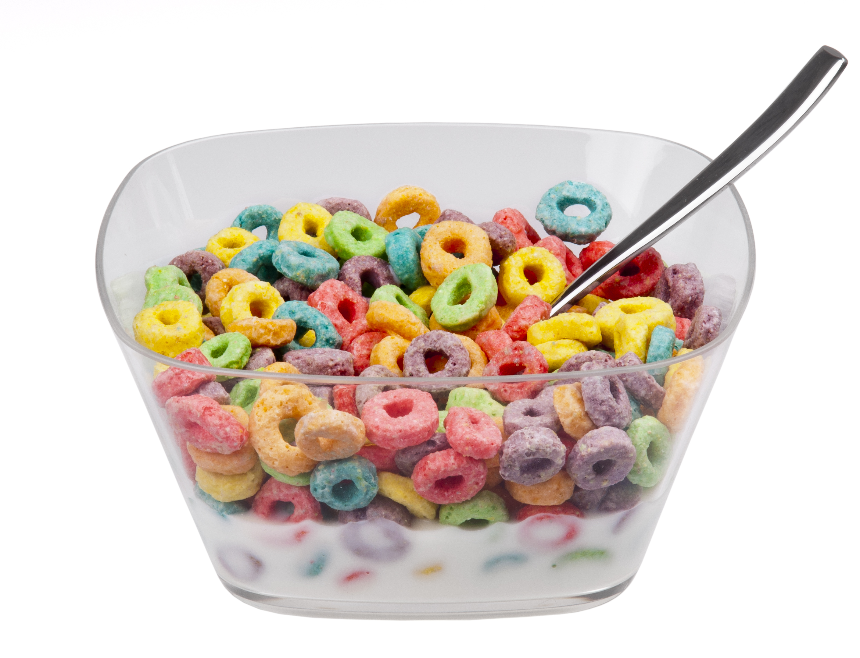
Loops Are Tough to Handle!
Global Dataflow Analysis
Issues with Loops
Generate lots of paths
Cyclic data dependency
Oh, brother! You may have some loops

Slide 34
Lecture END!
Local Dataflow analysis
Global Dataflow analysis

