Slide 1
ExerCise #11
Lattices Review
Write your name and answer the following on a piece of paper
Recall that the set of English words, ranked by substring inclusion, forms a poset but NOT a lattice. Explain why and give an example
Reflexive: every word includes the substring of itself
Anti-symmetric: if two words include substrings of each other, they must be the same word
Transitive: if a is a substring b, and b is a substring of c, then a is a substring of c
Not a lattice: consider the English words a and he. They have no greatest lower bound

Slide 2
Administrivia and
Announcements

Slide 3
Dataflow Frameworks
EECS 677: Software Security Evaluation
Drew Davidson

Slide 4
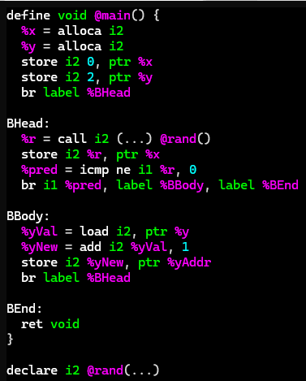
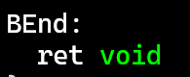
Dataflow: The BiG Ideas
Dataflow Frameworks
Key CFG Annotations
Mark each block to indicate all possible values coming into that program point
*x: num
*y: num
Mark each edge to indicate all possible values coming out of that point
*x: {0}
*y: {2}
*x: num
*y: num
*x: zero
*y: pos
*x: {-2,-1,1}
*y: {-2,-1,0,1}
Abstract Interpretation
*x: {-2,-1,0,1}
*y: {-2,-1,0,1}
Abstract domain: abstract summary values
Edge merging: join over lattice elements
*x: zero
*y: num
*x: num
*y: any
Transfer functions deal in abstract domain
*x: {-2,-1,1}
*y: {-2,-1,0,1}
*x: {0}
*y: {-2,-1,0,1}
*x: zero
*y: num
*x: {0}
*y: {-2,-1,0,-1}

Slide 5
Lecture Outline
Formalizing dataflow
Generalizing analysis

Slide 6

The Potential of Dataflow
Dataflow Frameworks
Dataflow analysis showed some real potential!
Relatively straightforward computation: update the dataflow fact stored at each basic block boundary until saturation
In our examples, output was always…
Complete behavioral over-approximation -> no behaviors missed
Relatively precise -> few “false positive” behaviors
Saturated -> terminated
We’d like some stronger guarantees
Algorithm needs
Guaranteed termination
Amenable to chaotic iteration
Some degree of precision

Slide 7

Dataflow Formalism job search
Dataflow Frameworks
Formal(ish) requirements
A fact datatype (ideally of unbounded size)
Property
of the fact
datatype
An ordering that indicates progress
Unique solution
A guarantee of a finite number of steps to hit the maximum value
Property
of the update
function
An update step that never loses progress

Slide 8
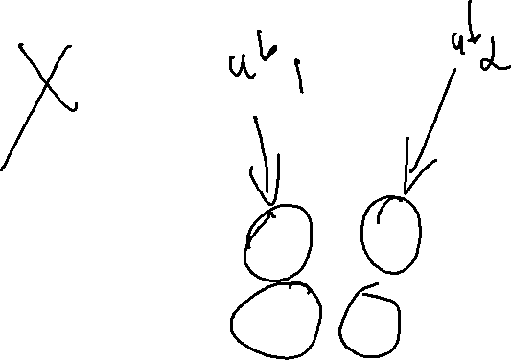
Fact datatype NEEDs
Dataflow Frameworks
Formal(ish) requirements
poset
A fact datatype (ideally of unbounded size)
An ordering that indicates progress
Unique solution
A guarantee of a finite number of steps to hit the maximum value
An update step that never loses progress
Try-outs
poset
Lattice
Complete lattice

Slide 9

Fact datatype NEEDs
Dataflow Frameworks
Formal(ish) requirements
A fact datatype (ideally of unbounded size)
An ordering that indicates progress
Unique solution
A guarantee of a finite number of steps to hit the maximum value
An update step that never loses progress
Try-outs
poset
Lattice
Complete lattice

Slide 10
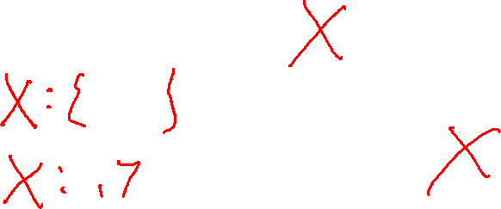
Fact datatype NEEDs
Dataflow Frameworks
Formal(ish) requirements
Lattice
A fact datatype (ideally of unbounded size)
Poset with a least upper bound and a greatest lower bound
An ordering that indicates progress
Unique solution
A guarantee of a finite number of steps to hit the maximum value
An update step that never loses progress
Try-outs
poset
Lattice
Complete lattice

Slide 11
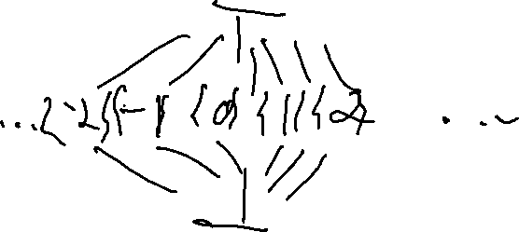
Fact datatype NEEDs
Dataflow Frameworks
Formal(ish) requirements
Complete lattice
A fact datatype (ideally of unbounded size)
Lattice with a least upper bound and greatest lower bound for all subsets of the set
An ordering that indicates progress
Unique solution
A guarantee of a finite number of steps to hit the maximum value
An update step that never loses progress
Try-outs
poset
Lattice
Complete lattice

Slide 12

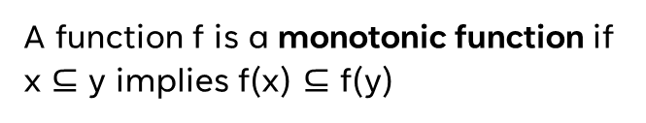
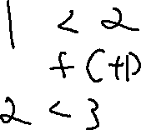
Function NEEDs
Dataflow Frameworks
Some Basic Definitions
A function f is a monotonic function if x $⊆$ y implies f(x) $⊆$ f(y)
An element z is a fixpoint of f iff z = f(z)

Slide 13
Function NEEDs
Dataflow Frameworks
Example
$$f\left(x\right)=x ∪\{ b \}$$
Some Basic Definitions
$\{b\}$ is a fixpoint of f
$$f\left(\{b\}\right)=\{ b \}$$
A function f is a monotonic function if x $⊆$ y implies f(x) $⊆$ f(y)
$$f\left(\{a\}\right)=\{ a, b \}$$
$\{a\}$ is not a fixpoint of f
$$f\left(\{a,b\}\right)=\{ a,b \}$$
$\{a,b\}$ is a fixpoint of f
An element z is a fixpoint of f iff z = f(z)
$f(f\left(\left\{a\right\}\right))$ is a fixpoint of f
$f(f\left(any set\right))$ is a fixpoint of f

Slide 14

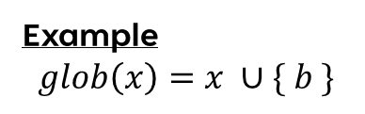







Function NEEDs
Dataflow Frameworks
Example
$$glob\left(x\right)=x ∪\{ b \}$$
Some Basic Definitions
$\{b\}$ is a fixpoint of glob
$$glob \left(\{b\}\right)⟶\{ b \}$$
A function f is a monotonic function if x $⊆$ y implies f(x) $⊆$ f(y)
$$glob \left(\{a\}\right)⟶\{ a, b \}$$
$\{a\}$ is not a fixpoint of glob
$$glob \left(\{a,b\}\right)⟶\{ a,b \}$$
$\{a,b\}$ is a fixpoint of glob
An element z is a fixpoint of f iff z = f(z)
$glob(glob\left(\left\{a\right\}\right))$ is a fixpoint of glob
$glob(glob\left(any set\right))$ is a fixpoint of glob

Slide 15

Why Does this Matter?
Dataflow Frameworks
Every finite lattice
is a complete lattice
Practical Upshot
If L is a complete lattice and f is monotonic, then f has a greatest fixpoint and a least fixpoint
If L has no infinite ascending chains, the least fixpoint can be computed by iterative application of f
So the analysis will terminate

Slide 16
Lecture Outline
Enhancing Dataflow analysis
Lattices
Abstract Interpretation

Slide 17


Chaotic Iteration
Static Analysis: Control Flow Graphs
A Worklist algorithm
Chaotic
Iteration
Select the next worklist item in any order
Necessarily assumes progress towards some goal
Dealing with “uncomputed” sets
Assume a reasonable “initial” value
Surprisingly, not a band with merch at Hot Topic

Slide 18

Analysis Precision
Abstract Interpretation
Precision / Efficiency Tradeoff
With a complete lattice we can, in theory, eventually terminate
The shallower the lattice, the faster the fixpoint
That’s not a very strong guarantee!
Choose to approximate the lattice

Slide 19

Analysis Precision
Abstract Interpretation
Precision / Efficiency Tradeoff
With a complete lattice we can, in theory, eventually terminate
The shallower the lattice, the faster the fixpoint
That’s not a very strong guarantee!
Choose to approximate the lattice

Slide 20

Let’s Consider A Very Approximate Lattice
Abstract Interpretation
Abstract Domain of Signs
{-2, -1, 0, 1}
num
{-2, 0, 1}
{-2, -1, 0}
{-1, 0, 1}
{-2, -1, 1}
pos
zero
neg
{-2, -1}
{-2, 0}
{-1, 0}
{-2, 1}
{-1, 1}
{0, 1}
$$∅$$
{-2}
{-1}
{0}
{1}

Slide 21
Let’s Consider A Very Approximate Lattice
Abstract Interpretation
Abstract Domain of Signs
{-2, -1, 0, 1}
num
{-2, 0, 1}
{-2, -1, 0}
{-1, 0, 1}
{-2, -1, 1}
≥ zero
≤ zero
pos
zero
neg
{-2, -1}
{-2, 0}
{-1, 0}
{-2, 1}
{-1, 1}
{0, 1}
$$∅$$
{-2}
{-1}
{0}
{1}

Slide 22
Abstract Domains in Practice
Static Analysis
Intervals
Property Existence
“Singleton Integer Sets”
You know the number, or you don’t
You know a concrete range
A property does or does not hold

Slide 23
Section Summary
Static Analysis
Static Analysis gives us an important guarantee
Anything that isn’t crystal clear to a static analysis tool probably isn’t clear to your fellow programmers, either. The classic hacker disdain for “bondage and discipline languages” is short-sighted – the needs of large, long-lived, multi-programmer projects are just different than the quick work you do for yourself.
- John Carmack's Static Code Analysis post
Completeness of bug finding / Soundness of verification
Thus far we’ve been using source code

