Slide 1
ExerCise #26
Control Flow Integrity Review
Write your name and answer the following on a piece of paper
Of the various CFI solutions we explored, none were calling-context sensitive. Why not?

Slide 2
ExerCise #26 Solution
Control Flow Integrity Review

Slide 3
Testing
EECS 677: Software Security Evaluation
Drew Davidson

Slide 4
Administrivia and Announcements

Slide 5
Last Time: Control-Flow Integrity
Review: Computability
Instrument the program to prevent “illegal” jumps
Intel CET
Microsoft control-flow guard
Clang instruction injection

Slide 6
Turning the page on this class
Next topic
Hopefully, you’ve got a taste of the challenges / benefits of instrumentation and mediation
Static cost/benefit
Runtime cost/benefit

Slide 7
Turning the page on this class
Next topic
Dynamic Analysis
Running the program to see what happens
Uses of dynamic analysis
Program comprehension
Bug elimination

Slide 8
Lecture Outline
The Testing Perspective
Test Generation

Slide 9
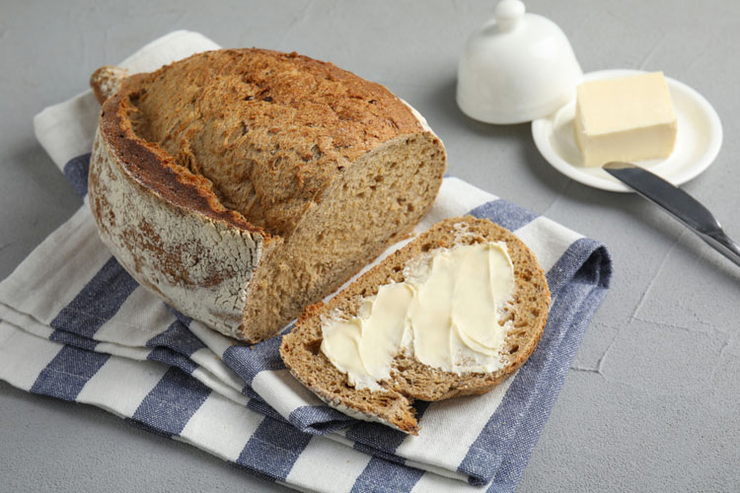
A formulation of dynamic Analysis
Testing
Input/expected output pairs
Does the program do what it’s supposed to do?

Slide 10
Test Suites
Testing
Ideally, we’ll capture a variety of behaviors
We’ll refer to the collection of test cases as our test suite
Regression suite
Capturing sufficient behavior enables capture of breaking changes
Generate Test Suite
Pass the Test Suite?
Release the System
Update the System

Slide 11
Non-determinism
Testing
Factor out external details into the environment
Time is an input
Random seed is an input
Network response is an input

Slide 12
Testing scope
Testing
Unit testing
Testing at the submodule level (e.g. function i/o)
Integration testing
Testing at the boundary between modules (e.g. library interfaces)
Application testing
Testing at the whole-program level

Slide 13
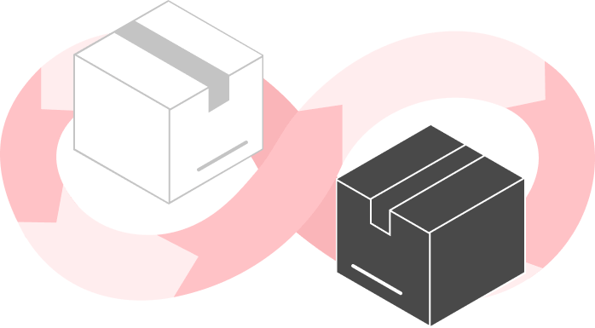
Program Visibility
CATEGORIZING ANALYSIS
White box
Testing with “complete” information about the analysis target (typically means source code)
Black box
Testing with “no” information about how the analysis target is architected (typically means binary only)
Grey box
Testing with “some” information about how the analysis target is architected (binary + some static analysis / probing)

Slide 14
Lecture Outline
The Testing Perspective
Test generation

Slide 15
Classic Limitations of Testing
Test Generation
It’s hard to predict what might go wrong (presumably you’d have fixed it in this first place)

Slide 16
“FiXing” Testing
Test Generation
It’s hard to predict what might go wrong (presumably you’d have fixed it in this first place)
Could try to make a more intentional correspondence (TDD)
Could try to leverage tools (Fuzzing)

Slide 17
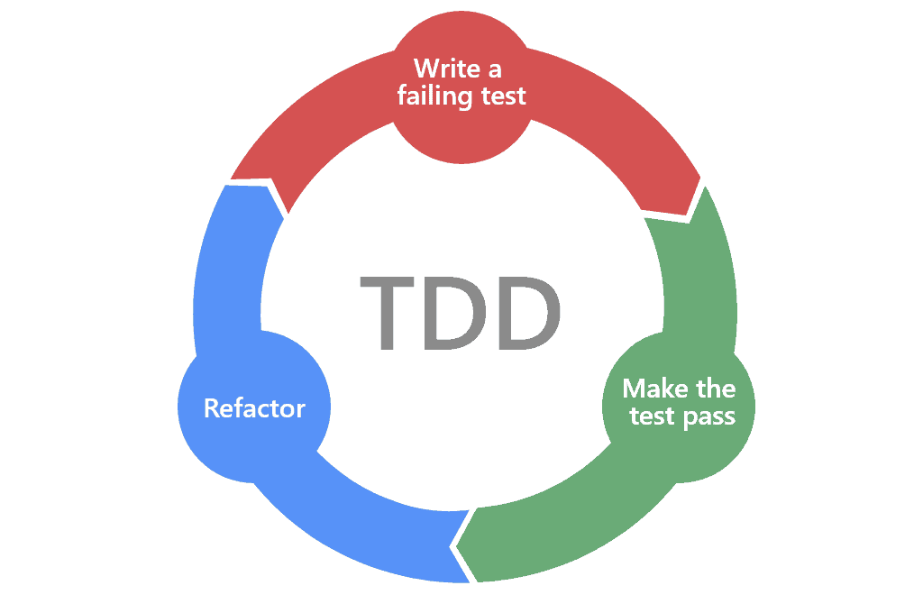
Test-Driven Development
CATEGORIZING ANALYSIS
1. Write a test case (expecting it to fail)
2. Implement enough functionality to pass the test case
3. Fix up the program
(repeat)

Slide 18
Testing vs Static Analysis
Test Generation
A fight (I guess?) in the software engineering community
Ask yourself why we are trying to plug defects with language features. The answer ought to be obvious. We are trying to plug these defects because these defects happen too often.
Now, ask yourself why these defects happen too often. If your answer is that our languages don’t prevent them, then I strongly suggest that you quit your job and never think about being a programmer again; because defects are never the fault of our languages. Defects are the fault of programmers. It is programmers who create defects – not languages.
And what is it that programmers are supposed to do to prevent defects? I’ll give you one guess. Here are some hints. It’s a verb. It starts with a “T”. Yeah. You got it. TEST!
The clean code blog
“The Dark Path”, 1/2017
“Tools are not the Answer”, 10/2017
I think that good software tools make it easier to write good software. However, tools are not the answer to the “Apocalypse”.
Nowhere in the article did the author examine the possibility that programmers are generally undisciplined.

Slide 19
Some difficulties of unit testing
Test Generation
Integrating testing into a workflow
googletest
apt install googletest
apt install libgtest-dev

Slide 20
Some difficulties of unit testing
Test Generation
What to do about a function’s “environment”?

Slide 21
Fuzzing
CATEGORIZING ANALYSIS
Automatically creating test cases

