Slide 1
ExerCise #10
DataFlow Review
Perform a value-set dataflow analysis on the following CFG, starting at B1, then B2 then BBL 3, then BBL 4. Give the value sets at the top of each block after 1 round of analysis
BBL1 in: <x: { } , y: { }, g: { }>
B1:
int x = 0;
int y = 2;
BBL1 out: <x: { } , y: { }, g: { }>
B2:
BBL2 in: <x: { } , y: { }, g: { }>
if (INPUT){
BBL2 out: <x: { } , y: { }, g: { }>
true
false
B3:
g = 1 / y;
y = 0;
BBL3 in: <x: { } , y: { }, g: { }>
BBL3 out: <x: { } , y: { }, g: { }>
BBL4 in: <x: { } , y: { }, g: { }>
B4:
return;
BBL4 out: <x: { } , y: { }, g: { }>

Slide 2
Administrivia and Announcements

Slide 3
DataFlow Fixpoints
EECS 677: Software Security Evaluation
Drew Davidson

Slide 4
Class Progress
Exploring a form of Static analysis that summarizes how Control and Data flows across a program
manifest a Complete analysis by denoting sets of all values memory might contain (NB – this will end up being cumbersome!)

Slide 5
Last Time: Value Set Analysis
Review: Dataflow
Conservatively Track the Possible set of values taken
1. uint4 x = randInt();
2. uint4 y = x % 2;
3. return x / y;
This approach is a complete over-approximation

Slide 6
Last Time: Flow Sensitivity
Review: Dataflow
Account for Program Flow, not paths
B1
int x = 0;
int y = 0;
if (g)
When control flow merges, merge the value sets
true
false
1. int x = 0;
2. int y = 0;
3. if (g)
4. x = 10;
5. y = 7
6. if (!g)
7. y = 1 / (x – 10);
8. return;
B2
x = 10;
B3
y = 7;
if (!g)
true
false
B4
y = 1 / (x – 10)
B5
y = 7;
if (!g)

Slide 7
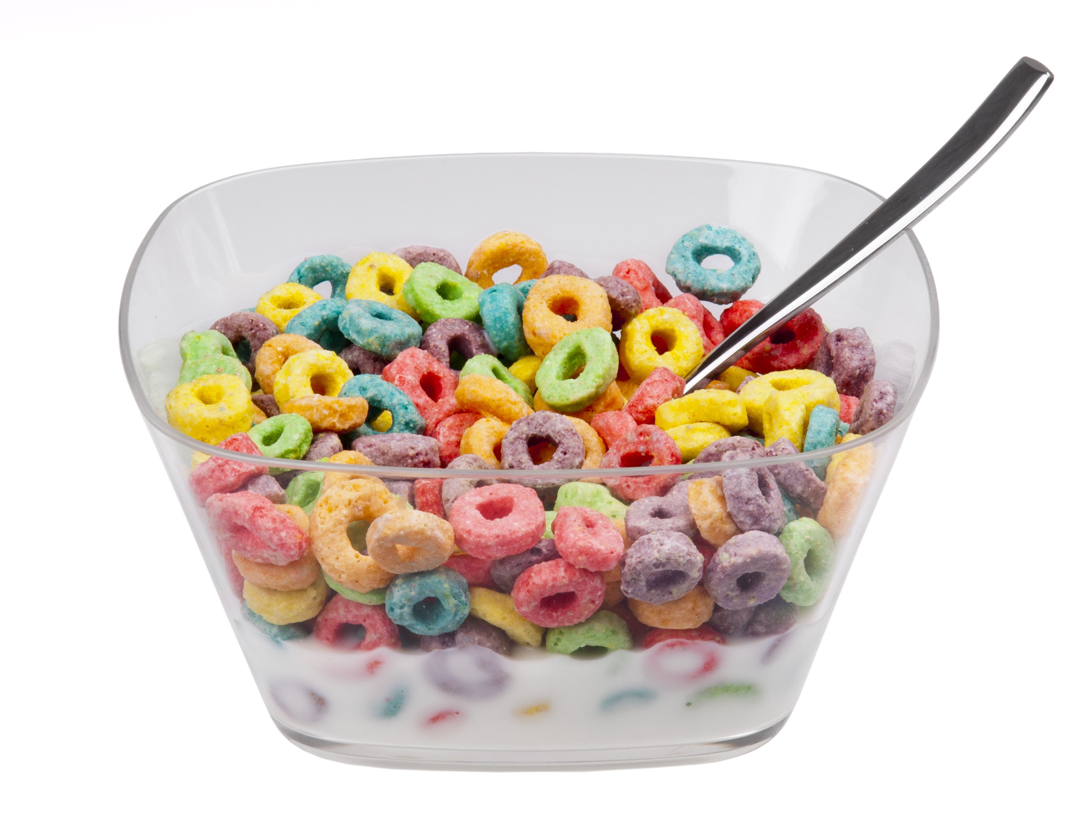
Loops Are Tough to Handle!
Review: Dataflow Analysis
Issues with Loops
Generate lots of paths
Cyclic data dependency

Slide 8
Lecture Outline
Handling cyclic dependency
Termination
Handling large value sets

Slide 9
A word of Caution
Dataflow Analysis
We need to build up a lot of interlocking machinery for a “real” flow-sensitive analysis
I’ll present a simplified algorithm here with some subtle problems, which we’ll fix up next time

Slide 10
Where to Start Analysis
Dataflow Analysis
B1
uint4 x = 0;
uint4 y = 2;
1. uint4 x = 0;
2. uint4 y = 2;
3. uint1 t;
4. while (t=rand()){
5. x = 1 / y;
6. y = 0;
7. }
8. return;
B2
uint1 t = rand()
while (rand()){
true
false
B3
x = 1 / y;
y = 0;
}
B4
7. return;

Slide 11
Where to start Analysis
Dataflow Analysis
 | x | y | t
B1 in
B1 out
B2 in
B2 out
B3 in
B3 out
B4 in
B4 out
B1
{1-15}
{1-15}
{0,1}
uint4 x = 0;
uint4 y = 2;
{0}
{2}
{0,1}
1. uint4 x = 0;
2. uint4 y = 2;
3. uint1 t;
4. while (t=rand()){
5. x = 1 / y;
6. y = 0;
7. }
8. return;
B2
uint1 t = rand()
while (rand()){
???
???
???
true
false
B3
x = 1 / y;
y = 0;
}
B4
7. return;

Slide 12
Chaotic Iteration
Static Analysis: Control Flow Graphs
A Worklist algorithm
Chaotic
Iteration
Select the next worklist item in any order
Necessarily assumes progress towards some goal
Dealing with “uncomputed” sets
Assume a reasonable “initial” value
Surprisingly, not a band with merch at Hot Topic

Slide 13
Chaotic Iteration
Static Analysis: Control Flow Graphs
B1
int x = 0;
int y = 0;
if (g)
true
A Worklist algorithm
false
B2
x = 10;
Select the next worklist item in any order
Necessarily assumes progress towards some goal
B3
return x
Dealing with “uncomputed” sets
 | x | y | g
B1 in
B1 out
B2 in
B2 out
B3 in
B3 out
Assume a reasonable “initial” value
For the sake of complete over-approximation, let’s assume a set that hasn’t been computed take could take on ANY value

Slide 14
Chaotic iteration: Loops
Dataflow Analysis
 | x | y | t
B1 in
B1 out
B2 in
B2 out
B3 in
B3 out
B4 in
B4 out
B1
{1-15}
{1-15}
{0,1}
uint4 x = 0;
uint4 y = 2;
1. uint4 x = 0;
2. uint4 y = 2;
3. uint1 t;
4. while (t=rand()){
5. x = 1 / y;
6. y = 0;
7. }
8. return;
B2
{1-15}
{1-15}
{0,1}
uint1 t = rand()
while (rand()){
true
{1-15}
{1-15}
{0,1}
false
B3
x = 1 / y;
y = 0;
}
{1-15}
{1-15}
{0,1}
B4
7. return;

Slide 15
Lecture Outline
Handling cyclic dependency
Termination
Handling large value sets

Slide 16
When to stop analysis?
Dataflow Analysis
 | x | y | t
B1 in
B1 out
B2 in
B2 out
B3 in
B3 out
B4 in
B4 out
B1
{1-15}
{1-15}
{0,1}
uint4 x = 0;
uint4 y = 2;
{0}
{2}
{0,1}
1. uint4 x = 0;
2. uint4 y = 2;
3. uint1 t;
4. while (t=rand()){
5. x = 1 / y;
6. y = 0;
7. }
8. return;
B2
{0}
{2,0}
{0,1}
uint1 t = rand()
while (rand()){
{0}
{2,0}
{0,1}
true
{0}
{2,0}
{1}
false
B3
x = 1 / y;
y = 0;
}
{0}
{0}
{1}
{0}
{2,0}
{0}
B4
7. return;
{0}
{2,0}
{0}

Slide 17
Analysis Progress
Static Analysis: Control Flow Graphs
Analysis Ends when the fact sets reach saturation
No additional elements will ever be added
It sure would be nice if we could guarantee that this will happen!
When your fact sets couldn’t
possibly hold any more data

Slide 18
FixED-Points
Static Analysis: Control Flow Graphs
A Fixed-Point (AKA fixpoint, fixed point)
A value that does not change under a given transformation
Our value-set analysis WILL have Facts that reach a Fixed-point
Why?
Finite set of configurations over INT32s
Data transforms only add data to fact sets

Slide 19
Lecture Outline
Breaking cyclic dependency
Termination
Handling large value sets

Slide 20
where to StOP THIS Analysis?
Analysis Termination
1. int x = 0;
2. int y = 2;
3. while (INPUT){
true
false
4. x = x + 1;
5. y = 0;
6. }
7. return y / x;

Slide 21
Widening
Analysis Termination
Accelerate progress towards Fix-Point
1. int x = 0;
2. int y = 2;
Lots of (over-approximate) ways to do this
1 simple idea: if we hit N values, immediately change the fact set to “All integers”
3. while (INPUT){
true
false
4. x = x++;
5. y = 0;
6. }
7. return y / x;

Slide 22
Lecture END!
Described some of the issues and Fixes for dataflow in the presence of loops

