Slide 1
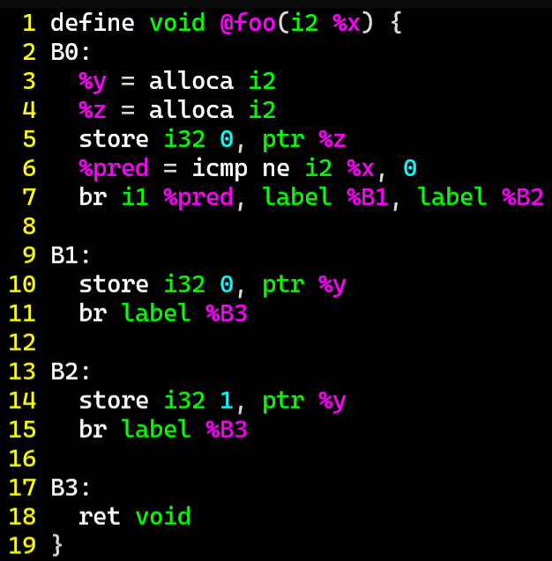
ExerCise #9
DataFlow Review
Fill out the value sets that a flow-sensitive dataflow analysis would assign
 | x | *y | *z
B0
B0→B1
B0→B2
B1
B2
B1→B3
B2→B3
B3
exit

Slide 2

ExerCise #9 Solution
DataFlow Review
 | x | *y | *z
B0
B0→B1
B0→B2
B1
B2
B1→B3
B2→B3
B3
exit

Slide 3

Administrivia and
Announcements

Slide 4
Dataflow Fixpoints
EECS 677: Software Security Evaluation
Drew Davidson

Slide 5
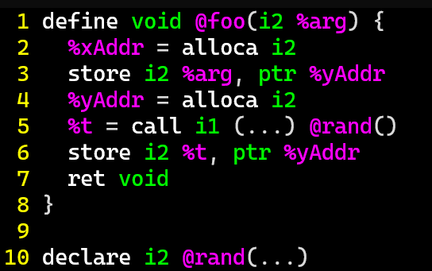
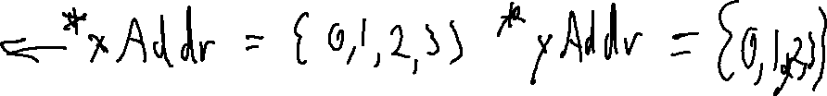
Last Time: Value Set Analysis
Review: Dataflow
Conservatively Track the Possible set of values taken
This approach is a complete over-approximation

Slide 6
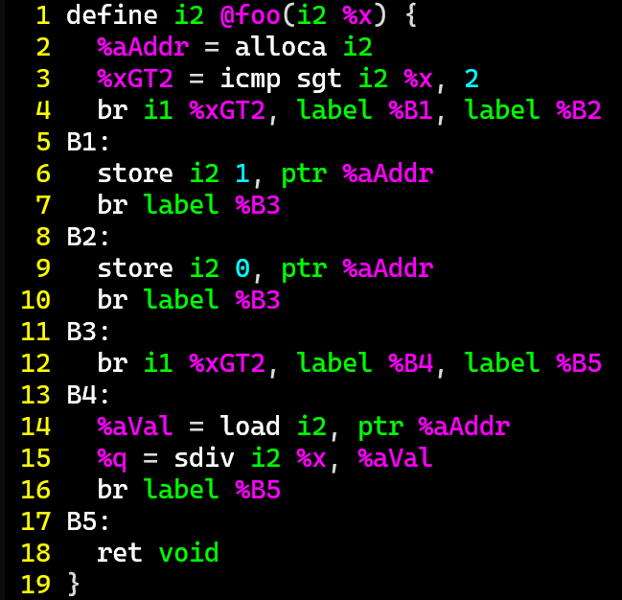
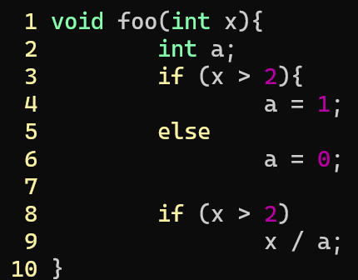

Last Time: Flow Sensitivity
Review: Dataflow
Account for Program Flow, not paths
: When control flow merges, merge the value sets
 | x | xGT2 | *aAddr
Entry
E→B1
B1
E→B2
B2
B1→B3
B2→B3
B3
B3→B4
B4
B3→B5
B4→B5
B5
exit
{0,1,2,3}
{0,1,2,3}
{3}
{1}
{0,1,2,3}
{3}
{1}
{0,1,2,3}
{0,1,2}
{0}
{0,1,2,3}
{0,1,2}
{0}
{0,1,2,3}
{3}
{1}
{1}
{0,1,2}
{0}
{0}
{0,1,2,3}
{0,1}
{0,1}
{0,1,2,3}
{1}
{0,1}
{0,1,2,3}
{1}
{0,1}
{0,1,2,3}
{0}
{0,1}
{0,1,2,3}
{1}
{1}
{0,1,2,3}
{0,1}
{1}
{0,1,2,3}
{0,1}
{0,1}

Slide 7
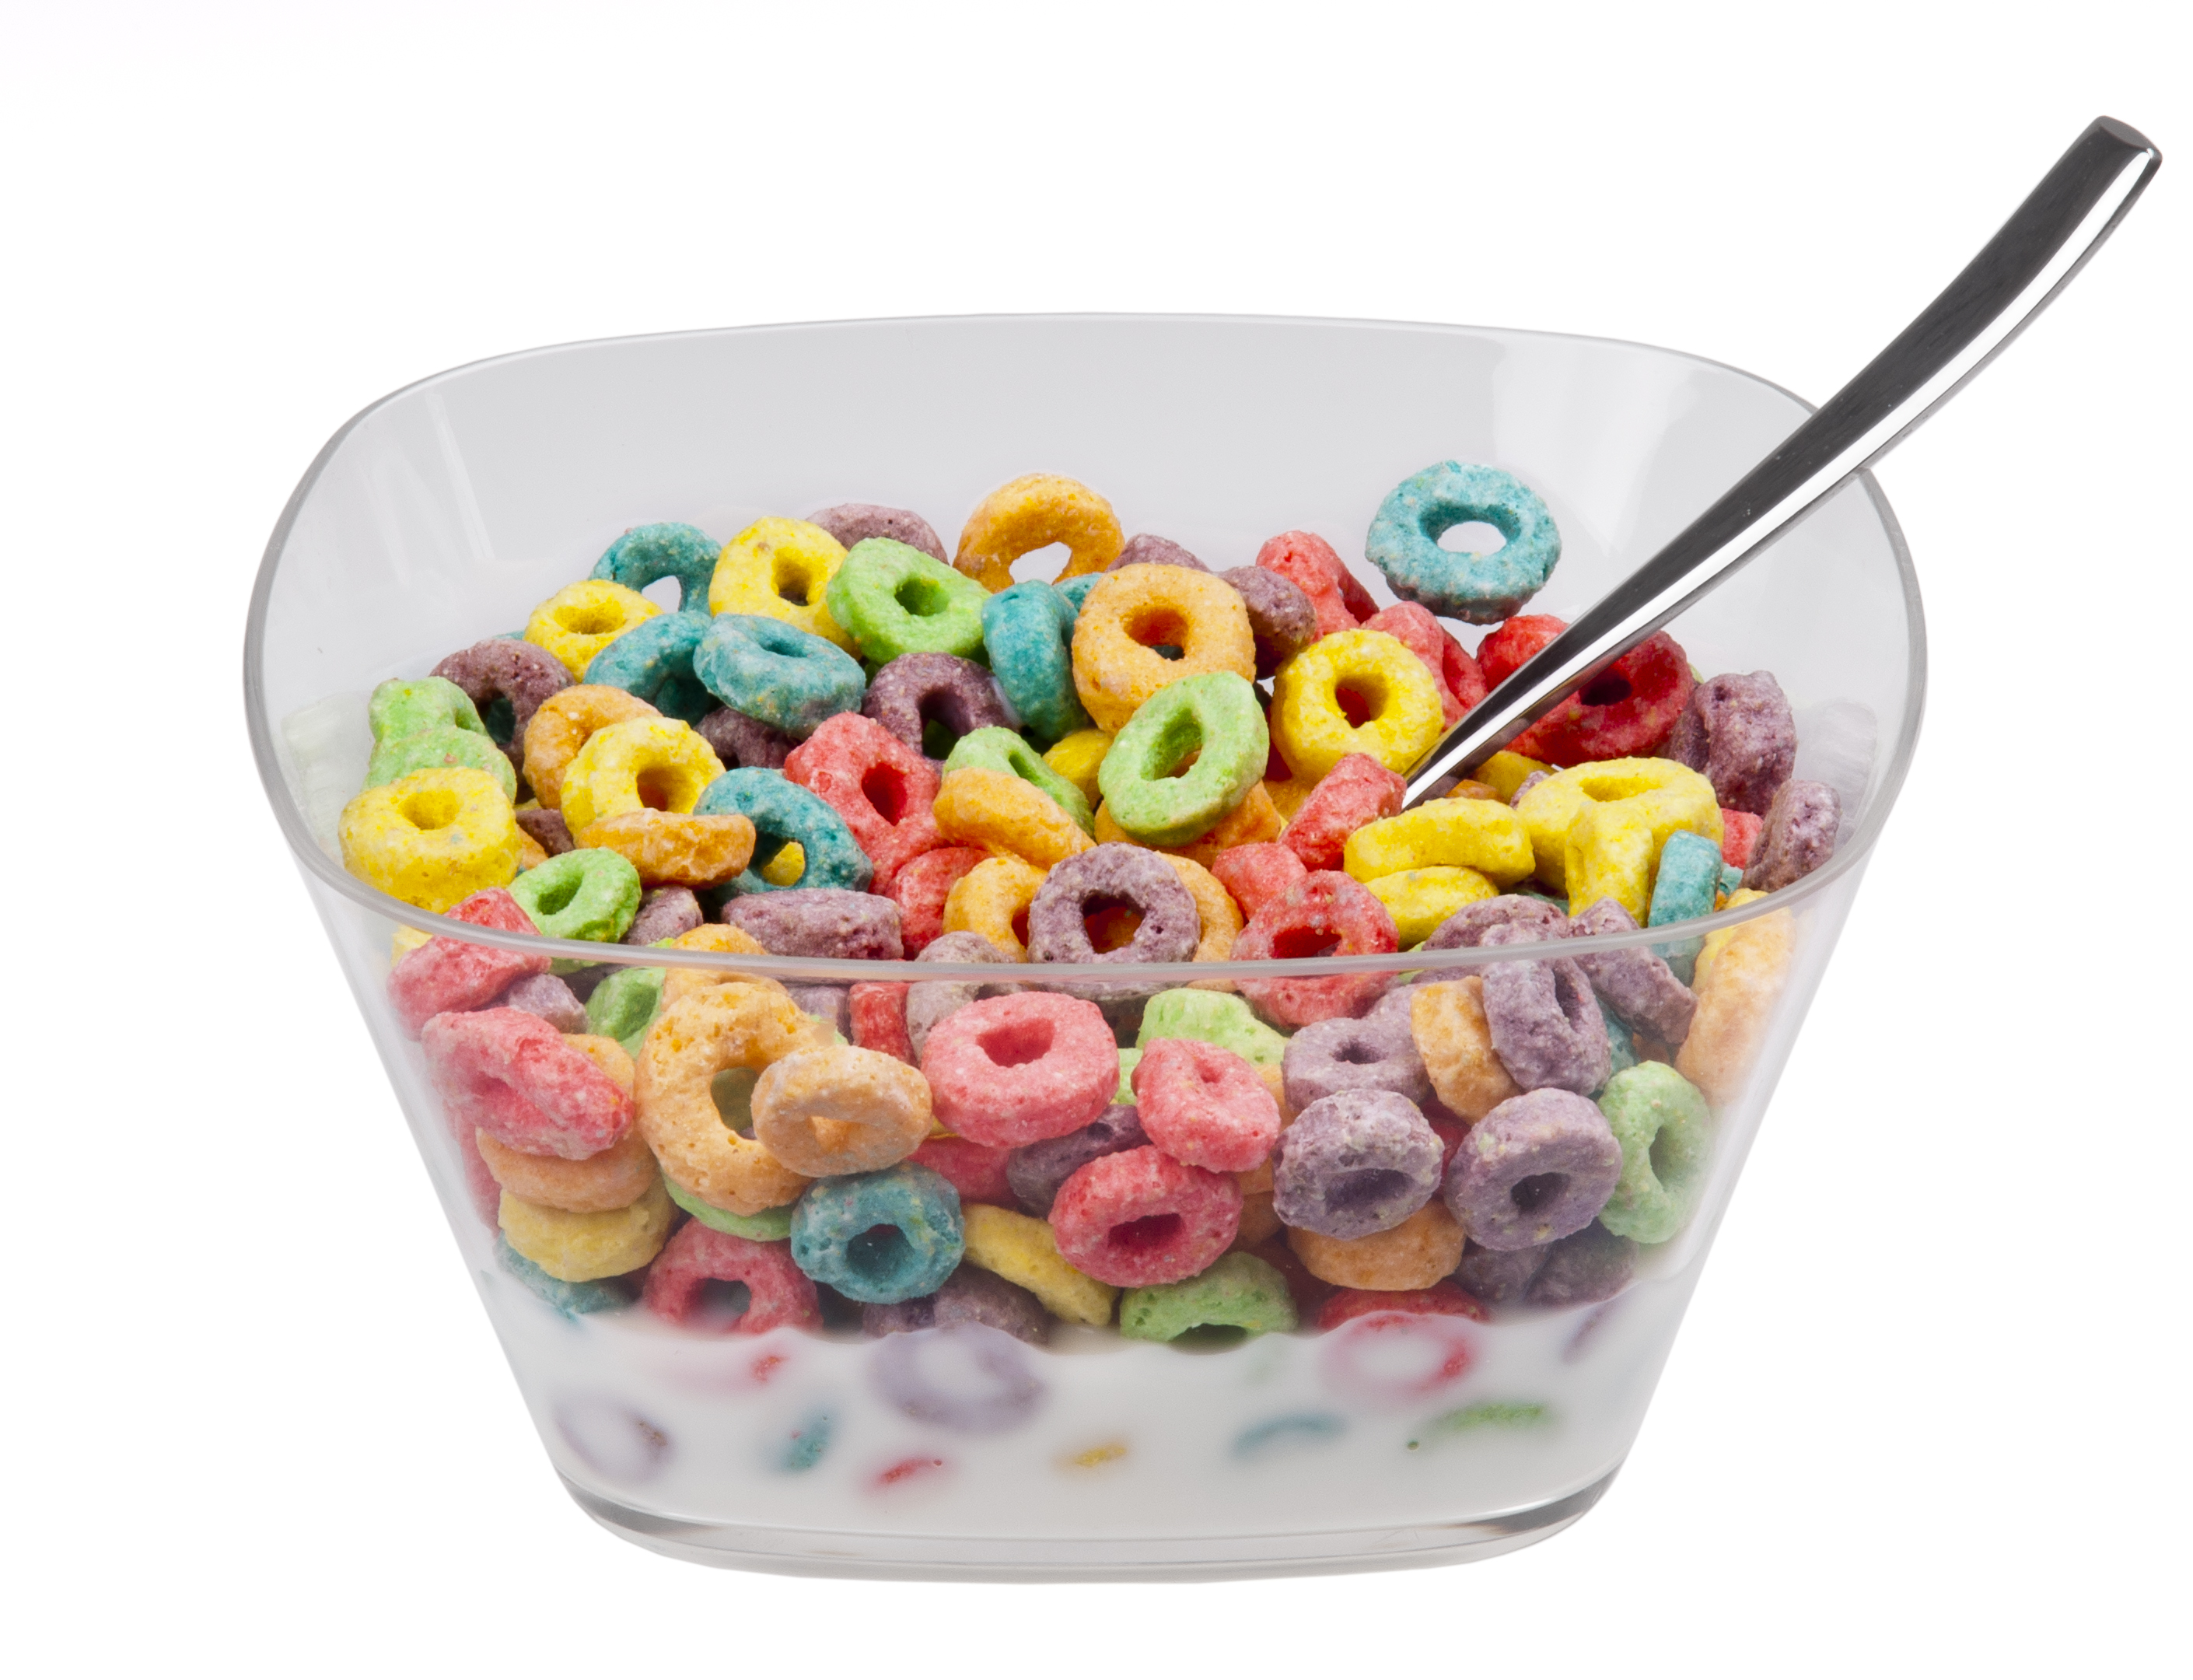
Loops Are Tough to Handle!
Review: Dataflow Analysis
Issues with Loops
Generate lots of paths
Cyclic data dependency

Slide 8
Lecture Outline
Handling cyclic dependency
Termination
Handling large value sets

Slide 9

A word of Caution
Dataflow Analysis
We need to build up a lot of interlocking machinery for a “real” flow-sensitive analysis
I’ll present a simplified algorithm here with some subtle problems, which we’ll fix up next time

Slide 10
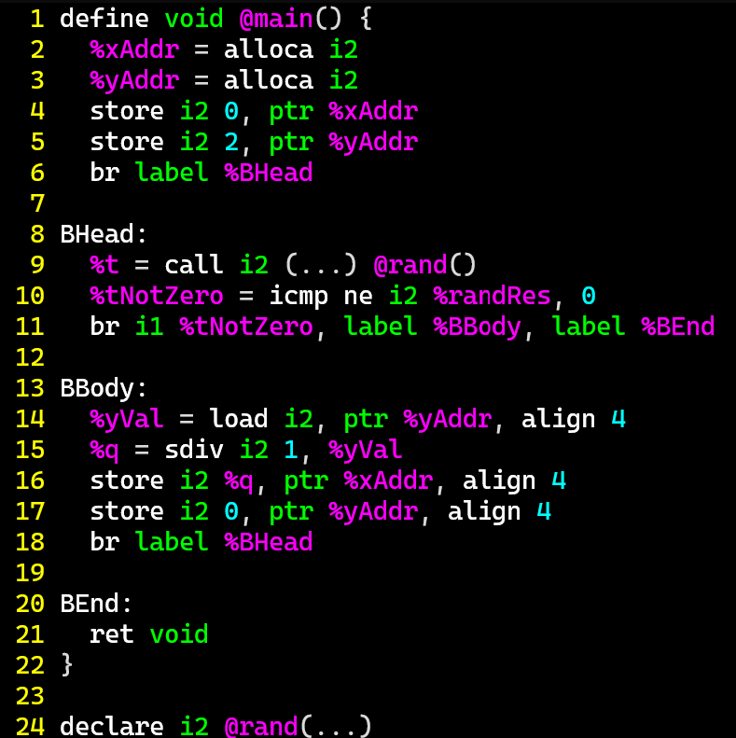
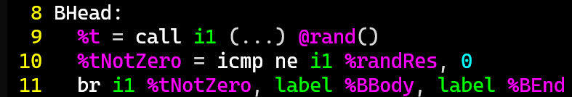
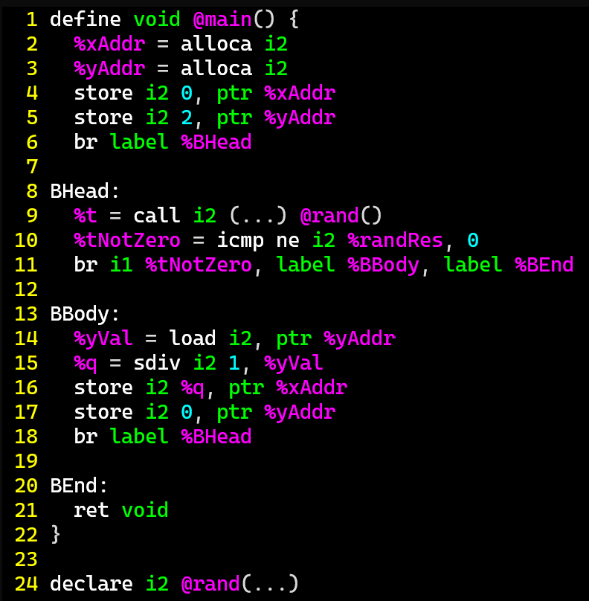

Cyclic Analysis
Dataflow Analysis
 | *x | *y | t
(entry)
(entry)→BHead
BHead
BHead→BBody
BHead→BEnd
BBody
BBody→BHead
BEnd
(exit)
{0,1,2,3}
{0,1,2,3}
{0}
{2}
{0}
{2}
{0,2}
{0}
{2}
{1}
{0,2}
{0}
{2}
{0}
1. int2 x = 0;
2. int2 y = 2;
3. int1 t;
4. while (t=rand()){
5. x = 1 / y;
6. y = 0;
7. }
8. return;
{0,2}
{0}
{2}
{1}
{0,2}
???
{ }
???
{ }
{ }
{0}
{0}
{1}
{0}
{0}
{0}
{0,2}

Slide 11
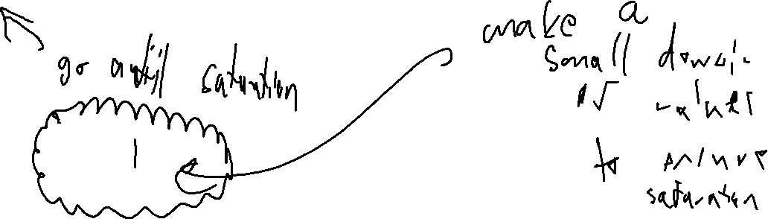
Cyclic Analysis: Initialization
Dataflow Analysis
Start every Value-Set with the “empty” value
Value will eventually be updated
Is exploring every edge enough?
No!

Slide 12
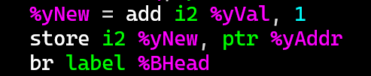
Cyclic Analysis
Dataflow Analysis
 | *x | *y | t
(entry)
(entry)→BHead
BHead
BHead→BBody
BHead→BEnd
BBody
BBody→BHead
BEnd
(exit)
{0,1,2,3}
{0,1,2,3}
{0}
{2}
{0}
{2}
{2,3}
{2,3,0}
{0}
{2}
{1}
{2,3}
{2,3,0}
{0}
{2}
{0}
{2,3}
1. int2 x = 0;
2. int2 y = 2;
3. int1 t;
4. while (t=rand()){
5. x = 1 / y;
6. y = 0;
7. }
8. return;
{0}
{2}
{1}
{2,3}
{2,3,0}
???
{ }
???
{ }
{ }
{0}
{3}
{3,0}
{1}
{0}
{2}
{0}
y+1;
{2,3}

Slide 13

Cyclic Analysis
Dataflow Analysis
 | *x | *y | t
(entry)
(entry)→BHead
BHead
BHead→BBody
BHead→BEnd
BBody
BBody→BHead
BEnd
(exit)
{0,1,2,3}
{0,1,2,3}
{0}
{2}
{0}
{2}
{2,3}
{0}
{2}
{1}
{2,3}
{0}
{2}
{0}
{2,3}
1. int2 x = 0;
2. int2 y = 2;
3. int1 t;
4. while (t=rand()){
5. x = 1 / y;
6. y = 0;
7. }
8. return;
{0}
{2}
{1}
{2,3}
???
{ }
???
{ }
{ }
{0}
{3}
{1}
{0}
{0}
{0}
y+1;
{2,3}

Slide 14
Lecture Outline
Handling cyclic dependency
Termination
Handling large value sets

Slide 15
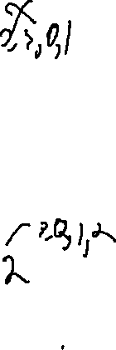
When to Stop?
Dataflow Analysis
 | *x | *y | t
(entry)
(entry)→BHead
BHead
BHead→BBody
BHead→BEnd
BBody
BBody→BHead
BEnd
(exit)
{0,1,2,3}
{0,1,2,3}
{0}
{2}
{0}
{2}
{2,3}
{2,3,0}
{0}
{2}
{1}
{2,3}
{2,3,0}
{0}
{2}
{0}
{2,3}
1. int2 x = 0;
2. int2 y = 2;
3. int1 t;
4. while (t=rand()){
5. x = 1 / y;
6. y = y+1;
7. }
8. return;
{0}
{2}
{1}
{2,3}
{2,3,0}
???
{ }
???
{ }
{ }
{0}
{3}
{3,0}
{1}
{0}
{0}
{0}
{2,3}

Slide 16

Analysis Progress
Static Analysis: Control Flow Graphs
Analysis Ends when the fact sets reach saturation
No additional elements will ever be added
When your fact sets couldn’t
possibly hold any more data

Slide 17
FixED-Points
Static Analysis: Control Flow Graphs
A Fixed-Point (AKA fixpoint, fixed point)
A value that does not change under a given transformation
Our value-set analysis WILL have Facts that reach a Fixed-point
Why?
Finite set of configurations over INT32s
Data transforms only add data to fact sets

Slide 18
Lecture Outline
Breaking cyclic dependency
Termination
Handling large value sets

Slide 19
When to Stop?
Dataflow Analysis
 | *x | *y | t
(entry)
(entry)→BHead
BHead
BHead→BBody
BHead→BEnd
BBody
BBody→BHead
BEnd
(exit)
{0,1,2,3}
{0,1,2,3}
{0}
{2}
{0}
{2}
{2,3}
{2,3,0}
{0}
{2}
{1}
{2,3}
{2,3,0}
{0}
{2}
{0}
{2,3}
1. int2 x = 0;
2. int2 y = 2;
3. int1 t;
4. while (t=rand()){
5. x = 1 / y;
6. y = y+1;
7. }
8. return;
{0}
{2}
{1}
{2,3}
{2,3,0}
???
{ }
???
{ }
{ }
{0}
{3}
{3,0}
{1}
{0}
{0}
{0}
{2,3}

Slide 20
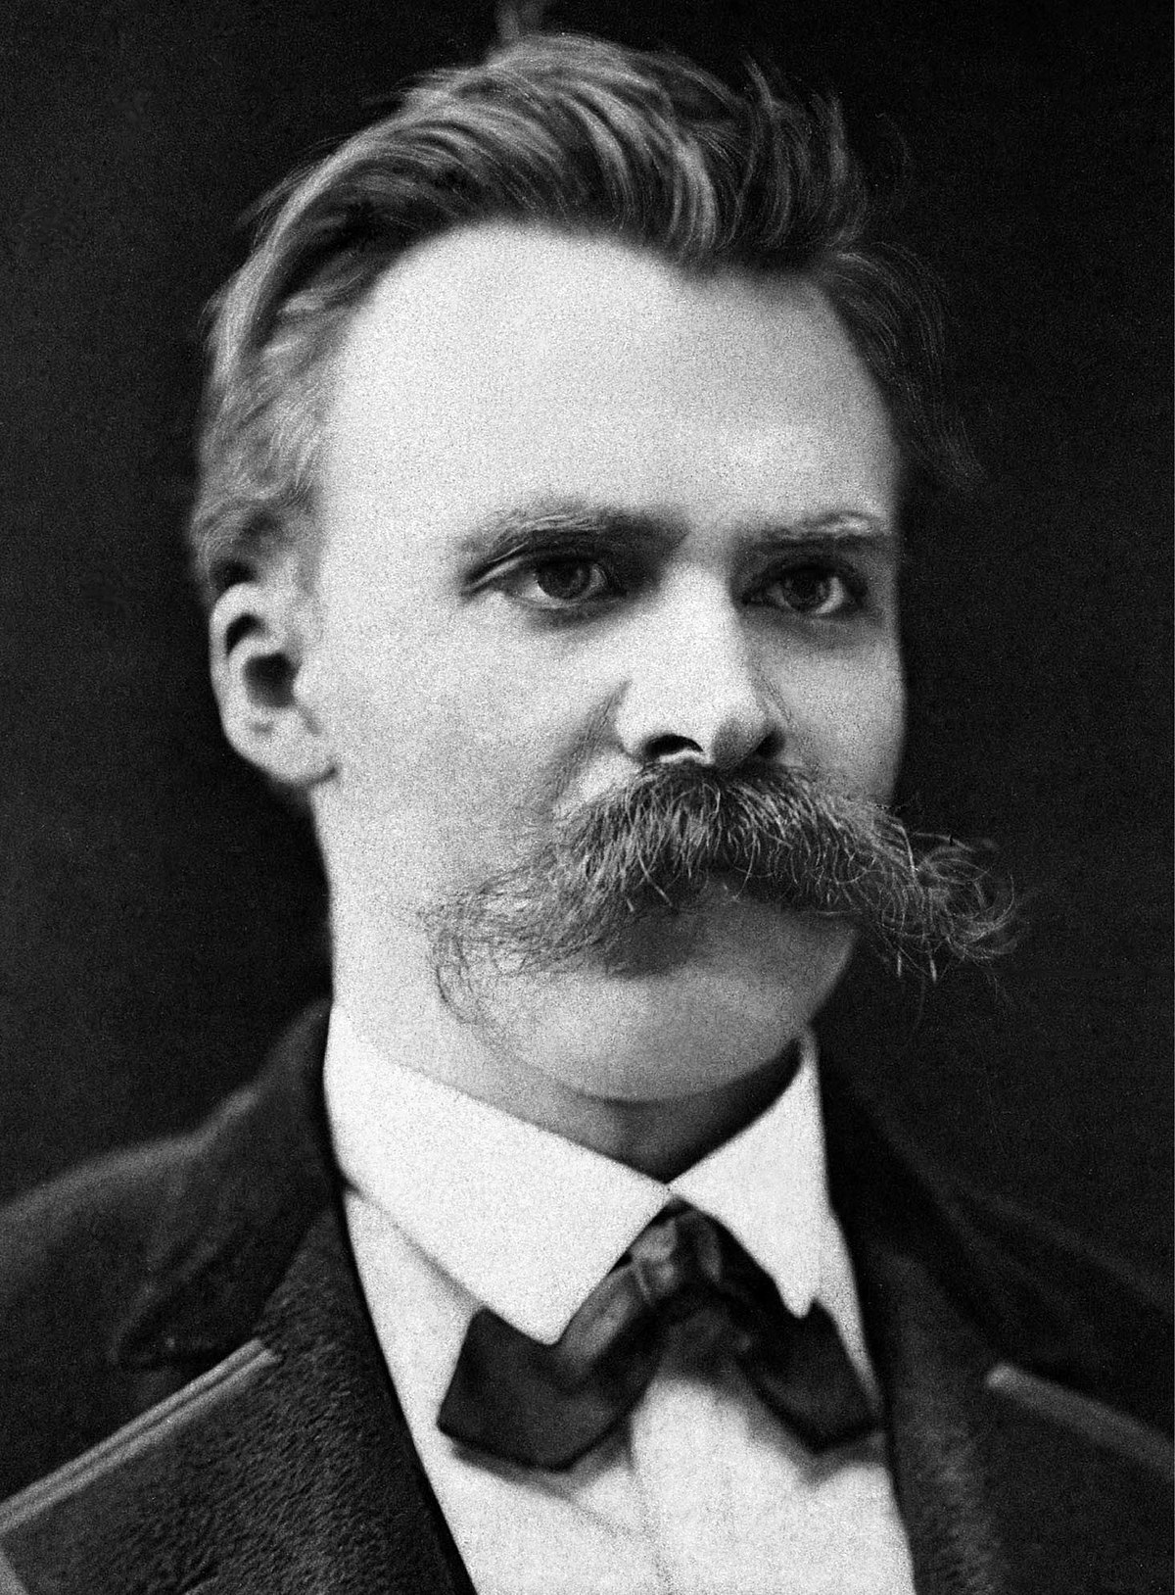
Does our Analysis Terminate?
Abstract Interpretation
We’ve spent some time on some uncomfortable truths:
Programs are often full of subtle bugs / vulnerabilities
It is effectively impossible to tell if an arbitrary program terminates
Bad news: our analysis engine in a program
What assurance do we have that our algorithm terminates as it analyzes an unknown / untrusted program?
“Whoever fights monsters should see to it that in the process he does not become a monster. And when you look long into an abyss, the abyss also looks into you.”
- Friedrich Nietzsche

Slide 21

Formalizing Termination
Dataflow Frameworks
{00,01,10,11}
Value-Set “Rank”
(2-bit computer)
{01,10,11}
{00,10,11}
{00,01,11}
{00,01,10}
{00,01}
{01,10}
{00,10}
{00,11}
{01,11}
{10,11}
{00}
{01}
{10}
{11}
?

Slide 22
Lecture END!
Described some of the issues and Fixes for dataflow in the presence of loops

