Slide 1
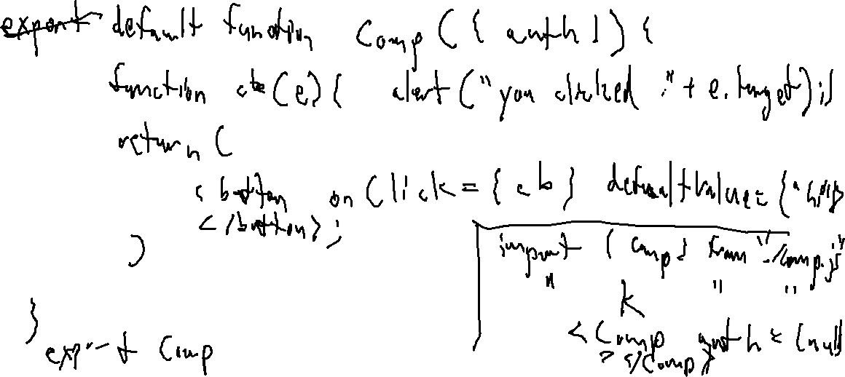
Exercise 36
Web Frameworks Review
Create a snippet of React code that generates a button that pops up an alert when clicked

Slide 2
Administrivia and
Announcements

Slide 3
Full-Stack Security
EECS 677: Software Security Evaluation
Drew Davidson

Slide 4

Last Time
Review: Web Frameworks
Authentication Security
Introduction to React
The client/server loop

Slide 5
Today
Web Protections
Putting it all together
- Developing a react app and examining security aspects

Slide 6
A Modern Web-App
Full Stack Security
frontend
api
database
react
node
sqlite

Slide 7
React Frontend
Web Frameworks
import { useState } from 'react'
import './App.css'
import { Login } from './Login.jsx'
export default function App() {
const [token, setToken] =
useState(window.sessionStorage.getItem("token"));
if (token === undefined || token === null){
return <Login tokenSetter={setToken} />
}
return (<p>{“Logged in!!!!"}</p>)
}
npm create vite@latest
Project name: frontend
Framework: React
Variant: Javascript
cd frontend
npm install axios
npm run dev

Slide 8
Node Backend Setup
Web Protections
#Configure codebase
#Configure database
npm create
npm install \
express \
cors \
sqlite3
CREATE TABLE accounts (
id INTEGER PRIMARY KEY,
name TEXT NOT NULL UNIQUE,
pw TEXT NOT NULL
);
CREATE TABLE tasks (
id INTEGER PRIMARY KEY,
owner INTEGER NOT NULL,
name TEXT NOT NULL
);
.save tasks.db

Slide 9
Node Backend API
Web Protections
index.js
import express from 'express';
import cors from 'cors';
import sqlite3 from 'sqlite3';
import { encodeJWT, decodeJWT } from "./token.js"
const app = express()
app.use(cors());
app.use(express.json());
// initializer server
// initializer database
// service routes
const db = new sqlite3.Database("tasks.db", sqlite3.OPEN_READWRITE);
app.post('/login', function(req, res){
…
})
app.post('/enroll', function(req, res){
…
})
app.post(‘/add', function(req, res){
…
})
…
app.listen(3001)

Slide 10
Node Backend API
Web Protections
index.js
app.post('/login', function(req, res){
// initializer server
const name = req.body.name;
const pw = req.body.pw;
const Q = "SELECT name,id FROM accounts"
+ " WHERE pw = '" + pw
+ "' AND name = '" + name + "'";
db.get(Q, function(err, row){
if (!row){
resp.send(JSON.stringify({ok:false}));
return;
}
const creds = { "name":row[‘name’], "id":row['id’]}
const token = encodeJWT(creds, SECRET);
const res = {'ok':true,'token':token};
resp.send(JSON.stringify(res));
});
// initializer database
// service routes
})

Slide 11

To the Terminal!
Full Stack Security

Slide 12

But I don’t like Writing Code!
Full Stack Security

Slide 13

To the Browser!
Full Stack Security

Slide 14
Lecture END!
Basic end-to-end scheme
Next Time: Filling out functionality

