Slide 1
Exercise 27
Dynamic Analysis Review
Write your name and answer the following on a piece of paper
What is the difference between unit testing and application testing?

Slide 2
Exercise 27: Solution
Dynamic Analysis Review

Slide 3
Administrivia and Announcements
Quiz 1 Graded!

Slide 4
Administrivia and Announcements

Slide 5
Quiz 1: Data and Thoughts
Administrivia
Perfect | ~15%
A (not perfect) | ~33%
B | ~27%
C | ~14%
D | ~4%
F | ~7%
(47)
(40)

Slide 6
Fuzzing
EECS 677: Software Security Evaluation
Drew Davidson

Slide 7
Previously: Testing
Review: Dynamic Analysis
Usage of LLVM built-in instrumentation Analysis
Described commands to use PGO for line coverage analysis
Setup for a Custom LLVM Analysis
Described the basic infrastructure necessary to craft a custom instrumentation

Slide 8
This Lesson: Fuzzing
Outline / Overview
Generating good test cases
Cases that increase coverage of program behaviors
Cases that exercise unexpected behavior
Previous stabs at this topic
Consider testing as an intrinsic part of the SSDLC methodology
Test-driven development
Post-hoc evaluation via coverage metrics
Today: Just guess
The random “fuzz” of white noise

Slide 9
History of Fuzzing
Outline / Overview
1988: It was a Dark and Stormy Night
Professor Bart Miller attempts to work from home…
noise
Telnet
Connection
Program
Crash!
Well-formed
Commands
Nonsense
Commands

Slide 10
breaking circular logic
Outline / Overview
Automated test case generation resolves a fundamental conflict in testing…
Tautologically impossible to predict unpredictable behavior
Apply a technique that obviated the need for expectations

Slide 11
Graceful Failure
Outline / Overview
Any error should be anticipated and handled by the system, with an informative error message should recovery become impossible
A key principle in the validity of fuzzing
“The user should never see a seg fault”

Slide 12
The Simplest Fuzzer
Fuzz testing
The Most Basic Form of Fuzzing
cat /dev/random | program
A study in the 90s basically did this, finding bugs in…
adb, as, bc, cb, col, diction, emacs, eqn, ftp, indent, lex, look, m4, make, nroff, plot, prolog, ptx, refer!, spell, style, tsort, uniq, vgrind, vi

Slide 13
An actual tool!
Fuzz testing
The Most Basic Form of Fuzzing
zzuf
A study in the 90s basically did this, finding bugs in…
adb, as, bc, cb, col, diction, emacs, eqn, ftp, indent, lex, look, m4, make, nroff, plot, prolog, ptx, refer!, spell, style, tsort, uniq, vgrind, vi

Slide 14
Exploring unexpected Behavior
Fuzzing
Random input is surprisingly effective
Numerous bugs found in practice via fuzzing…
Busybox utilities
Windows bugs
Linux Kernel bugs
Benefits of fuzzing
Very easy to run
Instant results
Highly scalable

Slide 15
Prioritizing Input
Fuzzing
The challenge of fuzzers is (usually) getting past the first validation check
if (!sane_input()){
exit 1;
}
//The rest of the program

Slide 16
Simple Testing Strategy
Fuzzing
Consider “Interesting” Input
Values close to the maximum, minimum, middle, etc
Case Study: Card reader input: [Frisby et al., 2012]

Slide 17
Mutation-Based Fuzzers
Fuzzing
Explore deviations from known input
Example mutations:
Binary input
– Bit flips
- Byte flips
- Change random bytes
- Insert random byte chunks
- Delete random byte chunks
- Set randomly chosen byte chunks to interesting values e.g. INT_MAX, INT_MIN, 0, 1, -1, … §
Text input
- Insert random symbols or keywords from a dictionary

Slide 18
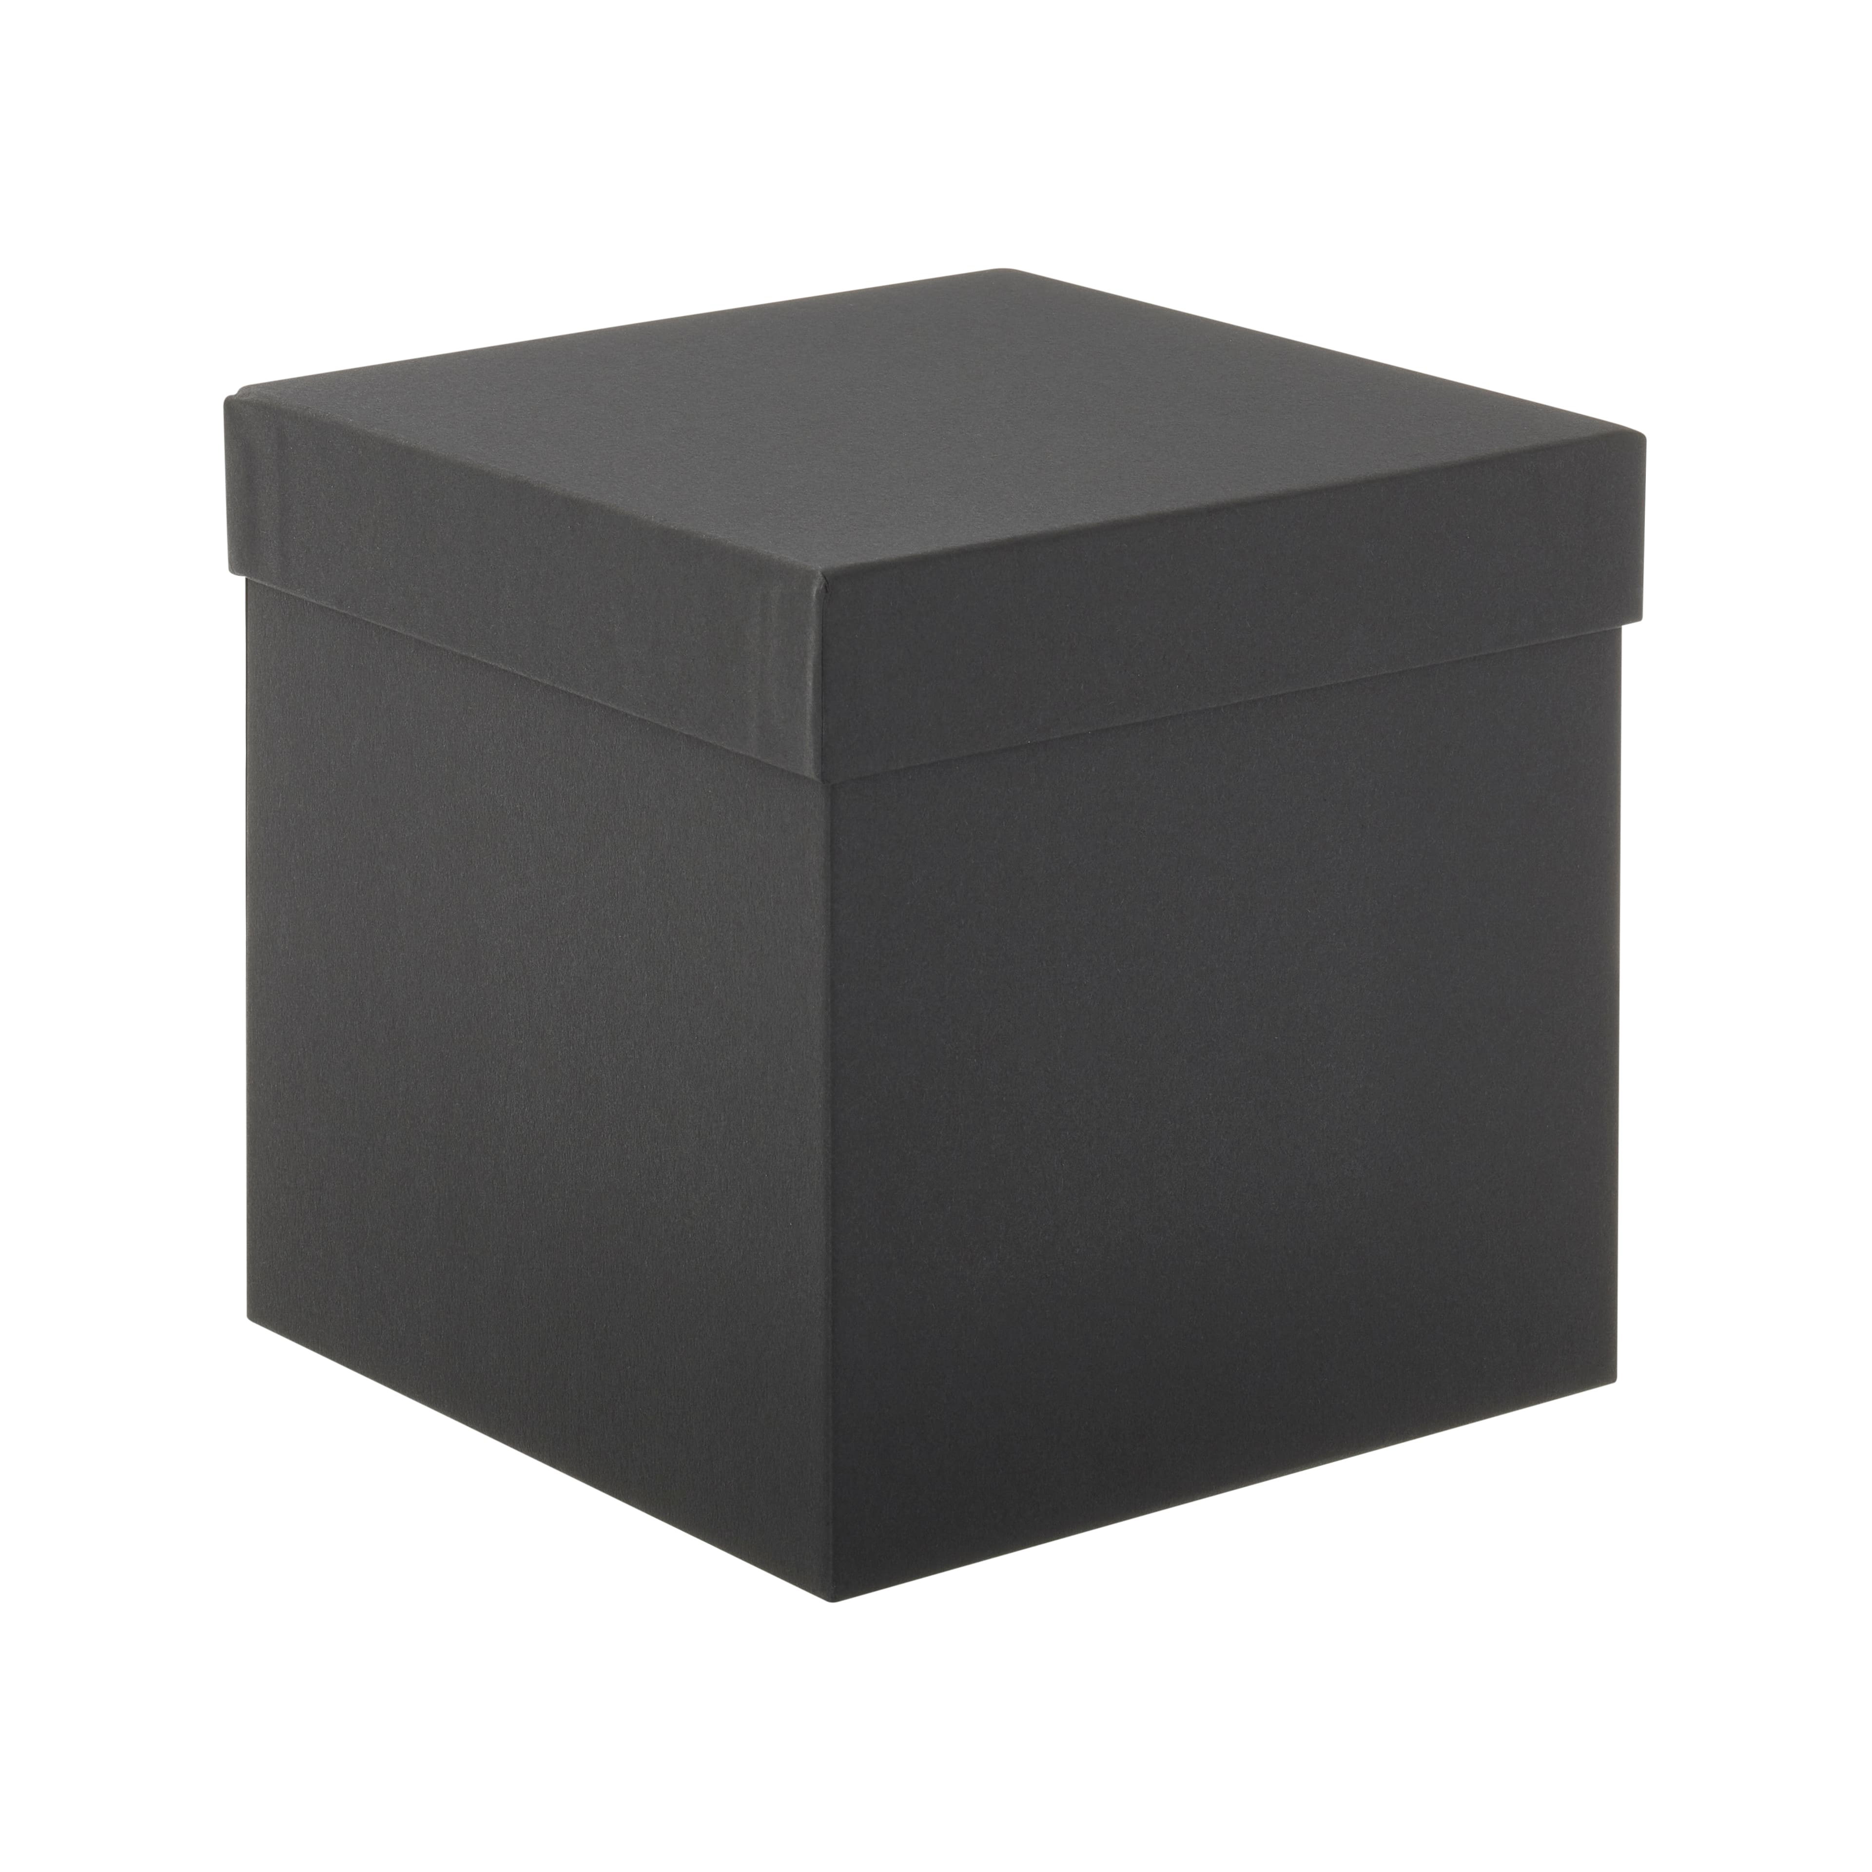
Black-Box Fuzzing
Fuzzing
Throw random input at the application interface

Slide 19
Representative Tool: zzuf
Black-box Fuzzing
The “Multipurpose fuzzer”
zzuf cat /dev/zero | hd -vn 32
zzuf -r 0.05 hd -vn 32 /dev/zero

Slide 20
White-Box Fuzzing
Fuzzing
Throw random input at the unit interface

Slide 21
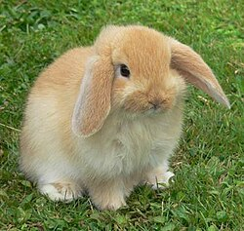
Representative Tool: AFL
Fuzzing
AFL (American Fuzzy Lop)
Maintained by Google
State of the art
Generally considered the best, state-of-the-art fuzzer

Slide 22
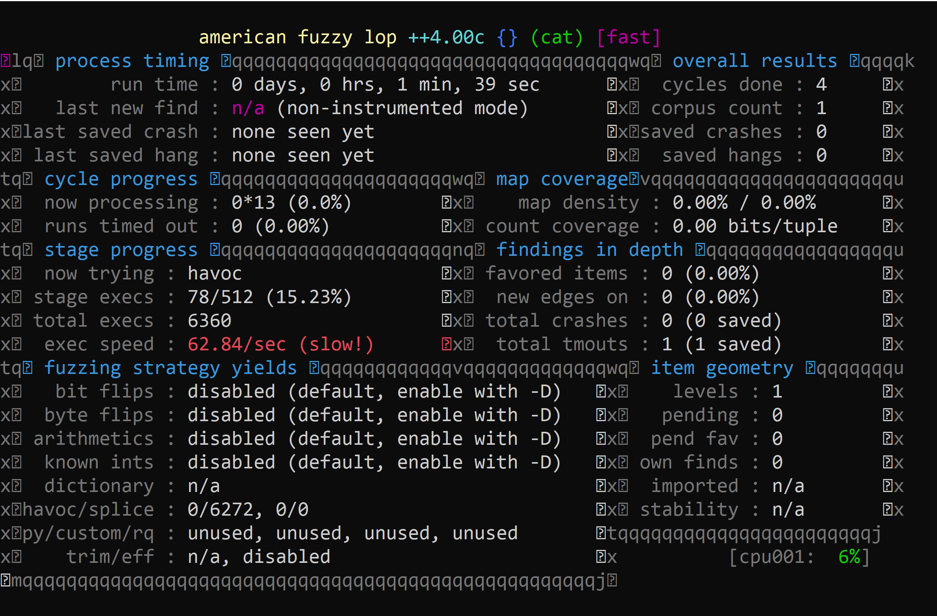
Representative Tool: AFL
Fuzzing
Example command
“traditional Fuzzing”
mkdir in_dir
echo “hello” > in_dir/hello
afl-fuzz -n -i in_dir -o out_dir cat

Slide 23
Representative Tool: AFL
Fuzzing
Instrumentation mode
Compile the program with coverage probes
Attempt to prioritize / mutate test cases that extend coverage
afl-clang++ <build command>

Slide 24
Generation-Based Fuzzing
Fuzzing
Attempt to discern patterns / Alternatives in Input
Potentially with the help of some guide of guide / input grammar

Slide 25
Fuzzing Oracles
Fuzzing
Beyond graceful Failure
In C/C++ there are a lot of violations of proper behavior that are invisible
“Seems fine until it’s a huge problem”
Sanitizers
UBSan – Undefined behavior sanitizer
ASan – Address sanitizer
TSan – Thread sanitizer

Slide 26
Research Direction: “Gunking”
Fuzzing
Fuzzing as adversarial recon
Fuzzing is so good at finding bugs that even the bad guys do it
Perhaps a program should deploy Anti-Fuzzing tech
What would that look like?

Slide 27
Wrap-up
Introduced the concept and the “industry standard” tool of fuzzing
A simple, elegant idea

