Slide 1
ExerCise #11: Dataflow Saturation Review
L1:
%varI = alloca i32
%varJ = alloca i32
store i32 0, ptr %varI
store i32 0, ptr %varJ
br label %L2
Consider the CFG to the right, roughly equivalent to the C code below.
Indicate the value-set computed for *varJ at the end of L6 using the flow-sensitive saturation algorithm described in the last lecture
%v1 = load i32, i32* %varI
%c = icmp slt i32 %v1, 2
br i1 %c, label %L3, label %L6
L2:
T
F
L3:
%b = call i1 @randBit()
br i1 %b, label %L4, label %L5
int i = 0;
int j = 0;
while (i < 2){
if (randBit()){
j += 1;
}
i++;
}
return j;
T
F
L4:
%v2 = load i32, ptr %varJ
%v3 = add i32 %v2, 1
store i32 %v3, ptr %varJ
br label %L5
L5:
%v4 = load i32, ptr %varI
%v5 = add i32 %v4, 1
store i32 %v5, ptr %varI
br label %L2
L6:
%res = load i32, ptr %varJ
ret i32 %res

Slide 4
Administrivia and Announcements

Slide 5
Abstract interpretation
EECS 677: Software Security Evaluation
Drew Davidson

Slide 6
Last Time: Saturation
Review: Static Analysis
Extending our basic dataflow to loops
No obvious start-point for analysis (circular dependence)
No obvious end-point (can’t necessarily do with a single pass)
Chaotic iteration
Run the algorithm until it hits a fixpoint
Reaching Fixpoints Faster
Intuitively: add some extra over-approximation
Perform an operation until it
stops making progress

Slide 7
Lecture Outline
Enhancing Dataflow analysis
Lattices
Abstract Interpretation

Slide 8
ExerCise #7: Dataflow Saturation Review
L1:
%varI = alloca i32
%varJ = alloca i32
store i32 0, ptr %varI
store i32 0, ptr %varJ
br label %L2
int i = 0;
int j = 0;
while (i < 2){
if (randBit()){
j += 1;
}
i++;
}
return j;
%v1 = load i32, i32* %varI
%c = icmp slt i32 %v1, 2
br i1 %c, label %L3, label %L6
Idea 1: Allow the br instruction to partition
value sets according to the condition
L2:
T
F
L3:
%b = call i1 @randBit()
br i1 %b, label %Lb, label %L5
T
F
L4:
%v2 = load i32, ptr %varJ
%v3 = add i32 %v2, 1
store i32 %v3, ptr %varJ
br label %Li
L5:
%v4 = load i32, ptr %varI
%v5 = add i32 %v4, 1
store i32 %v5, ptr %varI
br label %Lh
L6:
%res = load i32, ptr %varJ
ret i32 %res

Slide 9
ExerCise #7: Dataflow Saturation Review
L1:
%varI = alloca i32
%varJ = alloca i32
store i32 0, ptr %varI
store i32 0, ptr %varJ
br label %L2
int i = 0;
int j = 0;
while (i < 2){
if (randBit()){
j += 1;
}
i++;
}
return j;
 | *varI | *varJ
L1 in
L1->L2
L2 in
L2->L3
L2->L6
L3 in
L3->L4
L3->L5
L4 in
L4->L5
L5 in
L5->L2
L6 in
L6 end
ANY
ANY
ANY
{0}
ANY
{0}
ANY
ANY
$$⋃$$
L1→L2
L5→L2
%v1 = load i32, i32* %varI
%c = icmp slt i32 %v1, 2
br i1 %c, label %L3, label %L6
L2:
ANY
{0,1}
ANY
ANY
{2,3,…}
ANY
T
F
ANY
{0,1}
ANY
L2→L3
L3:
%b = call i1 @randBit()
br i1 %b, label %Lb, label %L5
ANY
{0,1}
ANY
T
ANY
ANY
F
L4:
%v2 = load i32, ptr %varJ
%v3 = add i32 %v2, 1
store i32 %v3, ptr %varJ
br label %Li
ANY
{0,1}
ANY
L3→L4
ANY
ANY
ANY
{0,1}
ANY
$$⋃$$
L3→L5
L4→L5
L5:
%v4 = load i32, ptr %varI
%v5 = add i32 %v4, 1
store i32 %v5, ptr %varI
br label %Lh
ANY
{0,1,2}
ANY
ANY
{2,3,…}
ANY
L2→L6
ANY
{2,3,…}
ANY
L6:
%res = load i32, ptr %varJ
ret i32 %res

Slide 10
ExerCise #7: Dataflow Saturation Review
L1:
%varI = alloca i32
%varJ = alloca i32
store i32 0, ptr %varI
store i32 0, ptr %varJ
br label %L2
int i = 0;
int j = 0;
while (i < 2){
if (randBit()){
j += 1;
}
i++;
}
return j;
 | *varI | *varJ
L1 in
L1->L2
L2 in
L2->L3
L2->L6
L3 in
L3->L4
L3->L5
L4 in
L4->L5
L5 in
L5->L2
L6 in
L6 end
ANY
ANY
ANY
{0}
ANY
{0}
ANY
ANY
$$⋃$$
L1→L2
L5→L2
%v1 = load i32, i32* %varI
%c = icmp slt i32 %v1, 2
br i1 %c, label %L3, label %L6
L2:
ANY
{0,1}
ANY
ANY
{2,3,…}
ANY
T
F
ANY
{0,1}
ANY
L2→L3
L3:
%b = call i1 @randBit()
br i1 %b, label %Lb, label %L5
ANY
{0,1}
ANY
T
ANY
ANY
F
L4:
%v2 = load i32, ptr %varJ
%v3 = add i32 %v2, 1
store i32 %v3, ptr %varJ
br label %Li
ANY
{0,1}
ANY
L3→L4
ANY
ANY
ANY
{0,1}
ANY
$$⋃$$
L3→L5
L4→L5
L5:
%v4 = load i32, ptr %varI
%v5 = add i32 %v4, 1
store i32 %v5, ptr %varI
br label %Lh
ANY
{0,1,2}
ANY
ANY
{2,3,…}
ANY
L2→L6
ANY
{2,3,…}
ANY
L6:
%res = load i32, ptr %varJ
ret i32 %res

Slide 11
ExerCise #7: Dataflow Saturation Review
L1:
%varI = alloca i32
%varJ = alloca i32
store i32 0, ptr %varI
store i32 0, ptr %varJ
br label %L2
int i = 0;
int j = 0;
while (i < 2){
if (randBit()){
j += 1;
}
i++;
}
return j;
%v1 = load i32, i32* %varI
%c = icmp slt i32 %v1, 2
br i1 %c, label %L3, label %L6
Idea 1: Allow the br instruction to partition
value sets according to the condition
L2:
T
F
Idea 2: Create a distinguished uninitialized value (?)
That is distinct from the ANY value
L3:
%b = call i1 @randBit()
br i1 %b, label %Lb, label %L5
T
F
L4:
%v2 = load i32, ptr %varJ
%v3 = add i32 %v2, 1
store i32 %v3, ptr %varJ
br label %Li
L5:
%v4 = load i32, ptr %varI
%v5 = add i32 %v4, 1
store i32 %v5, ptr %varI
br label %Lh
L6:
%res = load i32, ptr %varJ
ret i32 %res

Slide 12
ExerCise #7: Dataflow Saturation Review
L1:
%varI = alloca i32
%varJ = alloca i32
store i32 0, ptr %varI
store i32 0, ptr %varJ
br label %L2
int i = 0;
int j = 0;
while (i < 2){
if (randBit()){
j += 1;
}
i++;
}
return j;
 | *varI | *varJ
L1 in
L1->L2
L2 in
L2->L3
L2->L6
L3 in
L3->L4
L3->L5
L4 in
L4->L5
L5 in
L5->L2
L6 in
L6 end
?
?
?
{0}
?
{0}
?
{0}
{0,1}
?
{0}
{0,1}
{0,1,2}
L1→L2
L5→L2
{0,1,2}
$$⋃$$
%v1 = load i32, i32* %varI
%c = icmp slt i32 %v1, 2
br i1 %c, label %L3, label %L6
L2:
?
{0}
{0,1}
?
{0}
{0,1}
?
{2}
?
{0,1,2}
T
F
?
{0}
{0,1}
?
{0}
{0,1}
L2→L3
L3:
%b = call i1 @randBit()
br i1 %b, label %Lb, label %L5
?
{0}
{0,1}
?
{0}
{0,1}
T
?
{0}
{0,1}
?
{0}
{0,1}
F
L4:
%v2 = load i32, ptr %varJ
%v3 = add i32 %v2, 1
store i32 %v3, ptr %varJ
br label %Li
?
{0}
{0,1}
?
{0}
{0,1}
L3→L4
?
{0}
{0,1}
?
{1}
{1,2}
?
{0}
{0,1}
?
{0,1}
{0,1,2}
$$⋃$$
L3→L5
L4→L5
L5:
%v4 = load i32, ptr %varI
%v5 = add i32 %v4, 1
store i32 %v5, ptr %varI
br label %Lh
?
{1}
{1,2}
?
{0,1}
{0,1,2}
?
{2}
?
{0,1,2}
L2→L6
?
{2}
?
{0,1,2}
L6:
%res = load i32, ptr %varJ
ret i32 %res

Slide 13
ExerCise #7: Dataflow Saturation Review
L1:
%varI = alloca i32
%varJ = alloca i32
store i32 0, ptr %varI
store i32 0, ptr %varJ
br label %L2
int i = 0;
int j = 0;
while (i < 2){
if (randBit()){
j += 1;
}
i++;
}
return j;
 | *varI | *varJ
L1 in
L1->L2
L2 in
L2->L3
L2->L6
L3 in
L3->L4
L3->L5
L4 in
L4->L5
L5 in
L5->L2
L6 in
L6 end
?
?
?
?
?
?
?
?
{0}
{0}
{0}
?
{0}
{0}
?
{0}
{0,1}
?
{0}
{0,1}
{0,1,2}
L1→L2
L5→L2
{0,1,2}
$$⋃$$
%v1 = load i32, i32* %varI
%c = icmp slt i32 %v1, 2
br i1 %c, label %L3, label %L6
L2:
?
{0}
{0,1}
{0,1}
?
{0}
{0,1}
?
?
?
{2}
?
?
?
T
F
?
{0}
{0,1}
{0,1}
?
{0}
{0,1}
L2→L3
L3:
%b = call i1 @randBit()
br i1 %b, label %Lb, label %L5
?
{0}
{0,1}
{0,1}
?
{0}
{0,1}
T
?
{0}
{0,1}
{0,1}
?
{0}
{0,1}
F
L4:
%v2 = load i32, ptr %varJ
%v3 = add i32 %v2, 1
store i32 %v3, ptr %varJ
br label %Li
?
{0}
{0,1}
{0,1}
?
{0}
{0,1}
L3→L4
?
{0}
{0,1}
{0,1}
?
{1}
{1,2}
?
{0}
{0,1}
{0,1}
?
{0,1}
{0,1,2}
$$⋃$$
L3→L5
L4→L5
L5:
%v4 = load i32, ptr %varI
%v5 = add i32 %v4, 1
store i32 %v5, ptr %varI
br label %Lh
?
{1}
{1,2}
{1,2}
?
{0,1}
{0,1,2}
?
?
?
{2}
?
?
{0,1,2}
L2→L6
?
?
?
{2}
?
?
{0,1,2}
L6:
%res = load i32, ptr %varJ
ret i32 %res

Slide 14
Lecture Outline
Enhancing Dataflow analysis
Lattices
Abstract Interpretation

Slide 15
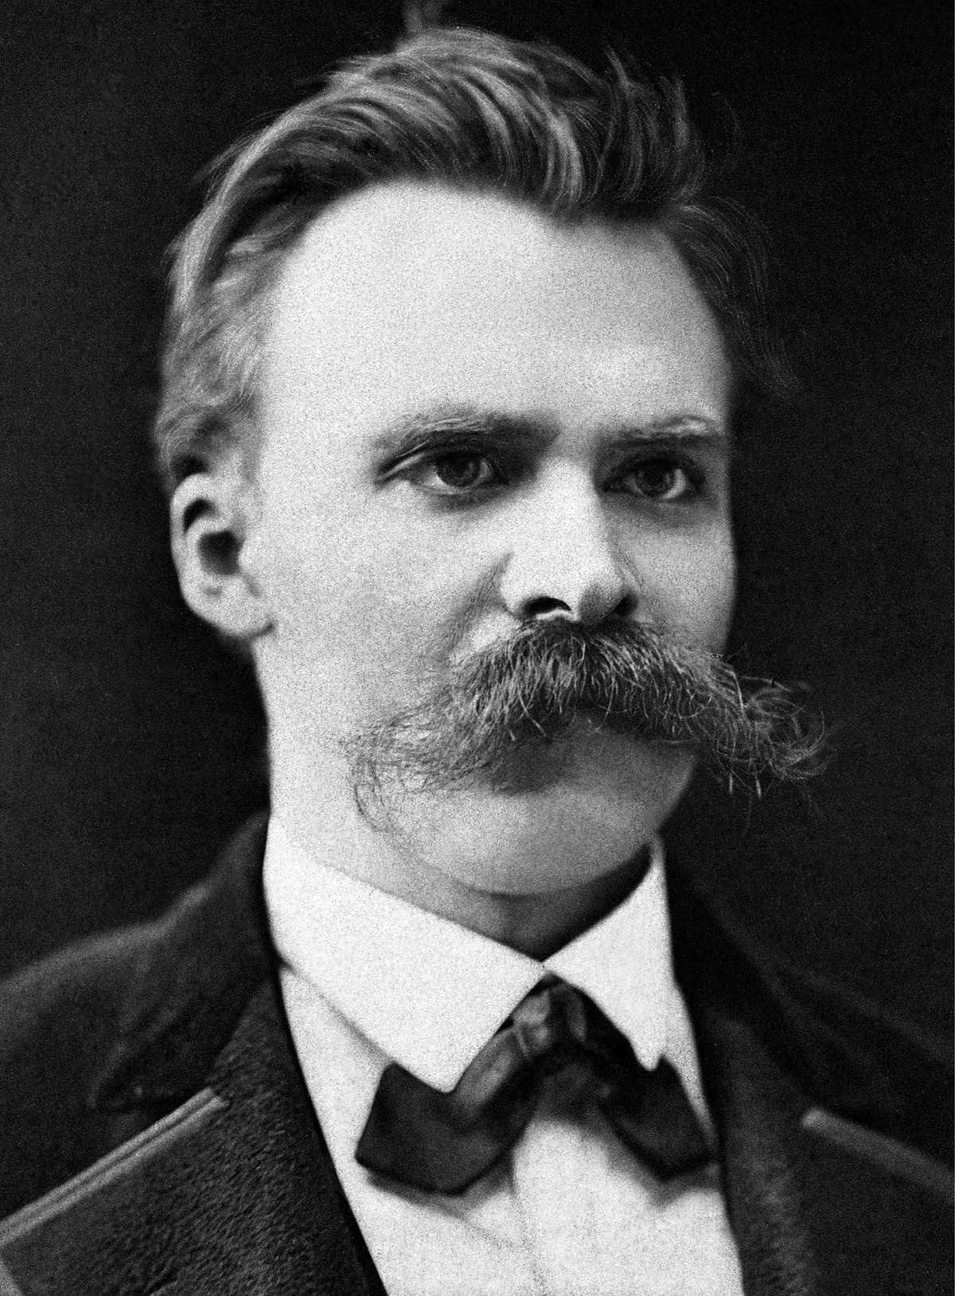
Does our Analysis Terminate?
Abstract Interpretation
We’ve spent some time on some uncomfortable truths:
Programs are often full of subtle bugs / vulnerabilities
It is effectively impossible to tell if an arbitrary program terminates
Bad news: our analysis engine in a program
What assurance do we have that our algorithm terminates as it analyzes an unknown / untrusted program?
“Whoever fights monsters should see to it that in the process he does not become a monster. And when you look long into an abyss, the abyss also looks into you.”
- Friedrich Nietzsche

Slide 16
Formalizing Termination
Dataflow Frameworks
Our value-set analyses (appeared to) have some nice properties
Guaranteed termination
Completeness in values found
A couple of conditions happened to occur:
Claims
A domain D of dataflow facts with a particular ordering
An operator to combine distinct dataflow facts
A dataflow function f_{n}: D $→$ D that defines the effect of BBL_{n}
Sets of possible integer values
Bold Claims
Union over value-sets
Composition of the individual instruction transfer functions

Slide 17
Formalizing Termination
Dataflow Frameworks
{00,01,10,11}
Value-Set “Rank”
(2-bit computer)
{01,10,11}
{00,10,11}
{00,01,11}
{00,01,10}
{00,01}
{01,10}
{00,10}
{00,11}
{01,11}
{10,11}
{00}
{01}
{10}
{11}
?

Slide 18
Domain Needs
Dataflow Frameworks
Some Basic Definitions
A partially-ordered set (poset) is a set S and a partial ordering $⊆$, such that the ordering $⊆$ is:
Reflexive
Anti-symmetric
Transitive
Example 1: S: English words, $⊆$ substring
Poset:
Lattice:
Example 2: S: English words, $⊆$ shorter or equal in length
A lattice is a poset in which each pair of elements has
A least upper bound (the join)
for x and y, the join z is defined such that:
- x $⊆$ z and
- y $⊆$ z and
- for all w such that x $⊆$ w and y $⊆$ w, w $⊇$ z
A greatest lower bound (the meet)
basically the same deal, but reversed
Poset:
Lattice:
Example 3: S: integers, $⊆$ as lte
Poset:
Lattice:
No upper bound
lower than z
z is actually an upper bound
Example 4: S: integers, $⊆$ as lt
Poset:
Lattice:
A complete lattice is a lattice in which all subsets have a meet and join
Example 5: S: set of all sets of letters, $⊆$ is subset
Poset:
Lattice:

