Slide 1

Exercise 10
L1:
%varI = alloca i32
%varJ = alloca i32
store i32 0, ptr %varI
store i32 0, ptr %varJ
br label %L2
Consider the CFG to the right, roughly equivalent to the C code below.
Indicate the value-set computed for *varJ at the end of L6 using the flow-sensitive saturation algorithm described in the last lecture
%v1 = load i32, i32* %varI
%c = icmp slt i32 %v1, 2
br i1 %c, label %L3, label %L6
L2:
T
F
L3:
%b = call i1 @randBit()
br i1 %b, label %L4, label %L5
int i = 0;
int j = 0;
while (i < 2){
if (randBit()){
j += 1;
}
i++;
}
return j;
T
F
L4:
%v2 = load i32, ptr %varJ
%v3 = add i32 %v2, 1
store i32 %v3, ptr %varJ
br label %L5
L5:
%v4 = load i32, ptr %varI
%v5 = add i32 %v4, 1
store i32 %v5, ptr %varI
br label %L2
L6:
%res = load i32, ptr %varJ
ret i32 %res

Slide 2
Administrivia and
Announcements

Slide 3
Abstract interpretation
EECS 677: Software Security Evaluation
Drew Davidson

Slide 4
Last Time: Saturation
Review: Static Analysis
Extending our basic dataflow to loops
No obvious start-point for analysis (circular dependence)
No obvious end-point (can’t necessarily do with a single pass)
Initializer values
Run the algorithm until the sets saturate
Terminate at saturation point (aka Fixpoint)
Perform an operation until it
stops making progress

Slide 5
Lecture Outline
Formalizing Dataflow
Lattices
Abstract Interpretation

Slide 6
Dataflow Saturation Review
L1:
%varI = alloca i32
%varJ = alloca i32
store i32 0, ptr %varI
store i32 0, ptr %varJ
br label %L2
int i = 0;
int j = 0;
while (i < 2){
if (randBit()){
j += 1;
}
i++;
}
return j;
%v1 = load i32, i32* %varI
%c = icmp slt i32 %v1, 2
br i1 %c, label %L3, label %L6
Idea 1: Allow the br instruction to partition
value sets according to the condition
L2:
T
F
L3:
%b = call i1 @randBit()
br i1 %b, label %Lb, label %L5
T
F
L4:
%v2 = load i32, ptr %varJ
%v3 = add i32 %v2, 1
store i32 %v3, ptr %varJ
br label %Li
L5:
%v4 = load i32, ptr %varI
%v5 = add i32 %v4, 1
store i32 %v5, ptr %varI
br label %Lh
L6:
%res = load i32, ptr %varJ
ret i32 %res

Slide 7


Dataflow Saturation Review
L1:
%varI = alloca i32
%varJ = alloca i32
store i32 0, ptr %varI
store i32 0, ptr %varJ
br label %L2
int i = 0;
int j = 0;
while (i < 2){
if (randBit()){
j += 1;
}
i++;
}
return j;
 | *varI | *varJ
L1 in
L1->L2
L2 in
L2->L3
L2->L6
L3 in
L3->L4
L3->L5
L4 in
L4->L5
L5 in
L5->L2
L6 in
L6 end
ANY
ANY
ANY
{0}
ANY
{0}
ANY
ANY
$$⋃$$
L1→L2
L5→L2
%v1 = load i32, i32* %varI
%c = icmp slt i32 %v1, 2
br i1 %c, label %L3, label %L6
L2:
ANY
{0,1}
ANY
ANY
{2,3,…}
ANY
T
F
ANY
{0,1}
ANY
L2→L3
L3:
%b = call i1 @randBit()
br i1 %b, label %Lb, label %L5
ANY
{0,1}
ANY
T
ANY
ANY
F
L4:
%v2 = load i32, ptr %varJ
%v3 = add i32 %v2, 1
store i32 %v3, ptr %varJ
br label %Li
ANY
{0,1}
ANY
L3→L4
ANY
ANY
ANY
{0,1}
ANY
$$⋃$$
L3→L5
L4→L5
L5:
%v4 = load i32, ptr %varI
%v5 = add i32 %v4, 1
store i32 %v5, ptr %varI
br label %Lh
ANY
{0,1,2}
ANY
ANY
{2,3,…}
ANY
L2→L6
ANY
{2,3,…}
ANY
L6:
%res = load i32, ptr %varJ
ret i32 %res

Slide 8

Dataflow Saturation Review
L1:
%varI = alloca i32
%varJ = alloca i32
store i32 0, ptr %varI
store i32 0, ptr %varJ
br label %L2
int i = 0;
int j = 0;
while (i < 2){
if (randBit()){
j += 1;
}
i++;
}
return j;
 | *varI | *varJ
L1 in
L1->L2
L2 in
L2->L3
L2->L6
L3 in
L3->L4
L3->L5
L4 in
L4->L5
L5 in
L5->L2
L6 in
L6 end
ANY
ANY
ANY
{0}
ANY
{0}
ANY
ANY
$$⋃$$
L1→L2
L5→L2
%v1 = load i32, i32* %varI
%c = icmp slt i32 %v1, 2
br i1 %c, label %L3, label %L6
L2:
ANY
{0,1}
ANY
ANY
{2,3,…}
ANY
T
F
ANY
{0,1}
ANY
L2→L3
L3:
%b = call i1 @randBit()
br i1 %b, label %Lb, label %L5
ANY
{0,1}
ANY
T
ANY
ANY
F
L4:
%v2 = load i32, ptr %varJ
%v3 = add i32 %v2, 1
store i32 %v3, ptr %varJ
br label %Li
ANY
{0,1}
ANY
L3→L4
ANY
ANY
ANY
{0,1}
ANY
$$⋃$$
L3→L5
L4→L5
L5:
%v4 = load i32, ptr %varI
%v5 = add i32 %v4, 1
store i32 %v5, ptr %varI
br label %Lh
ANY
{0,1,2}
ANY
ANY
{2,3,…}
ANY
L2→L6
ANY
{2,3,…}
ANY
L6:
%res = load i32, ptr %varJ
ret i32 %res

Slide 9
Dataflow Saturation Review
L1:
%varI = alloca i32
%varJ = alloca i32
store i32 0, ptr %varI
store i32 0, ptr %varJ
br label %L2
int i = 0;
int j = 0;
while (i < 2){
if (randBit()){
j += 1;
}
i++;
}
return j;
%v1 = load i32, i32* %varI
%c = icmp slt i32 %v1, 2
br i1 %c, label %L3, label %L6
Idea 1: Allow the br instruction to partition
value sets according to the condition
L2:
T
F
Idea 2: Create a distinguished uninitialized value (?)
That is distinct from the ANY value
L3:
%b = call i1 @randBit()
br i1 %b, label %Lb, label %L5
T
F
L4:
%v2 = load i32, ptr %varJ
%v3 = add i32 %v2, 1
store i32 %v3, ptr %varJ
br label %Li
L5:
%v4 = load i32, ptr %varI
%v5 = add i32 %v4, 1
store i32 %v5, ptr %varI
br label %Lh
L6:
%res = load i32, ptr %varJ
ret i32 %res

Slide 10

Dataflow Saturation Review
L1:
%varI = alloca i32
%varJ = alloca i32
store i32 0, ptr %varI
store i32 0, ptr %varJ
br label %L2
int i = 0;
int j = 0;
while (i < 2){
if (randBit()){
j += 1;
}
i++;
}
return j;
 | *varI | *varJ
L1 in
L1->L2
L2 in
L2->L3
L2->L6
L3 in
L3->L4
L3->L5
L4 in
L4->L5
L5 in
L5->L2
L6 in
L6 end
?
?
?
{0}
?
{0}
?
{0}
{0,1}
?
{0}
{0,1}
{0,1,2}
L1→L2
L5→L2
{0,1,2}
$$⋃$$
%v1 = load i32, i32* %varI
%c = icmp slt i32 %v1, 2
br i1 %c, label %L3, label %L6
L2:
?
{0}
{0,1}
?
{0}
{0,1}
?
{2}
?
{0,1,2}
T
F
?
{0}
{0,1}
?
{0}
{0,1}
L2→L3
L3:
%b = call i1 @randBit()
br i1 %b, label %Lb, label %L5
?
{0}
{0,1}
?
{0}
{0,1}
T
?
{0}
{0,1}
?
{0}
{0,1}
F
L4:
%v2 = load i32, ptr %varJ
%v3 = add i32 %v2, 1
store i32 %v3, ptr %varJ
br label %Li
?
{0}
{0,1}
?
{0}
{0,1}
L3→L4
?
{0}
{0,1}
?
{1}
{1,2}
?
{0}
{0,1}
?
{0,1}
{0,1,2}
$$⋃$$
L3→L5
L4→L5
L5:
%v4 = load i32, ptr %varI
%v5 = add i32 %v4, 1
store i32 %v5, ptr %varI
br label %Lh
?
{1}
{1,2}
?
{0,1}
{0,1,2}
?
{2}
?
{0,1,2}
L2→L6
?
{2}
?
{0,1,2}
L6:
%res = load i32, ptr %varJ
ret i32 %res

Slide 11
Dataflow Saturation Review
L1:
%varI = alloca i32
%varJ = alloca i32
store i32 0, ptr %varI
store i32 0, ptr %varJ
br label %L2
int i = 0;
int j = 0;
while (i < 2){
if (randBit()){
j += 1;
}
i++;
}
return j;
 | *varI | *varJ
L1 in
L1->L2
L2 in
L2->L3
L2->L6
L3 in
L3->L4
L3->L5
L4 in
L4->L5
L5 in
L5->L2
L6 in
L6 end
?
?
?
?
?
?
?
?
{0}
{0}
{0}
?
{0}
{0}
?
{0}
{0,1}
?
{0}
{0,1}
{0,1,2}
L1→L2
L5→L2
{0,1,2}
$$⋃$$
%v1 = load i32, i32* %varI
%c = icmp slt i32 %v1, 2
br i1 %c, label %L3, label %L6
L2:
?
{0}
{0,1}
{0,1}
?
{0}
{0,1}
?
?
?
{2}
?
?
?
T
F
?
{0}
{0,1}
{0,1}
?
{0}
{0,1}
L2→L3
L3:
%b = call i1 @randBit()
br i1 %b, label %Lb, label %L5
?
{0}
{0,1}
{0,1}
?
{0}
{0,1}
T
?
{0}
{0,1}
{0,1}
?
{0}
{0,1}
F
L4:
%v2 = load i32, ptr %varJ
%v3 = add i32 %v2, 1
store i32 %v3, ptr %varJ
br label %Li
?
{0}
{0,1}
{0,1}
?
{0}
{0,1}
L3→L4
?
{0}
{0,1}
{0,1}
?
{1}
{1,2}
?
{0}
{0,1}
{0,1}
?
{0,1}
{0,1,2}
$$⋃$$
L3→L5
L4→L5
L5:
%v4 = load i32, ptr %varI
%v5 = add i32 %v4, 1
store i32 %v5, ptr %varI
br label %Lh
?
{1}
{1,2}
{1,2}
?
{0,1}
{0,1,2}
?
?
?
{2}
?
?
{0,1,2}
L2→L6
?
?
?
{2}
?
?
{0,1,2}
L6:
%res = load i32, ptr %varJ
ret i32 %res

Slide 12
Goals and Needs
Abstract Interpretation
Goal: find potential divide-by-zero operations
Avert availability issue
Problem #1: value uncertainty
Problem #2: unbounded paths
Problem #3: cyclic dependency
Problem #4: tedious Saturation

Slide 13
Shortcut to Saturation
Dataflow Frameworks
Observation
You necessarily reach saturation once your set contains EVERY possible value
Widening
Place extra values in the set

Slide 14

Implementation Considerations
Dataflow Frameworks
How would you code up a flow-sensitive DFA?
Efficient (and correct!) data representation
Efficient (guaranteed terminating!) runtime
Generic / re-usable
od

Slide 15
Lecture Outline
Abstract Interpretation
Generalizing Dataflow
Dataflow Frameworks

Slide 16
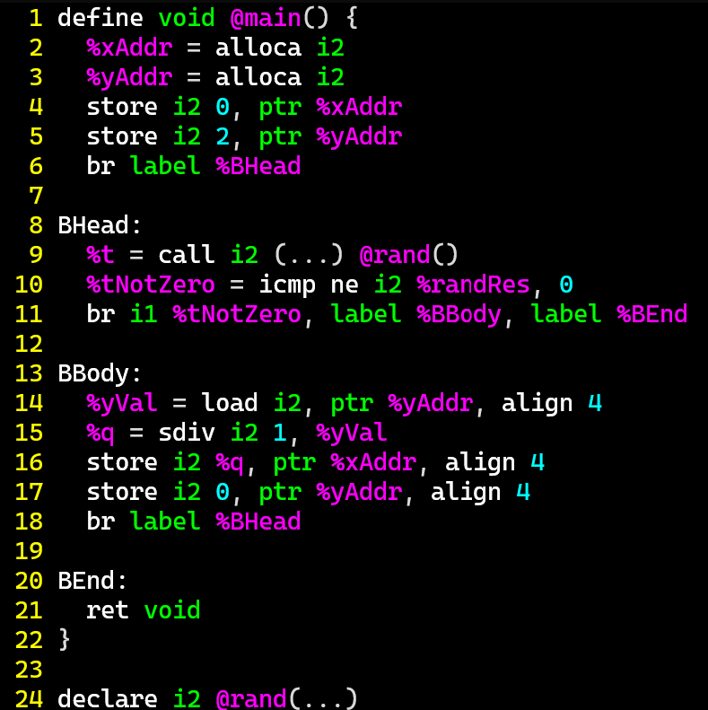
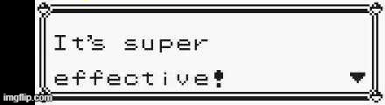
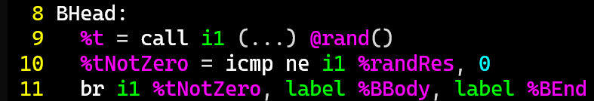
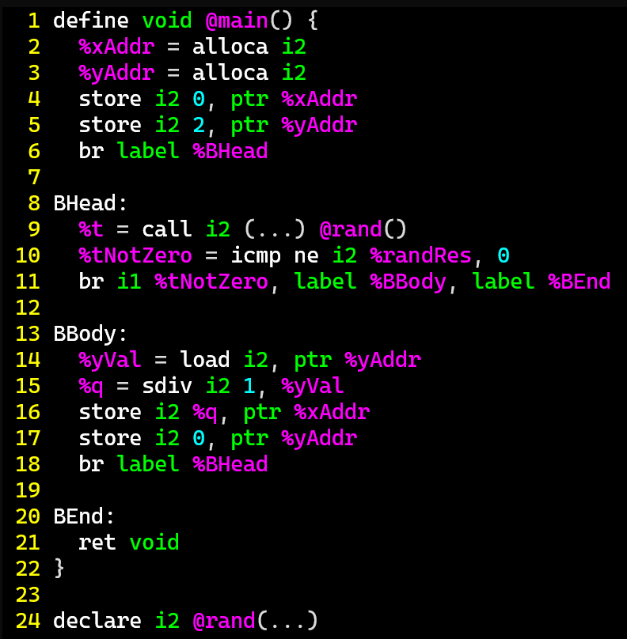
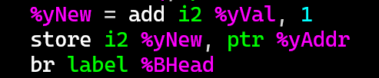
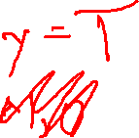
Abstract placeholders
Dataflow Frameworks
Are you really going to carry around the set of
ALL integers?
Use a placeholder for the “ALL INTEGERS” set
Works great for large sets!
1. int2 x = 0;
2. int2 y = 2;
3. int1 t;
4. while (t=rand()){
5. y = y+1;
6. }
7. return y;

Slide 17
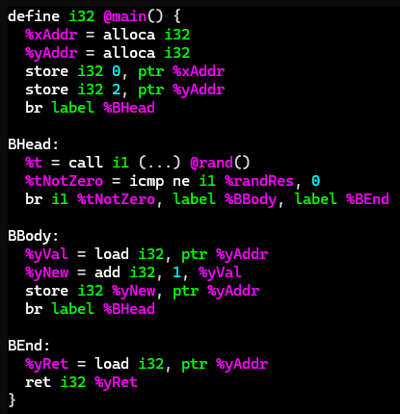

Abstract placeholders
Dataflow Frameworks
Are you really going to carry around the set of
ALL integers?
Use a placeholder for the “ALL INTEGERS” set
Works great for large sets!
1. int32 x = 0;
2. int32 y = 2;
3. int1 t;
4. while (t=rand()){
5. y = y+1;
6. }
7. return y;
While we’re at it, maybe we can abstract other values-set too

Slide 18
abstract DomainS
Dataflow Frameworks
BIG IDEA:
Operate over abstract values that represent sets of concrete values
From the Concrete Domain to the Abstract
α({0}) = | zero
α(S) = | if all values in S are greater than 0 then pos
 | else if all values in S are less than 0 then neg
 | else num
From the Abstract Domain to the Concrete
γ(zero) = {0}
γ(pos) = {all positive ints}
γ(neg) = {all negative ints}
γ(num) = Int (i.e., all ints)

Slide 19
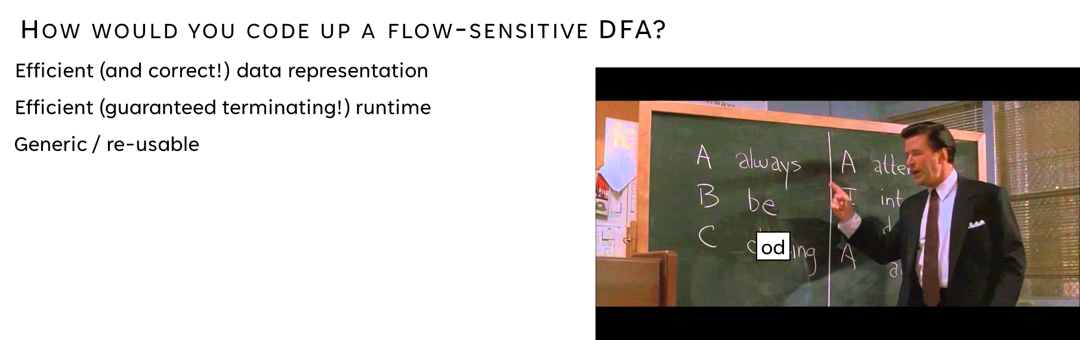
Is it correct?
Dataflow Frameworks
Constraints needed:
On “ranking” domain elements
On combining domain elements

Slide 20

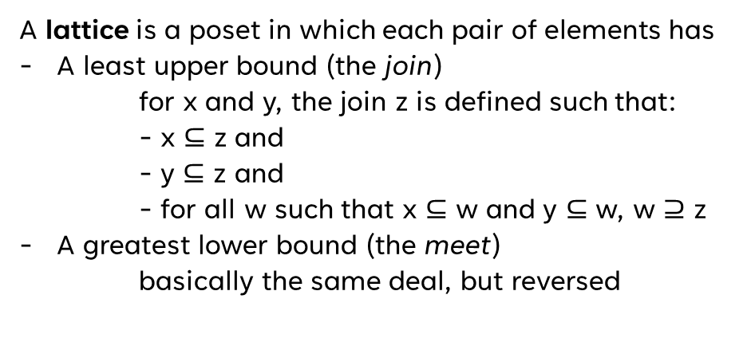

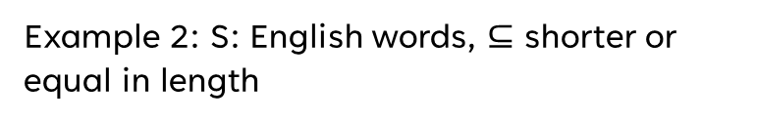

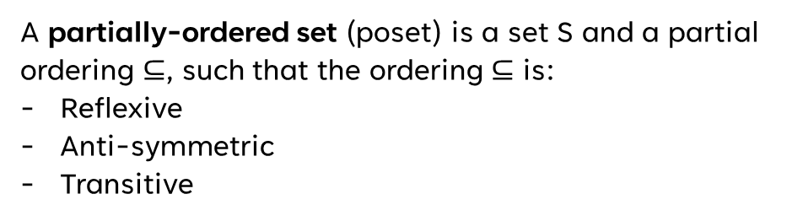
Domain Needs
Dataflow Frameworks
Some Basic Definitions
A partially-ordered set (poset) is a set S and a partial ordering $⊆$, such that the ordering $⊆$ is:
Reflexive
Anti-symmetric
Transitive
Example 1: S: English words, $⊆$ substring
Poset:
Lattice:
Example 2: S: English words, $⊆$ shorter or equal in length
A lattice is a poset in which each pair of elements has
A least upper bound (the join)
  for x and y, the join z is defined such that:
  - x $⊆$ z and
  - y $⊆$ z and
  - for all w such that x $⊆$ w and y $⊆$ w, w $⊇$ z
A greatest lower bound (the meet)
basically the same deal, but reversed
Poset:
Lattice:
Example 3: S: integers, $⊆$ as lte
Poset:
Lattice:
No upper bound
lower than z
z is actually an upper bound
Example 4: S: integers, $⊆$ as lt
Poset:
Lattice:
A complete lattice is a lattice in which all subsets have a meet and join
Example 5: S: set of all sets of letters, $⊆$ is subset
Poset:
Lattice:

Slide 21
Fact datatype NEEDs
Dataflow Frameworks
Formal(ish) requirements
poset
A fact datatype (ideally of unbounded size)
An ordering that indicates progress
Unique solution
A guarantee of a finite number of steps to hit the maximum value
An update step that never loses progress
Try-outs
poset
Lattice
Complete lattice

Slide 22
Fact datatype NEEDs
Dataflow Frameworks
Formal(ish) requirements
Lattice
A fact datatype (ideally of unbounded size)
Poset with a least upper bound and a greatest lower bound
An ordering that indicates progress
Unique solution
A guarantee of a finite number of steps to hit the maximum value
An update step that never loses progress
Try-outs
poset
Lattice
Complete lattice

Slide 23

A Very Approximate Lattice
Abstract Interpretation
Abstract Domain of Signs
{-2, -1, 0, 1}
num
{-2, 0, 1}
{-2, -1, 0}
{-1, 0, 1}
{-2, -1, 1}
pos
zero
neg
{-2, -1}
{-2, 0}
{-1, 0}
{-2, 1}
{-1, 1}
{0, 1}
$$∅$$
{-2}
{-1}
{0}
{1}

Slide 24
A LESS-Approximate Lattice
Abstract Interpretation
Abstract Domain of Signs
{-2, -1, 0, 1}
num
{-2, 0, 1}
{-2, -1, 0}
{-1, 0, 1}
{-2, -1, 1}
≥ zero
≤ zero
pos
zero
neg
{-2, -1}
{-2, 0}
{-1, 0}
{-2, 1}
{-1, 1}
{0, 1}
$$∅$$
{-2}
{-1}
{0}
{1}

Slide 25

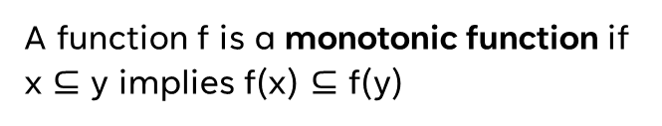
Function NEEDs
Dataflow Frameworks
Some Basic Definitions
A function f is a monotonic function if x $⊆$ y implies f(x) $⊆$ f(y)
An element z is a fixpoint of f iff z = f(z)

Slide 26

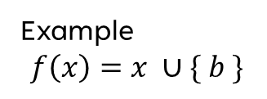







Function NEEDs
Dataflow Frameworks
Example
$$f\left(x\right)=x ∪\{ b \}$$
Some Basic Definitions
$\{b\}$ is a fixpoint of f
$$f\left(\{b\}\right)=\{ b \}$$
A function f is a monotonic function if x $⊆$ y implies f(x) $⊆$ f(y)
$$f\left(\{a\}\right)=\{ a, b \}$$
$\{a\}$ is not a fixpoint of f
$$f\left(\{a,b\}\right)=\{ a,b \}$$
$\{a,b\}$ is a fixpoint of f
An element z is a fixpoint of f iff z = f(z)
$f(f\left(\left\{a\right\}\right))$ is a fixpoint of f
$f(f\left(any set\right))$ is a fixpoint of f

Slide 27

Why Does this Matter?
Dataflow Frameworks
Every finite lattice
is a complete lattice
Practical Upshot
If L is a complete lattice and f is monotonic, then f has a greatest fixpoint and a least fixpoint
If L has no infinite ascending chains, the least fixpoint can be computed by iterative application of f
So the analysis will terminate

Slide 28
Lecture Outline
Enhancing Dataflow analysis
Lattices
Abstract Interpretation

Slide 29

Analysis Precision
Abstract Interpretation
Precision / Efficiency Tradeoff
With a complete lattice we can, in theory, eventually terminate
The shallower the lattice, the faster the fixpoint
That’s not a very strong guarantee!
Choose to approximate the lattice

Slide 30


Chaotic Iteration
Static Analysis: Control Flow Graphs
A Worklist algorithm
Chaotic
Iteration
Select the next worklist item in any order
Necessarily assumes progress towards some goal
Dealing with “uncomputed” sets
Assume a reasonable “initial” value
Surprisingly, not a band with merch at Hot Topic

Slide 31

Analysis Precision
Abstract Interpretation
Precision / Efficiency Tradeoff
With a complete lattice we can, in theory, eventually terminate
The shallower the lattice, the faster the fixpoint
That’s not a very strong guarantee!
Choose to approximate the lattice

Slide 32
Analysis Precision
Abstract Interpretation
1. int x = 0;
2. int y = 0;
3. while (INPUT){
true
1. int x = 0;
2. int y = 0;
3. while (INPUT){
4. if (x > 0)
5. if (x < 0)
6. y = y / 0;
7. x++;
}
return;
4. if (x > 0){
true
5. if (x < 0){
false
false
true
false
6. y = y / 0;
7. x++
8. }
9. return;

Slide 33
Analysis Precision
Abstract Interpretation
1. int x = 0;
2. int y = 0;
3. while (INPUT){
true
1. int x = 0;
2. int y = 0;
3. while (INPUT){
4. if (x > 0)
5. if (x < 0)
6. y = y / 0;
7. x++;
}
return;
4. if (x > 0){
true
5. if (x < 0){
false
false
true
false
6. y = y / 0;
7. x++
8. }
9. return;

Slide 34
Abstract Domains in Practice
Static Analysis
Intervals
Property Existence
“Singleton Integer Sets”
You know the number, or you don’t
You know a concrete range
A property does or does not hold

Slide 35
Section Summary
Static Analysis
Static Analysis gives us an important guarantee
Anything that isn’t crystal clear to a static analysis tool probably isn’t clear to your fellow programmers, either. The classic hacker disdain for “bondage and discipline languages” is short-sighted – the needs of large, long-lived, multi-programmer projects are just different than the quick work you do for yourself.
- John Carmack's Static Code Analysis post
Completeness of bug finding / Soundness of verification
Thus far we’ve been using source code

