Slide 1
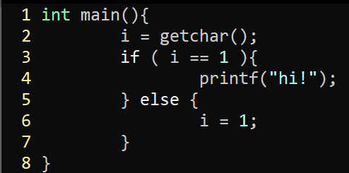
Exercise 16
Dependence Graph Review
Write your name and answer the following on a piece of paper
Draw the Control Dependence Graph for the following program

Slide 2
Exercise 16: Solution
Dependence Graph Review

Slide 3
Exercise 16: Solution
Dependence Graph Review

Slide 4
Exercise 16: Solution
Dependence Graph Review

Slide 5
Exercise 16: Solution
Dependence Graph Review

Slide 6
Administrivia and Announcements

Slide 7
Program Slicing
EECS 677: Software Security Evaluation
Drew Davidson

Slide 8
Last Time: Control Dependence
Review: Last Lecture
Focus the analysis on what we care about
Control Dependence Graph (CDG)
Shows what program statements most immediately decide which others execute

Slide 9
Overview
Extending the Dependence relation and showing its use

Slide 10
Lecture Outline
Data Dependence
PDGs
Slicing

Slide 11
Data Dependence
Dependence Relations
L₁
Influence is more than control, it’s also what values mattered to your behavior
L₂
L₃
L₄
1: READ i;
2: if ( i == 1)
3: PRINT “hi!”
else
4: i = 1;
5: PRINT i;
6: end
L₅
L₆
Note here: a value at L₁ might have set a value at L₅, but it’s not control dependent!

Slide 12
The Data Dependence Graph
Dependence Relations
Depiction of the reaching definitions of each statement
L₁
1: READ i;
2: if ( i == 1)
3: PRINT “hi!”
else
4: i = 1;
5: PRINT i;
6: end
L₂
L₃
L₄
L₅
L₆

Slide 13
The Data Dependence Graph
Dependence Relations
Depiction of the reaching definitions of each statement
L₁
1: READ i;
2: if ( i == 1)
3: PRINT “hi!”
else
4: i = 1;
5: PRINT i;
6: end
L₂
L₁
L₄
L₃
L₆
L₃
L₄
L₂
L₅
L₅
L₆

Slide 14
Lecture Outline
Data Dependence
PDGs
Slicing

Slide 15
The Program Dependence Graph
Dependence Relations
An overlay of the CDG + DDG = PDG
1: READ i;
2: if ( i == 1)
3: PRINT “hi!”
else
4: i = 1;
5: PRINT i;
6: end
E
E
L₁
L₁
L₂
L₅
L₆
L₁
L₂
L₅
L₆
L₂
L₃
L₄
L₃
L₄
L₃
L₄
L₁
L₄
L₃
L₆
L₅
L₆
L₂
L₅

Slide 16
Lecture Outline
Data Dependence
PDGs
Slicing

Slide 17
The “SUB-Program” Concept
Program Slicing
Big Idea: ignore “Irrelevant” functionality for a particular case
Control Dependence Graph (CDG)
Shows what program statements depend on each other
Program Dependence Graph (PDG)
At minimum: A CDG enriched with data dependence information

Slide 18
The Slice of the Program
Program Slicing
Forward Slice
Backwards Slice
Everything influenced by statement K
Everything that influences statement K
Forward reachability in the PDG
Backward reachability in the PDG
x = rand()
y = rand()
x = net_read()
if (y == 1){
printf(“hello”);
}
if (x > 2){
x = 2;
}
array[x] = 4;
x = net_read()
if (x > 2){
x = 2;
}
array[x] = 4;
y = rand()
if (y == 1){
printf(“hello”);
}

Slide 19
Slice Execution
Program Slicing
Do we need our sliced subprogram to BE Executable?
If so, we may need to include additional instructions

Slide 20
Output dependence
Program Slicing
Do we need our sliced subprogram to perform identically to the original?
If so, we’ll need additional output dependence edges

Slide 21
Slicing Summary
Program Slicing
Static Slicing has some promising applications
It’s not a one-size-fits-all scalability panacea
Any (sound) slicing is likely a benefit!
Some applications Beyond analysis
Automatic parallelization
Software metrics (how big of a change is this refactor?)

Slide 22
Analysis Tools
Switching Gears
We’ve Covered several popular analysis techniques for imperative programming
Let’s talk a bit about their tooling

Slide 23
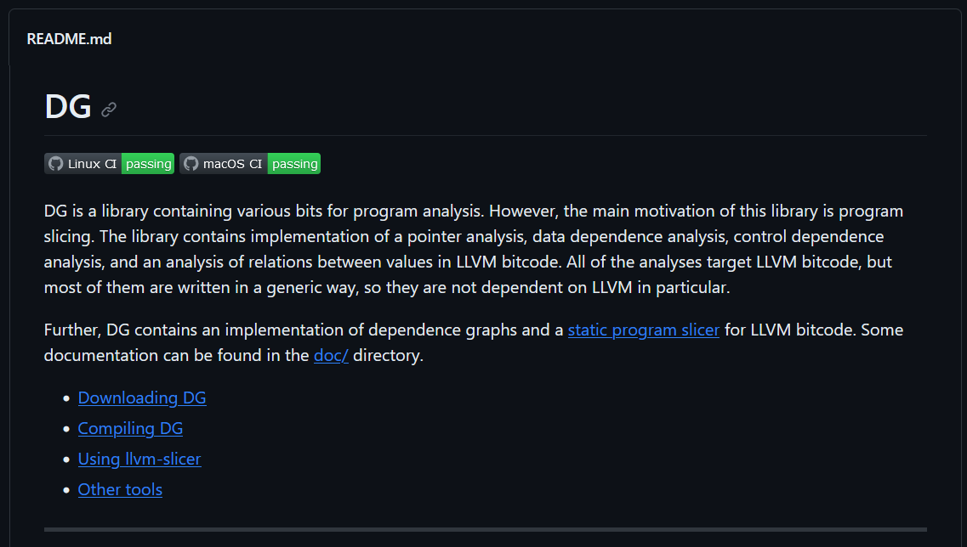
LLVM: Static Slicing
Analysis Tools
https://github.com/mchalupa/dg

Slide 24
Next Time
Dealing with “Real” programs
Pointers
(after that) Classes
(after that) Interprocedural Analysis

