Slide 1
Exercise #32
SSDLC Review
Write your name and answer the following on a piece of paper
At what point in the software development life cycle should threat modelling begin?

Slide 2
Exercise #32 Solultion
SSDLC Review
Write your name and answer the following on a piece of paper
At what point in the software development life cycle should threat modelling begin?
SDLC
– Requirement analysis
– Design
– Development
– Testing and verification
– Deployment
– Maintenance and evolution

Slide 3
Announcments
Administrivia
Drop day!

Slide 4
Announcments
Administrivia
Exercise Swap

Slide 5
Quiz 3 Review
EECS 677: Software Security Evaluation
Drew Davidson

Slide 6
Topics
Quiz 3 Review
Points-to Analysis
Reference Monitors
Program Instrumentation
Static Instrumentation
LLVM Instrumentation
Dynamic Analysis
Control Flow Integrity
Fuzzing
Symbolic Execution
Concolic Execution
Sat solving
SMT solving
SSDLC

Slide 7
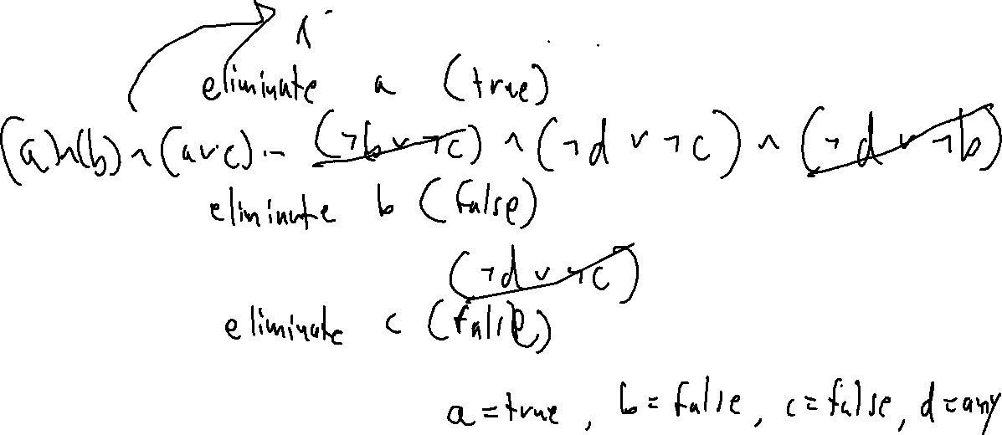
Review
Quiz 3 Review
Apply pure literal elimination to the following until no longer applicable
(a ∨ b) ∧ (a ∨ c) ∧ (¬b ∨ ¬c) ∧ (¬d ∨ ¬c) ∧ (¬d ∨ ¬b)

Slide 8
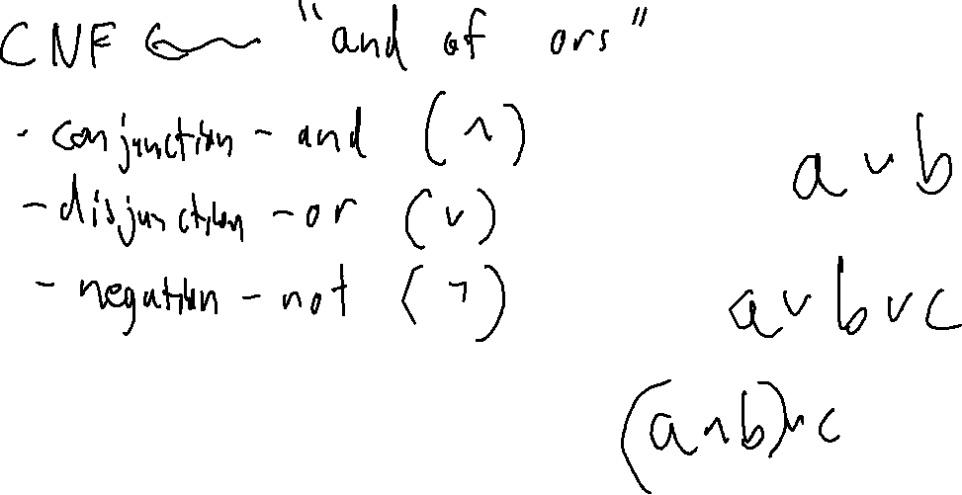
Review
Quiz 3 Review

Slide 9
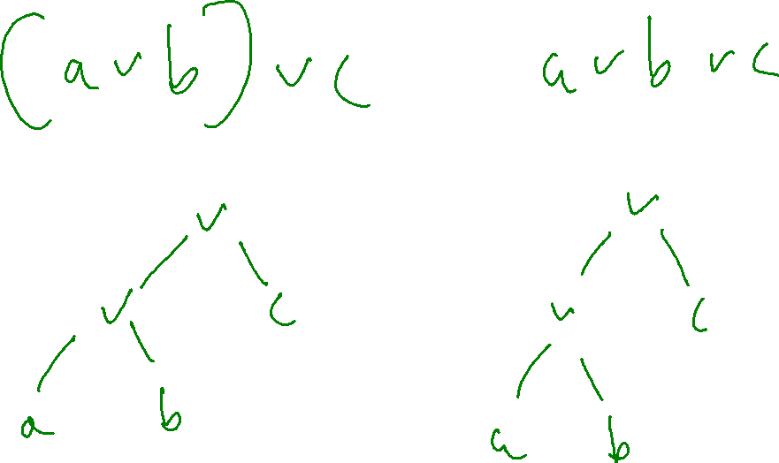
Review
Quiz 3 Review

Slide 10
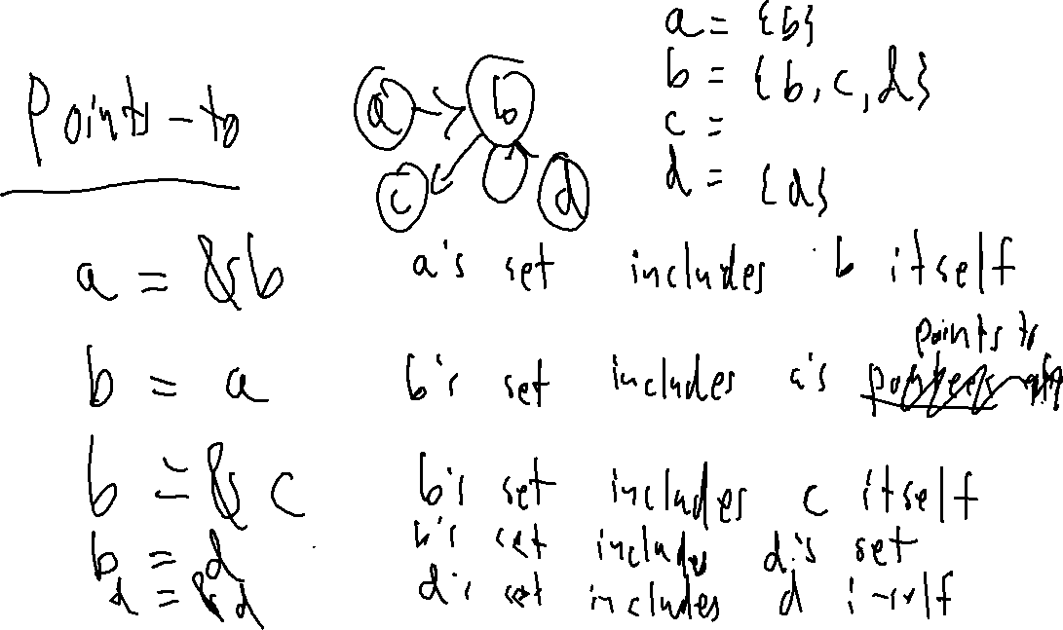
Review
Quiz 3 Review

Slide 11
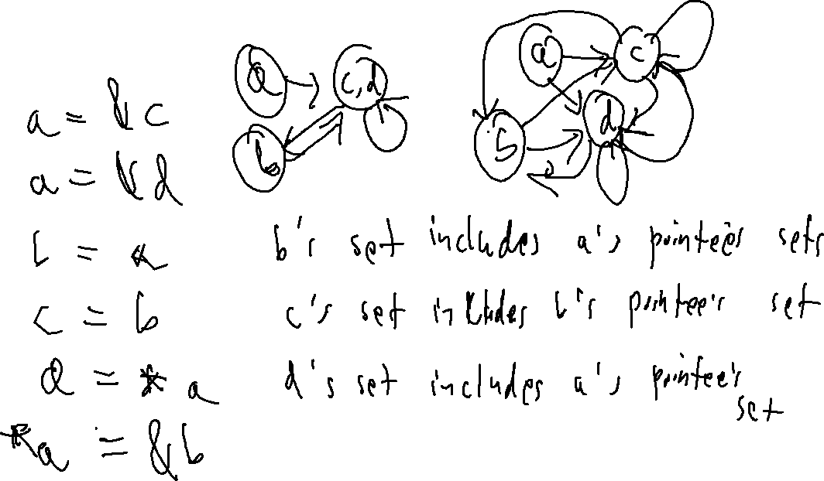
Review
Quiz 3 Review

Slide 12
Review
Quiz 3 Review

Slide 13
Review
Quiz 3 Review

Slide 14
Review
Quiz 3 Review

Slide 15
Review
Quiz 3 Review

Slide 16
Review
Quiz 3 Review

Slide 17
Review
Quiz 3 Review

