Slide 1
SSDLC
EECS 677: Software Security Evaluation
Drew Davidson

Slide 2
Last Time: SMT Solving
Review: Last Lecture
Beyond pure Boolean reasoning
Theories allow reasoning about a particular set of constants, variables, and operations
True
False
Sufficient to capture and reason about many of the constraints generated by the symbolic execution engine

Slide 3
SMT Solving – DPLL(T)
Review: Last Lecture
Create a satisfying assignment of values to variables in CNF formula clauses
Fit clauses into the signature of various theories
A $⋀$ (B $⋁$ C) $⋀$ ($¬$D)
May be necessary to re-arranging the formula to separate theories
i.e. replace subformulae with new propositional variables and constraints to separate theories (Nelson-Oppen)
Where A is x > 7
B is f(x) = 9
C is y = 9
DPLL to determine which clauses to investigate
Create a solution for the high-level clauses
Double check that solution is consistent with theory solvers
If not, block that solution and try again
D is z = 4

Slide 4
Saying goodbye To SMT
Review: Last Lecture
We only scratched the surface of SMT solving
Linear integer arithmetic – use the first phase of the two-phase simplex algorithm
SMT
us
EUF – apply congruence and transitivity to search for contradictions
Lots of clever techniques / optimizations in each theory
Beyond the scope of my ambitions for this class
For much more depth: https://www.decision-procedures.org/

Slide 5
Turning the page to a new chapter of this class
My goal is to provide you a sense of the challenges and solutions for engineering secure software
Tools
Techniques
Processes
Consider the humans

Slide 6
Lecture Outline
Human Factors of Security
Security as Process
The Secure Software Development Lifecycle

Slide 7
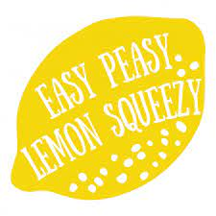
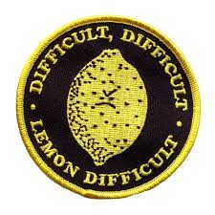
Securing software is hard!
Human Factors of Security
Surprising Threat Models
Security-deficient tooling

Slide 8
Software: A patchwork of many hands
Secure Software Engineering
Modern software projects involve teams of programmers
Introducing automated analysis and good development practices may win some battles
Hardening software means developing a commitment and understanding of secure development
Bad news: people are complicated
I hope to convince you to think about the problems that you’ll see, place value on security

Slide 9
Bolt-on security
Lifecycles
Attempting to retrofit a security solution onto a legacy system
Sometimes necessary
Ideally avoided

Slide 10
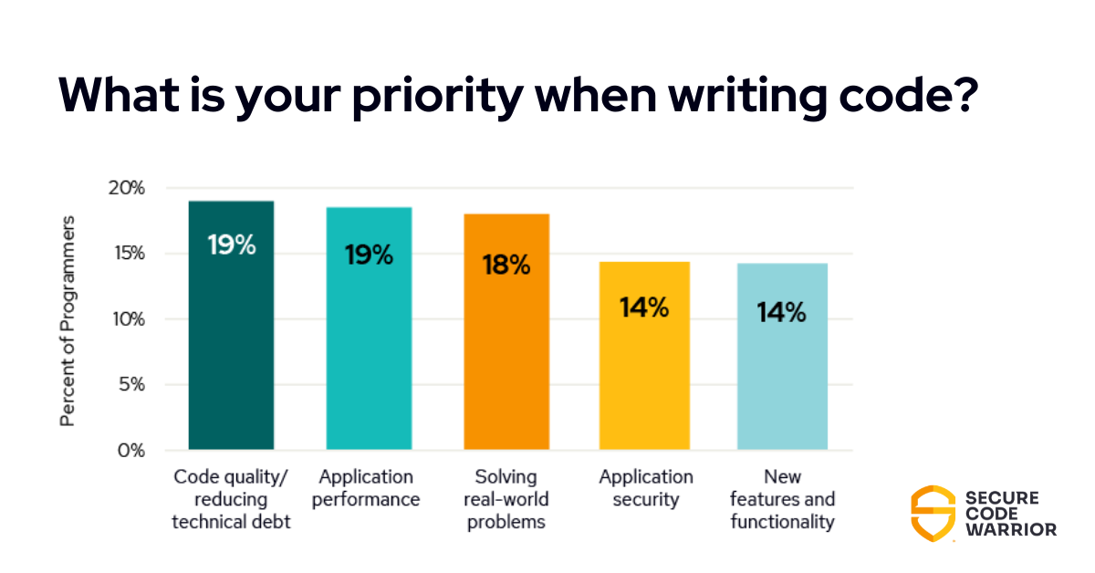
Vulnerabilities in the WilD
Human Factors of Security

Slide 11
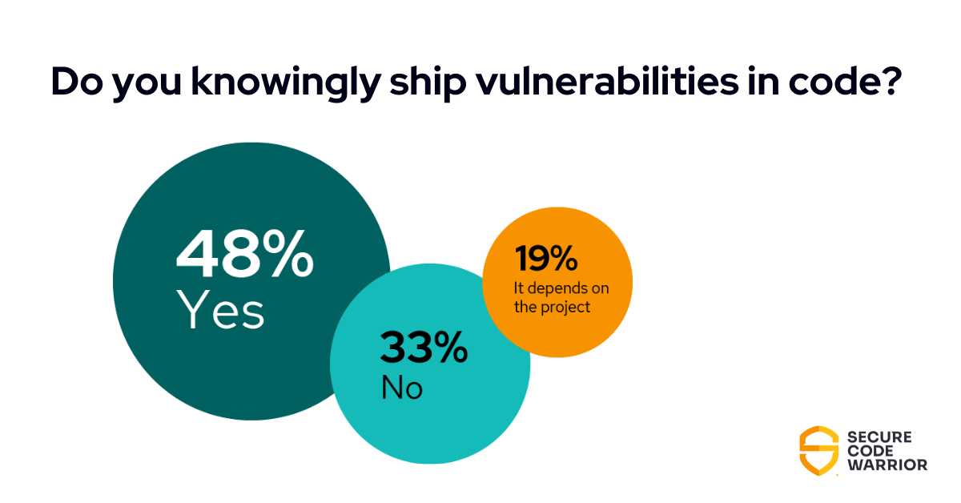
Vulnerabilities in the WilD
Human Factors of Security

Slide 12
Lecture Outline
Human Factors of Security
Security as Process
The Secure Software Development Lifecycle

Slide 13
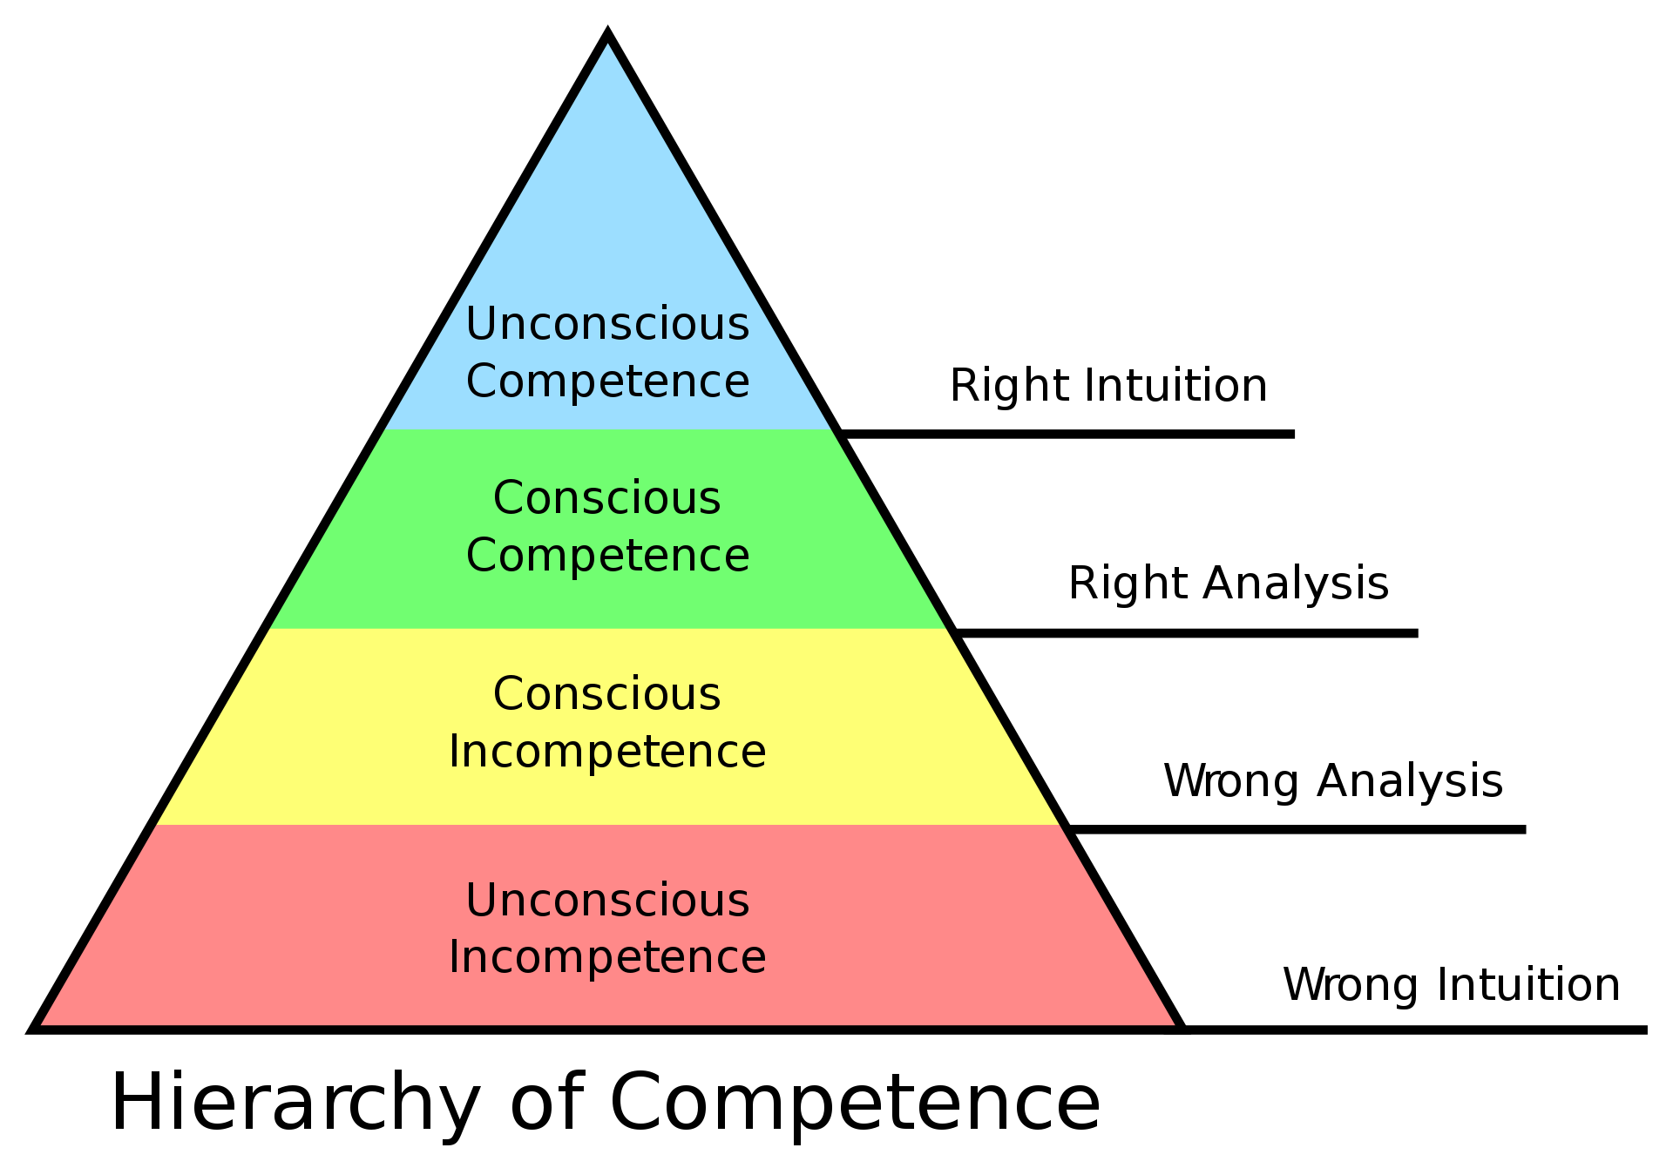
Process is Progress
Security as process

Slide 14
Corporate Snake Oil
Security as Process

Slide 15
Lifecycles

Slide 16
Security vs Usability
Security as Process
A fundamental tension
Occurs within the implementation of software, occurs within the processes guiding software development
Consider what we owe users
Negative externalities

Slide 17
Lecture Outline
Human Factors of Security
Security as Process
The Secure Software Development Lifecycle

Slide 18
The “Regular” SDLC
Lifecycles
Software Development Life Cycle
Requirement analysis
Design
Development
Testing and verification
Deployment
Maintenance and evolution
The circle of (software) life

Slide 19
Agile Development
SDLC: Lifecycles

Slide 20
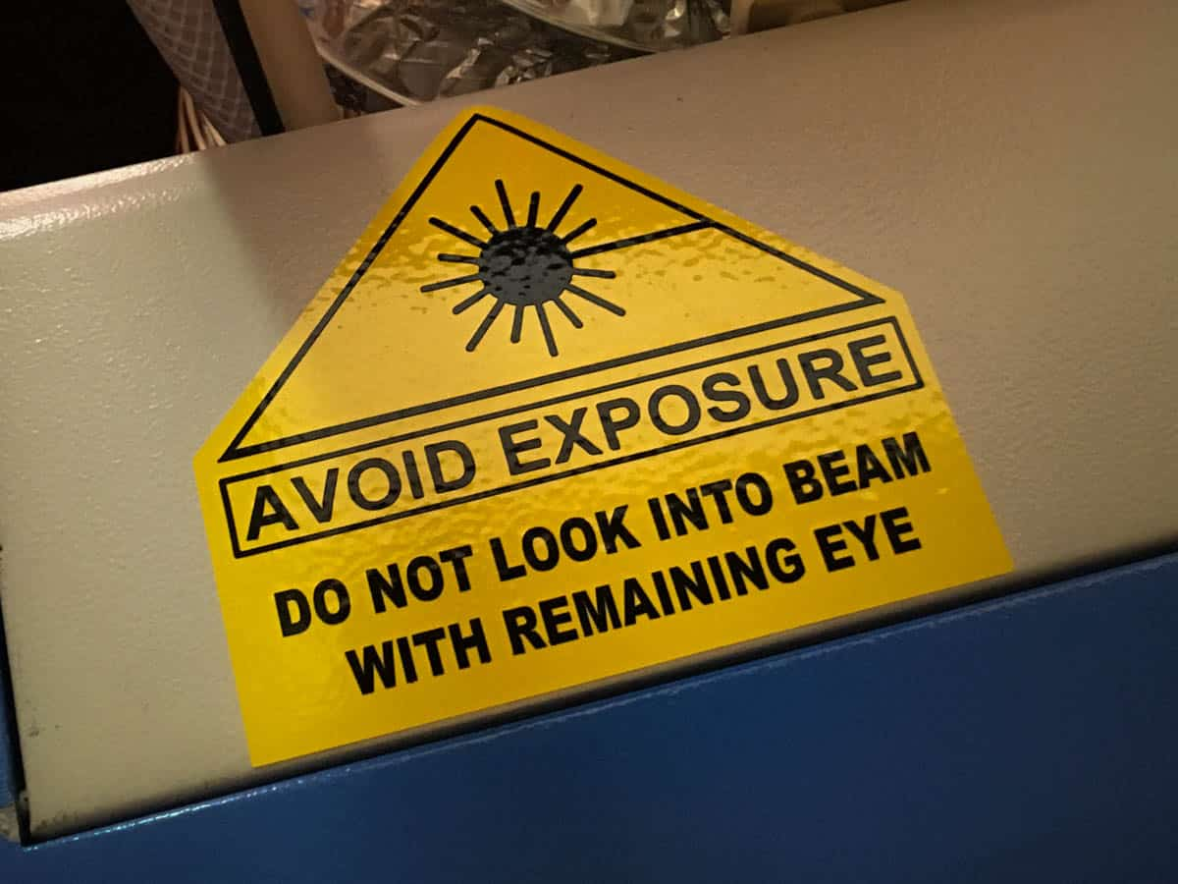
Risk Assessment and threat models
The SSDLC Components
Companion to Requirement Phase
Functional requirement: User must verify their own contact information
Security consideration: Mechanism misuse
- Users may attempt to access the contact information of others
- Users may attempt to subvert the verification mechanism for harassment

Slide 21
Security Design Review
The SSDLC COmponents
Companion to the Design Phase
Functional requirement: Page should retrieve user’s name, email, etc. from customer_info table in database
Security concern: Verify that user has a valid session token before retrieving information from database
Cancel my account
Destroy the database
Consider Security Design Principles
Principle of least privilege: Do entities in the system have exactly the privileges they need?
Bad design for a button panel

Slide 22
(Automated) Code Analysis
The SSDLC Components
Companion to Development
Apply best practices
- Accessing databases via read-only parameterized queries
- Validating user queries before processing them
- Chaos Engineering
Secure programming
- Assume a function might be misused
- Check arguments for reasonable values
- Canonicalize data

Slide 23
Security Testing And Code Review
The SSDLC Components
Companion to Verification
Ensure proper use of APIs
- Crypto library invocations
- Holistic audits
Test the test suite:
- Evaluate the coverage of your suite
- Ensure treatment of critical functionality
Value automation:
- Repeatability / reproducibility
- Static analysis!
- Monkey testing

Slide 24
Security Assessment And Configuration
The SSDLC Components
Companion to Maintenance and Evolution
Logging – Capture the behavior of the system (expected AND unexpected)
Metrics – Articulate needs of the system, measure expectations against reality
Auditing – Periodic retrospective analysis over codebase and configuration

Slide 25
Wrap-up
Human Factors of Security
Security as Process
The Secure Software Development Lifecycle

