Slide 1
Exercise 30
Concolic Execution Review
What is the benefit of concolic execution over symbolic execution? How does it compare in terms of soundness / completeness of vulnerability finding?

Slide 2
Exercise 30 Solution
Concolic Execution Review

Slide 3
Administrivia and Announcements
Quiz 3 next Friday

Slide 4
Boolean Satisfiability
EECS 677: Software Security Evaluation
Drew Davidson

Slide 5
Where We’re At
Tools / Techniques underlying Symbolic Execution

Slide 6
Previously: Enhancing Symbolic Execution
Outline / Overview
Generating test cases
Prioritizing states in the symbolic execution tree
Pruning Duplicate states
Concretizing (some) input to make progress

Slide 7
This Time: Satisfiability
Outline / Overview
The magic that made Symbolic execution work was the solver
Determines if a path constraint is feasible
Induces a test case that satisfies the path constraint
Allows for consistent concretization

Slide 8
Boolean Satisfiability
SAT and SMT
At the root of the solver is a mechanism for solving a hard problem:
Given a Boolean expression, provide a satisfying assignment to its variables or indicate no such assignment is possible
The search for a solution
requires a lot of computation
Constant time
$$B ∧A$$
B = 1, A = 1
Linear time
n log n time
Search scales rapidly with
the size of the problem
B = 0, A = 1
B = 1, A = 0
B = 1, A = 1
polynomial time
$$B ∨A$$
Exponential time
$$¬A∧A$$
No solution

Slide 9
NP
SAT and SMT
The class of problems where…
A solution can be generated in polynomial time by a nondeterministic Turing machine
A solution can be verified in polynomial time by a deterministic Turing machine

Slide 10
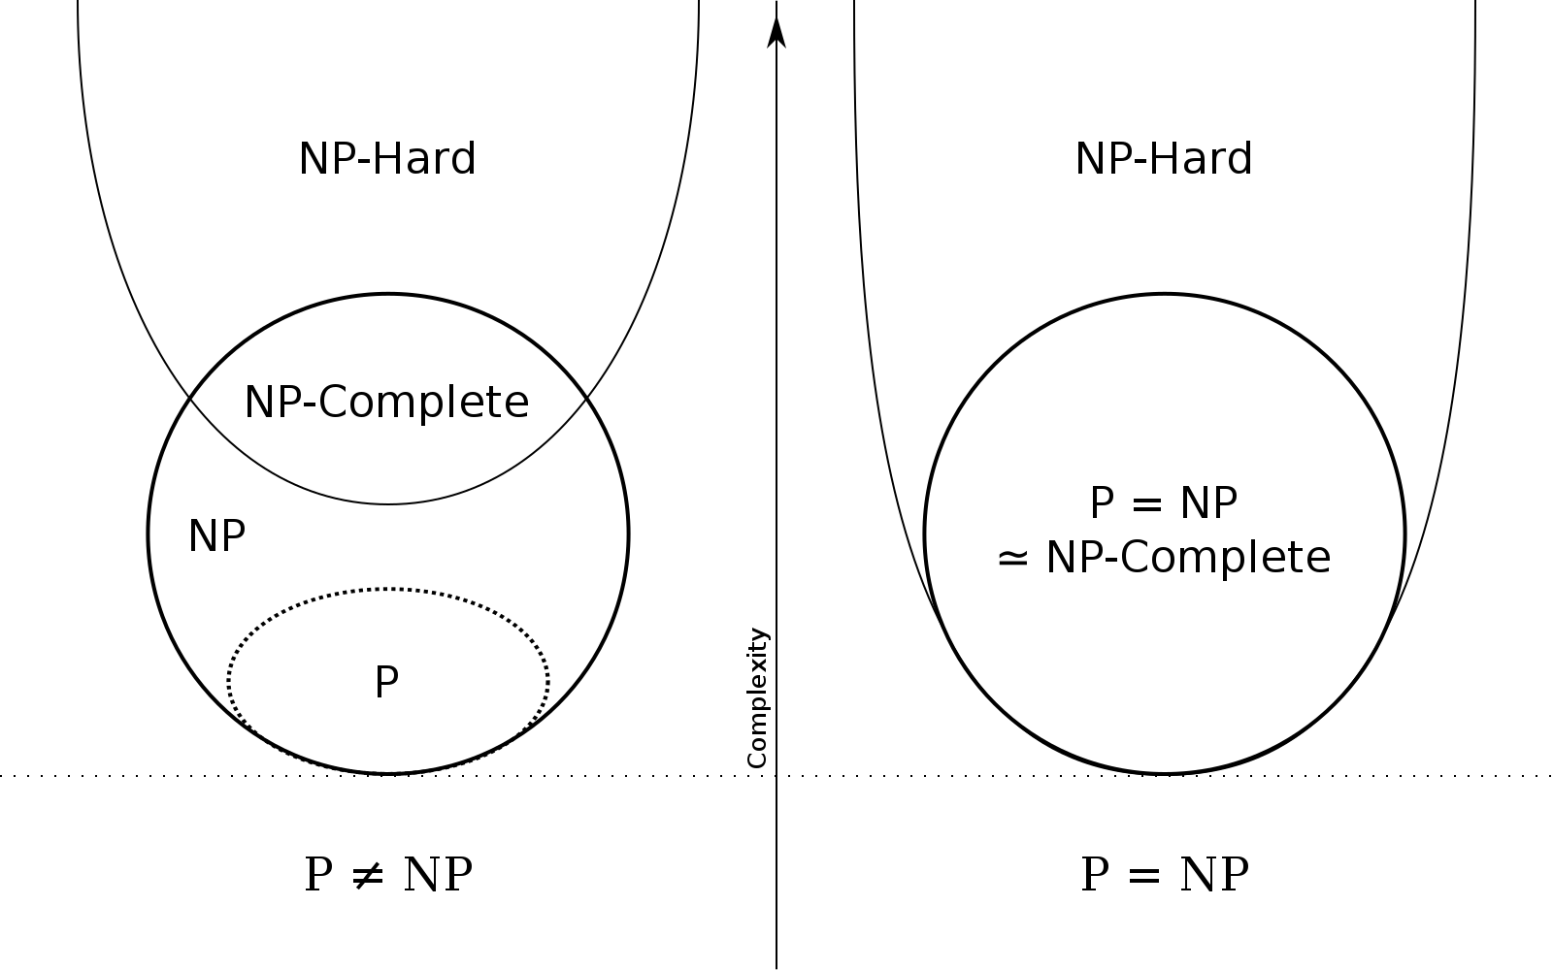
NP-Completeness
SAT and SMT
The class of problems where…
A solution could be used as a solver for any problem in NP
The “most difficult problems in NP”
SAT is the canonical example of an NP-Complete problem

Slide 11
A marvel of engineering
SAT and SMT
NP Reductions once were used to to show that a problem was difficult, now they are used to show that a problem is do-able
Sriram Rajamani, Microsoft Research

Slide 12
Solving sat
SAT and SMT
What are the truth values for an arbitrary equation?
a
b
c
d
0
0
0
0
(a) ∧ (b ∨ c) ∧ (¬a ∨ c ∨ d) ∧ (¬c ∨ d) ∧ (¬c ∨ ¬d ∨ ¬a) ∧ (b ∨ d)
0
0
0
1
0
0
1
0
0
0
1
1
Naïve Solution: Brute force
0
1
0
0
Guess every possible assignment of truth values
0
1
0
1
0
1
1
0
0
1
1
1
Complexity: Exponential (2^{N})
1
0
0
0
Intuition: think of the bitvector of length N
where each bit represents a variable (1 for true, 0 for false)
1
0
0
1
1
0
1
0
1
0
1
1
2^{N} numbers “fit” into N bits
1
1
0
0
1
1
0
1
1
1
1
0
1
1
1
1

Slide 13
Solving sat
SAT and SMT
What are the truth values for an arbitrary equation?
a
b
c
d
0
0
0
0
(a) ∧ (b ∨ c) ∧ (¬a ∨ c ∨ d) ∧ (¬c ∨ d) ∧ (¬c ∨ ¬d ∨ ¬a) ∧ (b ∨ d)
0
0
0
1
0
0
1
0
0
0
1
1
Naïve Solution: Brute force
0
1
0
0
Guess every possible assignment of truth values
0
1
0
1
0
1
1
0
0
1
1
1
Complexity: Exponential (2^{N})
1
0
0
0
Intuition: think of the bitvector of length N
where each bit represents a variable (1 for true, 0 for false)
1
0
0
1
1
0
1
0
1
0
1
1
2^{N} numbers “fit” into N bits
1
1
0
0
1
1
0
1
1
1
1
0
1
1
1
1

Slide 14
can We do better than Brute Force?
SAT and SMT
Generically speaking, no
there are common cases
where shortcuts apply

Slide 15
Strategy: pick “low-hanging fruit”
SAT and SMT
Some variables may have “obvious” assignments
Find and assign to easy variables
Reduce the expression
Brute force once no clever strategy remains

Slide 16
Conjunctive Normal Form
SAT and SMT
One or more clauses joined by conjunction where a clause is one or more possibly-negated variables joined by disjunction
“an AND of ORs”
(a) ∧ (b ∨ c)
(a) ∧ ¬(b ∨ c)
a ∨ b ∨ c
(a) ∧ (¬b ∨ c)
(a) ∧ ((b ∧ c) ∨ (c))
a ∨ b ∧ c
By convention, and has
higher precedence than or
(¬a) ∧ (¬b ∨ ¬c)
¬(a ∧ b)
(a ∧ b)

Slide 17
HOW Conjunctive Normal Form
SAT and SMT
One or more clauses joined by conjunction where a clause is one or more possibly-negated variables joined by disjunction
Any Boolean expression can be represented in CNF using the standard Boolean transformations
¬(P ∨ Q) $⇔$ ¬P ∧ ¬Q
¬(P ∧ Q) $⇔$ ¬P ∨ ¬Q
¬¬P $⇔$ P
P ∨ (Q ∧ R) $⇔$ (P ∨ Q) ∧ (P ∨ R)
(P ∧ Q) ∨ (P ∧ R) $⇔$P ∧ (Q ∨ R)

Slide 18
Why Conjunctive Normal Form
SAT and SMT
One or more clauses joined by conjunction where a clause is one or more possibly-negated variables joined by disjunction
If one clause is unsatisfiable, the whole equation is unsatisfiable
(false) ∧ (…) ∧ (…) ∧ (…) ∧ (…) ∧ (…) ∧ (…) …
This helps to realize our philosophy of “obvious choices” – we’ll try to sort out the most highly constrained clauses
Let’s next consider how to identify and utilitize these cases

Slide 19
The Unit Clause
SAT and SMT
A unit clause or just (“unit”) is a clause with no disjunctions
(a) ∧ (b ∨ c) ∧ (¬a ∨ c ∨ d) ∧ (¬c ∨ d) ∧ (¬c ∨ ¬d ∨ ¬a) ∧ (b ∨ d)
Units are tough customers! There’s only one way to make a unit true, so it yields an obvious choice
This Claus is an absolute unit

Slide 20
Leveraging Units
SAT and SMT
Once units have been assigned values, the equation can be reduced
(a) ∧ (b ∨ ¬a) ∧ (¬a ∨ c ∨ b)
The new equation might yield more units
(b) ∧ (c ∨ b)

Slide 21
Unit Propagation
SAT and SMT
Unit propagation: continue to identify and eliminate units until
There is a satisfying assignment
There is a false clause
There are no more units
(a) ∧ (b ∨ ¬a) ∧ (¬a ∨ c ∨ b)
(a) ∧ (b ∨ ¬a) ∧ (¬a ∨ ¬b)
(a) ∧ (b ∨ c) ∧ (¬a ∨ c ∨ d) ∧ (¬c ∨ d) ∧ (¬c ∨ ¬d ∨ ¬a) ∧ (b ∨ d)

Slide 22
Unit Propagation
SAT and SMT
Once units have been assigned values, the equation can be reduced
(a) ∧ (b ∨ ¬a) ∧ (¬a ∨ c ∨ b)
The new equation might yield more units
(b) ∧ (c ∨ b)
Unit propagation: continue to identify and eliminate units until
There is a satisfying assignment
There is a false clause
There are no more units
(a) ∧ (b ∨ ¬a) ∧ (¬a ∨ ¬b)

Slide 23
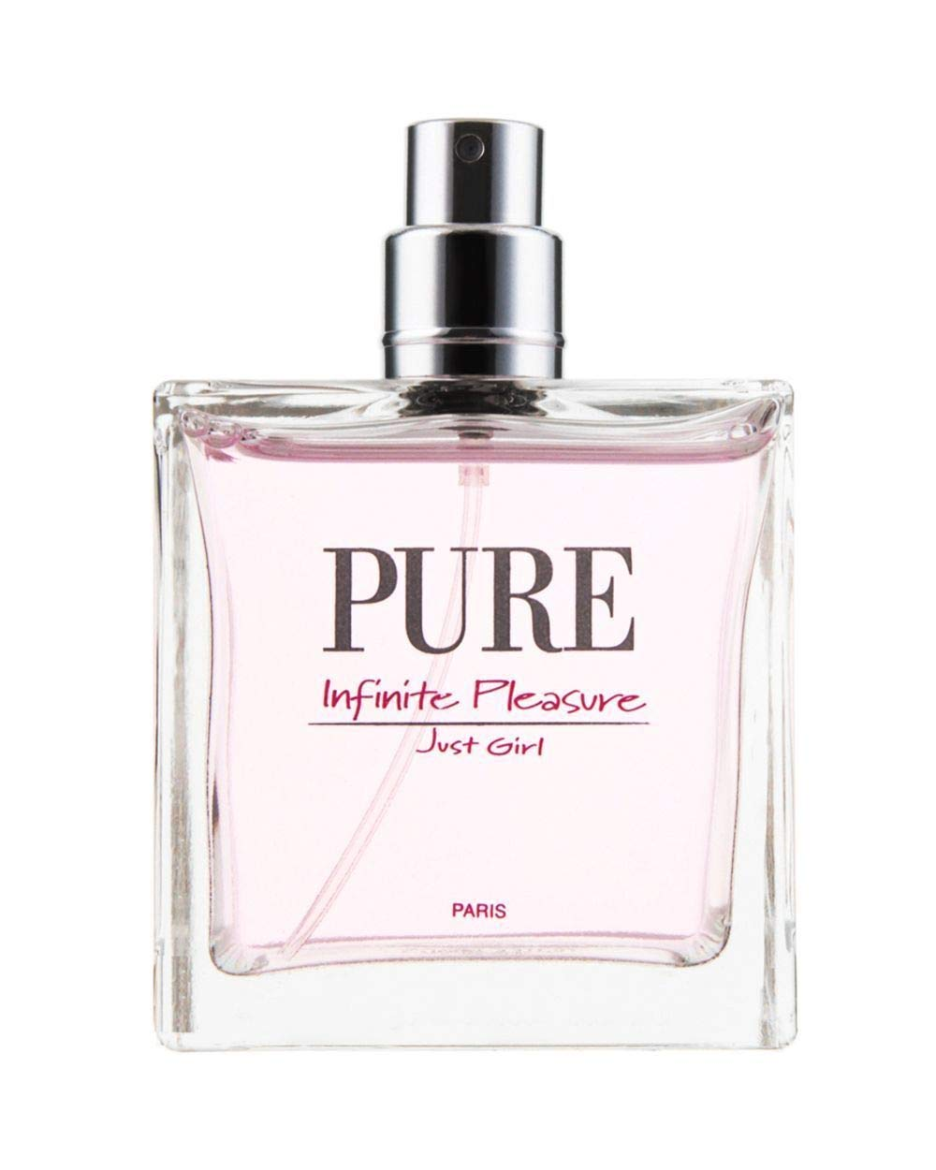
Pure literals
SAT and SMT
A literal (i.e. variable) that occurs only positively, or only negatively, throughout the entire formula is pure
(a) ∧ (b ∨ c) ∧ (¬a ∨ c ∨ d) ∧ (¬c ∨ d) ∧ (¬c ∨ ¬d ∨ ¬a) ∧ (b ∨ d)
Again, a pure literal makes for an obvious choice.
Assigning the “obvious” value to a pure literal doesn’t guarantee satisfiability, but it doesn’t hurt the search for satisfiability
Just like unit propagation, assigning to pure literals may simplify clauses to form new pure literals

Slide 24
Pure literal Elimination
SAT and SMT
Unit propagation: continue to identify and simplify out pure literals until
There is a satisfying assignment
There is a false clause
3) There are no more pure literals
(a ∨ ¬b) ∧ (¬b ∨ c)
(a ∨ ¬b) ∧ (¬b ∨ ¬c) ∧ (b ∨ c)

Slide 25
Putting the strategies together
SAT and SMT
Unit propagation and pure literal elimination form the core of the most classic sat-solving algorithm, DPLL

Slide 26
DPLL
SAT and SMT
(a) ∧ (b ∨ c) ∧ (¬a ∨ c ∨ d) ∧ (¬c ∨ d) ∧ (¬c ∨ ¬d ∨ ¬a) ∧ (b ∨ d)
function DPLL(φ)
if φ = true then
return true
end if
if φ contains a false clause then
return false
end if
for all unit clauses l in φ do
φ ← UNIT-PROPAGATE(l, φ)
end for
for all literals l occurring pure in φ do
φ ← PURE-LITERAL-ASSIGN(l, φ)
end for
l ← CHOOSE-LITERAL(φ)
return DPLL(φ ∧ l) ∨ DPLL(φ ∧ ¬l)
end function

Slide 27
No Magic Bullet
Outline / Overview
We know some constraints are computationally hard to unpack
int main(){ char s[80];
scanf(“%s”, s);
if (sha256sum(s) == c01b39c7a35ccc3b081a3e83d2c71fa9a767ebfeb45c69f08e17dfe3ef375a7b
}

Slide 28
From SAT to SMT
Outline / Overview
Next Time…
Symbolic execution requires path constraints far more complex than Boolean expressions.
Although a naïve reduction is somewhat straightforward, naivety does not gel well with NP-completeness

