Slide 1
ExerCise #8
Computability Review
Write your name and answer the following on a piece of paper
Consider a simple bug-finding analysis that looks for null pointer deferences in C programs. The analysis raises an alert on any program that has ANY pointer operation, and does not raise an alert on any other program.
Is this analysis sound, complete, neither, or both? Justify your answer.

Slide 2
Static Analysis
EECS 677: Software Security Evaluation
Drew Davidson

Slide 3
Administrivia and Announcements

Slide 4
Last Time: Analysis Definitions
Review: Computability
Analysis Target – The system being analyzed
For us this will usually be a software program
Analysis Engine – The system doing analysis
For us this will usually be a software program
Analysis Goal – The phenomenon we are detecting
The existence of a certain (program) behavior?
The absence of a certain (program) behavior?

Slide 5
Last Time: Analysis Limits
Review: Computability
The limits of computability
The Halting Problem: No decision procedure for halting
Rice’s Theorem: The Halting Problem implies no decision procedure for any reachability problem
Analysis without decision procedures
Approximation
How do we approximate? Soundness / Completeness

Slide 6
Last Time: Analysis Guarantees
Review: Computability
NO analysis can be both sound and complete
Building an analysis that is either sound or complete is trivial
Complete – Always report positive, no false negatives
Sound – Always report negative, no false positives

Slide 7
Lecture Outline
The Big Idea
Program Guarantees
Analysis Specificity
Dataflow analysis

Slide 8
High-Level Definition
Static Analysis – The Big Idea
Static analysis – analysis that is done without running the program

Slide 9
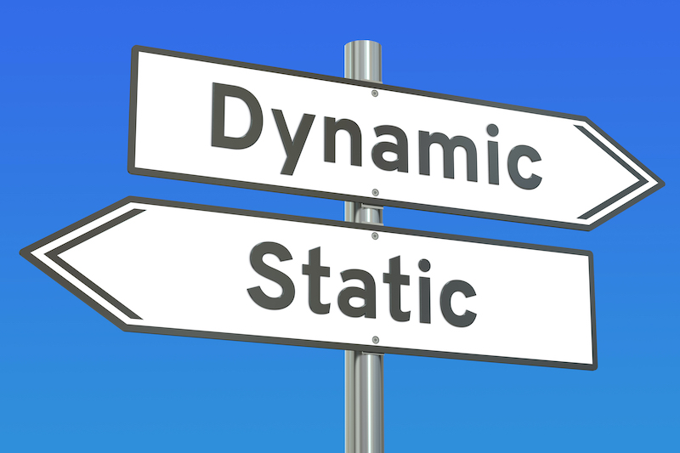
Analysis in Contrast
Static Analysis Philosophy
Static analysis – analysis that is done without running the program
Dynamic analysis – analysis that is done with running the program
Simplest example - testing

Slide 10
STATIC Analysis - Opportunities
Static Analysis Philosophy
Global view of every instruction in the program
Provide result about what a program MIGHT do
A global view (of the program)

Slide 11
Static Analysis for Quality Assurance
Static Analysis Philosophy
Filter out “trivial” code issues
Provide insights to aid manual analysis

Slide 12
“Trivial” Syntax Analysis
OverView: Static Analysis
Some troubling behavior of a program may be discoverable via simply observing syntactic structure
int main(int argc, const char * argv[]){
const char * password = argv[1];
if (password == “supersecret”){
authenticate();
}
}

Slide 13
Insights
OverView: Static Analysis
Software engineering “code smells” / stats
Use of the forbidden / arcane constructs
Cyclomatic complexity
Long functions

Slide 14
Lecture Outline
The Big Idea
Program Guarantees
Analysis Specificity
Dataflow analysis

Slide 15
STATIC Analysis - Opportunities
Static Analysis Philosophy
The true power of static analysis: one-sided error
Provide assurances about what a program will NEVER or ALWAYS do
Static analysis might report EVERY program that (possibly) has a null-pointer dereference
Static analysis might certify EVERY program that (definitely) is null-pointer deference free
“Hey! Those are the
same thing!”

Slide 16
STATIC Analysis - Opportunities
Static Analysis Philosophy
Provide assurances about what a program will NEVER or ALWAYS do
Static analysis might report EVERY program that (possibly) has a null-pointer dereference
Static analysis might certify EVERY program that (definitely) is null-pointer deference free
“Hey! Those are the
same thing!”
Program verifier (detect “good” programs)
Bug finder (detect “bad” programs)
Complete (no FNs) – all good programs are reported
Sound (no FPs) – all bad programs are unreported
Complete (no FNs) – all bad programs are reported
Sound (no FPs) – all good programs are unreported

Slide 17
STATIC Analysis - Opportunities
Static Analysis Philosophy
For security analysis, we want to lock out “bad” programs
(even at the cost of locking out some “good” programs)
Program verifier (detect “good” programs)
Bug finder (detect “bad” programs)
Complete (no FNs) – all good programs are reported
Sound (no FPs) – all bad programs are unreported
Complete (no FNs) – all bad programs are reported
Sound (no FPs) – all good programs are unreported

Slide 18
Lecture Outline
The Big Idea
Program Guarantees
Analysis Specificity
Dataflow analysis

Slide 19
Consider Program Configuration
Analysis Specificity
The good news about static analysis:
You can see beyond the instructions that are executed in an individual trace
The bad news about static analysis:
You need to construct the conditions/circumstances/context in which those instructions are executed
*p = 2
You exist in the context of all in which you live and what came before you

Slide 20
Wrasslin’ With State Space
Analysis Specificity
State space: the set of all possible configurations of the analysis target
Naïve state space representation: enumerate all configurations of a program

Slide 21
History: Hardware Model Checking
Static Analysis – Analysis Specificity
Extract a (finite) state system that approximates the analysis target
Example:
States: configuration of the system
Edges: transitions within the system
Check if the system can violate some correctness property
Each state indicates the value of a memory bit

Slide 22
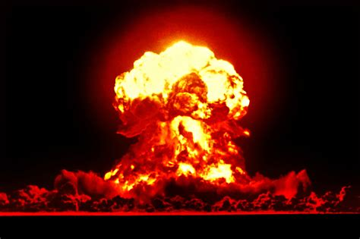
History: Hardware Model Checking
Static Analysis – Analysis Specificity
State space
(artist’s rendition)
State space explosion!

Slide 23
Wrasslin’ With State Space
Analysis Specificity
State space: the set of all possible configurations of the analysis target
Naïve state space representation: enumerate all configurations of a program
Practical state space representation: Summarize sets of configurations of a program
Never gonna work for large analysis targets

Slide 24
Aside: Software Model Checking
Analysis Specificity
Extract a (finite) state system that approximates the analysis target
States: configurations of the system
Edges: transitions within the system
Check if the system can violate some correctness property
Each state indicates a set of values
or the truth of some abstract predicate

Slide 25
Aside: CEGAR
Analysis Specificity
Counterexample-guided abstraction refinement
Begin with a coarse, over-approximate abstraction of the system
Check system correctness
If a violation is reported, verify it!
If its a true positive – report it
If it’s a false positive – refine the model to exclude it and check the new model

Slide 26
Aside: Model Checking Is great!
Analysis Specificity
Super-interesting approach to program analysis
Some scalability issues
Not the focus of our course
Edmund Clarke: Turing
Award co-winner
for model checking

Slide 27
State Space Summarization
Static Analysis: Analysis Specificity
Lesson learned: The way we choose to summarize state space makes or breaks our analysis
Too much summarization leads to approximation
Too little summarization leads to state space explosion

Slide 28
Lecture Outline
The Big Idea
Program Guarantees
Analysis Specificity
Dataflow analysis

Slide 29
DataFLOW Intuition
Static Analysis: Dataflow Analysis
Capture the effect of each statement on the program’s data
Treat each instruction as a data transformer
Compose the effect of multiple data transformers to elicit composite effects

Slide 30
Composite Effects
Static Analysis: Dataflow
Dataflow analysis comes in a variety of configurations that stake out different precision/efficiency tradeoffs
Maintain sound verification / complete bugfinding
Consider sets of values that may not actually co-exist

Slide 31
Flow-Insensitive Dataflow Analysis
Static Analysis: Dataflow
Consider the effect of each statement without respecting the order of execution

Slide 32
Flow-Insensitive Dataflow Analysis
Static Analysis: Dataflow
Is a function FOO called from within a program?

Slide 33
Path-Sensitive Dataflow Analysis
Static Analysis: Dataflow
Consider the effect of each statement with respect to a unique program path

Slide 34
Path-Sensitive Dataflow Analysis
Static Analysis: Dataflow
int f(bool b) {
Obj * o = null;
int v = 2;
if (b) {
o = new Obj ();
v = rand_int();
}
if (v == 2){
o->setInvalid()
}
return o->property();
}

Slide 35
Flow-Sensitive Dataflow Analysis
Static Analysis: Dataflow
Consider the effect of each statement with respect to order in the Control-Flow Graph

Slide 36
Flow-Sensitive Dataflow Analysis
Static Analysis: Dataflow
int f(bool b) {
Obj * o = null;
int v = 2;
if (b) {
o = new Obj ();
v = rand_int();
}
if (v == 2){
o->setInvalid()
}
return o->property();
}

Slide 37
Abstract Interpretation
Categorizing Analyses
(Over)approximate the state of the program
(Over)approximate the domain of values

Slide 38
Lecture End!
The Big Idea
Program Guarantees
Analysis Specificity
Dataflow analysis

Slide 39
Next TiME
Systematizing Flow-Sensitive Analyses

