Slide 1
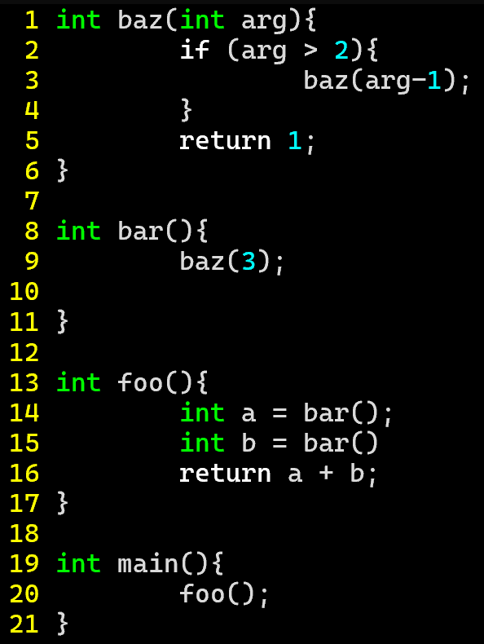
Exercise #18
Review Interprocedural Analysis
Write your name and answer the following on a piece of paper
Draw the exploded supergraph for the following program:

Slide 2
Exercise #18: Solution
Review Interprocedural Analysis

Slide 3
Administrivia and Announcements

Slide 4
Summary Functions
EECS 677: Software Security Evaluation
Drew Davidson

Slide 5
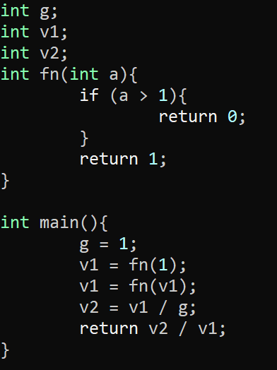
Last Time: Interprocedural Analysis
Review: Last Lecture
Consider the effect of multiple functions
Simplistic
Function call overturns all global / aliased facts
Supergraph / Context String
1-CFA (use a call-chain of 1)

Slide 6
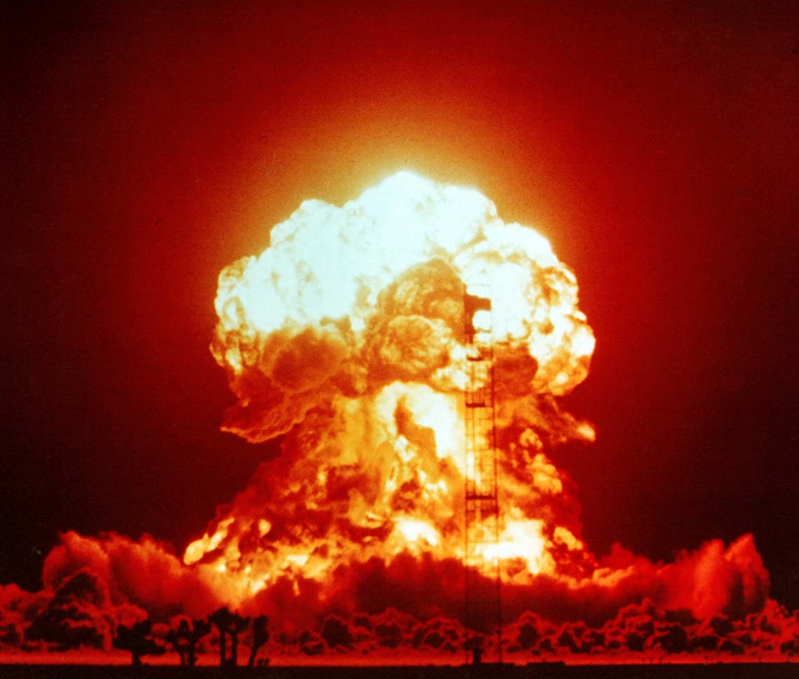
Exploding Supergraphs
Supergraphs
The Exploded Supergraph… Explodes
For large programs, the supergraph may be too large (and exploding the supergraph certainly will not help)
What can we do in the presence of such limitations?
Gather a lightweight, over-approxmation of the effect of a function call

Slide 7
Lecture Outline
Intuition
MOD/REF analysis
Global only
Globals, Locals and args
Abstract Summaries

Slide 8
Intuition
Summary Functions
Tracking context is expensive
Maybe our analysis can get by without it
Coarse-Grained analysis need only capture coarse-grained function information
“Summarize” the information we need to know
Function
summary

Slide 9
Intuition
Summary Functions
Tracking context is expensive
Maybe our analysis can get by without it
global1 = SOURCE();
Coarse-Grained analysis need only capture coarse-grained function information
foo();
SINK(global2);
“Summarize” the information we need to know
Does foo…
reference (i.e. read) global1?
Modify (i.e. write) global2?
Function
summary

Slide 10
Lecture Outline
Intuition
MOD/REF analysis
Global only
Globals, Locals and args
Abstract Summaries

Slide 11
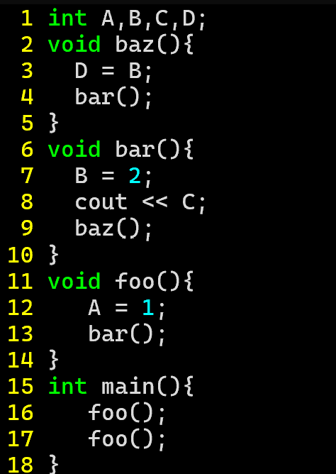
Interprocedural MOD/REF Analysis
Summary Functions
Let us attempt to compute 2 sets
int globalA;
int globalB;
int globalC;
void bar(){ globalB = 2;
cout << (globalC);
}
void foo(){
globalA = 1;
bar();
}
int main(){ foo();
}
GMOD(P) – The set of variables that might be modified as a result of calling P
Also includes
variables
mod/ref’ed
by P’s callees!
GREF(P) – The set of variables that might be referenced as a result of calling P
Basic idea (let’s ignore parameters, pointers, and Locals for now)
Build IMOD(P) and IREF(P) – the variables immediately modified in P (ignoring callees)
Build the simple call graph
Repurpose the call graph for dataflow algorithm!
Run the dataflow algorithm to saturation

Slide 12
Interprocedural MOD/REF Analysis
Summary Functions
Basic idea (let’s ignore parameters, pointers, and Locals for now)
int globalA;
int globalB;
int globalC;
void bar(){ globalB = 2;
cout << (globalC);
}
void foo(){
globalA = 1;
bar();
}
int main(){ foo();
}
Build IMOD(P) and IREF(P) – the variables immediately modified in P (ignoring callees)
Build the simple call graph
Repurpose the call graph for dataflow algorithm!
Run the dataflow algorithm to saturation
“Good enough” initial approximation:
Simple statement scan
IMOD(main) = { }
IREF(main) = { }
IMOD(foo) = { A }
IREF(foo) = { }
IMOD(bar) = { B }
IREF(bar) = { C }
IMOD(baz) = { D }
IREF(baz) = { B }

Slide 13
Interprocedural MOD/REF Analysis
Summary Functions
Basic idea (let’s ignore parameters, pointers, and Locals for now)
main
int globalA;
int globalB;
int globalC;
void bar(){ globalB = 2;
cout << (globalC);
}
void foo(){
globalA = 1;
bar();
}
int main(){ foo();
}
Build IMOD(P) and IREF(P) – the variables immediately modified in P (ignoring callees)
Build the simple call graph
foo
Repurpose the call graph for dataflow algorithm!
Run the dataflow algorithm to saturation
bar
IMOD(main) = { }
IREF(main) = { }
baz
IMOD(foo) = { A }
IREF(foo) = { }
IMOD(bar) = { B }
IREF(bar) = { C }
IMOD(baz) = { D }
IREF(baz) = { B }

Slide 14
Interprocedural MOD/REF Analysis
Summary Functions
Basic idea (let’s ignore parameters, pointers, and Locals for now)
main
main
Build IMOD(P) and IREF(P) – the variables immediately modified in P (ignoring callees)
Build the simple call graph
foo
foo
Repurpose the call graph for dataflow algorithm!
(optimization)
collapse cycles
Run the dataflow algorithm to saturation
bar
bar/baz
IMOD(main) = { }
IREF(main) = { }
baz
IMOD(foo) = { A }
IREF(foo) = { }
IMOD(bar) = { B }
IREF(bar) = { C }
IMOD(baz) = { D }
IREF(baz) = { B }

Slide 15
Interprocedural MOD/REF Analysis
Summary Functions
GMOD: f_{P}(S) = S U IMOD(P)
GREF: f_{P}(S) = S U IREF(P)
Basic idea (let’s ignore parameters, pointers, and Locals for now)
Init GMOD: {}
Init GREF: {}
Join = Union
Build IMOD(P) and IREF(P) – the variables immediately modified in P (ignoring callees)
main
Build the simple call graph
(optimization)
collapse cycles
Repurpose the call graph for dataflow algorithm!
foo
Add a dummy
exit node targeted
by all leaves
Run the dataflow algorithm to saturation
bar/baz
IMOD(main) = { }
IREF(main) = { }
Exit
IMOD(foo) = { A }
IREF(foo) = { }
IMOD(bar) = { B }
IREF(bar) = { C }
IMOD(baz) = { D }
IREF(baz) = { B }

Slide 16
Interprocedural MOD/REF Analysis
Summary Functions
GMOD: f_{P}(S) = S U IMOD(P)
GREF: f_{P}(S) = S U IREF(P)
Basic idea (let’s ignore parameters, pointers, and Locals for now)
Init GMOD: {}
Init GREF: {}
Join = Union
Build IMOD(P) and IREF(P) – the variables immediately modified in P (ignoring callees)
main
Build the simple call graph
Repurpose the call graph for dataflow algorithm!
foo
Run the dataflow algorithm to saturation
bar/baz
IMOD(main) = { }
IREF(main) = { }
Exit
IMOD(foo) = { A }
IREF(foo) = { }
IMOD(bar) = { B }
IREF(bar) = { C }
IMOD(baz) = { D }
IREF(baz) = { B }

Slide 17
Interprocedural MOD/REF Analysis
Summary Functions
Basic idea (let’s ignore parameters, pointers, and Locals for now)
This is a pretty big restriction, we should remove it
Build IMOD(P) and IREF(P) – the variables immediately modified in P (ignoring callees)
Build the simple call graph
Good news:
GMOD computation is the same
Repurpose the call graph for dataflow algorithm!
Bad news:
We’ll need to use the compound call graph
More elaborate IMOD computation
Can’t collapse cycles
Run the dataflow algorithm to saturation

Slide 18
Lecture Outline
Intuition
MOD/REF analysis
Global only
Globals, Locals and args
Abstract Summaries

Slide 19
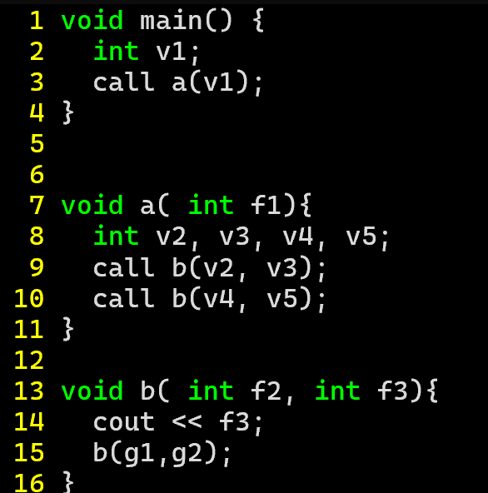
Interprocedural MOD/REF Analysis
Summary Functions
Full Idea
Build IMOD(P) and IREF(P) – the variables immediately modified in P (ignoring callees)
main
Build the compound call graph
L3
Repurpose the call graph for dataflow algorithm!
a
Run the dataflow algorithm to saturation
L9
L10
b
L15
IMOD(main) = { }
IREF(main) = { }
IMOD(foo) = { A }
IREF(foo) = { }
IMOD(bar) = { B }
IREF(bar) = { C }
IMOD(baz) = { D }
IREF(baz) = { B }

Slide 20
Last Time: Gmod & GREF Computation
Review: Last Lecture
Globals, Locals & Value-Passing
GREF will change, GMOD doesn’t need to change
void main() {
S1: call a(v1)
}
main
IREF = { }
s1
node or call site | GREF set
main | g2
a | g2, v3, v5
b | f3, g2
s1 | g2
s2 | v3, g2
s3 | v5, g2
s4 | g2
Init all node GREF sets to their IREF sets
Init all call site GREF sets to empty
Put all nodes and call sites on a worklist
Iterate until the worklist is empty.
Each time a node n is removed from the worklist, its current GREF set is computed. If that set doesn't match its previous value, then add all call sites to n to the worklist (if not present).
Each time a call site s is removed from the worklist, its current GREF set is computed. If that set doesn't match its previous value, then the node that contains s is added to the worklist (if not present).
void a( f1 ) {
S2: call b(v2, v3)
S3: call b(v4, v5)
}
a
IREF = { }
s2 s3
void b( f2, f3 ) {
print f3;
S4: call b(g1, g2)
}
b
IREF = {f3}
s4

Slide 21
Lecture Outline
Intuition
MOD/REF analysis
Global only
Globals, Locals and args
Abstract Summaries

Slide 22
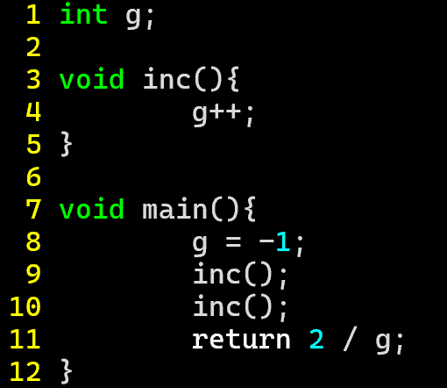
Abstract Summaries
Summary Functions
Let’s Recall the problem that got us into this mess
Summarize callee analysis (rather than include it in the analysis)
int main(){
g = -1;
inc();
void inc(){
g++;
inc();
return 2 / g;

Slide 23
Abstract Summaries
Summary Functions
What if the callee isn’t so tricky
Summarize callee analysis (rather than include it in the analysis)
int main(){
g = -1;
inc();
void inc(){
g++;
inc();
return 2 / g;

Slide 24
Wrap-up

