Slide 1
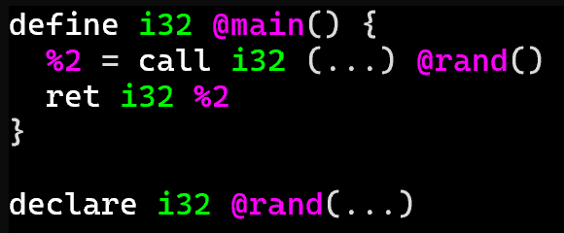
Exercise #5
LLVM Calls Review
Write your name and answer the following on a piece of paper
Write LLVM IR corresponding to the following C snippet:
extern int rand();
int foo(){
return rand(); }

Slide 2
Administrivia and Announcements
Quiz 1 on Friday
Review Session on Thursday

Slide 3
Malware
EECS 677: Software Security Evaluation
Drew Davidson

Slide 4
Last Time: LLVM CAlls
Review: Last Lecture
How to invoke your own functions
How to declare the existence of external functions

Slide 5
Last Time: LLVM CAlls
Review: Last Lecture
How to automatically generate LLVM IR
llvm-emit –S –emit-llvm <prog>
Creates a <prog>.ll file

Slide 6
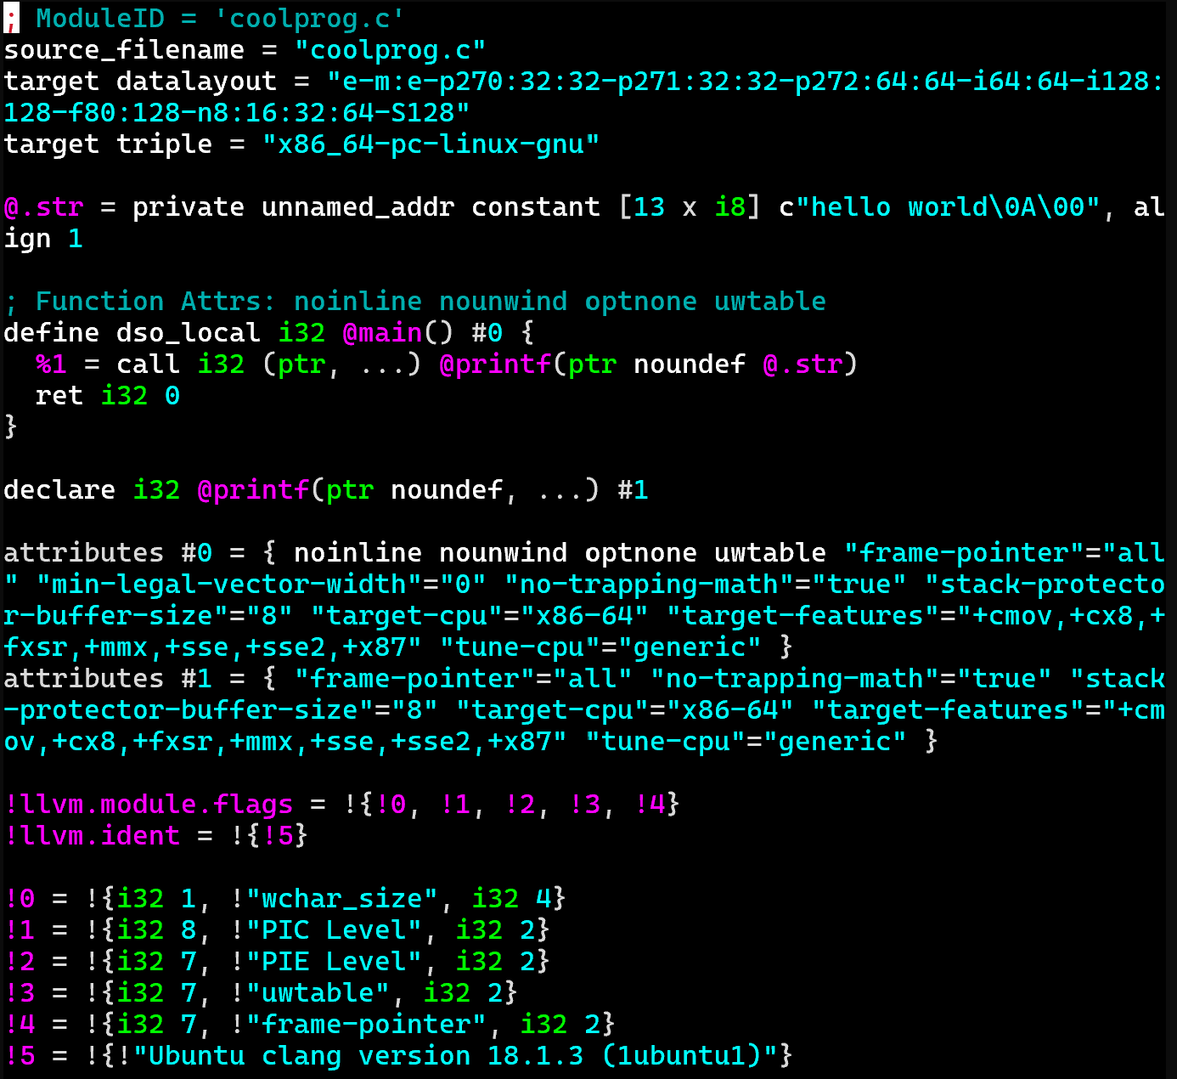
Some Stuff you Might see in programs
Extra Info: LLVM

Slide 7
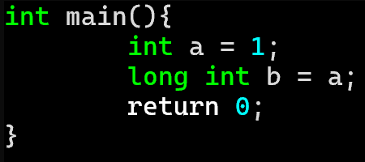
LLVM Casting: Sign Extension
Extra Info: LLVM
The (slightly unfortunately named) sext instruction
Promotes a sign-extended value of one type to a larger type

Slide 8
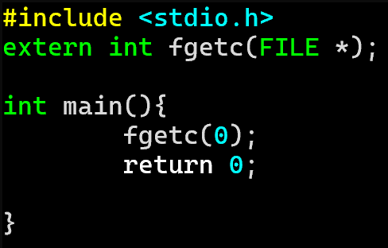
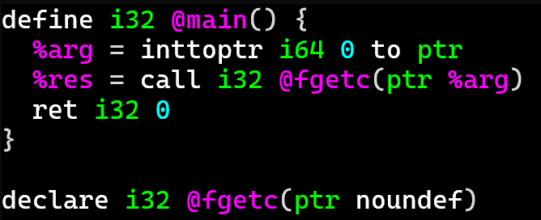
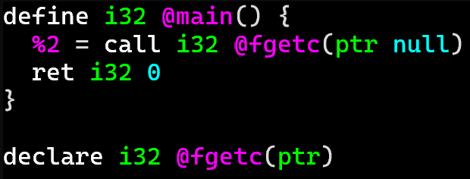
LLVM type Conversion
Extra Info: LLVM IR
inttoptr
Side note: LLVM does actually have the concept of the null pointer, so another program could be

Slide 9
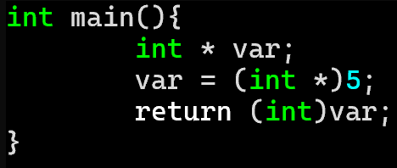
LLVM type Conversion
Extra Info: LLVM IR
inttoptr (and ptrtoint) as operand

Slide 10
Class Progress
We’ve got ourselves a way to represent programs
What are we trying to prevent?

Slide 11
Overview
Preventing bad stuff from happening in a program
Program

Slide 12
Lecture Outline
Terms/Concepts
What can go wrong?
How incidents happen

Slide 13
A Security Incident Workflow
Malware – Terms and Concepts
Exploit
Malicious
Behavior
Threat Actor
Attack Vector
Security Impact

Slide 14
A Security Incident Workflow
Malware – Terms and Concepts
Exploit
Malicious
Behavior
Threat Actor
Attack Vector
Security Impact
Scenario #1

Slide 15
A Security Incident Workflow
Malware – Terms and Concepts
Exploit
Malicious
Behavior
Threat Actor
Attack Vector
Security Impact
Scenario #2

Slide 16
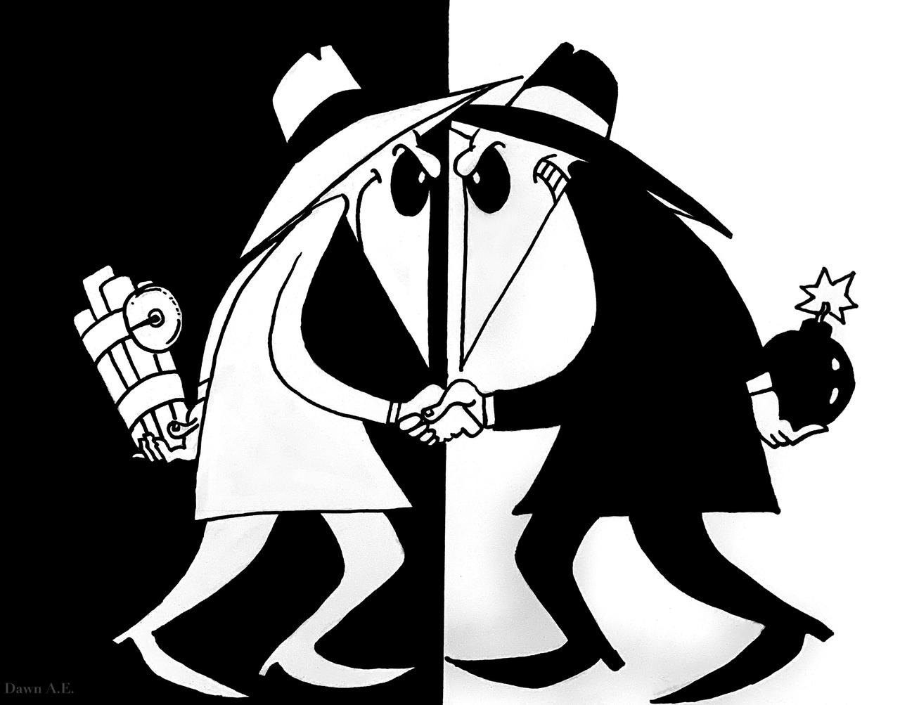
Adversaries
Malware – Terms and Concepts

Slide 17
Threat models
Malware – Terms and Concepts

Slide 18
Lecture Outline
Terms/Concepts
What can go wrong?
How incidents happen

Slide 19
The CIA Triad
Malware – What can go wrong?

Slide 20
Denial of Service
Malware – What can go wrong

Slide 21
Information Leakage
Malware – What can go wrong

Slide 22
Program Misbehavior
Malware – What can go wrong

Slide 23
Lecture Outline
Terms/Concepts
What can go wrong?
How incidents happen

Slide 24
How do “BAD” programs run?
Malware – terms and concepts
Reactive Concerns
Social engineering
“Flaws” in system installation policies
Proactive Concerns
The program accidentally does damage
The program contains a vulnerability

Slide 25
How do “BAD” programs run?
Malware – terms and concepts
Reactive Concerns
Social engineering
“Flaws” in system installation policies
We’re concerned about all these threats
Proactive Concerns
The program accidentally does damage
The program contains a vulnerability

Slide 26
Remote Code Execution (RCE)
Malware – Terms and Concepts

Slide 27
Drive By Downloads
Malware – Terms and Concepts

Slide 28
Behavioral Opacity
Malware – Terms and Concepts

Slide 29
Wrap-up

