Slide 1
Exercise #6
Malware Review
Write your name and answer the following on a piece of paper
Give an example of a security incident that results in a loss of integrity for a target software system. Who is the adversary and what is the threat model?

Slide 2
Administrivia and Announcements

Slide 3
memory attacks
EECS 677: Software Security Evaluation
Drew Davidson

Slide 4
Last Time: Malware Review
Last Lecture
Security incidents
Threat models
Confidentiality, integrity, availability

Slide 5
How do “BAD” programs run?
Last Lecture
Reactive Concerns
Social engineering
“Flaws” in system installation policies
Proactive Concerns
The program accidentally does damage
The program contains a vulnerability

Slide 6
How do “BAD” programs run?
Last Lecture
Reactive Concerns
Social engineering
“Flaws” in system installation policies
We’re concerned about all these threats
Proactive Concerns
The program accidentally does damage
The program contains a vulnerability
This time

Slide 7
Class Progress
Describing What can go wrong, and how it happens
This will help to focus our analysis

Slide 8
Lecture Outline
A history of computers
Memory overview
Memory attacks

Slide 9
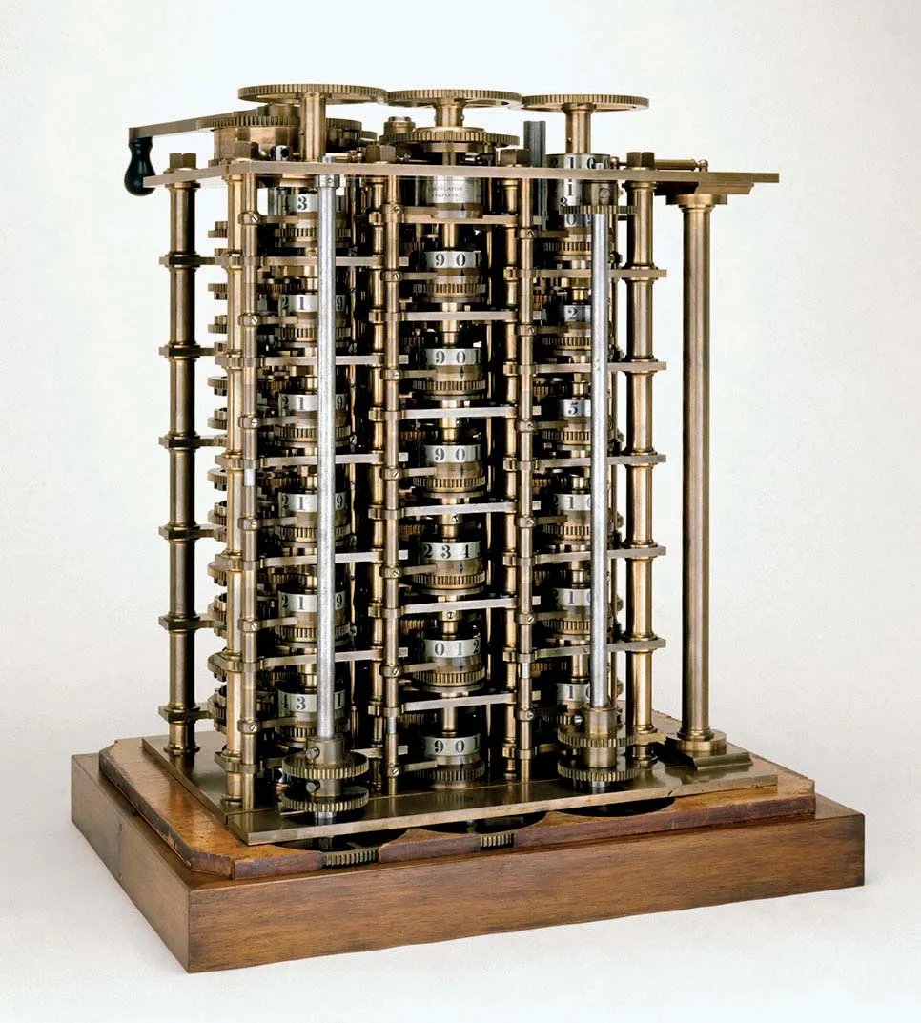
Data and Code
A history of Computing
Consider the History of Computation
The earliest devices recognized as computers were built to perform some specific type of computation

Slide 10
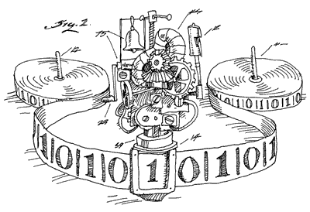
Data and Code
A history of Computing
Consider the History of Computation
The earliest devices recognized as computers were built to perform some specific type of computation
Algorithmic Purpose specified by hardware
Consider the theory analogy: a Turing Machine to compute a Fibonnaci Sequence
- Fibonnaci computation encoded into the state machine
- Input number encoded into the tape at start
- Output number encoded onto the tape at halt

Slide 11
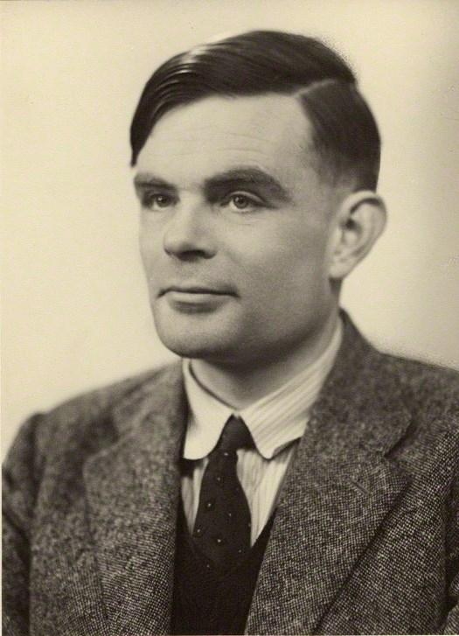
Data and Code
A history of Computing
A major paradigm shift: The Universal Computation Machine
The hardware contains generally-useful instructions
A particular algorithm is encoded in terms of those instructions
The Theory: The Universal Turing Machine
Consider the theory analogy: a Turing Machine that computes any function
- “Instruction set” encoded into the state machine
- Desired algorithm encoded into the tape at start
- Input to the algorithm encoded into the tape at start as well
- Output number encoded onto the tape at halt

Slide 12
Data and Code
A history of Computing
A major paradigm shift: The Universal Computation Machine
Numbers as stored voltage levels
The hardware contains generally-useful instructions
A particular algorithm is encoded in terms of those instructions
Symbols as numbers
The Theory: The Universal Turing Machine
Consider the theory analogy: a Turing Machine that computes any function
- “Instruction set” encoded into the state machine
- Desired algorithm encoded into the tape at start
- Input to the algorithm encoded into the tape at start as well
- Output number encoded onto the tape at halt
Operations as symbols

Slide 13
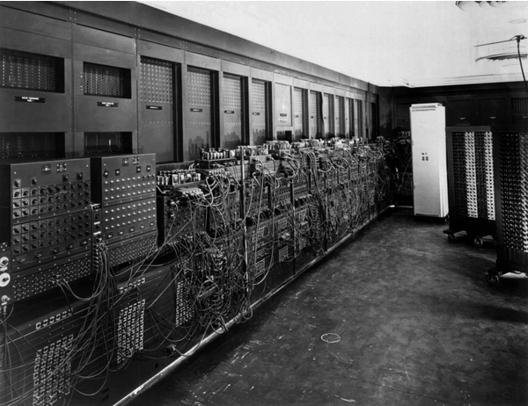
Data and Code
A history of Computing
Numbers as stored voltage levels
Symbols as numbers
Operations as symbols
Code is data

Slide 14
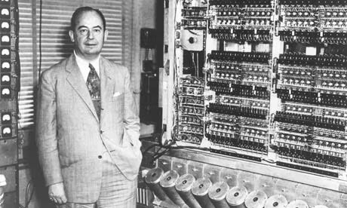
Data and Code
A history of Computing
The Von Neumann architecture
Another big idea: Code and data share memory
Good news!
Programs can write code just like any other form of data
Bad news!
Code is data

Slide 15
Lecture Outline
A history of computers
Memory overview
Memory attacks

Slide 16
Program Memory
A history of Subversion
A 1-D array
Code
Data
Load 2 bytes memory[G] into register a
Store register a into 4 bytes memory[K]
More ops …
Global variable G
Foo’s local variable K
Program instructions (binary sequences)
Program data & metadata (binary sequences)
Addr
0x01
Addr
0x02
Addr
0x01
Addr
0x03
Addr
0x04
Addr
0x05
Addr
0x06
Addr
0x07
Addr
0x08
Addr
0x09
Addr
0x0A
Addr
0x0B
Addr
0x0C
Addr
0x0D
Addr
0x0E
Addr
0x0F
Addr
0x10
Addr
0x11
Addr
0x12
Addr
0x13
Addr
0x14
Addr
0x15
Addr
0x16
Addr
0x17
f0
ef
0c
0a
e1
39
0a
12
ef
5b
76
1b
4f
bf
01
35
13
08
dd
cb
11
93
27
19
Load 4 bytes
from memory[G]
to register a
Store 4 bytes
from register a
Into memory[k]
More
ops …
global
variable
G
Program
metadata
and
bookkeeping
local
variable
K
More
metadata
and
bookkeeping

Slide 17
Simulating Source Constructs
A history of Subversion
Assume main calls foo
foo (recursively) calls foo
Code
Data
All the code in function main()
All the code in function foo()
Global variable G
foo’s local variable K
Program instructions (binary sequences)
Program data & metadata (binary sequences)
Addr
0x01
Addr
0x02
Addr
0x01
Addr
0x03
Addr
0x04
Addr
0x05
Addr
0x06
Addr
0x07
Addr
0x08
Addr
0x09
Addr
0x0A
Addr
0x0B
Addr
0x0C
Addr
0x0D
Addr
0x0E
Addr
0x0F
Addr
0x10
Addr
0x11
Addr
0x12
Addr
0x13
Addr
0x14
Addr
0x15
Addr
0x16
Addr
0x17
f0
ef
70
81
e1
39
ac
00
ef
5b
76
1b
4f
bf
01
35
13
08
dd
cb
11
93
27
19
main instructions
foo instructions
foo call 1
data
main data

Slide 18
Simulating Source Constructs
A history of Subversion
Assume main calls foo
foo (recursively) calls foo
Code
Data
All the code in function main()
All the code in function foo()
Global variable G
foo’s local variable K
Program instructions (binary sequences)
Program data & metadata (binary sequences)
Addr
0x01
Addr
0x02
Addr
0x01
Addr
0x03
Addr
0x04
Addr
0x05
Addr
0x06
Addr
0x07
Addr
0x08
Addr
0x09
Addr
0x0A
Addr
0x0B
Addr
0x0C
Addr
0x0D
Addr
0x0E
Addr
0x0F
Addr
0x10
Addr
0x11
Addr
0x12
Addr
0x13
Addr
0x14
Addr
0x15
Addr
0x16
Addr
0x17
f0
ef
70
81
e1
39
ac
00
ef
5b
76
1b
4f
bf
01
35
13
08
dd
cb
11
93
27
19
main instructions
foo instructions
foo call 2
data
foo call 1
data
main data

Slide 19
Simulating Source Constructs
A history of Subversion
Assume main calls foo
foo (recursively) calls foo
Code
Data
All the code in function main()
All the code in function foo()
Global variable G
foo’s local variable K
Program instructions (binary sequences)
Program data & metadata (binary sequences)
Addr
0x01
Addr
0x02
Addr
0x01
Addr
0x03
Addr
0x04
Addr
0x05
Addr
0x06
Addr
0x07
Addr
0x08
Addr
0x09
Addr
0x0A
Addr
0x0B
Addr
0x0C
Addr
0x0D
Addr
0x0E
Addr
0x0F
Addr
0x10
Addr
0x11
Addr
0x12
Addr
0x13
Addr
0x14
Addr
0x15
Addr
0x16
Addr
0x17
f0
ef
70
81
e1
39
ac
00
ef
5b
76
1b
4f
bf
01
35
13
08
dd
cb
11
93
27
19
main instructions
foo instructions
foo call 2
data
foo call 1
data
main data

Slide 20
Simulating Source Constructs
A history of Subversion
Assume main calls foo
foo (recursively) calls foo
Code
Data
All the code in function main()
All the code in function foo()
Global variable G
foo’s local variable K
Program instructions (binary sequences)
Program data & metadata (binary sequences)
Addr
0x01
Addr
0x02
Addr
0x01
Addr
0x03
Addr
0x04
Addr
0x05
Addr
0x06
Addr
0x07
Addr
0x08
Addr
0x09
Addr
0x0A
Addr
0x0B
Addr
0x0C
Addr
0x0D
Addr
0x0E
Addr
0x0F
Addr
0x10
Addr
0x11
Addr
0x12
Addr
0x13
Addr
0x14
Addr
0x15
Addr
0x16
Addr
0x17
f0
ef
70
81
e1
39
ac
00
ef
5b
76
1b
4f
bf
01
35
13
08
dd
cb
11
93
27
19
main instructions
foo instructions
foo call 1
data
main data

Slide 21
Simulating Source Constructs
A history of Subversion
Assume main calls foo
foo (recursively) calls foo
Code
Data
All the code in function main()
All the code in function foo()
Global variable G
foo’s local variable K
Program instructions (binary sequences)
Program data & metadata (binary sequences)
Addr
0x01
Addr
0x02
Addr
0x01
Addr
0x03
Addr
0x04
Addr
0x05
Addr
0x06
Addr
0x07
Addr
0x08
Addr
0x09
Addr
0x0A
Addr
0x0B
Addr
0x0C
Addr
0x0D
Addr
0x0E
Addr
0x0F
Addr
0x10
Addr
0x11
Addr
0x12
Addr
0x13
Addr
0x14
Addr
0x15
Addr
0x16
Addr
0x17
f0
ef
70
81
e1
39
ac
00
ef
5b
76
1b
4f
bf
01
35
13
08
dd
cb
11
93
27
19
main instructions
foo instructions
main data

Slide 22
Lecture Outline
A history of computers
Memory overview
Memory attacks

Slide 23
Breaking Bounds
A history of Subversion
foo(){
int c = getc(stdout);
*((int *)c) = 2;
}
Program instructions
Program (meta)data
Addr
0x40
Addr
0x41
Addr
0x42
Addr
0x43
Addr
0x44
Addr
0x45
Addr
0x46
Addr
0x47
Addr
0x48
Addr
0x49
Addr
0x4A
Addr
0x4B
Addr
647E
Addr
647F
Addr
6480
Addr
6481
Addr
6482
Addr
6483
Addr
6484
Addr
6485
Addr
6486
Addr
6487
…
f0
ef
70
81
e1
39
ac
00
ef
5b
76
…
00
00
00
00
00
00
00
40
27
19
…
int c
Return addr.
foo instructions
foo
caller’s
data
foo’s
data

Slide 24
Buffer Overflows
A history of Subversion
int nm()
{
char name[5];
printf("Enter your name: ");
gets(name);
printf(“hi %s\n", name);
return 0;
}
D r e w
(end)
0x44
0x72
0x65
0x77
0x00
Program instructions
Program (meta)data
Addr
1010
647E
Addr
1010
647F
Addr
1010
6480
Addr
1010
6481
Addr
1010
6482
Addr
1010
6483
Addr
1010
6484
Addr
1010
6485
Addr
1010
6486
Addr
1010
6487
Addr
1010
6488
Addr
0x40
Addr
0x41
Addr
0x42
Addr
0x43
Addr
0x44
Addr
0x45
Addr
0x46
Addr
0x47
Addr
0x48
Addr
0x49
Addr
0x4A
Addr
0x4B
…
f0
ef
70
81
e1
39
ac
00
ef
5b
76
…
00
00
00
00
00
00
00
40
27
19
8c
…
44
72
65
77
00
char name[5]
Return addr.
nm instructions
nm
caller’s
data
nm’s
data

Slide 25
Buffer Overflows
A history of Subversion
int nm()
{
char name[5];
printf("Enter your name: ");
gets(name);
printf(“hi %s\n", name);
return 0;
}
A n d r e w
(end)
0x41
0x6e
0x64
0x72
0x65
0x77
0x00
Program instructions
Program (meta)data
Addr
1010
647E
Addr
1010
647F
Addr
1010
6480
Addr
1010
6481
Addr
1010
6482
Addr
1010
6483
Addr
1010
6484
Addr
1010
6485
Addr
1010
6486
Addr
1010
6487
Addr
1010
6488
Addr
0x40
Addr
0x41
Addr
0x42
Addr
0x43
Addr
0x44
Addr
0x45
Addr
0x46
Addr
0x47
Addr
0x48
Addr
0x49
Addr
0x4A
Addr
0x4B
…
f0
ef
70
81
e1
39
ac
00
ef
5b
76
…
00
00
00
00
00
00
00
40
27
19
8c
…
41
6e
64
72
65
77
00
char name[5]
Return addr.
nm instructions
nm
caller’s
data
nm’s
data

Slide 26
Script Injection
A history of Subversion
int nm()
{
char name[5];
printf("Enter your name: ");
gets(name);
printf(“hi %s\n", name);
return 0;
}
A n d r e LF LF d ~
(end)
0x41
0x6e
0x64
0x72
0x65
0x10
0x10
0x64
0x7e
0x00
Program instructions
Program (meta)data
Addr
1010
647E
Addr
1010
647F
Addr
1010
6480
Addr
1010
6481
Addr
1010
6482
Addr
1010
6483
Addr
1010
6484
Addr
1010
6485
Addr
1010
6486
Addr
1010
6487
Addr
1010
6488
Addr
0x40
Addr
0x41
Addr
0x42
Addr
0x43
Addr
0x44
Addr
0x45
Addr
0x46
Addr
0x47
Addr
0x48
Addr
0x49
Addr
0x4A
Addr
0x4B
…
f0
ef
70
81
e1
39
ac
00
ef
5b
76
…
00
00
00
00
00
00
00
40
27
19
8c
…
41
6e
64
72
65
10
00
64
7e
00
char name[5]
Return addr.
nm instructions
nm
caller’s
data
nm’s
data

Slide 27
Script Injection: The FIX
A history of Subversion
int nm()
{
char name[5];
printf("Enter your name: ");
gets(name);
printf(“hi %s\n", name);
return 0;
}
A n d r e LF LF d ~
(end)
0x41
0x6e
0x64
0x72
0x65
0x10
0x10
0x64
0x7e
0x00
Program instructions
Program (meta)data
Addr
1010
647E
Addr
1010
647F
Addr
1010
6480
Addr
1010
6481
Addr
1010
6482
Addr
1010
6483
Addr
1010
6484
Addr
1010
6485
Addr
1010
6486
Addr
1010
6487
Addr
1010
6488
Addr
0x40
Addr
0x41
Addr
0x42
Addr
0x43
Addr
0x44
Addr
0x45
Addr
0x46
Addr
0x47
Addr
0x48
Addr
0x49
Addr
0x4A
Addr
0x4B
…
f0
ef
70
81
e1
39
ac
00
ef
5b
76
…
00
00
00
00
00
00
00
40
27
19
8c
…
41
6e
64
72
65
10
00
64
7e
00
char name[5]
Return addr.
nm instructions
nm
caller’s
data
nm’s
data

Slide 28
ROP
A history of Subversion
int nm()
{
char name[5];
printf("Enter your name: ");
gets(name);
printf(“hi %s\n", name);
return 0;
}
A n d r e LF LF d ~
(end)
0x41
0x6e
0x64
0x72
0x65
0x10
0x10
0x64
0x7e
0x00
Program instructions
Program (meta)data
Addr
1010
647E
Addr
1010
647F
Addr
1010
6480
Addr
1010
6481
Addr
1010
6482
Addr
1010
6483
Addr
1010
6484
Addr
1010
6485
Addr
1010
6486
Addr
1010
6487
Addr
1010
6488
Addr
0x40
Addr
0x41
Addr
0x42
Addr
0x43
Addr
0x44
Addr
0x45
Addr
0x46
Addr
0x47
Addr
0x48
Addr
0x49
Addr
0x4A
Addr
0x4B
…
f0
ef
70
81
e1
39
ac
00
ef
5b
76
…
00
00
00
00
00
00
00
40
27
19
8c
…
char name[5]
Return addr.
nm instructions
nm
caller’s
data
nm’s
data

Slide 29
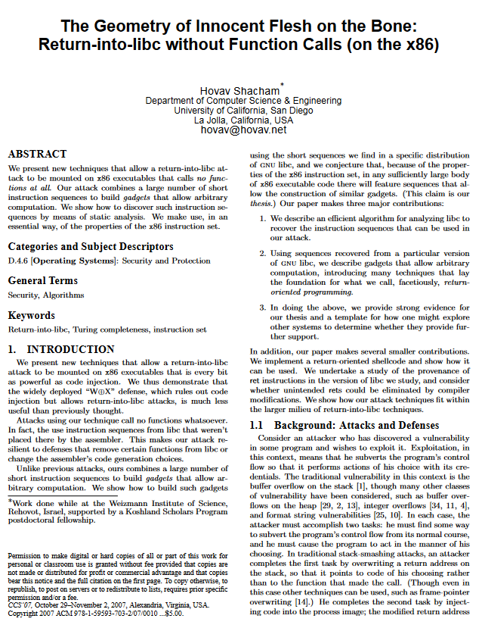
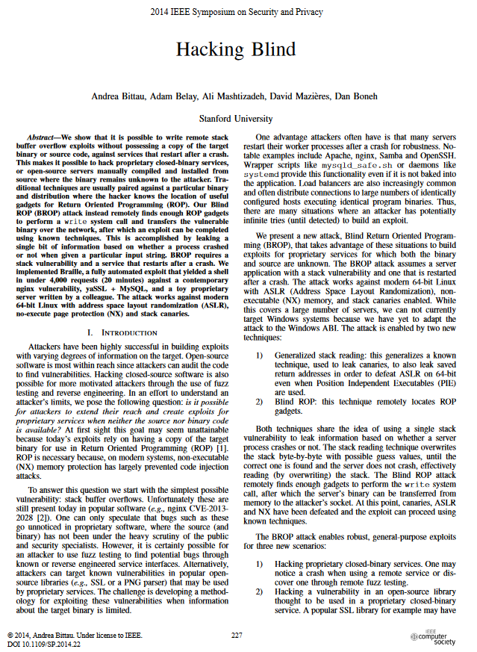
ROP Challenges
A history of Subversion
The practicality of this attack may seem limited
Are (sub)sequences present in process code to do the attack?
Are the (sub)sequences placed in predictable positions?

Slide 30
Return-into-LIBC
A history of Subversion
int nm()
{
char name[5];
printf("Enter your name: ");
gets(name);
printf(“hi %s\n", name);
return 0;
}
Program instructions
Program (meta)data
Addr
1010
647E
Addr
1010
647F
Addr
1010
6480
Addr
1010
6481
Addr
1010
6482
Addr
1010
6483
Addr
1010
6484
Addr
1010
6485
Addr
1010
6486
Addr
1010
6487
Addr
1010
6488
Addr
0x40
Addr
0x41
Addr
0x42
Addr
0x43
Addr
0x44
Addr
0x45
Addr
0x46
Addr
0x47
Addr
0x48
Addr
0x49
Addr
0x4A
Addr
0x4B
…
f0
ef
70
81
e1
39
ac
00
ef
5b
76
…
00
00
00
00
00
00
00
40
27
19
8c
…
char name[5]
Return addr.
nm instructions
libc instructions
nm
caller’s
data
nm’s
data

Slide 31
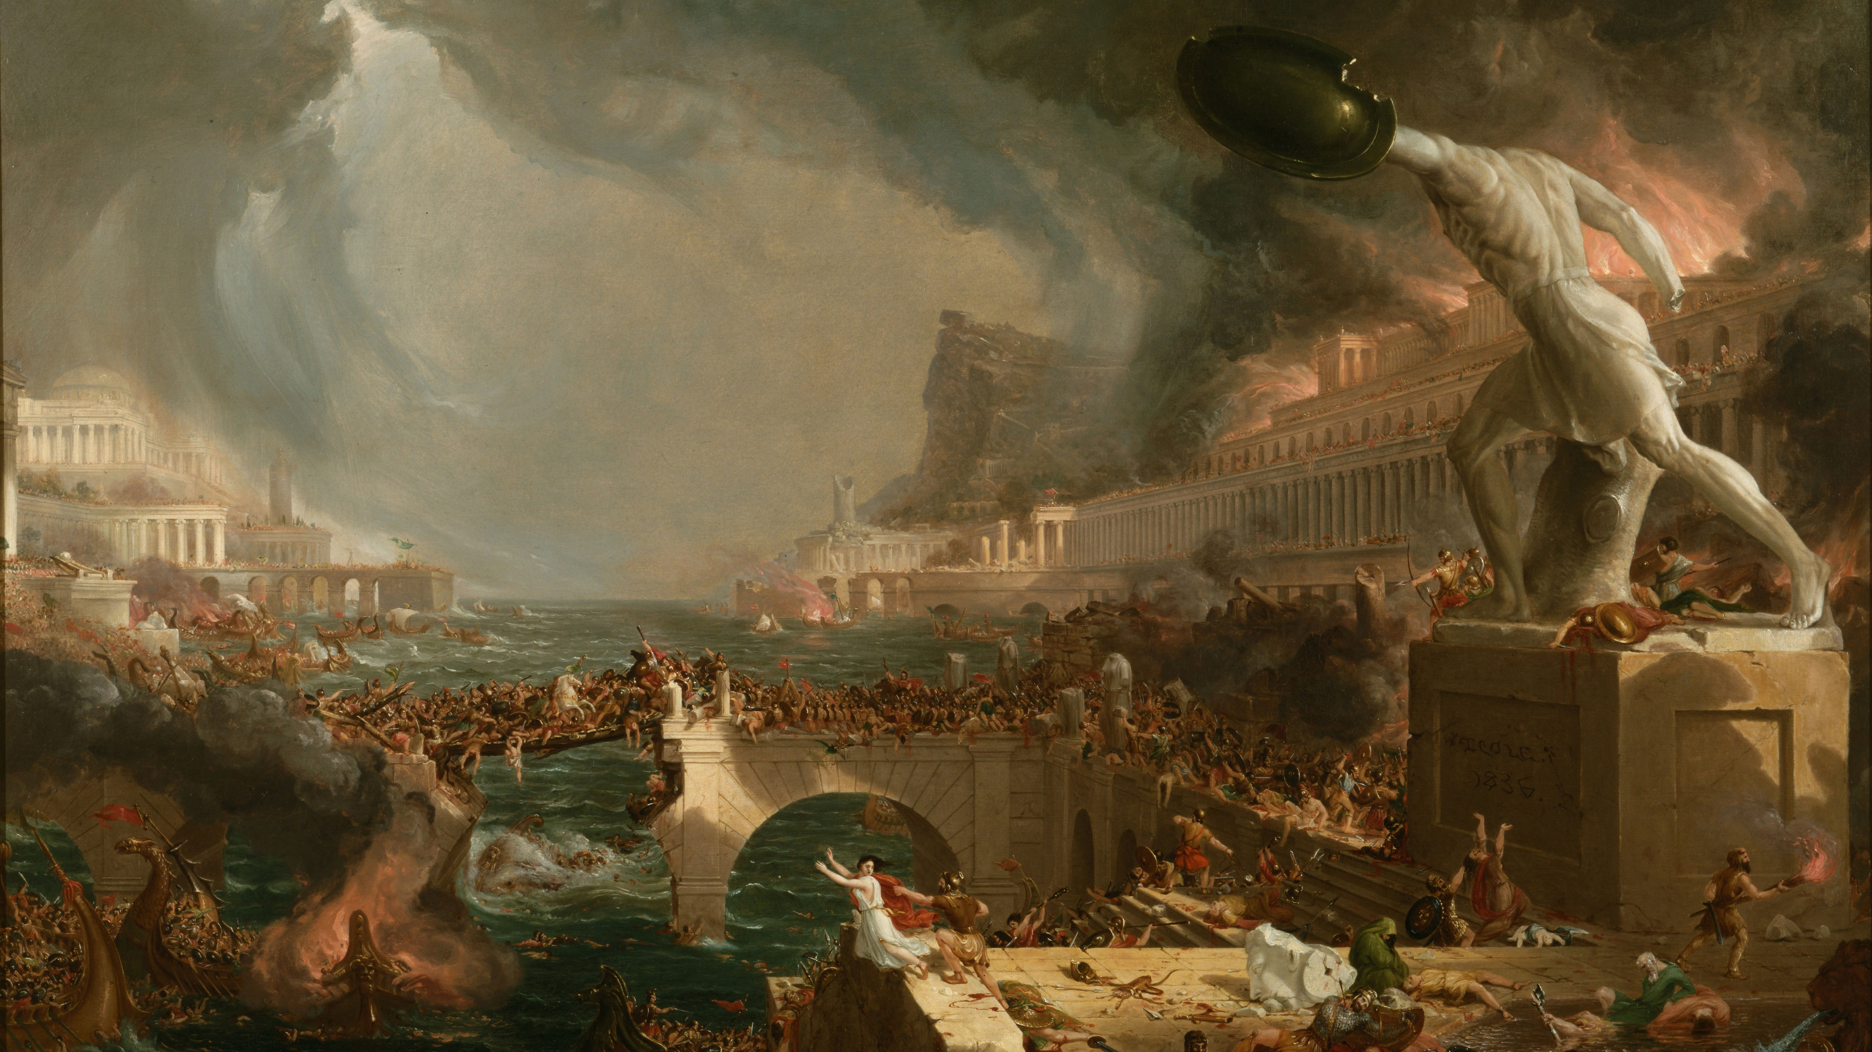
(yes, time to panic)

Slide 32
BEYOND ROP as RCE
A history of Subversion
Return oriented Programming constitutes a form of Remote code execution
It’s not the only form of remote code execution
Web programming

Slide 33
Thinking About Defenses
A history of Subversion
Can we detect programs with overflow potential?

Slide 34
Wrap-up
How good programs go bad

Slide 35
Stack Canaries
A history of subversion

Slide 36
Stack Canaries
A history of subversion
Program instructions (binary sequences)
Program data & metadata
User data
f0ef7081e1539ac00ef5b761b4fb01b351308dd003cb4b8930e27195a6ef34ba476e80e53f2af0

Slide 37
ASLR
A history of subversion

Slide 38
ASLR
A history of subversion
Program instructions (binary sequences)
Program data & metadata
User data
f0ef7081e1539ac00ef5b761b4fb01b351308dd003cb4b8930e27195a6ef34ba476e80e53f2af0

Slide 39
CFI
A history of subversion

Slide 40
Wrap-up

