Slide 1
Exercise #33
Boolean Satisfiability Review
Write your name and answer the following on a piece of paper
Use the Nelson-Oppen procedure to separate theories in the following formula
$$\left(a−f\left(b+c\right)=3\right)∧\left(a −1=0\right)∧\left(b>10\right)$$

Slide 2
Administrivia and Announcements

Slide 3
Principles of Secure Engineering
EECS 677: Software Security Evaluation
Drew Davidson

Slide 4
Where We’re At
Finished up dynamic analysis
Grab-bag time!

Slide 5
Previously: SMT Solving
Review Last Lecture
Satisfiability beyond simple Boolean expressions
Gets us (closer) to the real programs that we want to analyze
Key principles
Individual theory solvers
Formulating constraints modularize a concern to a theory

Slide 6
This lecture
SMT Solving
Best Practices

Slide 7
Secure Design
Principles of Secure Software Development
Security is Relative
Obviously (from our previous study) it is relative to a threat model
Less obviously (from our topics) is that it should be conceptualized in terms of improvements
Mindsets
Convince yourself that the system is secure
Convince yourself that you are identifying and fixing weaknesses of the system

Slide 8
Security Principles
Principles of Secure Software Development
Simplicity
Open design
Maintainability
Privilege Separation / Least priviledge
Defense in depth / diversity
Complete mediation and fail-safe

Slide 9
The Principle of least privilege
Principles of Secure Software Development
“Entities should only have access to the data and
resources needed to provide authorized tasks”
At what granularity do we consider an entity?

Slide 10
Privilege Separation
Principles of Secure Software Development
Break system into compartments
Ensure each compartment is isolated
Ensure each compartment runs with least privilege
Treat compartment interface as trust boundary

Slide 11
Privilege Separation
Principles of Secure Software Development
Example: The operating system
Users can execute programs/processes
Processes can access resources
UNIX ACLs
Permissions to access files are granted based on user IDs
Every user has a unique UID
Access Operations: Read, Write, Execute
Each le has an access control list (ACL)
Grants permissions to users based on UIDs and roles
(owner, group, other)
root (UID 0) can access everything
Process should not be able to access another process’s
memory
Memory Isolation
Resource Isolation
Process should only be able to access certain resources

Slide 12
Establish the Trusted Computing Base
Principles of Secure Software Development
What Are the security assumptions about the code base?
What are the components critical for security?
Trusted != secure
Related concern: minimizing attack surface
Adversaries can only attack what’s there

Slide 13
Simplicity
Principles of Secure Software Development
We have to trust some components of our system.
In general keeping the Trusted Computing Base small and
simple makes it easier to verify.
In theory a hypervisor can be less complex than a full
host operating system.
A small OS kernel has less attack surface than one with
many features.
Consider the ease of analysis!

Slide 14
Fail-Open vs Fail-CloseD
Principles of Secure Software Development
What do you do if your security mechanism breaks down?
Fail-open
Allow anybody access
Fail-Closed
Allow nobody access

Slide 15
Maintainability
Principles of Secure Software Development
Develop good Logging / Reporting
Ensure the state of the system is easy to ascertain
Assume extensions to the system may expose internal functionality
- Proactive sanity checking / data sanitization

Slide 16
Complete Mediation
Principles of Secure Software Development
Every Access request should be subject to the same authorization
Subsequent requests should re-check rights regardless of the success of the first check
Simple way to ensure that updates to state do open a security hole

Slide 17
Open Design
Principles of Secure Software Development
The security of the system should not depend on an adversary’s knowledge of the system
Over-approximate adversarial capabilities
Review of the design should not be considered a security incident
Does not (for better or worse) preclude secret implementation

Slide 18
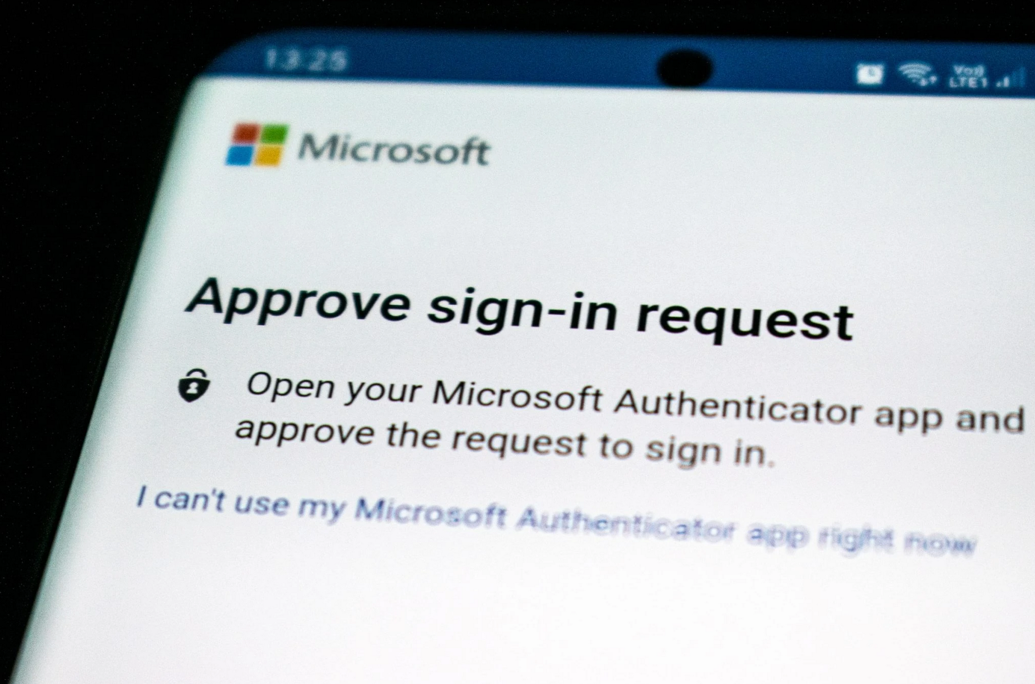
Psychological acceptability
Principles of Secure Software Development
Ease of use and transparency are essential requirements for security

Slide 19
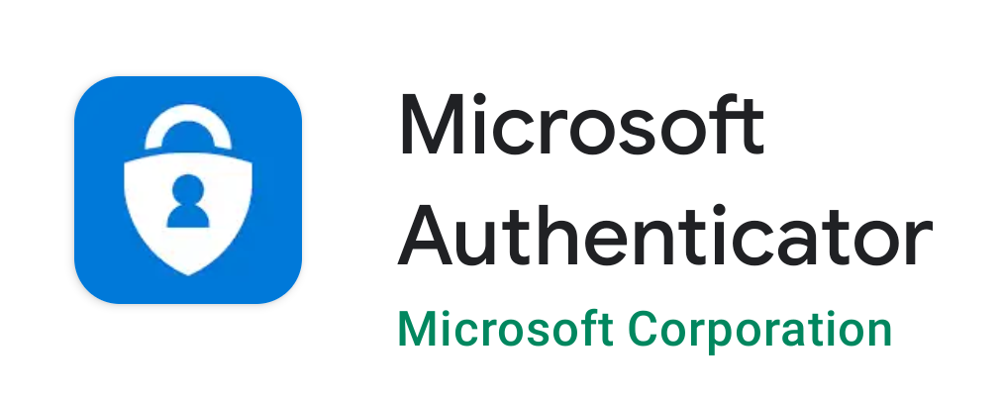
MFA Fatigue Attacks
Principles of Secure Software Development
Example: 2022 UBER attack by LapSUs$

Slide 20
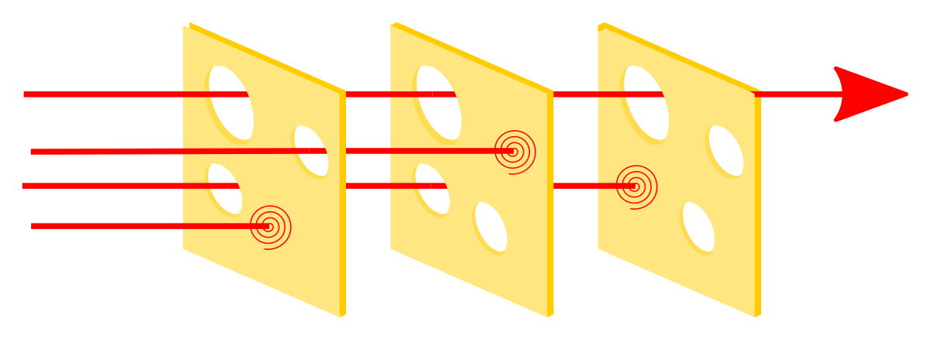
Defense in depth
Principles of Secure Software Development

Slide 21
Wrap-Up
SMT Solvers
Keep secure development in mind!
The principles serve as guides and goals to aspire to

